Slide 1
Open Access Workshop Graduate Students Union
Lisa Goddard
Memorial University Libraries
November 18TH, 2010

Slide 2
Outline
Traditional Academic Publishing
Open Access Alternatives
OA Journals
OA Repositories
Creative Commons
Faculty Engagement

Slide 3
Traditional Academic Publishing

Slide 4
University Environment
Copyright is automatically granted to author upon the creation of an original work in a tangible medium.
Most universities have agreements stating that faculty own copyright in their scholarly works.
Notes:
Copyright is automatically generated up the production of an original work.
In most cases when someone pays you to do work, copyright is transferred to the employer. This is not true in the university environment where individual faculty members retain copyright.
"for copyright to exist in a 'work' it must be expressed to some extent at least in some material form, capable of identification and having a more or less permanent endurance.” Insufficient fixation in the live broadcast of a sports event. Any sort of broadcast, telecast, or display of a spectacle on its own is not sufficient to be fixed.
http://www.arl.org/sparc/publications/opendoors_v1.shtml

Slide 5
Copyrights
reproduce
distribute
publicly display
publicly perform
prepare derivative works
Notes:
Copyright is not a single right, but rather a set of rights.
Each of these rights can be managed independently.

Slide 6
Transferring Rights
assign ownership of copyright
grant permission via license
all rights? exclusive? perpetual?
Notes:
Can give some or all rights, exclusive or non-exclusive.
A license to any or all of these rights can be supplemented by specific license limitations, such as the duration, geographical scope, revocability, and right to sublicense, or any other restrictions that the licensor wishes to specify.
The law therefore offers great potential for flexibility.

Slide 7
Publisher Agreements
Academic authors traditionally transfer exclusive, full copyrights to the publishers of the journals in which their articles appear.
Many disadvantages to this approach…

Slide 8
Subscribers Only
Notes:
Subscribers can access, assuming that they can jump through the appropriate authentication hoops. Greatly reduces the number of people who will conceivably read & cite your article.

Slide 9
No Google
Notes:
Gated articles cannot be full-text searched through Google, and cannot be accessed directly from Google.

Slide 10
No Course Websites
Notes:
Cannot distribute it within a learning management system.

Slide 11
No Professional Websites
Notes:
Cannot link to it from online portfolio, academic c.v., faculty profile page, blogs, or other social media sites,

Slide 12
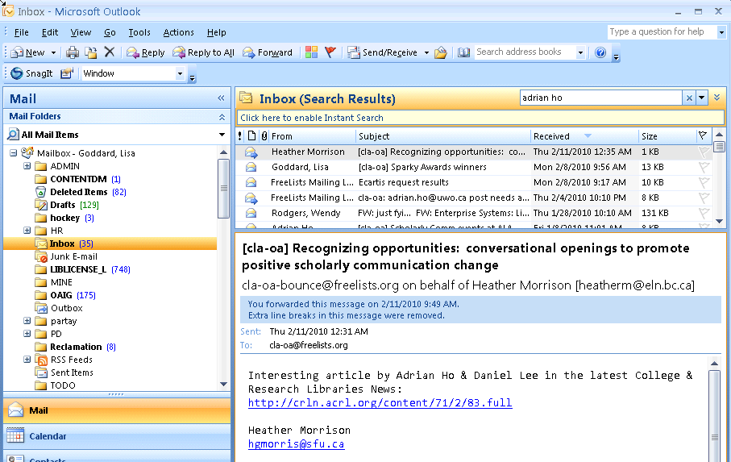
No Sharing with Colleagues
Notes:
Cannot share a copy with colleagues on a listserv.

Slide 13
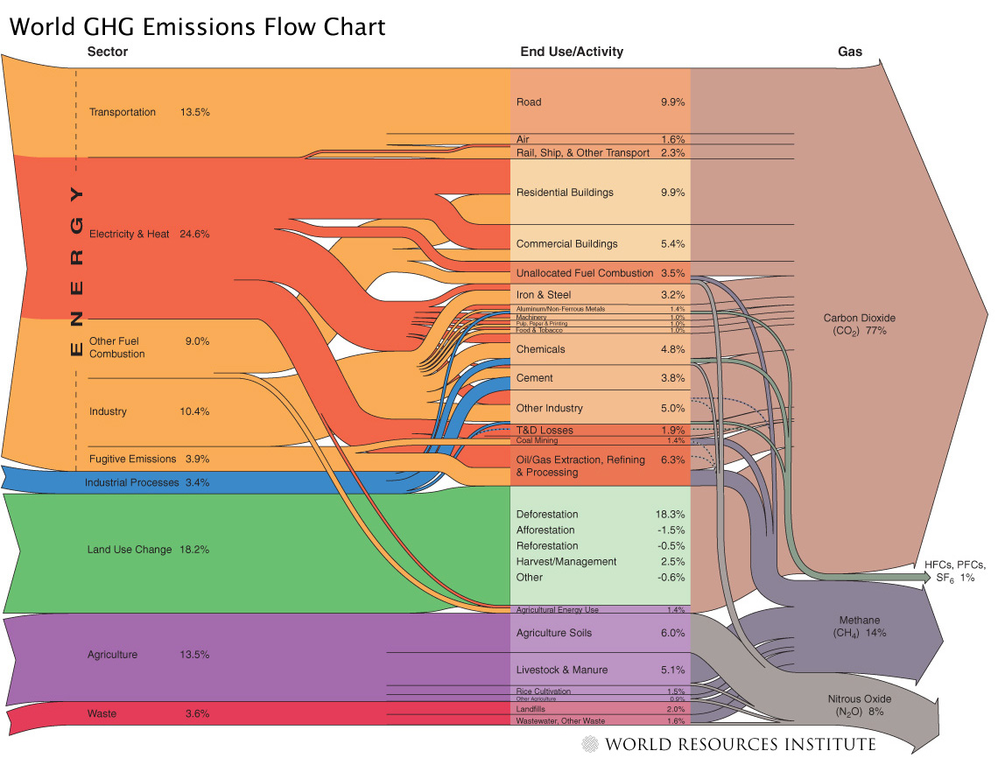
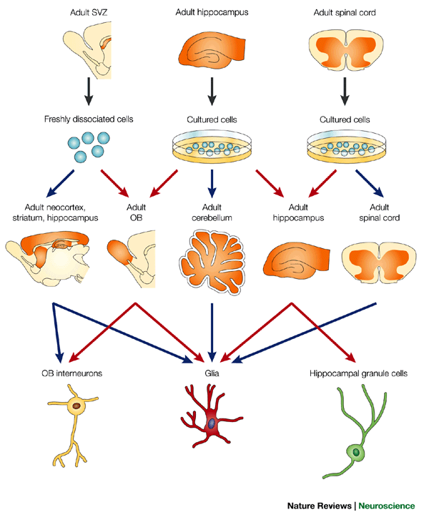
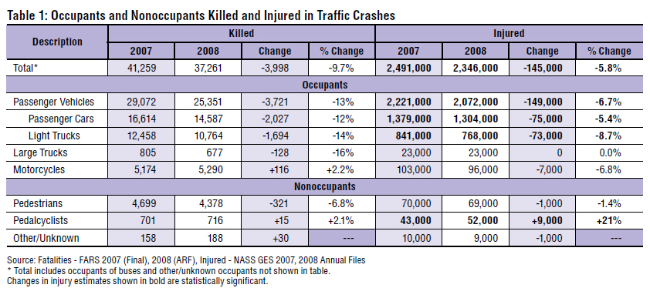
No Reuse
Notes:
Charts, tables, images take a long time to produce and format, but once you give up your copyright on these items, you cannot reuse or share them.
New York Times science writer Carl Zimmer demonstrated the distinction succinctly. He discusses a recent case where Wiley threatened legal action after a neuroscience graduate posted some figures from one of their journal articles on her blog (despite the fact that this is already permitted under terms of “fair dealing” or “fair use”). (When OA not OA, PLOS Bio, October 2007)

Slide 14
YOU may not have access

Slide 15
Current Situation
Publicly funded research
Faculty time & expertise
Rights given to commercial publisher free of charge
Academic community purchases the work back from publisher
Notes:
Governments, universities, tax-exempt organizations
Often at great expense!

Slide 16
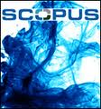
Licensed Resources
70,000+ journal titles
450+ article indexes
$4 million annually
Notes:
Memorial libraries pay over $4 million annually to provide access to licensed scholarly materials. Off campus use licensed for MUN faculty/students only.
No remote access for alumni
On campus access only

Slide 17
The “Broken” Journal
Issues/volumes/pages
5000 words
Many months to publish
Not truly collaborative
Limited, elite readership
Stifle innovation
Perpetuate global inequity
Notes:
Electronic journals simply mimic paper journals – there is little about them that is truly radical.
Journals and books are still very much the mainstays of faculty P&T evaluations. New media like blogs, wikis, websites are not considered as highly as traditional books and articles published in high impact journals, many of which are gated.

Slide 18
Promotion & Tenure
Books & peer-reviewed journal articles highly valued.
Blogs, wikis, website development, multimedia works, software tools, less so.
Notes:
Even if you agree that journals are no longer the most effective way to share scholarly information, as a young academic, you will have to toe the line drawn by your more senior colleagues.
So what alternatives are there?

Slide 19
Open Access Alternatives
Publish in Open Access journals.
Self-archive in Open Access repositories.

Slide 20
I. Open Access Journals
Immediate, universal access
You retain ownership/control
Peer-reviewed, scholarly
Citation advantage
Notes:
Gold OA focuses on publishing in OA journals.
Free access
There are 1000s of OA journals, and when we’re talking about free access, this means that the content in these journals is available for free to the entire world. There are no subscription fees (whether through the reader, or their institutional affiliation). As long as you can get online, you can access content in OA journals without paying for anything other than your internet connection.
“OA journals do not depend on subscription revenue because their costs are recovered up front through other revenue streams, such as publication fees, advertising revenue, sponsorships, institutional subsidies, grants, or some combination of these.” p 6 of http://www.aau.edu/policy/scholarly_publishing_roundtable.aspx?id=6894
But what do OA journals look like? Exactly the same as other online journals, only difference is that access is free.

Slide 21
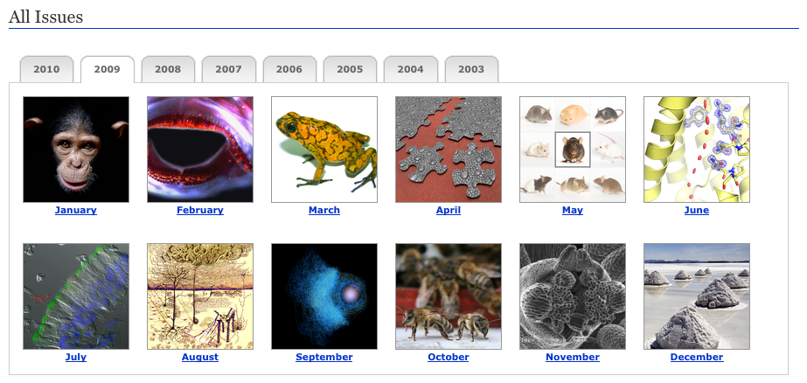
PLOS Biology
Notes:
This journal started in 2003 and is one of the several journals published by the Public Library of Science which I’ll be mentioning later on. As you can see, OA journals look the same as other online journals, the difference is that access is free.

Slide 22
Mathematics

Slide 23
Economics

Slide 24
Finance

Slide 25
Sociology

Slide 26
Education

Slide 27
Classics

Slide 28
Where can I publish?
http://www.doaj.org
Notes:
If you’re wondering what OA journals exist in certain subject areas, the Directory of Open Access Journals (or DOAJ) is the source to use. It is a directory of more than 4000 OA journals from more than 100 countries. It links out to the OA journal and also provides information re: publisher, country of origin, language, keywords and journal start year.
Journals included must be free to access and they must be freely available from date of publication (i.e. no embargo period). And at least 5 articles must have been published. RSS feed available for daily/weekly/monthly update.s
“What is the SPARC Europe Seal for Open Access Journals? A Seal to Set Standards for Open Access Journals. SPARC Europe and DOAJ have entered an agreement about introducing a certification scheme for Open Access journals, the SPARC Europe Seal for Open Access Journals. To receive the "Seal" the journal has to choose the CC-BY license (Creative Commons license) and provide DOAJ with metadata on article level.
What are the advantages of having the SPARC Europe Seal? Improved information as to what users are allowed to do with papers published in an open access journal.
Possible long-term archiving of content, which makes publishing in the journal more attractive to authors.
Better exposure as a high-quality journal based on state-of-the art dissemination technologies.
The DOAJ team converts the metadata and makes it harvestable, which means the widest possible dissemination and thus increased usage and impact. http://www.doaj.org/doaj?func=loadTempl&templ=faq#seal

Slide 29
Author Fees
Some OA journals charge author fees
Author pays ~$1500 to defray costs
After article reviewed & accepted
Notes:
While access is free, fees sometimes do exist in the form of ‘author processing charges’ (APCs)
Author processing charges These fees are processing or publishing fees and means that rather than the subscriber paying to access the publication, a payment is made once the paper is accepted. This amount is often paid by the author’s institution, research grant or via a funding agency. The plot thickens as some OA journals require publishing fees BUT are able to waive them if the author is unable to pay. Fees exist to cover production/layout/copyediting/technical costs Open Medicine March 1, 2010: C$1200 for research and review articles and C$300 for commentary/analysis articles. http://www.openmedicine.ca/about/submissions#authorFees
OA for-profit publishers
Public Library of Science (PLOS): launched in 2002; is an organization of scientists and physicians committed to making the world's scientific and medical literature freely available. Publish 7 journal. Other examples include BioMed Central, Hindawi. Medknow, and Optics Express.
pe157:” OA journals and hybrid journals like PNAS, as well as traditional publishers like Blackwell Publishing (‘‘Online Open’’), Oxford University Press (‘‘Oxford Open’’), and Springer (‘‘Springer Open Choice’’) are now offering authors an immediate OA option if the author pays a fee.” Eysenbach, Gunther. "Citation Advantage of Open Access Articles." PLoS Biology 4.5 (2006): 692-8. <http://www.pubmedcentral.nih.gov.qe2a-proxy.mun.ca/picrender.fcgi?artid=1459247&blobtype=pdf>.
Fact “…many more TA journals charge author-side fees than OA journals, both in percentages and absolute numbers. The Kaufman-Wills report in October 2005 found that 75% of TA journals charged author-side fees, compared to only 47% of OA journals. Stuart Shieber's study in May 2009 lowered the number for OA journals to 29.7%. But as far as I know, no new study has updated the number for TA journals.” http://www.earlham.edu/~peters/fos/newsletter/10-02-09.htm#challenges Stuart’s 2009 study: http://blogs.law.harvard.edu/pamphlet/2009/05/29/what-percentage-of-open-access-journals-charge-publication-fees/

Slide 30
OA Author’s Fund
Notes:
At University of Ottawa the University has provided funding.

Slide 31
Start Your Own OA Journal
http://journals.library.mun.ca

Slide 32
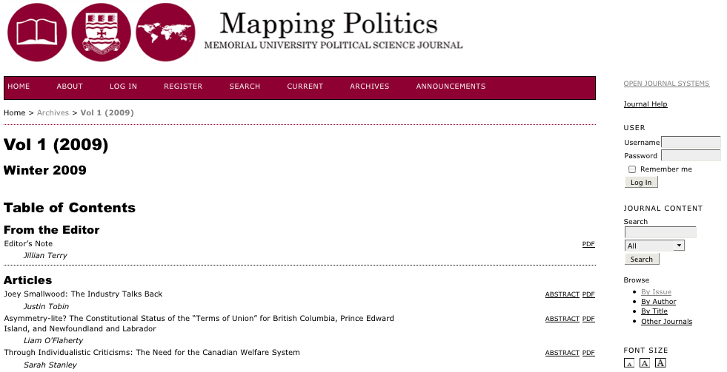
Open Access Journals @ MUN

Slide 33
Open Access Journals @ MUN

Slide 34
II. Open Access Repositories
Publish in traditional journals
Archive a copy of your work in an Open Access Repository

Slide 35
Subject Repository
Notes:
http://aquacomm.fcla.edu/

Slide 36
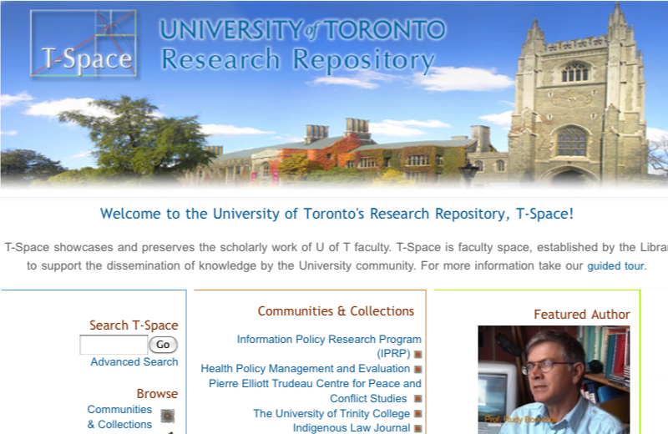
Institutional Repository
Notes:
Web submission interfaces to provide a publishing platform for registered users.

Slide 37
Memorial

Slide 38
Archiving Published Works
Published Works
Peer-reviewed articles Book chapters
Is that legal?

Slide 39
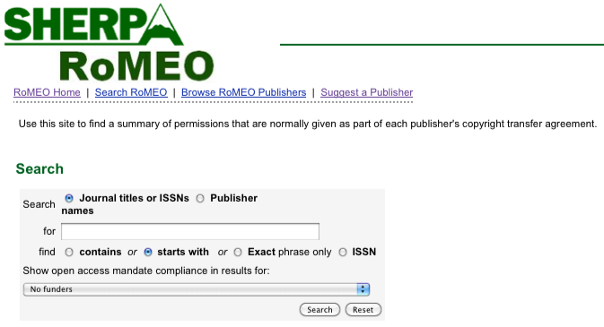
Publisher Archiving Policies
Notes:
What are the publisher’s copyright and archiving policies?
Even though OA repositories exist, you have have to obtain permission to do so if you’ve published in a traditional journal. Your archiving MUST be legal. I.E. you can’t just do this on a whim. That being said, “most journals (now about 70%) already allow postprint archiving.” http://www.earlham.edu/~peters/fos/overview.htm
Keep in mind that “Authors need no permission for preprint archiving. When they have finished writing the preprint, they still hold copyright. If a journal refuses to consider articles that have circulated as preprints, that is an optional journal-submission policy, not a requirement of copyright law. (Some journals do hold this policy, called the Ingelfinger Rule, though it seems to be in decline, especially in fields outside medicine.)”
The key is to know our rights as a researcher and SHERPARoMEO is the ideal source for this kind of information. It is a searchable database of publisher's copyright & archiving policies. Each entry provides a summary of the publisher's policy, including what version of an article can be deposited, where it can be deposited, and any conditions that are attached to that deposit. http://www.sherpa.ac.uk/romeo/romeofaq.html
ROMEO covers peer-reviewed journals and serials, provided by feeds from the British Library service Zetoc, Entrez and DOAJ.
Participation: “…the inability to convince 100 per cent of authors to self-archive 100 percent of their articles” (Jacobs 31)

Slide 40
Publisher Archiving Policies
Notes:
What are the publisher’s copyright and archiving policies?
Even though OA repositories exist, you have have to obtain permission to do so if you’ve published in a traditional journal. Your archiving MUST be legal. I.E. you can’t just do this on a whim. That being said, “most journals (now about 70%) already allow postprint archiving.” http://www.earlham.edu/~peters/fos/overview.htm
Keep in mind that “Authors need no permission for preprint archiving. When they have finished writing the preprint, they still hold copyright. If a journal refuses to consider articles that have circulated as preprints, that is an optional journal-submission policy, not a requirement of copyright law. (Some journals do hold this policy, called the Ingelfinger Rule, though it seems to be in decline, especially in fields outside medicine.)”
The key is to know our rights as a researcher and SHERPARoMEO is the ideal source for this kind of information. It is a searchable database of publisher's copyright & archiving policies. Each entry provides a summary of the publisher's policy, including what version of an article can be deposited, where it can be deposited, and any conditions that are attached to that deposit. http://www.sherpa.ac.uk/romeo/romeofaq.html
ROMEO covers peer-reviewed journals and serials, provided by feeds from the British Library service Zetoc, Entrez and DOAJ.
Participation: “…the inability to convince 100 per cent of authors to self-archive 100 percent of their articles” (Jacobs 31)

Slide 41
Archiving Unpublished Works
Unpublished Works
Presentations Reports Lectures Teaching Aids Data sets Performances Video, multimedia
Notes:
The ability to easily share unpublished material is one of the major benefits of the research repository. If you put unpublished material on the web it is a good idea to explicitly state how other people may use or re-use it by applying a Creative Commons license.

Slide 42
Creative Commons Licenses
legally valid, no charge
you retain copyrights
allows you to prevent some uses of a work, authorize others.
Notes:
http://creativecommons.org/
http://creativecommons.ca/

Slide 43
Creative Commons Licenses
Attribution
Attribution Non-commercial
Attribution No Derivatives
Attribution Share Alike
Notes:
Anyone can do anything with your work, but must give you attribution. All CC licenses stipulate attribution.
Anyone can do anything with your work except make money from it.
Anyone can use your work in an unchanged way, as long as it is credited to you.
Anyone can do anything with your work, as long as they credit you and license their new creations under the identical terms.
Put a creative commons license on work that you post to the web. This allows you to grant permissions in a granular way, while retaining all of your own rights over the work.
The different license attributes can be mixed and matched in various ways.

Slide 44
OA Journals
Notes:
Many different resources on the web use Creative Commons licenses.

Slide 45
OA Repositories

Slide 46
MIT Open Courseware
Notes:
You can’t talk about Open Course Ware without mentioning MIT who were pioneers in this area.
MIT OpenCourseWare is a free, web-based publication of virtually all MIT course content. Basically opens up the contents of their Learning Management System to the world.
Includes lecture notes, readings, assignments, evaluation tools. MIT provides faculty support for digitization of course materials.

Slide 47
Open Text Books
Notes:
Flatworld Knowledge is a site that allows faculty to freely share entire books or chapters for which they hold copyright.
Students can choose to use the material online for free, or can pay a nominal amount to get copies in print or audio.
http://www.flatworldknowledge.com/
http://opentextbook.org
http://textbookrevolution.org/index.php/Main_Page

Slide 48
Open Educational Resources

Slide 49
Faculty Engagement
Notes:
Busy. Worried about promotion and tenure.

Slide 50
P&T Fears
Will OA publishing effect my ability to get tenure or promotion?
Notes:
If faculty members are afraid that OA publishing will hurt their chances at Promotion and Tenure, then they just won’t do it.

Slide 51
US Federal Research Public Access Act of 2009
Federal agencies with extramural research expenditures of over $100,000,000
Results from research supported, in whole or in part, by gov funding must be made freely available online
Notes:
Many funding agencies are starting to insist that researchers share the results of funded research.
Fantastic precedent globally, but also for Canada.
Federal Research Public Access Act of 2009
http://www.arl.org.qe2a-proxy.mun.ca/pp/access/frpaa2010.shtml
http://thomas.loc.gov/cgi-bin/query/z?c111:H.R.5037:
If passed, this will give all public libraries around the world free access to US government funded research output. Imagine the incredible potential if more governments followed suit to make this information available on line. Imagine especially the benefits to countries who are less economically well-positioned to purchase this information. Public libraries would suddenly have access to collections that would previously have been completely out of reach financially.

Slide 52
National Science Foundation
Investigators are expected to share with other researchers, within a reasonable time, the primary data, samples, physical collections and other supporting materials created or gathered in the course of work under NSF grants.
Notes:
The NSF policy framework for sharing/disseminating research data.
Grant proposals submitted to NSF must include a two page supplementary document labeled “Data Management Plan”.
http://www.nsf.gov/bfa/dias/policy/dmp.jsp

Slide 53
CIHR OA Policy
Notes:
In Canada, the Canadian Institutes of Health Research already have OA conditions in their Policy on Research Outputs.

Slide 54
P&T Solutions
Statement of support from Administration
Notes:
A statement from university administration showing support for Open Access publishing can help to alleviate some faculty concerns that OA publishing will have a negative effect on P&T.
The Office of the Vice-President of Research and Graduate Studies at Concordia recently commissioned a report concluding that Open Access publishing would have many benefits for the university.
Our own VP research is in the process of developing a Research Plan. It would be great if we could get OA on the radar for that plan.

Slide 55
Collective Agreement
We will regard a record of open access publication as evidence of service to the community, in evaluation of applications for faculty appointments, promotions and grants.
Notes:
If you want to get a bit more radical the collective agreement could include a statement that gives preference to OA publishing.

Slide 56
Institutional OA Policies
Collective, university-wide action.
Faculty agreements to retain author rights, and allow open access to intellectual output.

Slide 57
Harvard
Notes:
The University License serves three purposes: (1) it covers all the faculty’s scholarly
articles, including those published in journals that have not to date permitted authors to post
articles in their institutional repositories; (2) it standardizes the terms of the Institution’s right to
host its faculty’s work and make it openly accessible; and (3) it grants the Institution the right to
make additional copies of articles – for permanent archiving, for example – and to permit others
to use the articles so long as the use is not done for profit. http://www.arl.org/sparc/publications/opendoors_v1.shtml

Slide 58
MIT

Slide 59
Funding Models
Many models transfer the costs of scholarly publishing to the university.
Author’s fees, publishing platforms
BUT we already pay, so it’s just a redirection of funds.

Slide 60
OA Success
20% of peer-reviewed articles across all disciplines are now freely available

Slide 61
The Tipping Point
Student Movement
Public Funding Agencies
Digital Rights
Management
Three Strikes Law
Open Access
Digital Locks
Public Data
Gated Sites
Creative Commons
Industry Pressure
Open Education
Corporate Money

Slide 62
What can I do?
Publish in OA journals
Archive in Research Repositories
Use Creative Commons licenses on your unpublished works
Share your data
Support OA initiatives on campus

Slide 63
Right to Research
Notes:
http://www.righttoresearch.org/
Another group supporting the FRPAA is the student organization Right to Research. Student groups have been active in the Open Access movement from the very beginning.
So there is a broad spectrum of public interest in Open Access and Open Initiatives.

