Slide 1
Trends in Questionable Journal Publishing: A Year in Review
Lise Brin & Lisa Goddard
Atlantic Provinces Library Association
June 5, 2014 - Moncton, NB

Slide 2
March 2013
Notes:
[I’ll be honest – at this point I just had a vague idea about open access journals…
Of course I’ve heard of PLOS, and it seems an honorable idea,
but beyond that I can’t say I’d paid much attention to OA journals.]

Slide 3
http://www.nature.com/news/investigating-journals-the-dark-side-of-publishing-1.126661
Notes:
[But then this article comes out on the faculty listserv at my institution –
it being in Nature and all, this seems like a pretty big deal -- and then suddenly
everybody’s talking about those darned OA journals.]

Slide 4
http://scholarlyoa.com/2013/03/26/author-misconduct/
Notes:
[I even had a look at this site, and that “Beall’s list” that was mentioned in the Nature article]

Slide 5
April 2013
Notes:
And then a few weeks later…

Slide 6
http://www.nytimes.com/2013/04/08/health/for-scientists-an-exploding-world-of-pseudo-academia.html
Notes:
[…this comes out in the New York Times, and even some of my non-academic friends are talking about predatory publishers.]
[Well I must say it’s not too often I see librarians in the news. You must love this guy! Isn’t it great to have a librarian doing this important work?]
[This really has me thinking about these “predatory” Open Access journals. Better watch out for these.]

Slide 7
http://en.wikipedia.org/wiki/Predatory_open-access_publishing
Notes:
Of course, I’ve been on the receiving end of scam emails from some of these publishers, and I’ve never considered that to be such a big deal, because frankly, any reasonable academic should be able to see right through these, right? If a journal claims to be in your discipline but you don’t know about it, well – ding ding ding – that should set off some alarms, you know?

Slide 8
October 2013

Slide 9
http://www.sciencemag.org/content/342/6154/60.full
Notes:
[And then THIS comes out! This is pretty crazy stuff. This guy John Bohanon did some investigative reporting
for Science, and half of the 304 OA journals to which he submitted his bogus article accepted it. One thing I
hadn’t realized before is that, at least according to Bohanon, MOST of the OA publishers out there are dodgy.
It sounds like PLOS is still reliable, though (even though I’ve heard recently that its impact factor has gone down).
It’s pretty scary that even the Elsevier and Sage OA journals accepted the article.]
[Oh, and there’s Jeffrey Beall again – and this time he’s even compared to Batman!]
[One of my drinking buddies over in the Social Sciences is freaking out because the journal he published in
last year is on this Beall’s list, and now he’s worried he won’t get tenure…]

Slide 10
November 2013

Slide 11
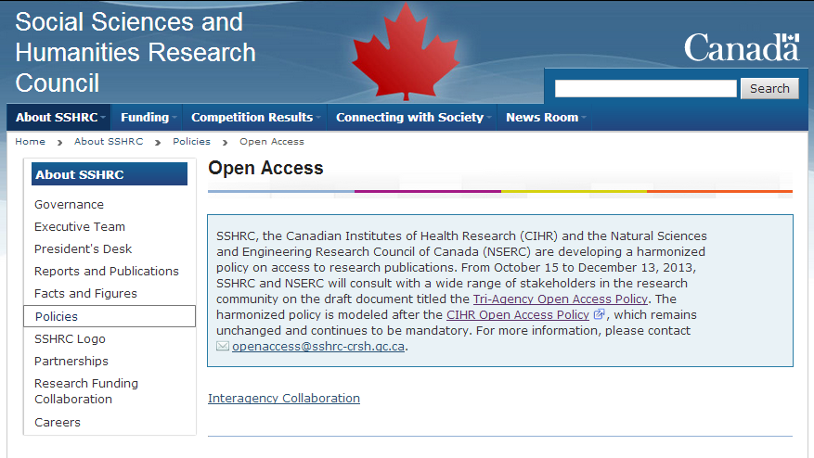
Notes:
[So when SSHRC, CIHR and NSERC started asking for feedback about their draft OA policy, I must admit I was quite surprised
that they were still going ahead with this. I know they’re not saying you *have* to publish in one of those OA journals, but shouldn’t
they be a bit more cautious now that OA has been tainted in this way?]
And I’m not sure how I feel about them dictating which journals we can and can’t publish in. Some of the top journals in my field don’t even allow self-archiving, even after 12 months! And I need to publish in the best journals I possibly can – end of story. My career depends on it.

Slide 12
March 2014

Slide 13
http://scholarlyoa.com/2014/03/20/misleading-metrics-a-new-list-on-this-blog/
Notes:
[And if things weren’t bad enough already, I read on Jeffrey Beall’s website that now they’re not just running fake journals,
but some are creating fake impact factors! There were 11 when he started this list in March, and as of May 7th he had 17!]

Slide 14
May 2014

Slide 15
http://www.ottawacitizen.com/technology/Blinded+scientific+gobbledygook/9757736/story.html
Notes:
[And then… My mother sent me this in the mail. I couldn’t believe a daily newspaper was reporting on this.
The situation must be REALLY serious, right?]

Slide 16
http://www.ottawacitizen.com/technology/Blinded+scientific+gobbledygook/9757736/story.html
Notes:
[The article offers advice from a University of Saskatchewan professor on avoiding predatory publishers (circled above).
So I guess that’s it, right? Although – am I even going to be able to get my articles into these journals?
And even if I can, am I going to be able to afford their page costs?]

Slide 17
Predatory publisher numbers according to Beall’s List
Notes:
[I checked Beall’s blog last month just to see how many of these “predatory” journals are out there, and he currently lists 551 publishers (that’s up from 225 in December 2012, and 23 when he started the list in 2011)

Slide 18
What can we learn from looking at the past year from the point of view of a researcher?
Notes:
Audience participation time!
Are you surprised by the way our fictitious faculty member reacted to the news stories about predatory publishers?
Note that all these statements (except for the Beall praise) are things I’ve heard directly from faculty members.
What did the professor miss in the OA context?:
How crazy Jeffrey Beall is…; no questioning of Beall’s criteria; no criticisms of traditional publishing model
The discussion about other efforts
The fact that there are still many reliable OA journals beyond PLOS
No understanding that there are questionable journals outside OA as well
Any criticism of impact factors or peer review despite their known limitations
Researchers entering into new areas of research or cross-disciplinary work may not know all the journals in that area
A new journal (especially in an emerging area of research) isn’t necessarily a bad thing!

Slide 19
How concerned should we be about the emergence of these questionable publishers?

Slide 20
Talking to faculty about Gold OA.

Slide 21
Faculty Motivators
Tenure
Prestige
Funding
Control over work
Accessibility of scholarly literature
Benefit to community
Global innovation
Library budgets

Slide 22
P&T Fears
Will my committee consider OA journals to be of low quality?

Slide 23
Open Access is now a mainstream publishing model.
Approximately 10 - 12% of academic journals are Open Access.
Notes:
We can see from the chart that the number of Gold OA journals has been climbing steadily since 2000.
In May 2013 the DOAJ indexes 9315 OA journals.
The JournalSeek database contains 100 101 journals.
Ulrich’s Web indexes 99 458 current journals in the Academic/Scholarly category, and 101 330 if proceedings are included.
Mikael Laakso and Bo-Christer Björk. Anatomy of open access publishing: a study of longitudinal development and internal structure. BMC Medicine 2012, 10:124. doi:10.1186/1741-7015-10-124

Slide 24
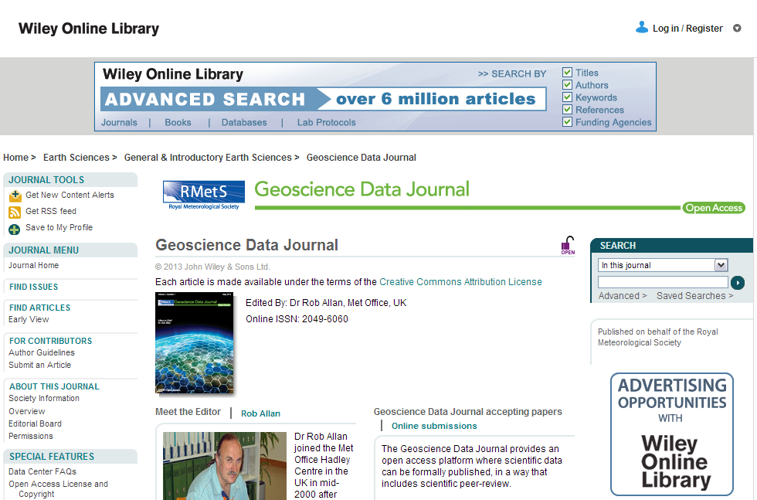
Open Access Journals - Wiley
Notes:
Open Access has adoption among existing scholarly publishers as well including Wiley,

Slide 25
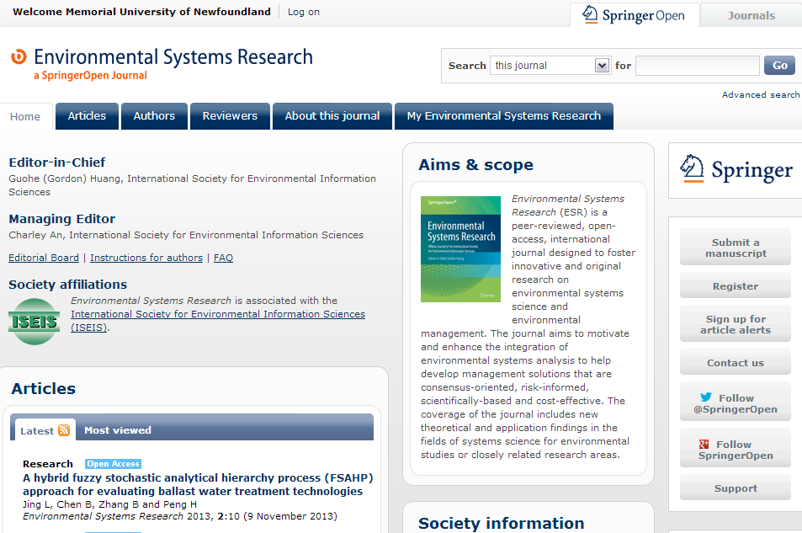
Open Access Journals - Springer
Notes:
Springer (who invoice under BMC),

Slide 26
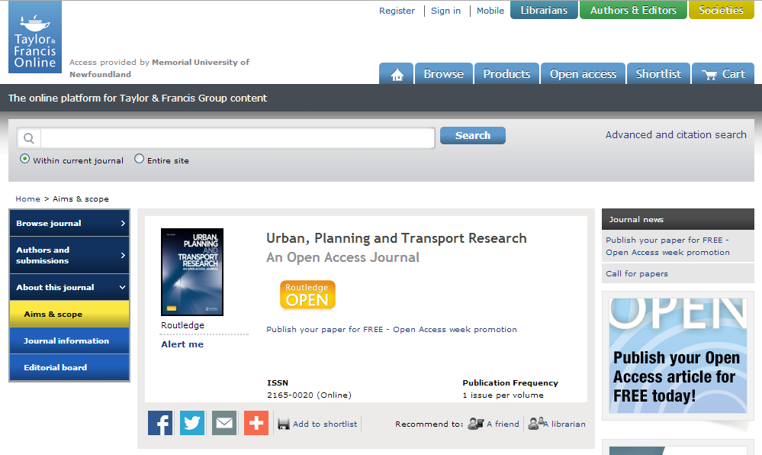
Open Access Journals – T&F
Notes:
Taylor & Francis,

Slide 27
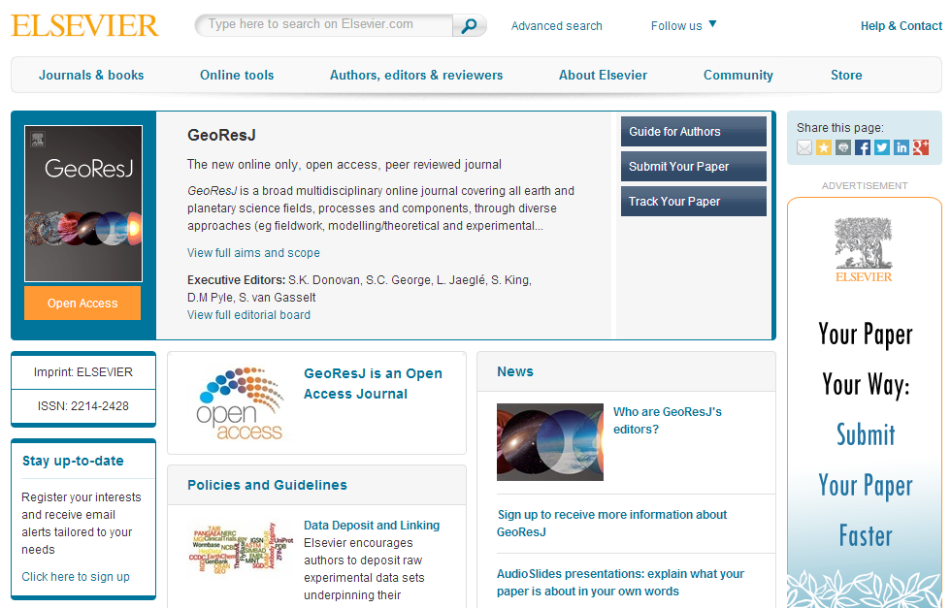
Open Access Journals - Elsevier
Notes:
And even Elsevier.

Slide 28
Funder Support for OA

Slide 29
SSHRC/NSERC OA Mandate

Slide 30
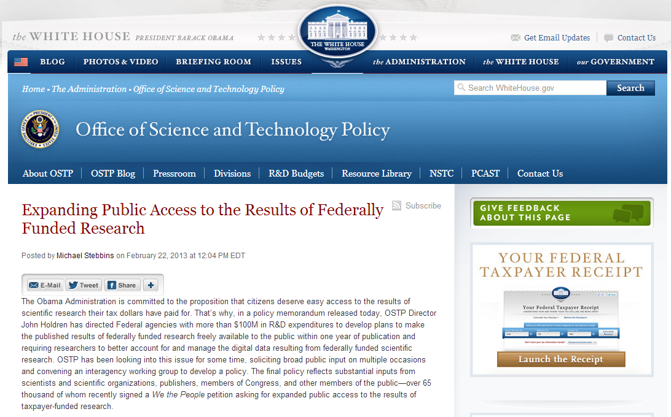
Government Policy - US
Notes:
In February of this year the Obama government issued a directive for large US funding agencies to prepare Open Access policies that will make funded research publicly available within 12 months of publication.
Although the directive frequently references innovation in Science and Technology, the policy will apply to all large federal funding agencies (> 100 million in R&D expenditures annually) SSH funders including the National Endowment for the Humanities and the Social Sciences Research Council.
This means that the National Endowment for the Humanities and the Social Sciences Research Council will be using mandates similar to the one that the National Institutes of Health has had in effect since 2008.
http://www.neh.gov/news/press-release/2013-02-26
I have issued a memorandum today (.pdf) to Federal agencies that directs those with more than $100 million in research and development expenditures to develop plans to make the results of federally-funded research publically available free of charge within 12 months after original publication. As you pointed out, the public access policy adopted by the National Institutes of Health has been a great success. And while this new policy call does not insist that every agency copy the NIH approach exactly, it does ensure that similar policies will appear across government.
http://www.whitehouse.gov/blog/2013/02/22/expanding-public-access-results-federally-funded-research
http://chronicle.com/article/White-House-Delivers-New/137549/

Slide 31
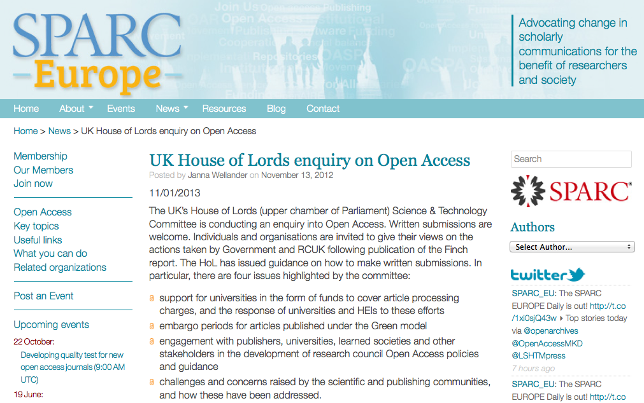
Government Policy - UK
Notes:
The UK government is having similar conversations about Open Access. An early policy out of the Research Councils UK embraced a fairly aggressive move to Gold OA publishing for publicly funded research.
A recent report from the House of Lords recommends a much more conservative approach that uses Green OA with a two year embargo.
http://sparceurope.org/uk-house-of-lords-enquiry-on-open-access/
http://www.rcuk.ac.uk/research/Pages/outputs.aspx
http://www.publications.parliament.uk/pa/ld201213/ldselect/ldsctech/122/122.pdf

Slide 32
Assessing Journal Quality

Slide 33
Journal Quality Indicators
peer-review quality
editorial board
acceptance rates
readership
citation rate
years of publication
indexing
Impact Factor*
business model
*Reliance on journal metrics may vary according to discipline.

Slide 34
OA Journal Quality
ISI Journal Citation Reports
Notes:
Some OA journals are at the top of their fields.

Slide 35
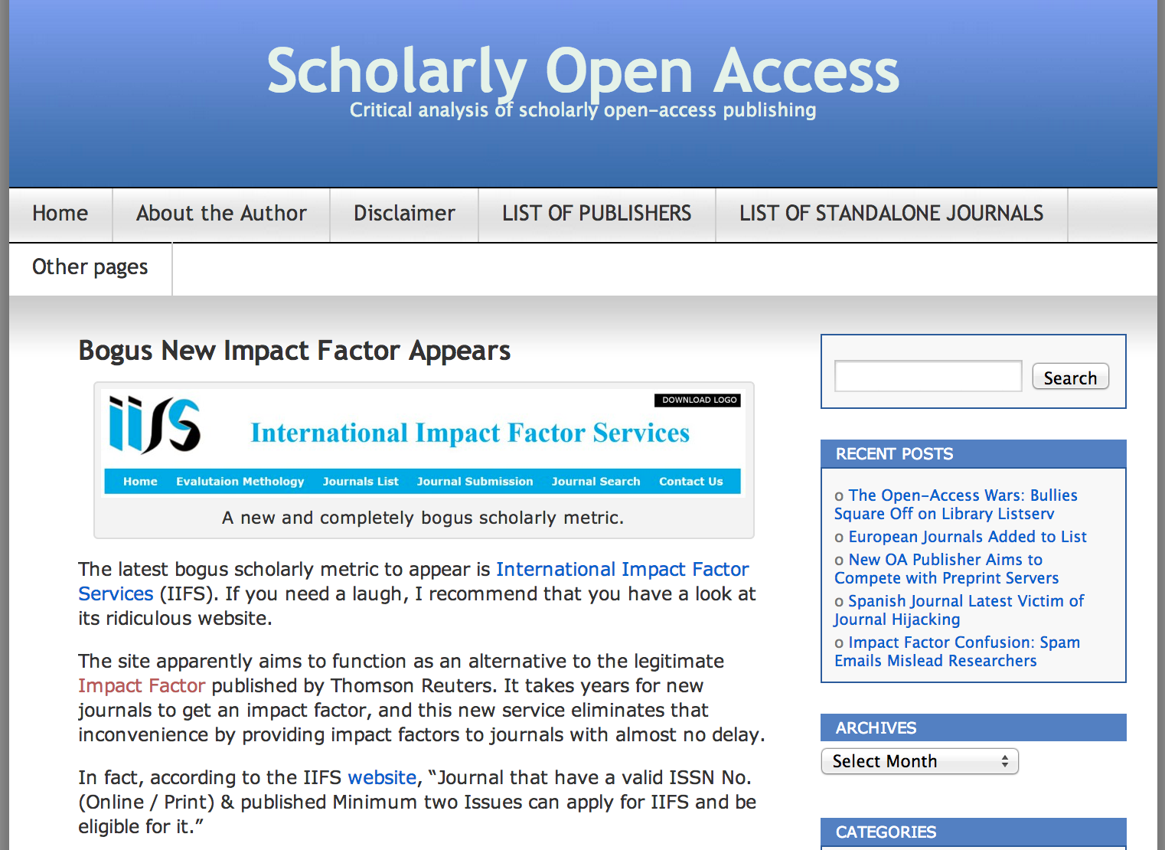
Journal Metrics
Notes:
http://scholarlyoa.com/2014/02/11/bogus-new-impact-factor-appears/

Slide 36
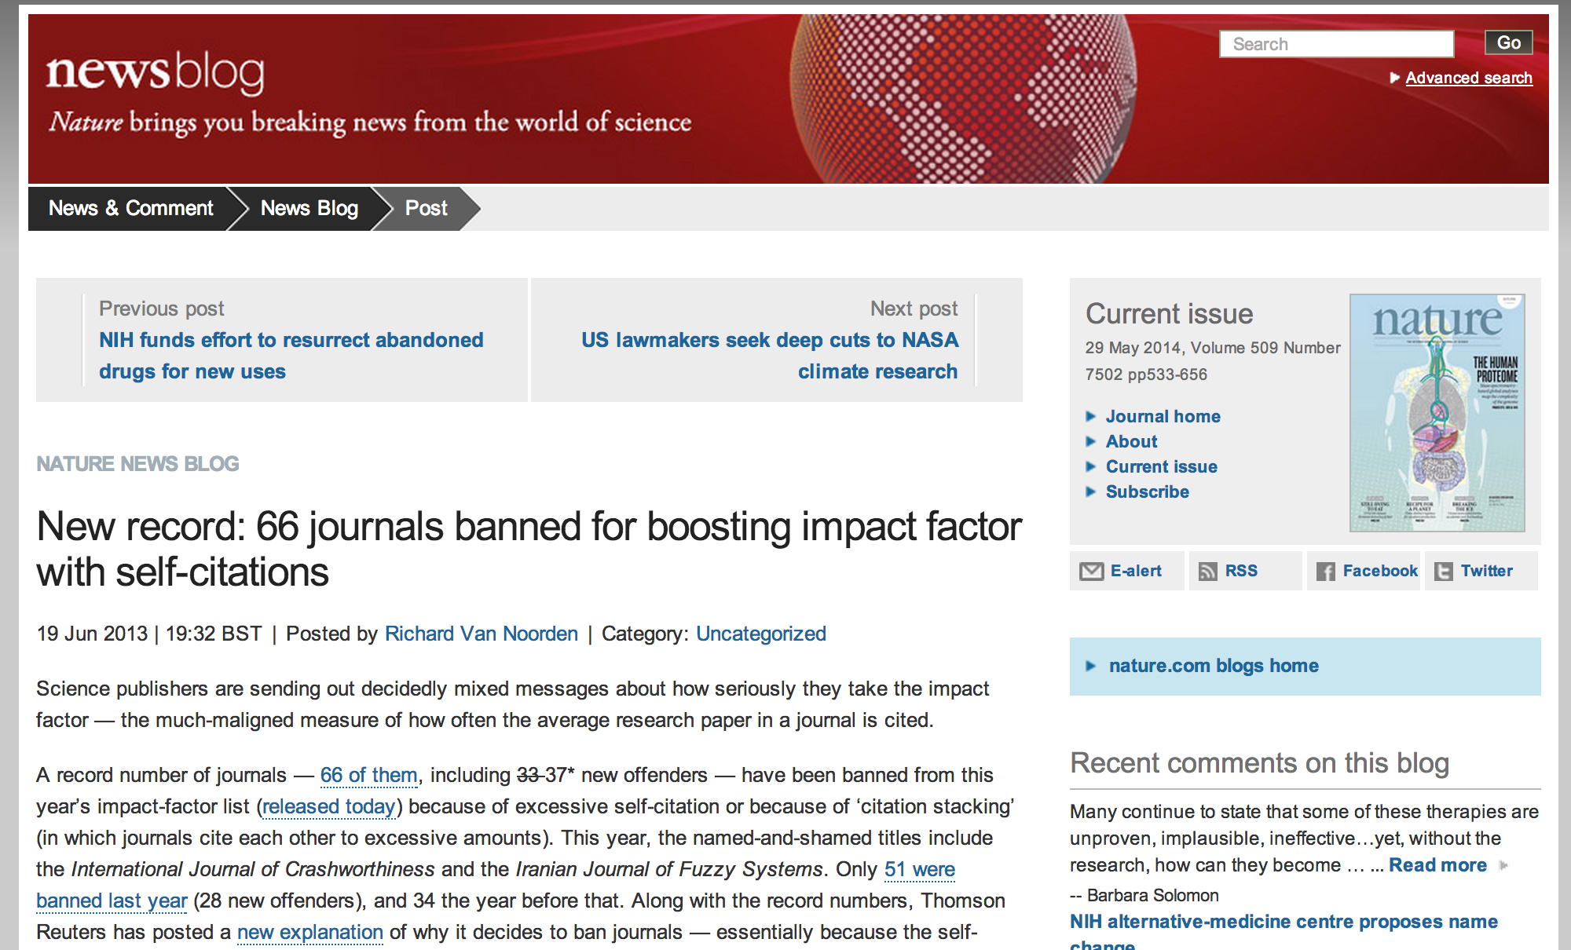
Journal Metrics
Notes:
http://www.nature.com/news/publishers-withdraw-more-than-120-gibberish-papers-1.14763

Slide 37
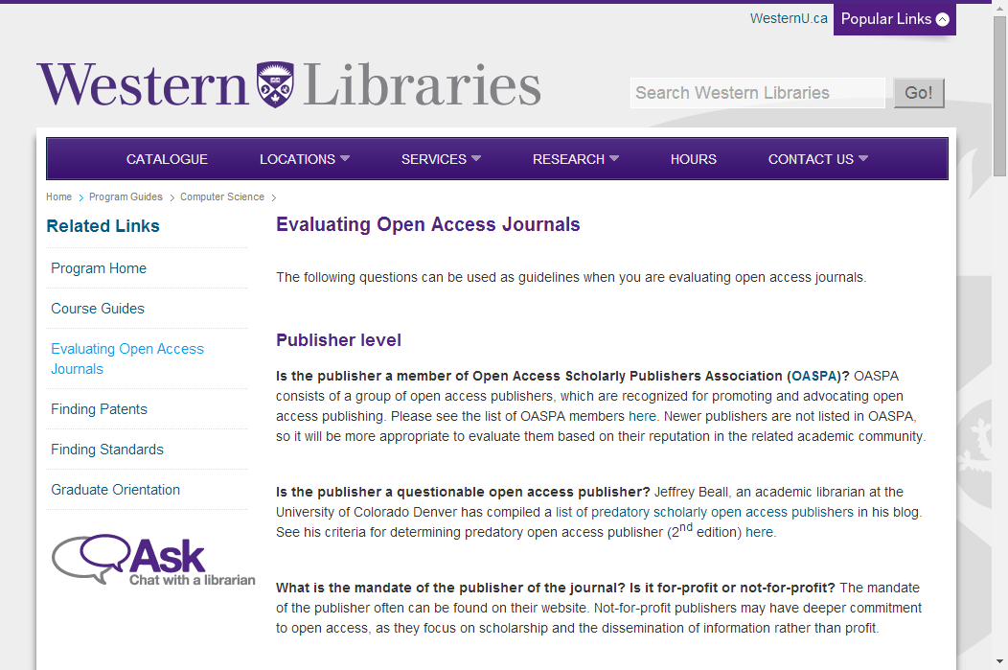
Notes:
http://www.lib.
uwo.ca/programs/computerscience/evaluatingopenaccessjournals.html

Slide 38
Notes:
http://sites.stfx.ca/library/evaluating_OA_journals

Slide 39
Journal Quality Standards

Slide 40
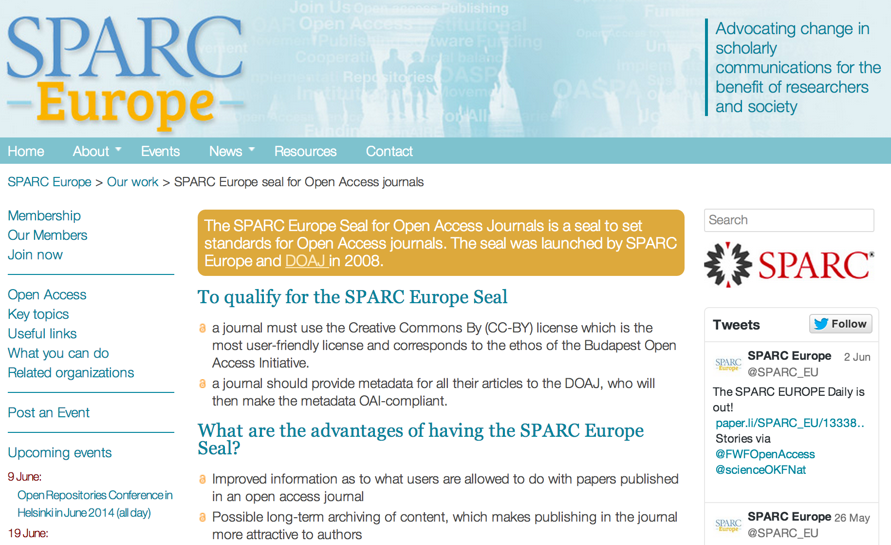
SPARC Europe Seal of Approval

Slide 41
DOAJ Listing Criteria
Registered with SHERPA/RoMEO
Editorial board with clearly identifiable members
Clear review process
Allows use and reuse at least at the levels specified in the Open Access Spectrum. (e.g. HTML vs. PDF)
Notes:
http://aims.fao.org/community/open-access/blogs/doaj-announces-new-selection-criteria-journals
42 Fields

Slide 42
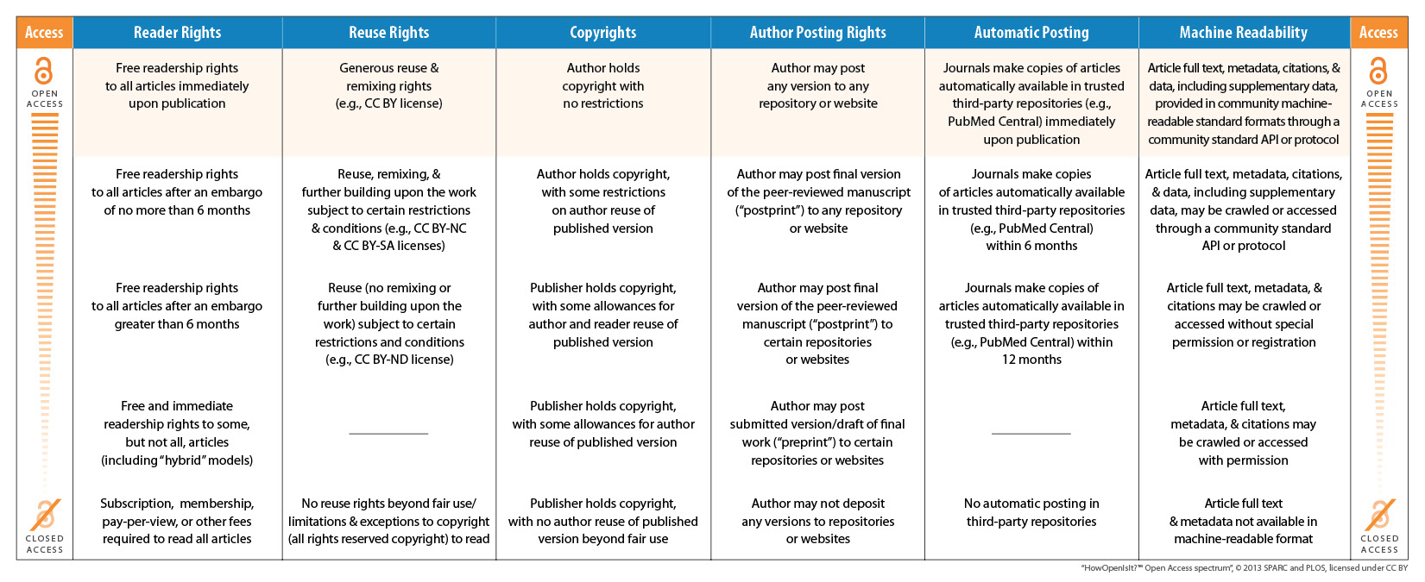
Open Access Spectrum

Slide 43
DOAJ Seal of Approval
Use DOIs (digital object identifiers) as permanent article-level identifiers
Provide article-level metadata to DOAJ
Have a long-term digital preservation arrangement in place with an external party
Embed machine-readable CC copyright information in its articles’ metadata
Notes:
http://aims.fao.org/community/open-access/blogs/doaj-announces-new-selection-criteria-journals
DOAJ Listing Criteria

Slide 44
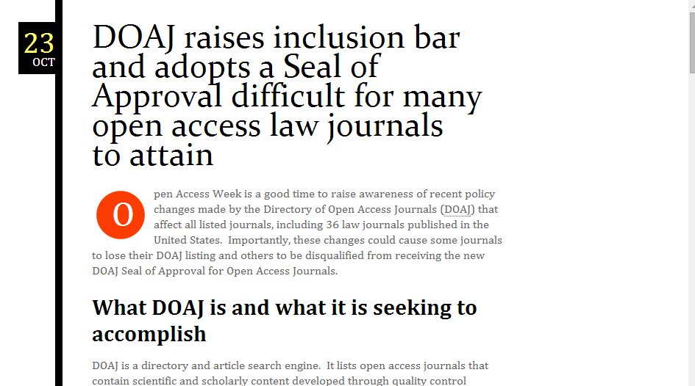
Notes:
http://ljeds.wordpress.com/2013/10/23/doaj-inclusion-seal-approval-open-access-law-journals/

Slide 45
OASPA Membership
Notes:
http://oaspa.org/

Slide 46
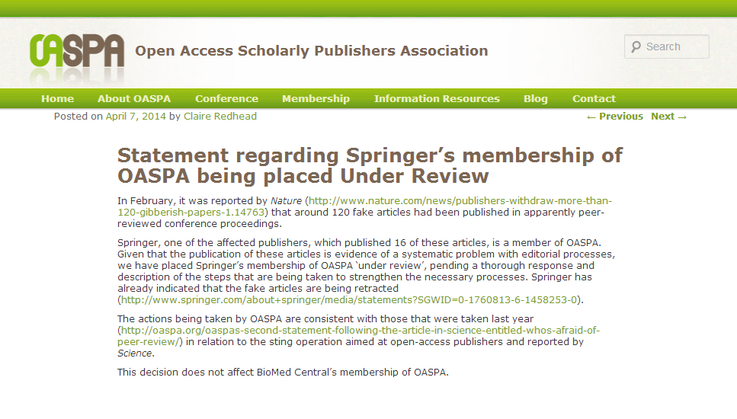
OASPA Censure
Notes:
http://oaspa.org/statement-regarding-the-suspension-of-springers-membership-in-oaspa/
http://www.nature.com/news/publishers-withdraw-more-than-120-gibberish-papers-1.14763

Slide 47
Institutional Reassurance

Slide 48
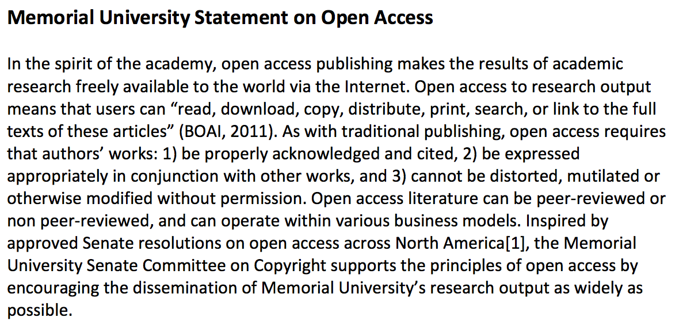
Statement of Support for OA
Notes:
http://research.library.mun.ca/248/1/MUN_Statement_on_Open_Access.pdf

Slide 49
Collective Agreement
“ We will regard a record of open access publication as evidence of service to the community in evaluation of applications for faculty appointments, promotions and grants.”
Notes:
If you want to get a bit more radical you could include a statement that gives preference to OA publishing.

Slide 50
Visibility

Slide 51
Social Media Sharing
Notes:
Social networks are acting as trusted recommender systems, but gated links are less likely to be shared in forums where many readers will not be able to gain access.

Slide 52
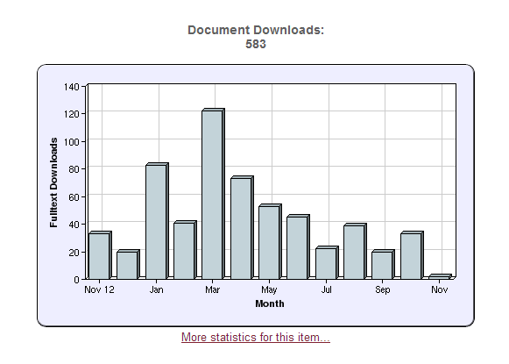
RR Download Stats

Slide 53
Teaching & MOOCs
Notes:
Cannot distribute it within a learning management system.

Slide 54
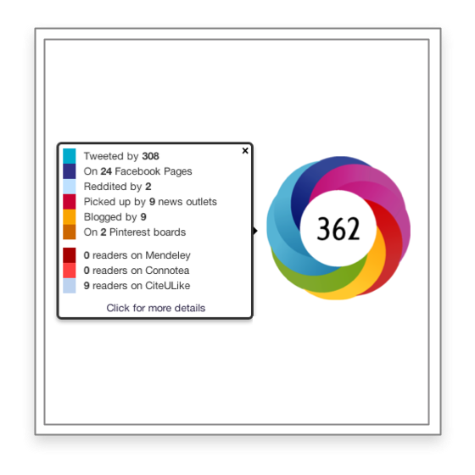
Altmetrics
Sharing in social media.
Reporting in news outlets.
Prevalence in citation managers.
Notes:
http://altmetrics.org

Slide 55
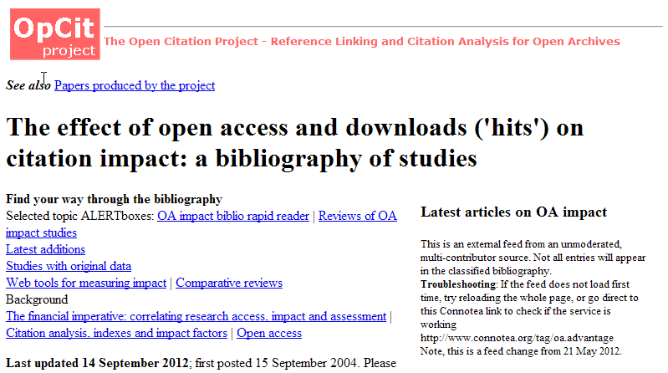
More Citations
Notes:
http://opcit.eprints.org/oacitation-biblio.html

Slide 56
Control over your work.

Slide 57
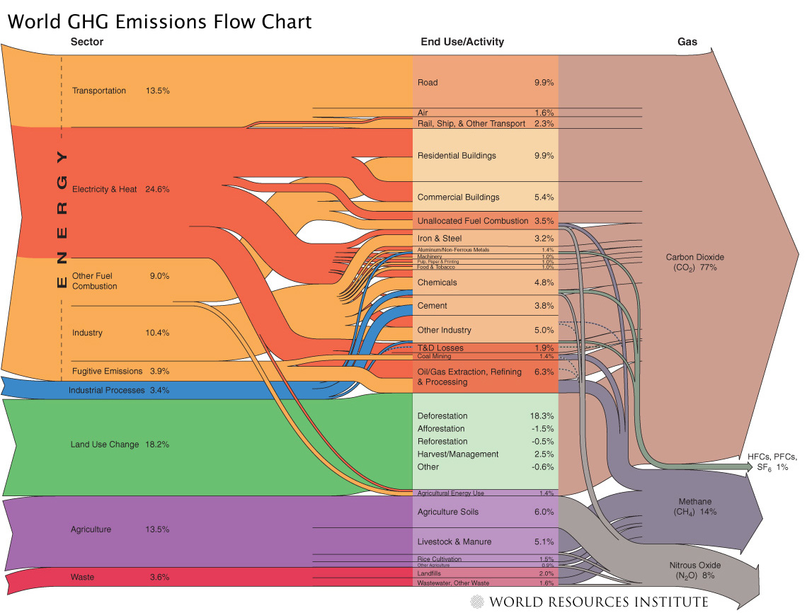
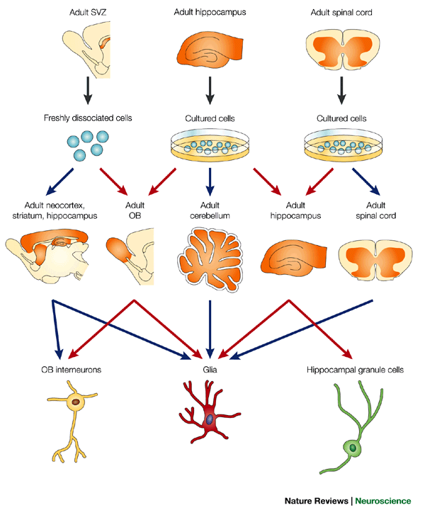
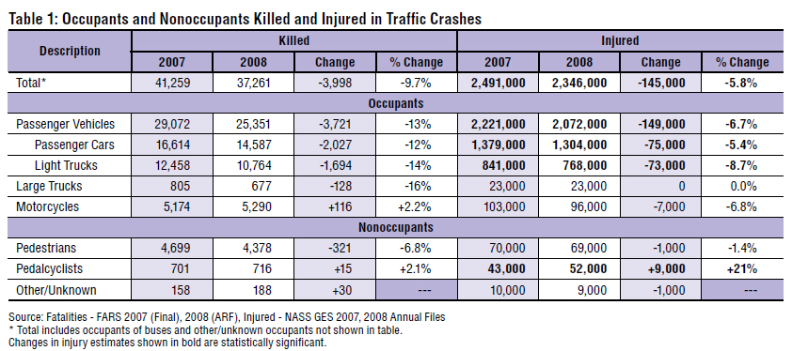
Reuse Your Work
Notes:
Charts, tables, images take a long time to produce and format, but once you give up your copyright on these items, you cannot reuse or share them.
New York Times science writer Carl Zimmer demonstrated the distinction succinctly. He discusses a recent case where Wiley threatened legal action after a neuroscience graduate posted some figures from one of their journal articles on her blog (despite the fact that this is already permitted under terms of “fair dealing” or “fair use”). (When OA not OA, PLOS Bio, October 2007)

Slide 58
Professional Websites
Notes:
Cannot link to it from online portfolio, academic c.v., faculty profile page, blogs, or other social media sites,

Slide 59
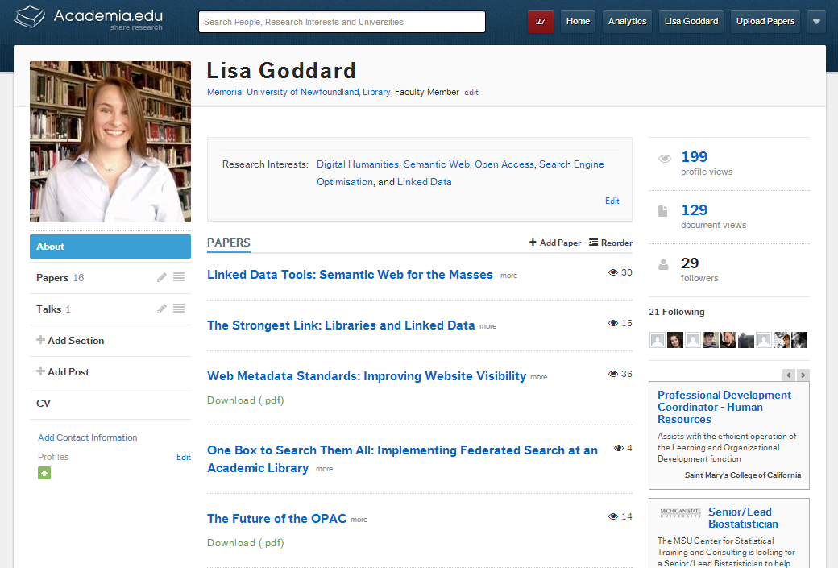
Scholarly Networking

Slide 60
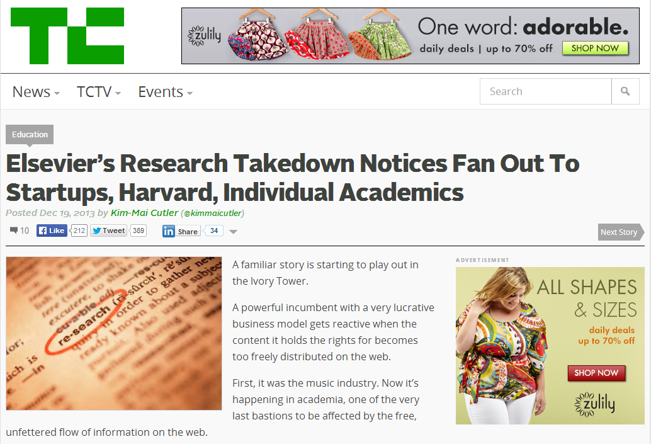
Notes:
http://techcrunch.com/2013/12/19/elsevier/

Slide 61
I can’t afford to pay to write.
Notes:
You can’t afford to pay to read, either.

Slide 62
Open Access Author’s Fund
Library pays author’s fee for publication in OA journals.
Faculty & grad students
$3000/year

Slide 63
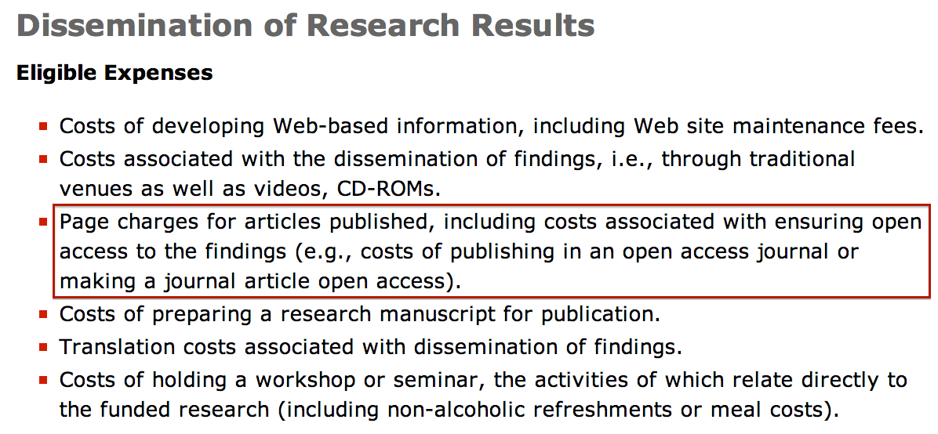
Tri-Agency Support
Notes:
http://www.nserc-crsng.gc.ca/Professors-Professeurs/FinancialAdminGuide-GuideAdminFinancier/FundsUse-UtilisationSubventions_eng.asp#dissemination

Slide 64
No Fee OA Journals
Fees
No fees
- Laakso and Björk (2012)
Notes:
Although Gold OA is typically linked with the concept of author’s fees, we can see from the first chart, that actually a majority of Gold OA journals do not charge processing fees. Many of these are supported by universities, societies, and funding agencies.
Laakso and Björk (2012) “Anatomy of open access publishing: a study of longitudinal development and internal structure”, BMC Medicine, 10:124. http://www.biomedcentral.com/1741-7015/10/124

Slide 65
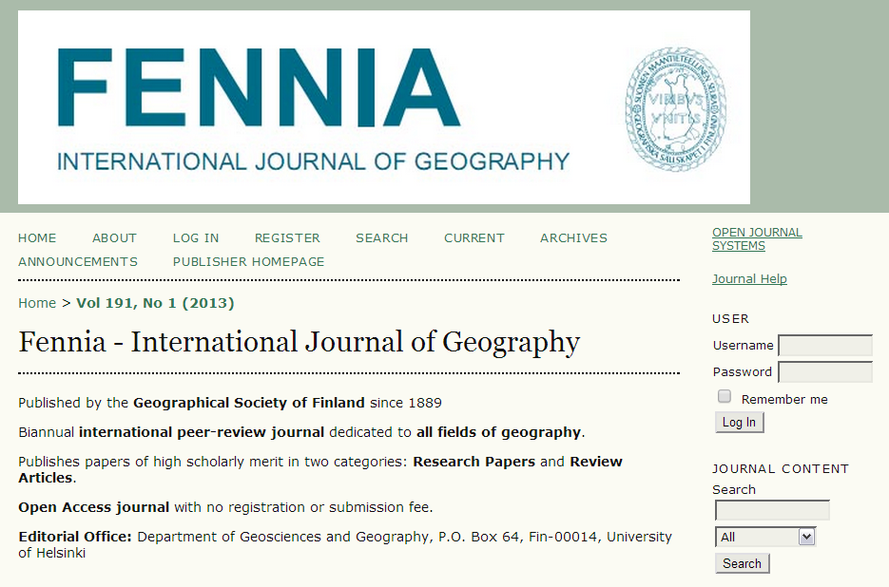
No Fee OA Journals
Notes:
Fennia is an example of a no fee OA journal that is published by the Geographical Society of Finland.

Slide 66
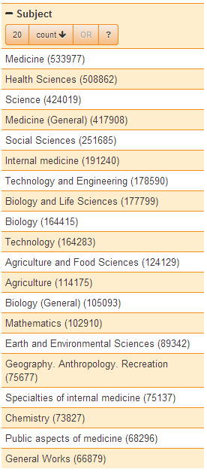
Discipline Matters

Slide 67
Thank you!

