Slide 1
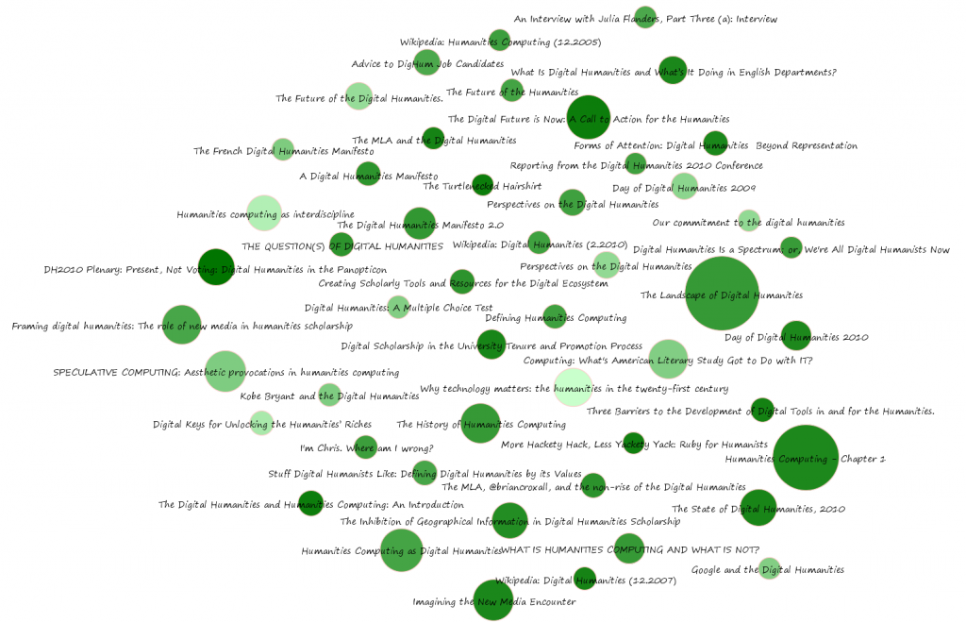
Digital Humanities
Lisa Goddard
ENGL 7003 – Studies in Literary Theory
September 2012

Slide 2
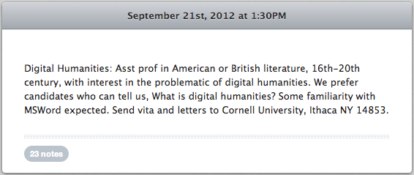
http://mlajobs.tumblr.com/post/31991562450/digital-humanities-asst-prof-in-american-or
Notes:
Digital Humanists have been trying to answer the question “What is the digital humanities?” for almost a decade now.

Slide 3
‘Big Tent’ Digital Humanities
Music
History
Philosophy
Linguistics
Digital Publishing
Design
ePerformance
Text Analysis
Cultural Studies
Art History
Digital Pedagogy
Big Data
Library Science
Interactivity
Literary Studies
New Media Studies
Geography
Archeology
Gaming
Visualization
Multimedia
Collaborative
Notes:
The question is difficult to answer in part because the term DH is often stretched to encompass a huge variety of disciplines and methodologies.

Slide 4
You talk now.
Did your undergrad programs introduce you to the digital humanities?
Notes:
You are all graduate students in a humanities discipline, and yet most of you have no experience with the Digital Humanities. There is still a wide divide between those working in traditional humanities and those working in the digital humanities.
In the sciences there is no such divide. We do not have a separate department for “digital scientists”.
I come from a discipline where we have libraries and “digital libraries” and the distinction between the two is still quite meaningful to people.
That’s something to think about as we talk today: is it still important and meaningful to distinguish between the humanities and the digital humanities.

Slide 5
Text Mining

Slide 6
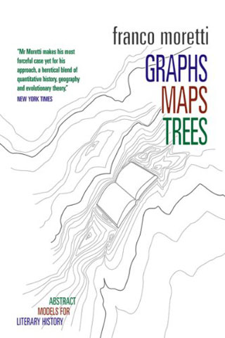
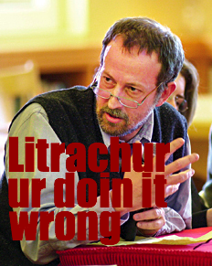
Moretti: Distant Reading
Notes:
Franco Moretti from Stanford’s Literary Lab coined the term “Distant Reading” as a practice that is intended to contrast with the practice of “close reading”.
The meme here is tongue in cheek. Moretti doesn’t say that traditional humanist approaches are wrong, but he thinks that there are new arguments to be made when we view literature at a different scale.

Slide 7
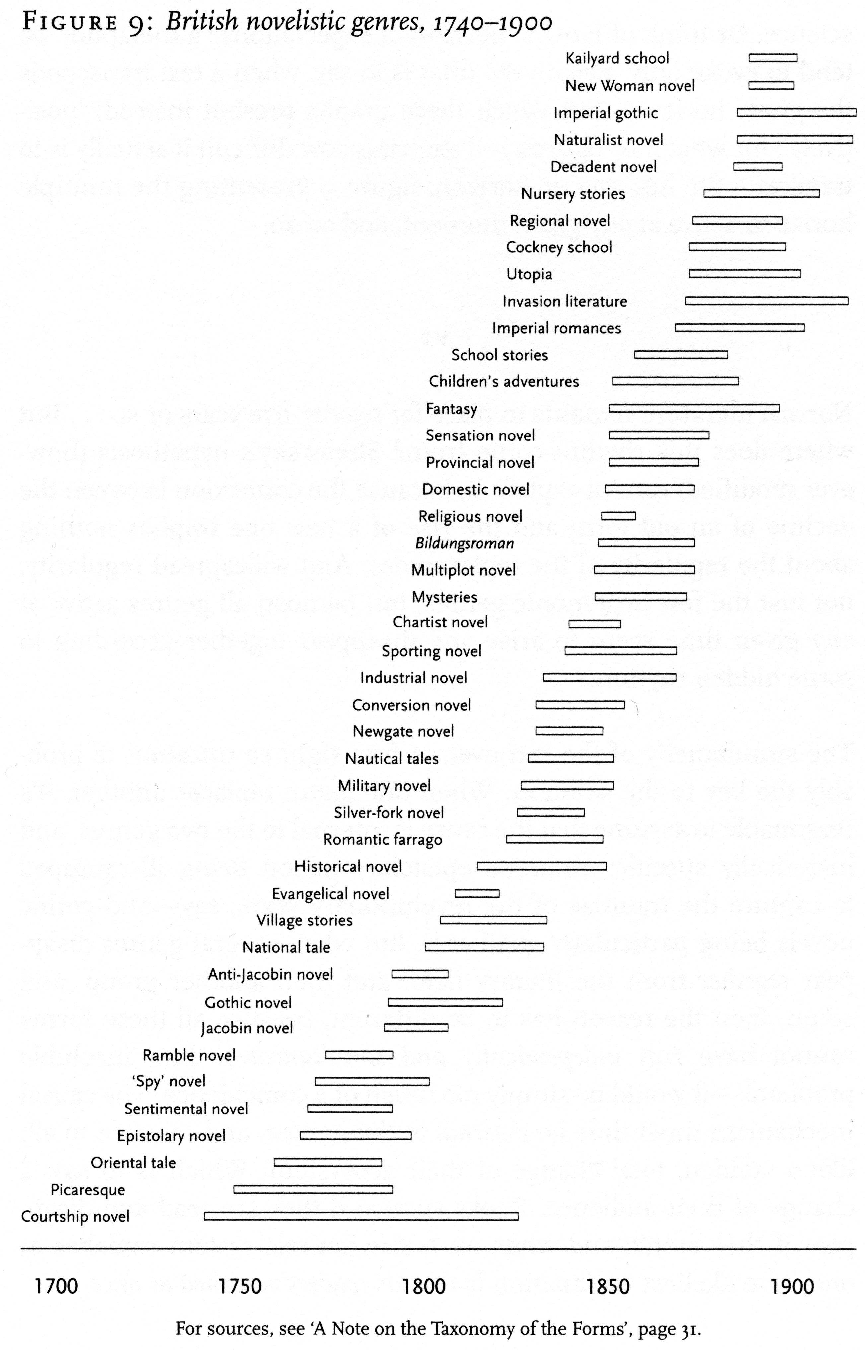
Distant Reading
Distant reading takes the lost 99% of the archive and reintegrates it into the fabric of literary history allowing us to finally ‘see’ it.
Notes:
Combines over 100 studies on genre in British Literature.
Genres rise and disappear in clusters.
Genres have a lifespan of about 25-30 years, likely tied to generational tastes.

Slide 8
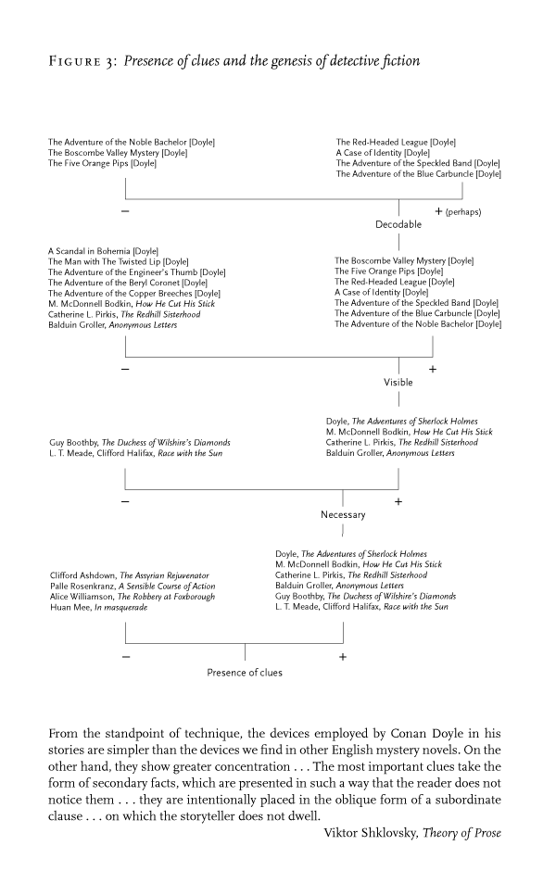
Distant Reading
The very small and the very large, these are the forces that shape literary history. Devices and genres; not texts.
Notes:
Studying the literary device of “clues” across a set of over 100 detective stories that were published in Strand magazine in the 1890s.
Demonstrates how the use of clues distinguishes Doyle from his competitors.
Like language, literature evolves by diverging. When we trace a specific device through a genre we can understand evolution and diversity within a genre.

Slide 9
Anatomy of a Text Analysis Project
Dunning et al, “Freeing up digital content with text mining”, Serials. 22(2), July 2009
Notes:
http://juilland.comp.lancs.ac.uk/hardiea/newsbooks/
The term “Digital Humanities project” is currently being applied to a wide spectrum of different types of academic undertakings. This one is a text mining project.

Slide 10
Text Corpus
17thC English news pamphlets
Dec 1653 to May 1654
British Library electronic texts
312 documents, 800 000 words
Notes:
In order to undertake a text mining project, you need to start with a fairly large corpus of accurately transcribed text, ideally without too many copyright restrictions. In this case the researchers first want to extract Geographical place names from the text.
(Dunning et al, “Freeing up digital content with text mining”, Serials. 22(2), July 2009)

Slide 11
CLAWS: Part of Speech Tagging
Grammar parsing tool (Linguistics)
Identifies proper nouns, common nouns, plural nouns, adjectives, prepositions…
95–97% accuracy
Notes:
First run the texts through a grammatical parser that tags all of the different parts of speech. As you may be able to see from this screenshot, proper nouns are tagged with the code NP1. Software is not completely accurate, but at 95-97 percent accuracy, it does most of the heavy lifting.
Using tools such as CLAWS4, which incorporates embedded dictionary resources, it is possible to parse
an entire corpus of text, and make sophisticated interpretations of the grammatical purpose of each word.
So for example, usages of proper nouns, such as cities or people, are tagged with NP1 (Patrick, Liverpool),
while common nouns in the plural are marked with NN2 (Ships, Seas). The analysis is not always
entirely correct (for example, one example of Brest in the example above has been analysed correctly
as NP1, while the other has been incorrectly analysed as JJT (an adjective in superlative form)
(Dunning et al, “Freeing up digital content with text mining”, Serials. 22(2), July 2009)

Slide 12
Geographical Analysis
Place name matching, w/ historical and place name variations.
Notes:
In order to find out which of the proper nouns are actually place names, the researchers compare the list of NP1 tagged words against a list of place names from the World Gazetteer. The Gazetteer is useful because it also contains historical place names, and place name variations. Once the place names are identified, they are associated with geographic coordinates.
Creating a related database that contained every instance of a place name, drawn from the family
NP1 for proper nouns, within the corpus, matching up place names to the glossary of places names
made freely available on the website (http://www.world-gazetteer.com/).
(Dunning et al, “Freeing up digital content with text mining”, Serials. 22(2), July 2009)

Slide 13
Geographical Analysis
Notes:
It would now be possible to create a heat map of all of the locations discussed in the 17 century news books, including a view of how the distribution of place references changed over time with historical events and power shifts. The researchers are interested in going further, though. They want to map specific topics.
Dunning et al, “Freeing up digital content with text mining”, Serials. 22(2), July 2009

Slide 14
USAS: Semantic Parsing
... two_N1 ships_M4 from_Z5 Dunkirk_Z2 have_Z5 brought_M2 Men_S2.2m Arms_B1 ,_PUNC and_Z5 Ammunition_G3 to_Z5 Middleton_Z1mf
Ships = M4 (shipping, swimming, etc.)
Men = S2.2m (People:-Male)
Ammunition = G3 (warfare, defense and the army; weapons)
Notes:
So the text has to be parsed again, this time for semantic meaning. Semantic parsers are based on sophisticated thesauri that can identify and cluster words that express a concept. So, for example, a search for war will also bring back conceptually related words like miitary, battle, violence, etc.
Using a system called USAS 5, which is embedded with specially prepared thesauri, an entire
corpus of text can be parsed semantically. This system makes sophisticated interpretations of the
meanings of individual words, thus grouping particular words into larger families of concepts.
The advantage of this is that it allows the scholar to search not just for instances of precise words
within a corpus, but for particular concepts. So, for example, a scholar searching for war will, with a
semantically parsed text, not only be able to locate instances of the string ‘war’ but also conceptually
related words, like military, battle, violence, etc.6
(Dunning et al, Freeing up digital content, Serials – 22(2), July 2009)

Slide 15
GIS Mapping: Topic ‘War’
Notes:
Now the topic clusters can be cross-referenced with the geographical data to create heat maps showing the geographical areas that the newsbooks referenced most often in relation to specific topics like war…
(Dunning et al, “Freeing up digital content with text mining”, Serials. 22(2), July 2009)

Slide 16
GIS Mapping: Topic ‘Money’
Notes:
…or money. While this kind of research undeniably uncovers new factual information, it’s still unclear what actual question is being answered here. The authors behind the Lancaster Newsbook study suggest that their topic maps primarily uncover new questions, and open up new fields of investigation.
To consider this in more detail, the large numbers of references to money and finance in London, Edinburgh and Paris are perhaps not surprising. However, why are other places that might be expected here, such as Amsterdam, not mentioned? Is this to do with the Anglo-Dutch war?
(Dunning et al, “Freeing up digital content with text mining”, Serials. 22(2), July 2009)

Slide 17
Text Analysis
Because the patterns are undetectable, you don’t know in advance what they are and you cannot begin your computer-aided search (called text-mining) in a motivated — that is, interpretively directed — way.
-Stanley Fish, NYT, January 2012
Notes:
http://opinionator.blogs.nytimes.com/2012/01/23/mind-your-ps-and-bs-the-digital-humanities-and-interpretation/

Slide 18
You talk now.
Do you see value in these kinds of projects?
Do they answer humanities questions or make humanities arguments?
Notes:
http://www.foundhistory.org/2010/05/12/wheres-the-beef-does-digital-humanities-have-to-answer-questions/

Slide 19
Digital Editions

Slide 20
TEI Encoding
<div n="castlist” type="DramatisPersonae" org="uniform" sample="complete"> <castList>
<head>Dramatis Personae</head>
<castItem type="role">
<role xml:id="wag">Wagner</role>
</castItem>
<castItem type="role">
<role xml:id="luc">Lucifer</role>
</castItem>
…</castlist>
</div>
Notes:
An excerpt of an electronic version of Marlowe’s Dr. Faustus. This snippet is from the cast list, wherein each character in the play is accorded an xml tag to identify him or her. Here we can see that words and actions attributed to Wagner will be tagged with the attribute “wag”.
Example from: http://tbe.kantl.be/TBE/examples/TBED05v00.htm#marlowe

Slide 21
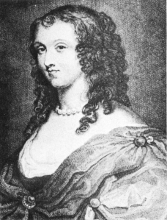
Brown Women Writer’s Project
Notes:
Recovered a huge archive of pre-Victorian women writers. These are being marked up in TEI on an ongoing basis. Grad students do a lot of the work of TEI markup in the project.

Slide 22
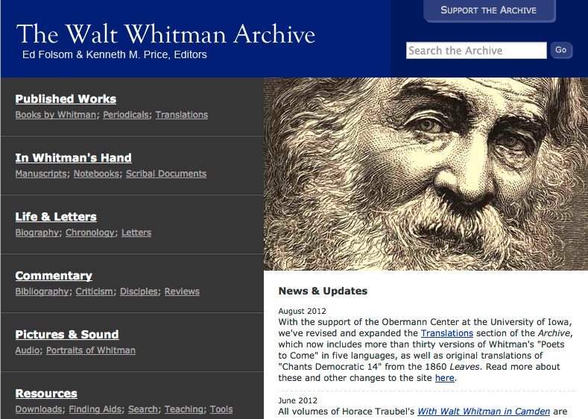
Digital Editions
Notes:
Includes manuscripts, recordings, multiple editions of his works, and a lot of additional interpretation added by scholars.
http://www.whitmanarchive.org/

Slide 23
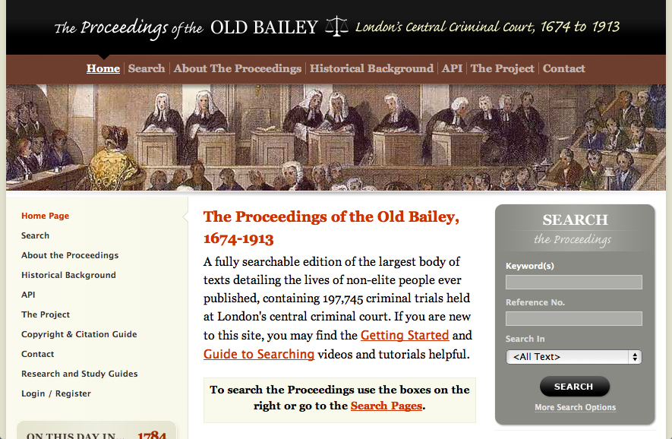
Digital Archives
Notes:
Three hundred years worth of transcripts from London’s Criminal Court are now available digitally. Exciting insight into the lives of non-elite Londoners.
http://www.oldbaileyonline.org/

Slide 24
Big Data
Scale is a new horizon of intellectual inquiry. What kinds of humanistic phenomena appear only at scale? (Liu, 2012)

Slide 25
Text Visualization
Notes:
http://www.nytimes.com/interactive/2009/01/17/washington/20090117_ADDRESSES.html

Slide 26
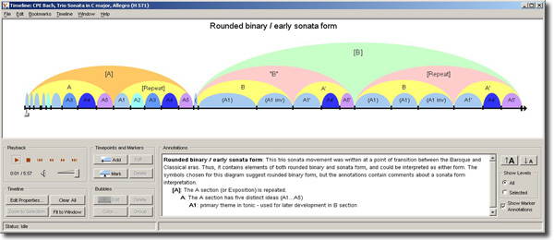
Structural Analysis of Music
SALAMI: Structural analysis of 350,000 pieces of recorded music from all over the world.
Notes:
http://ddmal.music.mcgill.ca/salami
350,000 pieces (~23,000 hours) of recorded music from all over the world.
Formal analysis is potentially useful in classifying different genres of music and it can be used to compare different styles of composition within a composer’s works or between composers.
It can also be used to understand historical influences over time and location.

Slide 27
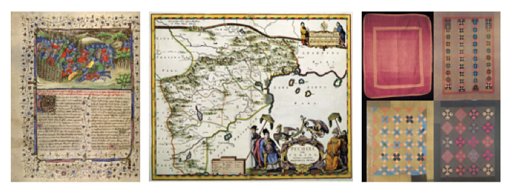
Authorship Analysis
DID-ARQ: Discover what salient characteristics make an artist different from others, and enable statistical learning about individual and collective authorship.
Notes:
http://isda.ncsa.illinois.edu/DID/
identifying distinct characteristics of artists is time-consuming for individual researchers using traditional methodologies, computer-assisted techniques can help humanists discover salient characteristics and increase the reliability of those findings over a large-volume corpus of digitized images. Computer-assisted techniques can provide an initial bridge from the low-level image units, such as color of pixels, to higher-level semantic concepts such as brush strokes, compositions or patterns.

Slide 28
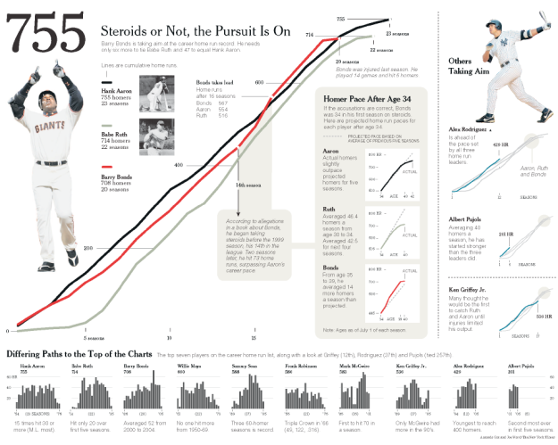
Visual Narratives
Notes:
http://vis.stanford.edu/papers/narrative

Slide 29
Tool Building

Slide 30
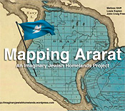
DH Apps
Notes:
The Victorianator was developed at Concordia. It’s a game in which players score points for how well they master the techniques of Victorian elocution, from giving words their proper inflection to accenting their delivery with appropriate gesticulation. http://ludicvoice.concordia.ca/?page_id=1148
Developed by Cleveland State University, Cleveland Historical lets you explore the people, places, and moments that have shaped the city’s history. Learn about the region through layered, map-based, multimedia presentations, use social media to share your stories, and experience curated historical tours of Northeast Ohio. http://clevelandhistorical.org/
Augmented reality project. In September 1825, Major Mordecai Noah founded Ararat, “a city of refuge for the Jews” in Grand Island, New York. This turned out to be just one of many failed projects and schemes in modern history that sought to carve out a nation for the Jewish people http://imaginaryjewishhomelands.wordpress.com/

Slide 31
You talk now.
A book with a bibliography is surely scholarship. Is a tool for keeping track of bibliographic data (like Zotero) scholarship? (Geoffrey Rockwell, 2012)
Is tool-building ‘real’ humanities research?

Slide 32
DH Theory
A prototype is a theory. Stop apologizing for your prototypes. - Manovich, 2007
Digital artifacts themselves—not just their surrogate project reports—should stand as peer-reviewable forms of research, worthy of professional credit and contestable as forms of argument. - Ruecker and Galey, 2010
Notes:
Alan Galey and Stan Ruecker. How a prototype argues. Lit Linguist Computing (2010) 25(4): 405-424, October 27, 2010 http://dx.doi.org/10.1093/llc/fqq021

Slide 33
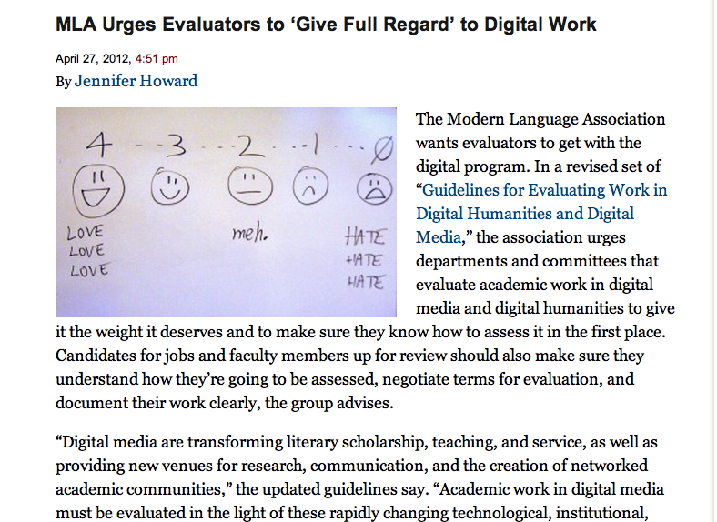
Notes:
http://chronicle.com/blogs/wiredcampus/modern-language-association-urges-evaluators-to-give-full-regard-to-digital-work/36200

Slide 34
The Spatial Turn
The humanities traditionally have been conceived and organized within a temporal framework. Time was more than our agent, it was our master. Space was the unexamined landscape on which time played out its game.
- Bodenhamer, 2007
Notes:
David J. Bodenhamer. Creating a Landscape of Memory: The Potential of Humanities GIS. International Journal of Humanities and Arts Computing. Volume 1, no. 2, 2007. p. 97-110 http://dx.doi.org/10.3366/E1753854808000207

Slide 35
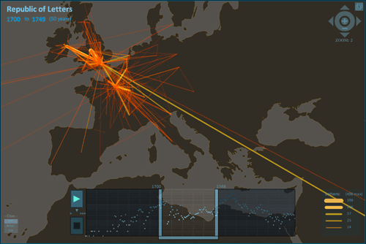
GIS & Mapping

Slide 36
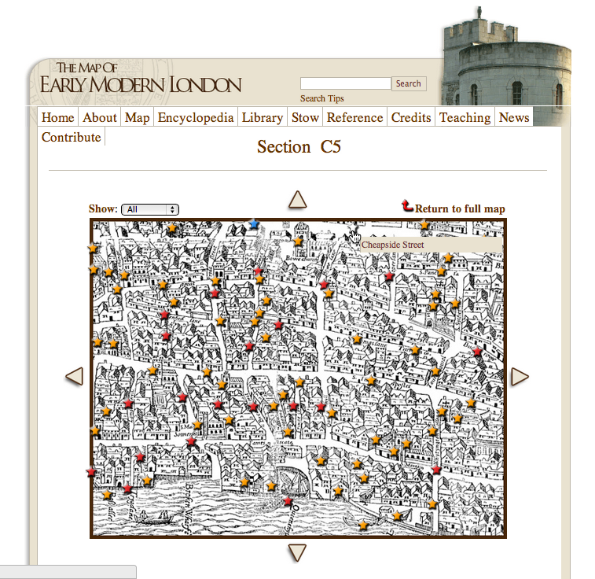

Slide 38
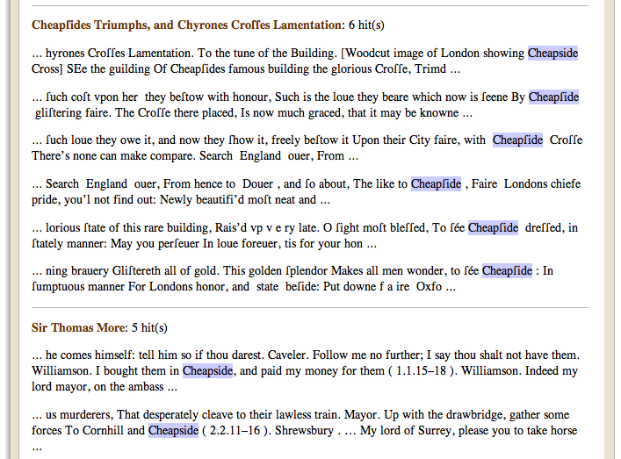

Slide 39
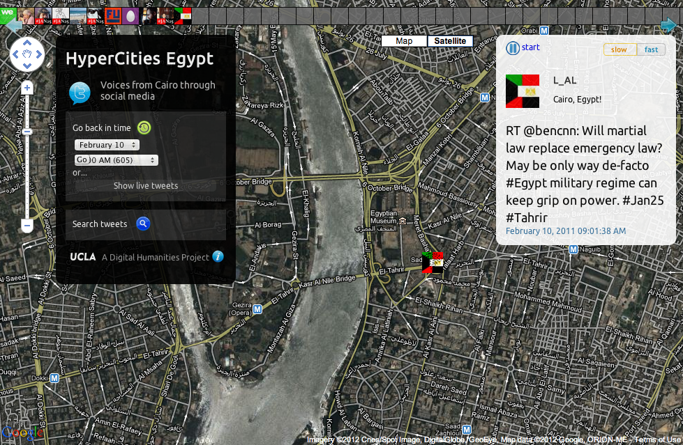
GIS Narratives
Notes:
http://egypt.hypercities.com/

Slide 40
Multimedia Forms
Notes:
The proliferation of new formats has led to a renewed interest in formalist analysis.

Slide 41
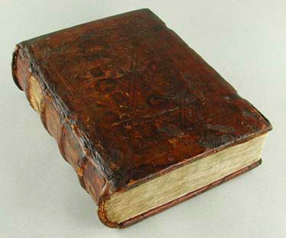
Printed Text
To change the material artifact is to transform the context and circumstances for interacting with the words, which inevitably changes the meaning of the words as well. (Hayles)
Notes:
The digital gives us a new way to understand print. Print is a technology. It has benefits and limitations. By studying how people interact with etexts we can learn a lot about print.
Mangen, A. (2008), Hypertext fiction reading: haptics and immersion. Journal of Research in Reading, 31: 404–419. doi: 10.1111/j.1467-9817.2008.00380.x
The number of assimilations recalled in the presence of the paper book is higher than in its absence. But, we observe the inverse effect in the case of the e-book. Its presence interferes with recall of concepts assimilated. - (Thierry Morineau, Caroline Blanche, Laurence Tobin, Nicolas Guéguen, The emergence of the contextual role of the e-book in cognitive processes through an ecological and functional analysis, International Journal of Human-Computer Studies, Volume 62, Issue 3, March 2005, 10.1016/j.ijhcs.2004.10.002. http://www.sciencedirect.com/science/article/pii/S1071581904001089)
The results suggest that the primary differences between the two study media are not cognitive but rather metacognitive--less accurate prediction of performance and more erratic study-time regulation on screen than on paper. - Ackerman, Rakefet, and Morris Goldsmith. “Metacognitive Regulation of Text Learning: On Screen Versus on Paper.” Journal of Experimental Psychology: Applied 17.1 (2011): 1
high education group comprehended news with the same level of efficiency across online and newspaper formats while low education participants gained more knowledge from reading a newspaper than using an online news source. - Yang, JungAe, and Maria Elizabeth Grabe. “Knowledge Acquisition Gaps: A Comparison of Print Versus Online News Sources.” New Media & Society 13.8 (2011): 1211 –1227.

Slide 42
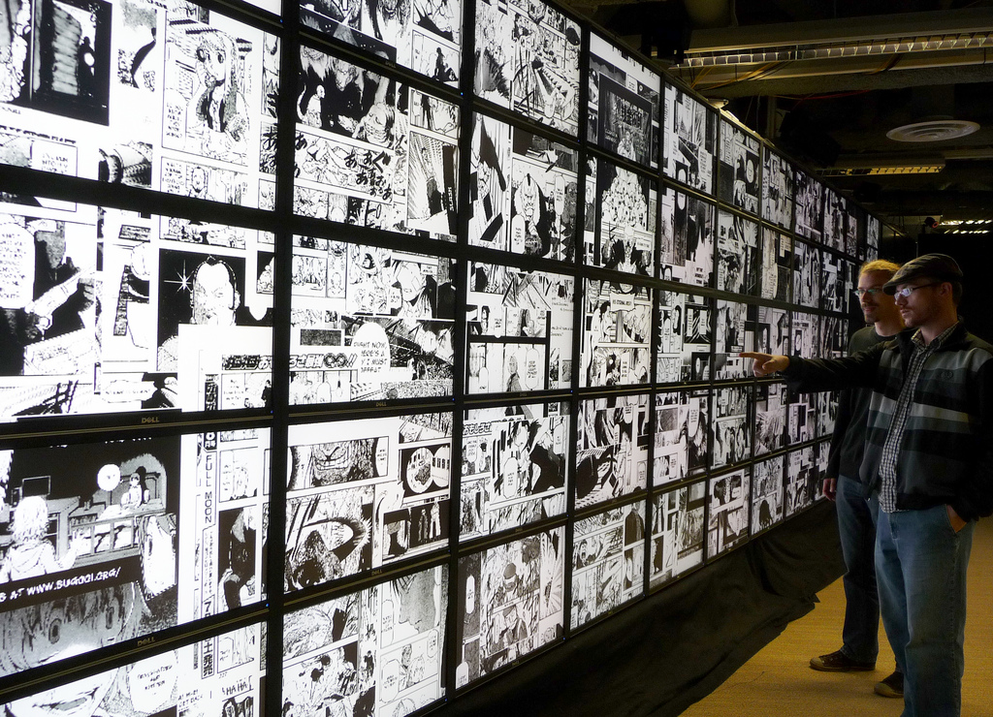
Images
Notes:
Students in Lev Manovich’s lab compare multiple images from Japanese manga.
manovich.net (CUNY)
We have a number of ways of searching and analysing text, but it is still much harder to search for images with particular characteristics.
E.g. images that are mostly red, images of girls holding swords, domestic scenes

Slide 43
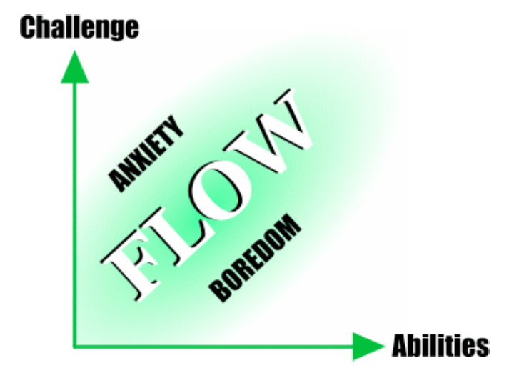
Gaming
- Jenova Chen, MFA Thesis
Notes:
Jenova Chen, MFA Thesis http://www.jenovachen.com/flowingames/thesis.htm
Jenova Chen, is the designer of the award-winning games Cloud, Flow, and Flower, and is co-founder of Thatgamecompany.

Slide 44
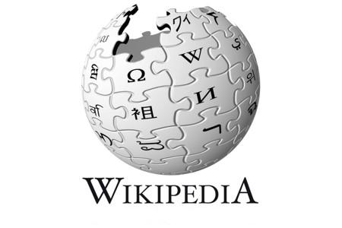
Interactive Forms
Exponential growth in user generated content has created a fundamentally new cultural situation, and a challenge to our normal ways of tracking and studying culture.
- Manovich, 2012
Notes:
The majority of the web now consists of user generated content. Cultural theorists are interested in understanding who posts,
The platforms themselves are also of interest. Who controls the content? Who decides what is offensive?
What assumptions are embedded in social network platforms? What are you allowed to do, and what are you not allowed to do? E.g. facebook allows us to like things, but not to dislike things.

Slide 45
You talk now.
What is the formal difference between a blog and a wiki? How might this impact on knowledge creation?

Slide 46
Collaboration
We need to stop talking around the issue of the single-author monograph as the benchmark for excellence, and to confront what new kinds of collaboration mean for tenure review, accreditation, and more. (Davidson & Goldberg, 2004)

Slide 47
You talk now.
What kinds of collaborative projects have you undertaken during your undergraduate & graduate studies?

Slide 48
Is it still humanities?
…platforms and protocols created by disciplines whose methodological premises are often at odds with, even hostile to, humanistic values and thought. - Drucker, 2012

Slide 49
