Slide 1
Farmers in Padilla: A Case Study of Engagement Among a Small Community in Bolivia, the City of Corner Brook, and International Business Students at Grenfell Campus, Memorial University
Mike Jackson, City of Corner Brook
Jose Lam, Grenfell Campus
Kathleen Penney, Grenfell Campus
Rebecca Pevie, Grenfell Campus
Adrianna Saunders, Grenfell Campus
2013 CUEXPO, Corner Brook, Newfoundland
June 14, 2013

Slide 2
Municipal Partners
In Economic Development
Corner Brook, NL and Padilla, Bolivia

Slide 3
The Mission
Municipal Partners for Economic Development.
An International Program Co-managed by the Federation of Canadian Municipalities (FCM) and the Federation of Municipal Associations of Bolivia (FAM Bolivia).
The City of Corner Brook was matched with the Municipality of Padilla, Bolivia to assist in Local Economic Development (LED).
Notes:
political constraints, lack of citizen education on LED, and low technical expertise of local government leaders and officials have resulted in the low investment of municipalities in LED activities

Slide 4
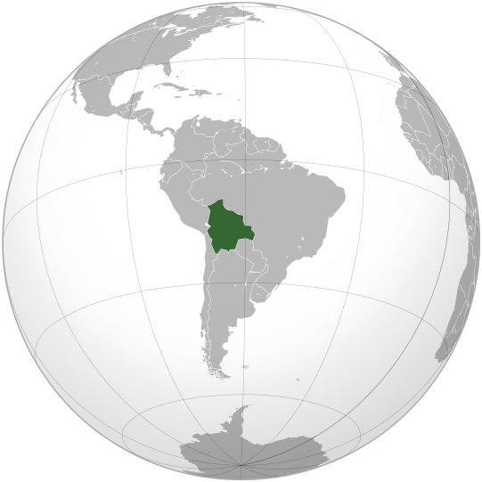
Bolivia

Slide 5
Bolivia
Capital City - Sucre - 300,000
Largest City - Santa Cruz – 1.5 million
Official Language - Spanish
Total Population - 11 million
Average Income - $1800 US
Currency – Boliviano
Poorest & Least developed country in Latin America
However, it is one of the richest in terms of Natural Resources (sound familiar?)
Resources include: Tin, Silver, Hydrocarbons, Lithium(up to 70% of the world’s reserves) because of their Lithium some call Bolivia the “Saudi Arabia of the Green World”.

Slide 6
Padilla
Padilla is a municipality made up of 59 communities, located in the department of Chuquisaca and in the province of Tomina.
It was founded in 1583
Population of 12000
Elevation of 2086 meters
Padilla lies in one of the poorest regions of Bolivia and has few natural resources.
Economy based on agriculture – Corn, Potatoes, Beans, Wheat, Peanuts, Peppers and Stevia.

Slide 7
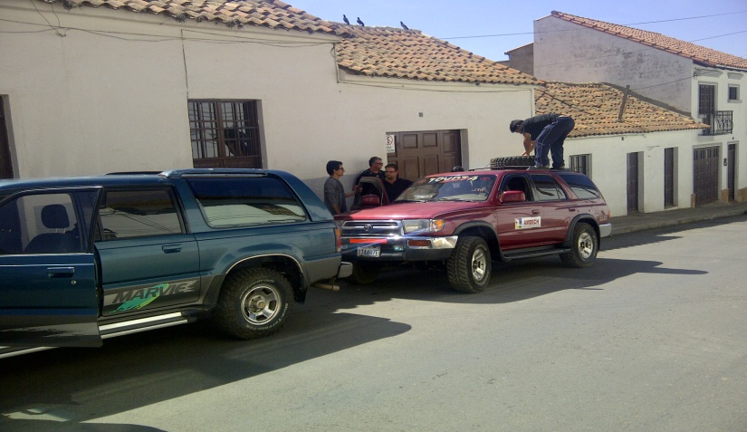
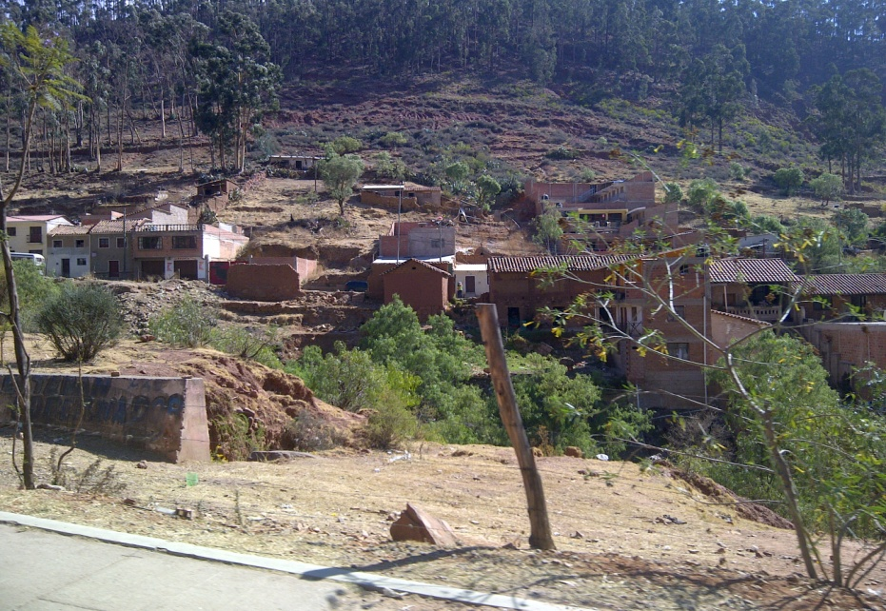
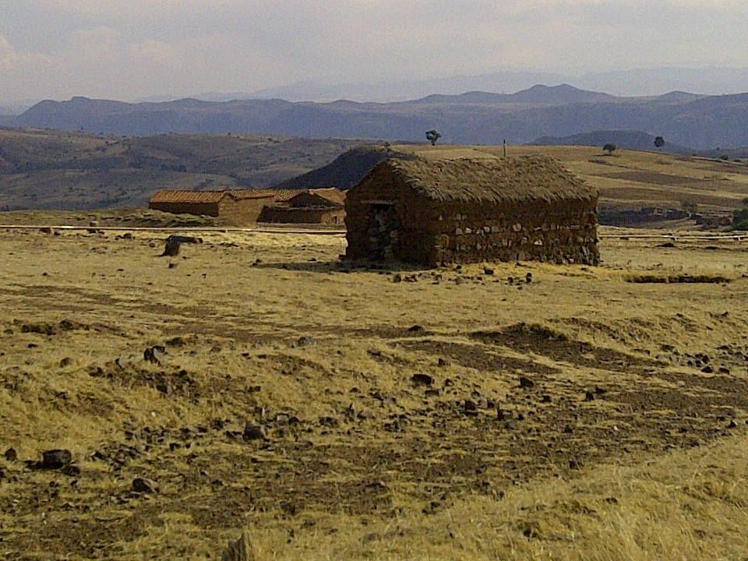
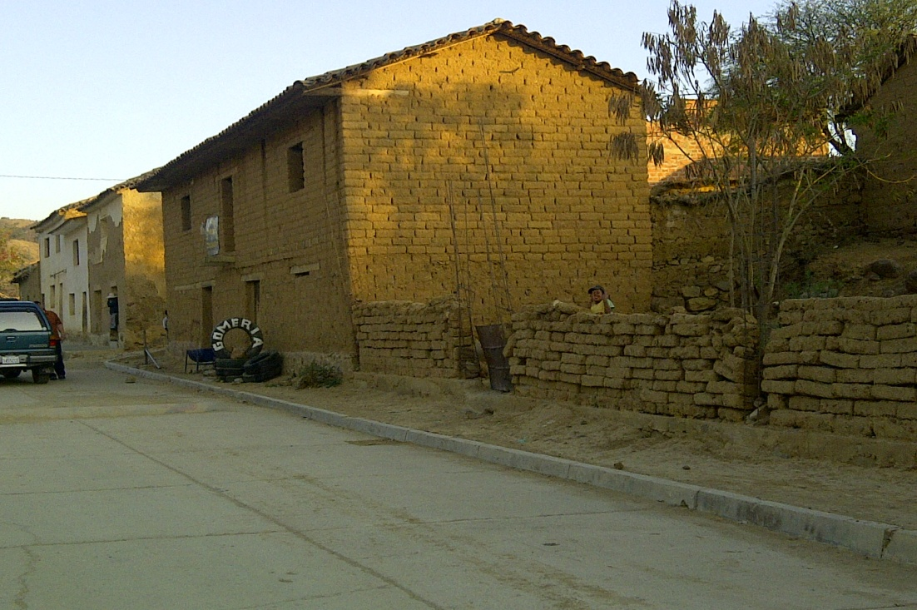
Journey to Padilla

Slide 8
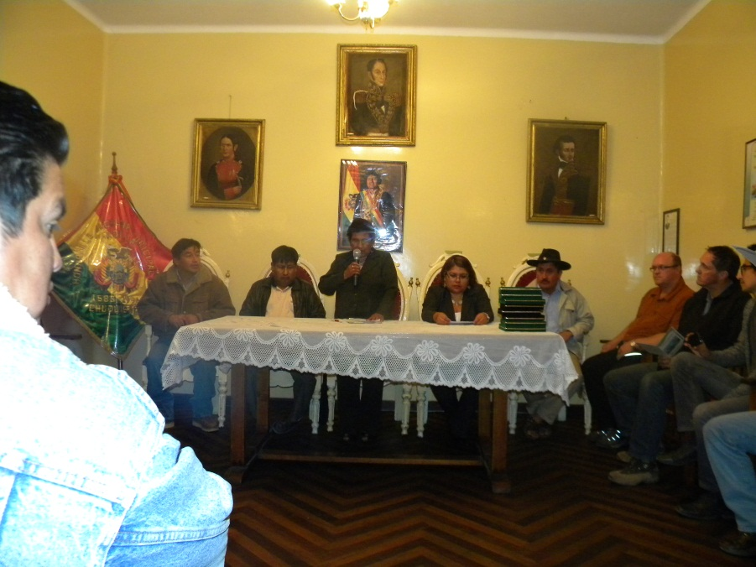
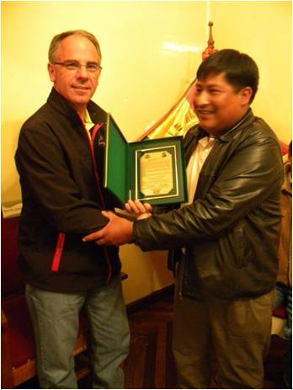
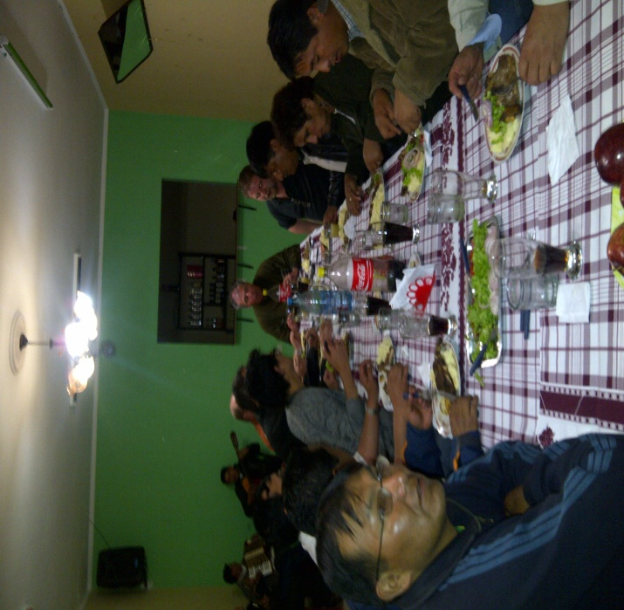
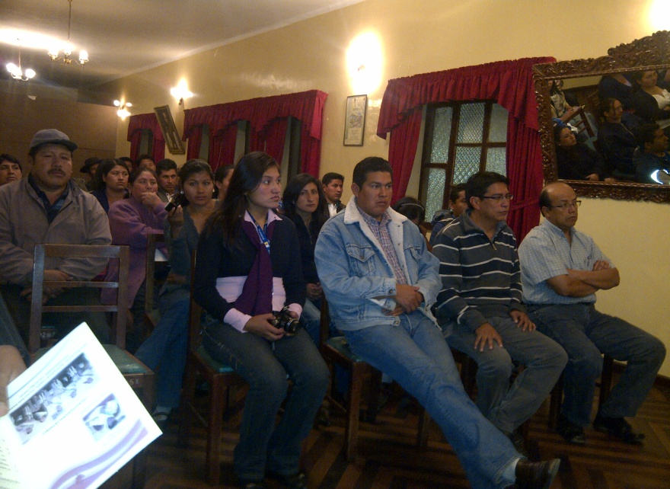
Welcome to Padilla

Slide 9
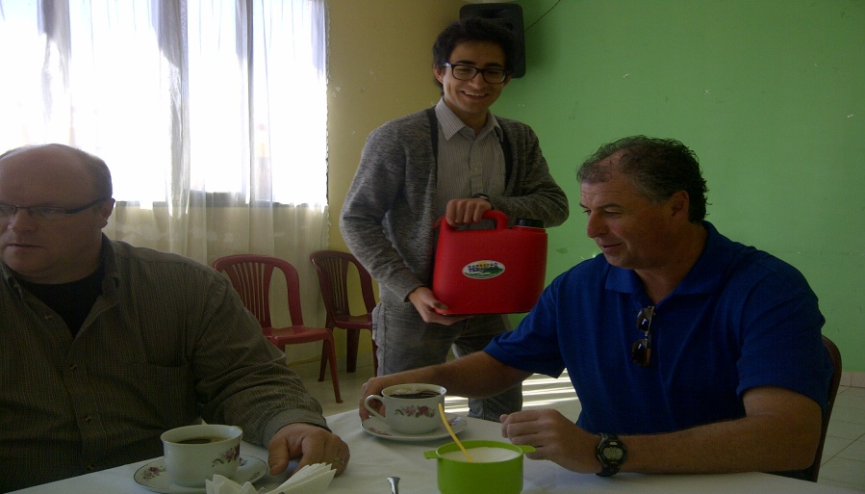
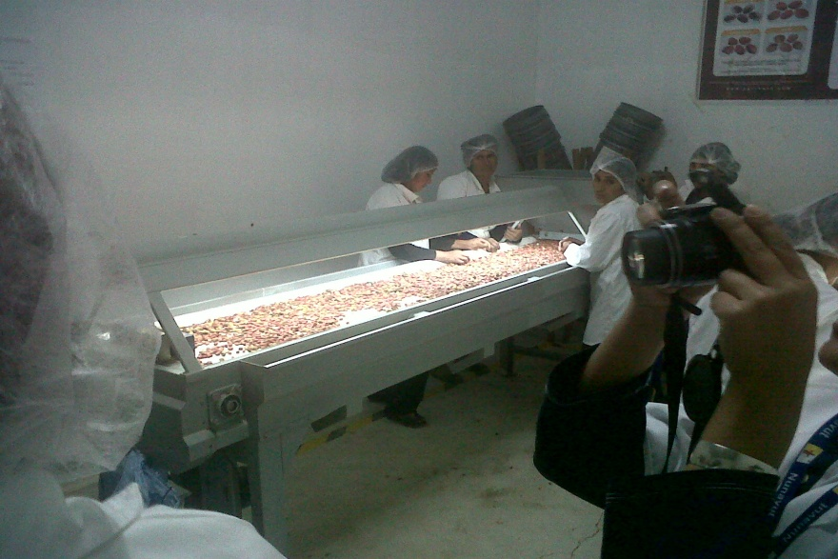
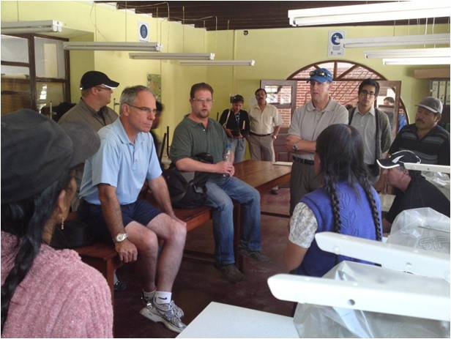
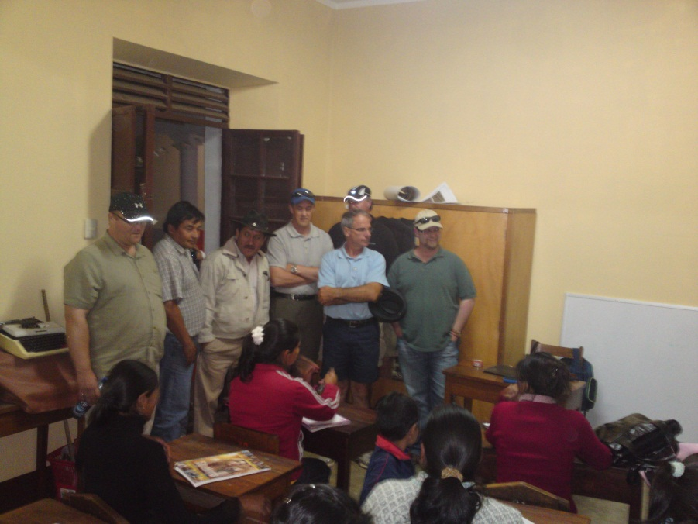
Site Visits

Slide 10
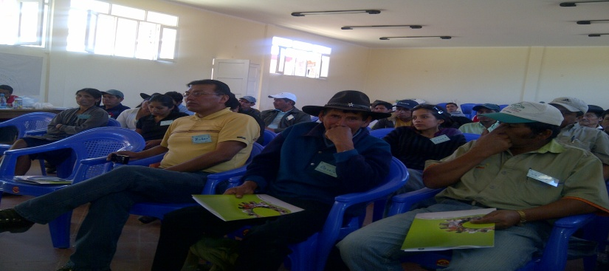
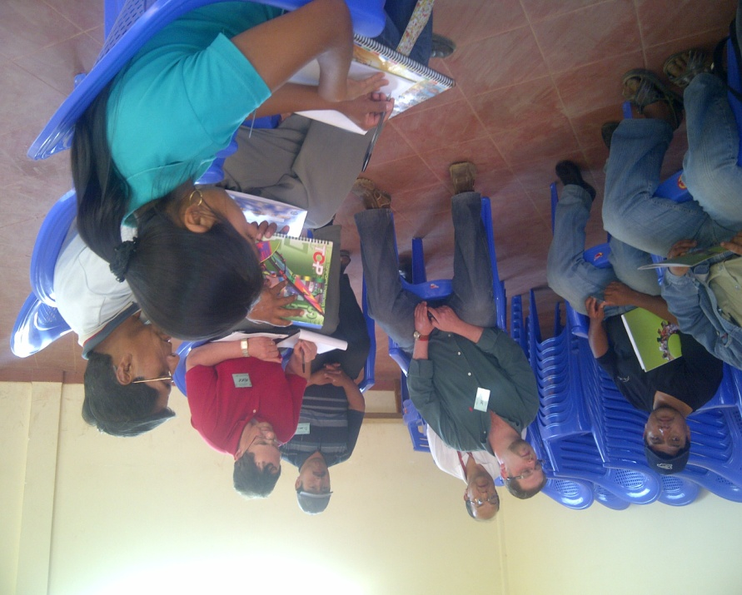
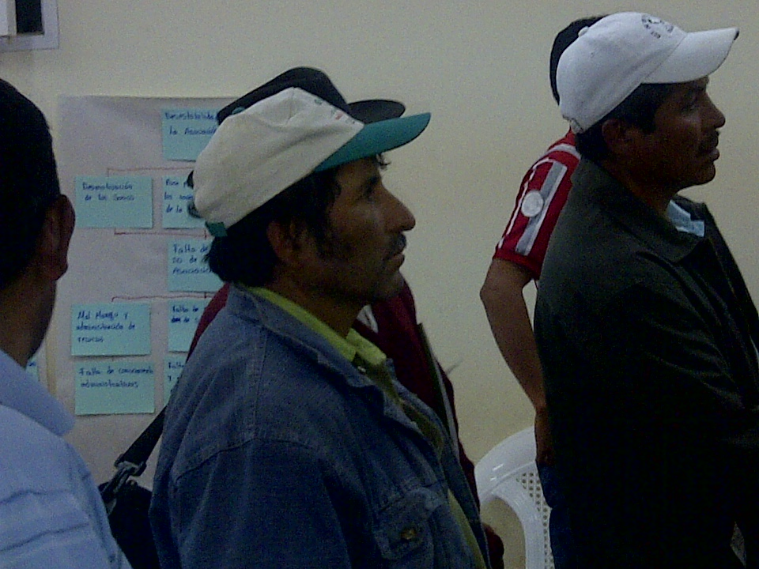
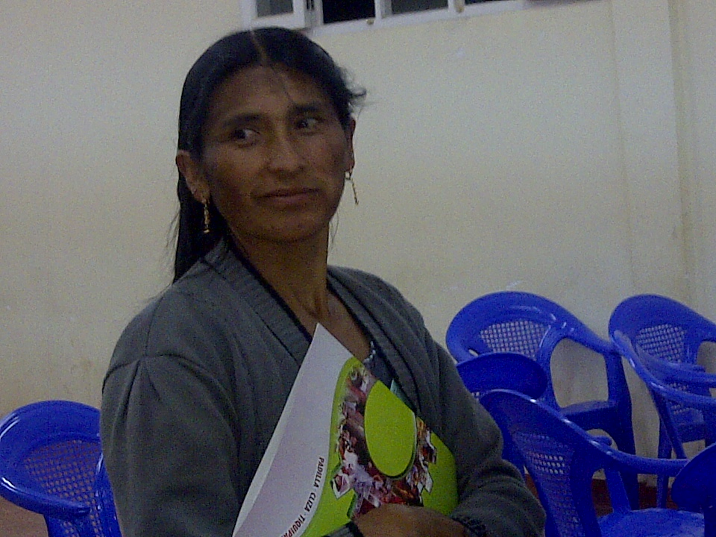
Public Consultation

Slide 11
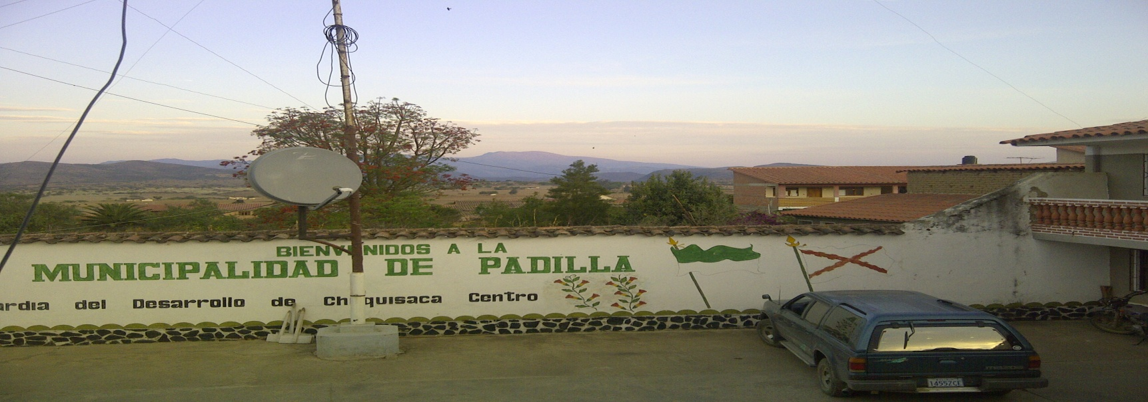
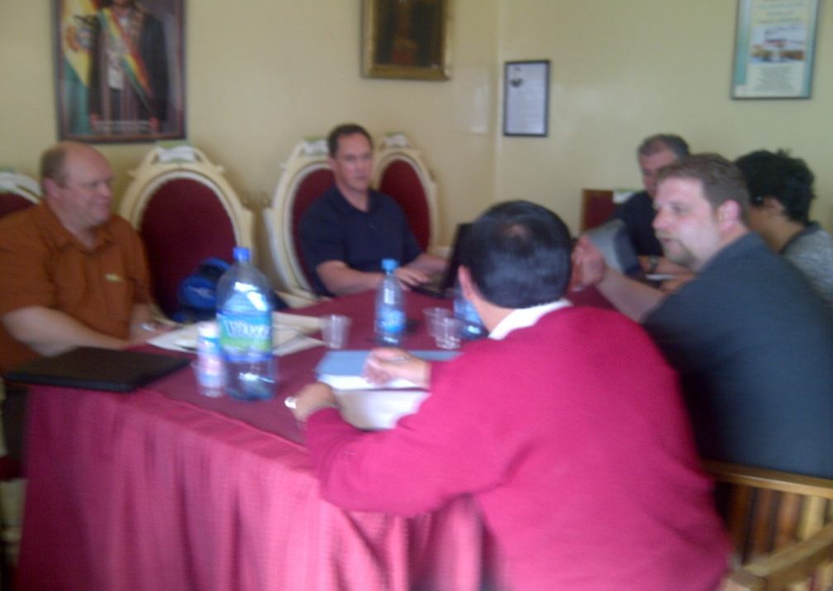
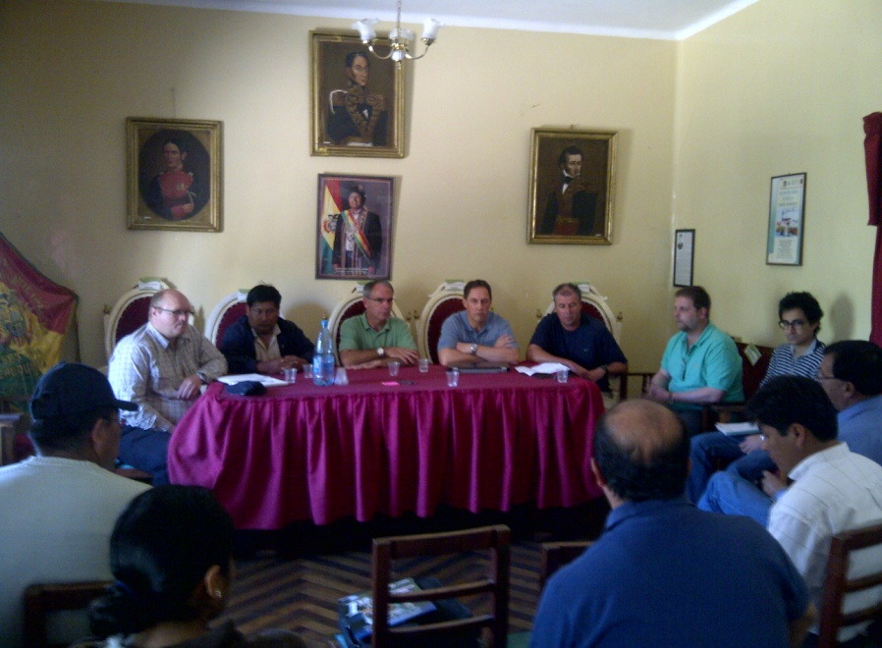
Municipal Staff Consultation

Slide 12
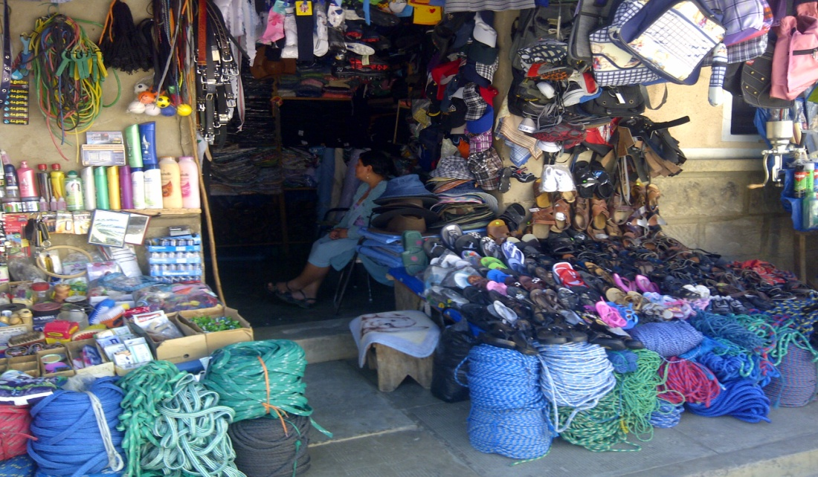
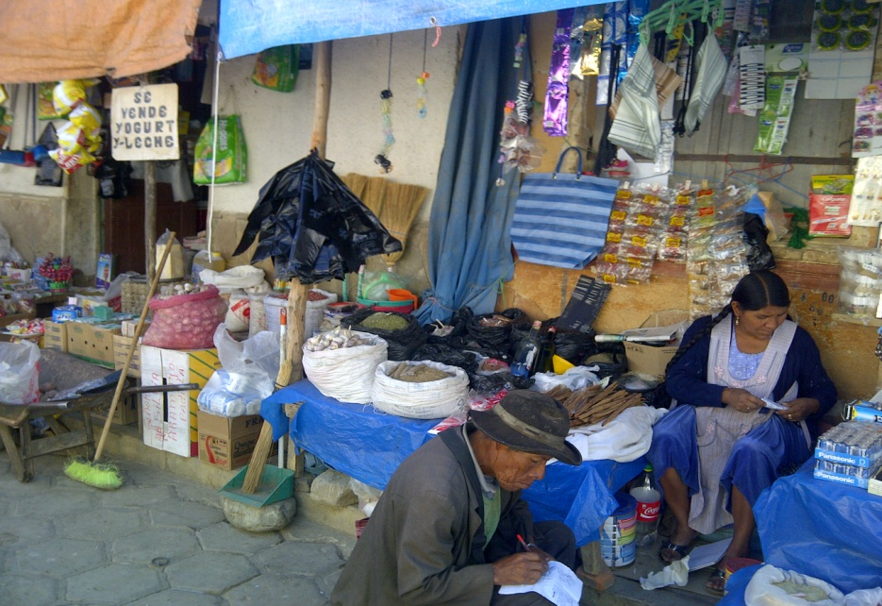
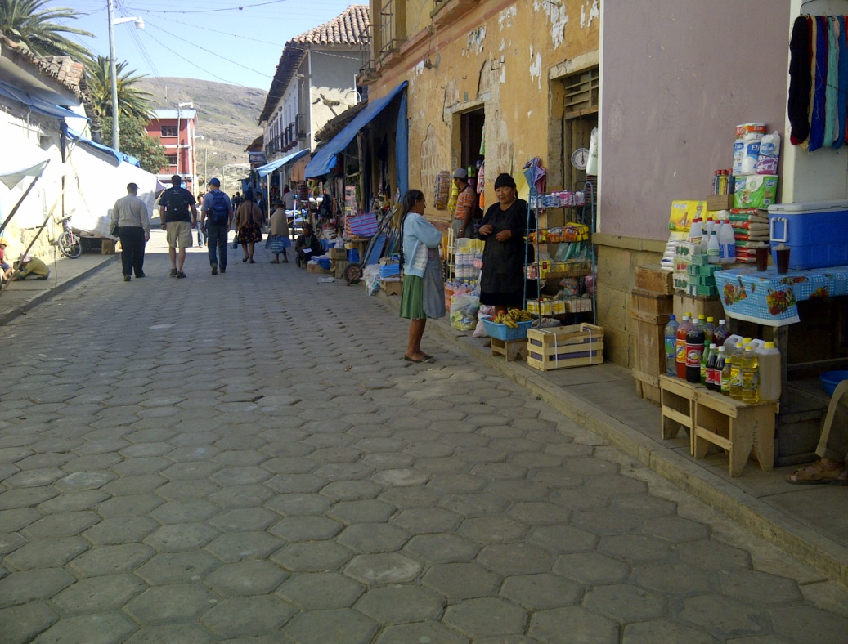
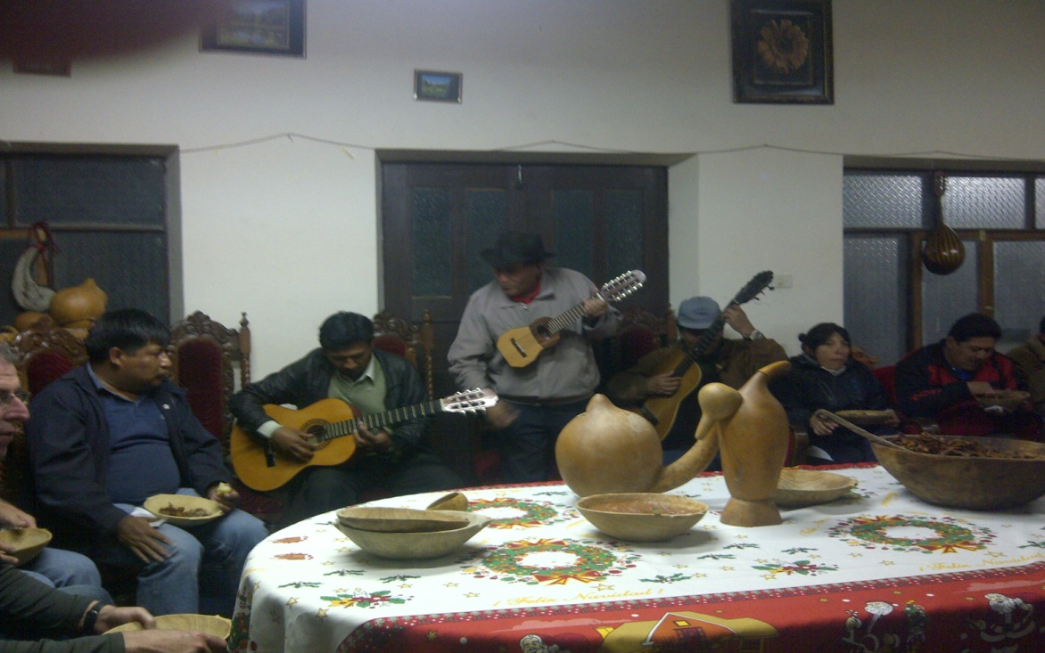
Padilla

Slide 13
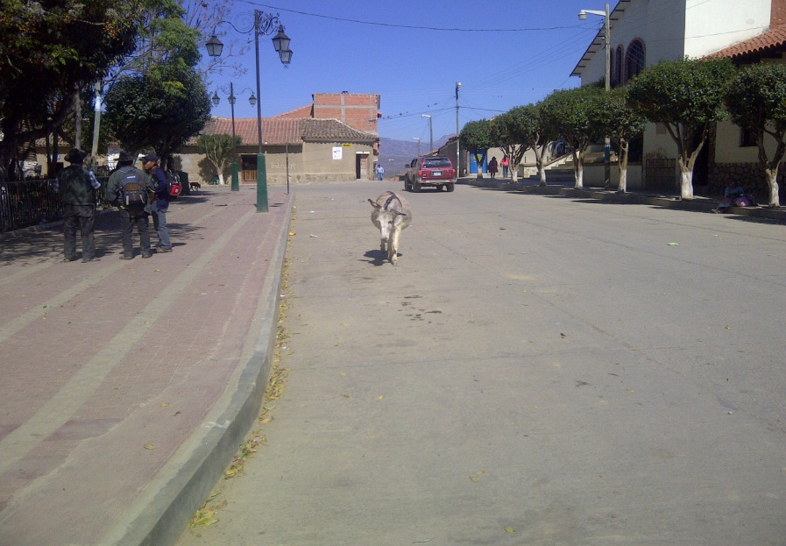
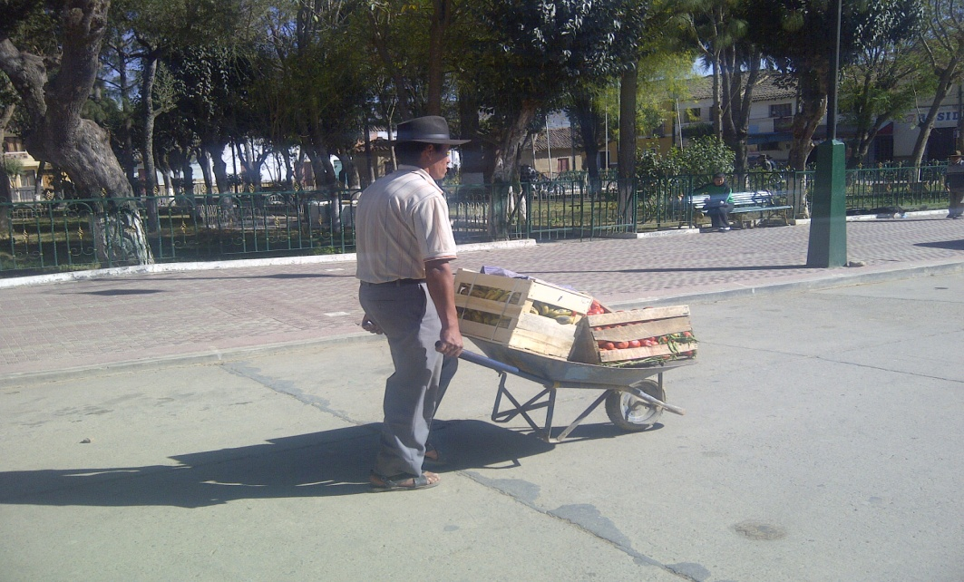
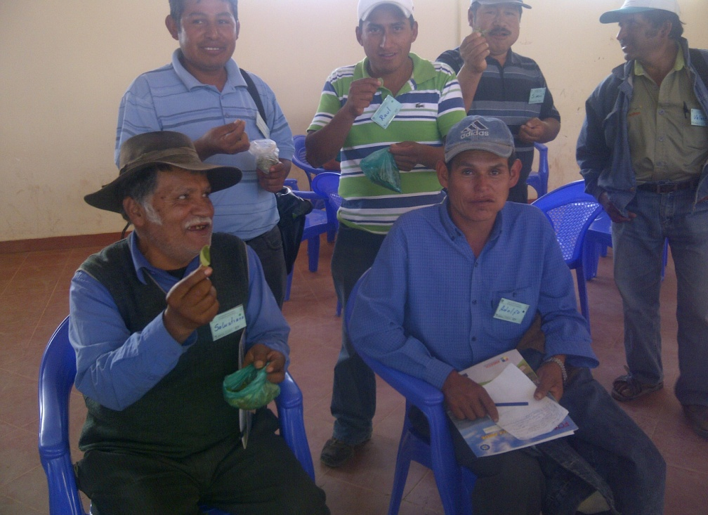
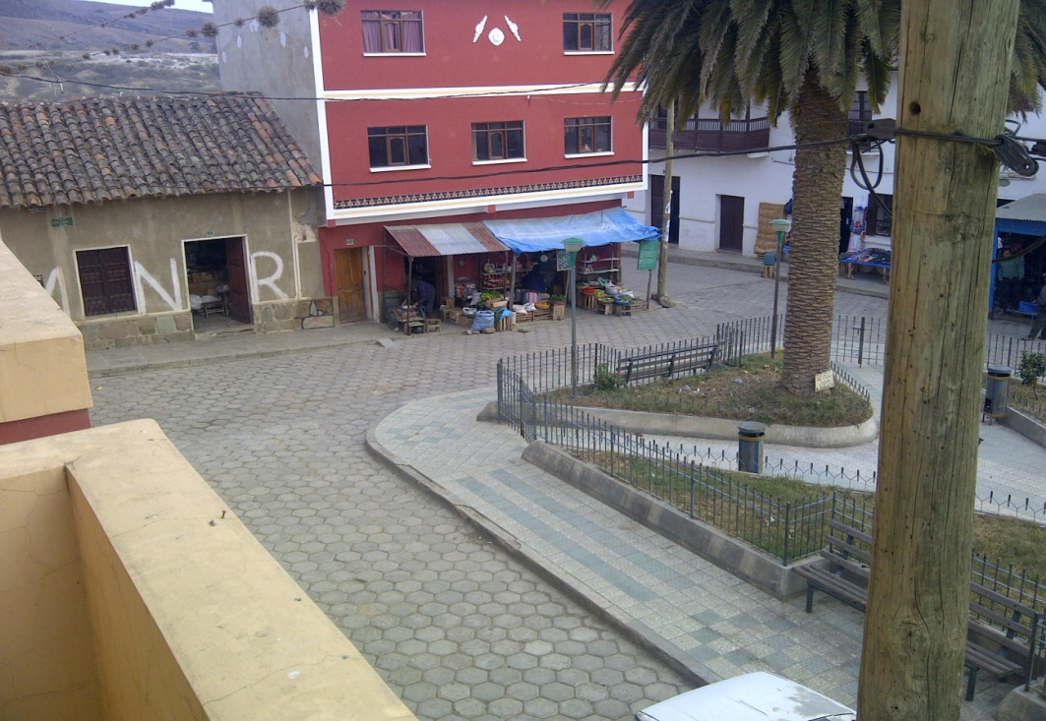
Padilla

Slide 14
Major Issues
Lack of Water
Lack of coordination between Associations and with the Municipality
Lack of Municipal policies to support entrepreneurship
Lack of technology
Lack of Citizen participation in decision making
Lack of trust on the part of producers and small business
Poor quality education
Lack of specialization, primary producers only
Notes:
Until recently, you were jailed if you went bankrupt. Now you can expect to have no ability to secure credit for the rest of your life.

Slide 15
Project Proposal
The focus of our demonstration project to be divided in three areas:
Municipal government
Associations of Producers (corn, pepper, peanuts, etc.)
Entrepreneurship Education & Training
Notes:
Municipal Government
Observations:
Need for stability within municipal governments, changeover of staff identified as a risk
Need a method for working with associations of producers
Need to have some income for the municipality, practically all revenue is from top-down sources
Spending rules and criteria are not clear
Associations of Producers
Observations:
Lack of technical capacity within members of the association
Members of associations express discontent with current system
Duplication of resources in similar associations doing similar tasks (two pepper grinding coops within 10 min of each other)

Slide 16
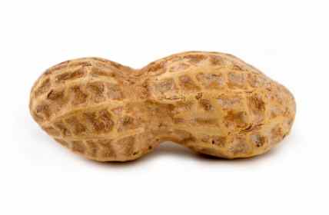
International Business Project: Feasibility Study

Slide 17
Project
Taken on by the City Council of Corner Brook
Council travelled to Padilla
Officials for Bolivia visited Corner Brook

Slide 18
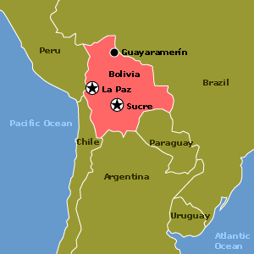
Country Information

Slide 19
Research Project Challenges
Distance
Language
Culture

Slide 20
Team
Gathered information from internet and library sources
Discussed the ongoing project with Mike Jackson
Chose peanuts over peppers, garlic and beans

Slide 21
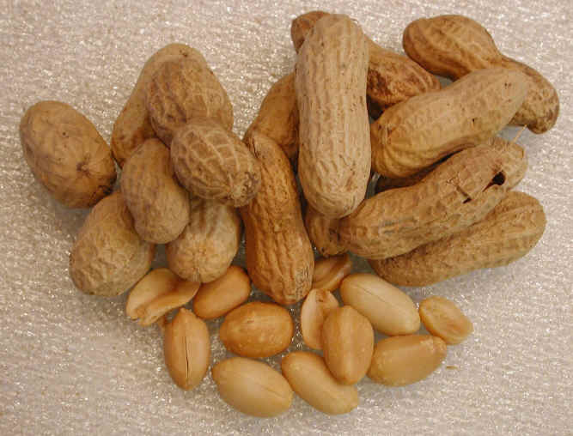
Concept Statement
Help the small town of Padilla, Bolivia
Educate Citizens
Increase Household Income
Reduce Amount of Youth Leaving
Export Peanuts to Canada

Slide 22
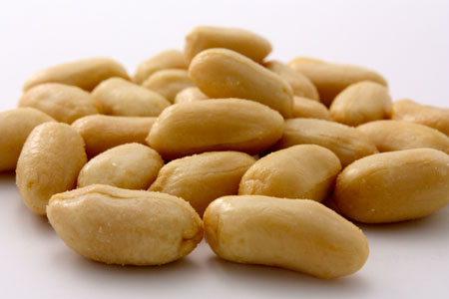
Industry/Market Feasibility
Industry Attractiveness
Target Marketing Attractiveness
Timeliness of Entry into the Target Market

Slide 23
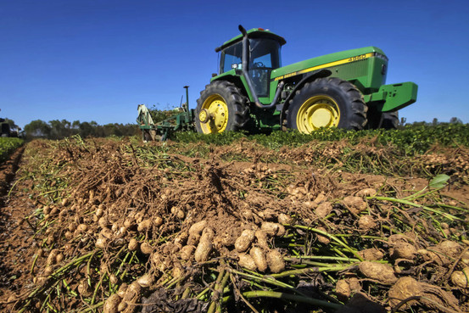
Industry Attractiveness
80% of peanuts within Canada come from U.S.
Canada produces a couple hundred Tons per year while 87,640 is imported in
U.S. has excellent growing conditions and advance technology

Slide 24
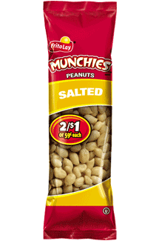
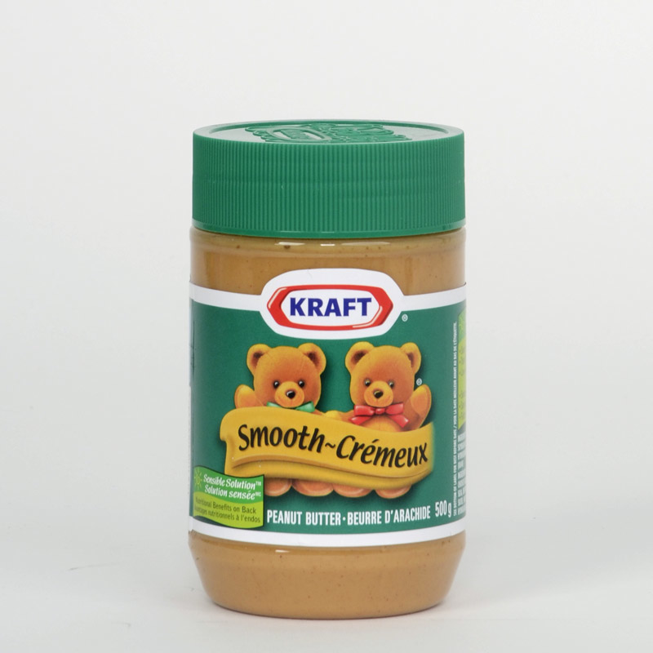
Demand

Slide 25
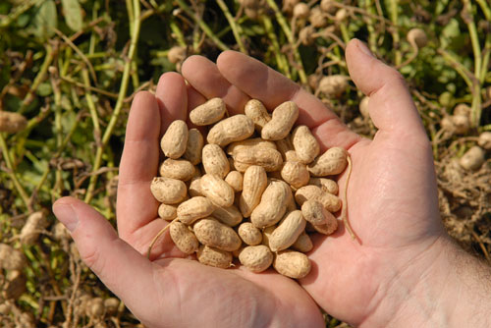
Farmers Prowess
Passion for the Business
Industry Experience
Entrepreneurial Experience
Experience and Expertise in Cash Flow Management
College Education

Slide 26
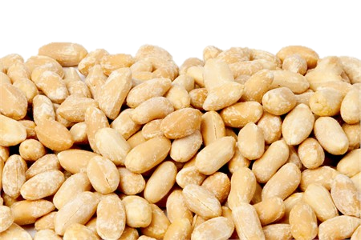
Target Market Attractiveness
Targeting People who wish to purchase Virginia Peanuts
Advantages
Bolivia grows “giant breeds” of Virginia Peanuts
Helping farmers of Padilla
Disadvantage
Competitors have high net income and are well known

Slide 27
Market Timeliness
Open Window of Opportunity
1 in 10 Canadians consuming peanuts daily and 2 in 5 weekly
Innovative ideas for the usage of peanuts being developed
No current peanut industry in Padilla
12,000 farmers growing peanuts in Bolivia annually

Slide 28
Fair Trade
“Trade between nations that takes place under active government intervention to ensure that the companies of each nation receive their fair share of the economic benefits of trade; also called managed trade.”
Grown in last 20 years
More than 1.2 million producers and workers in 58 developing countries now benefit

Slide 29
How Can Fair Trade Help
Help Bolivian Peanut Farmers to ensure it is a Fair Trade
Guarantee they get a Profit that is Equal
Improve Quality of Life
Everyone Wins

Slide 30
Conclusion
Project feasible
Fair Trade distributor
Market in Canada

Slide 31
Farmers in Padilla: A Case Study of Community-University Engagement

Slide 32
CU Engagement
Think Global

Slide 33
CU Engagement
Benefits to stakeholders
Farmers in Padilla
City of Padilla
City of Corner Brook
Grenfell Campus
Students

Slide 34
CU Engagement
Lessons Learned
Opportunity to help with social and economic development
Opportunity to share knowledge and ideas
Opportunity to make a difference

