Slide 1
Open Access: Accessibility for the Ivory Tower
Crystal Rose, Kate Rose, Lisa Goddard
Memorial University Libraries
CUExpo, Corner Brook NL, June 13, 2013
http://research.library.mun.ca/1831

Slide 2
Overview
What is Open Access?
Open Access Journals
Research Repositories

Slide 3
Traditional Scholarly Publishing

Slide 4
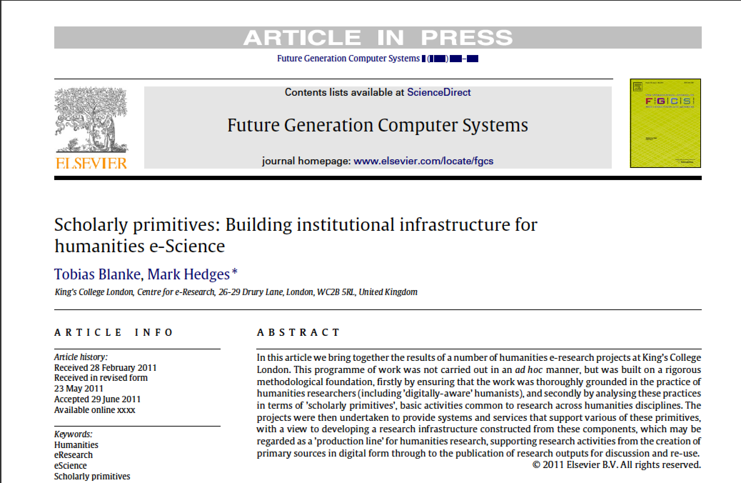
Academic Journals
Notes:
Academic articles that communicate the results of research. Intended for an expert audience. Usually peer-reviewed, lots of citations.

Slide 5
Who Pays for Research?

Slide 6
Who Writes Articles?
$
$

Slide 7
Who Does Peer Review?
$
$

Slide 8
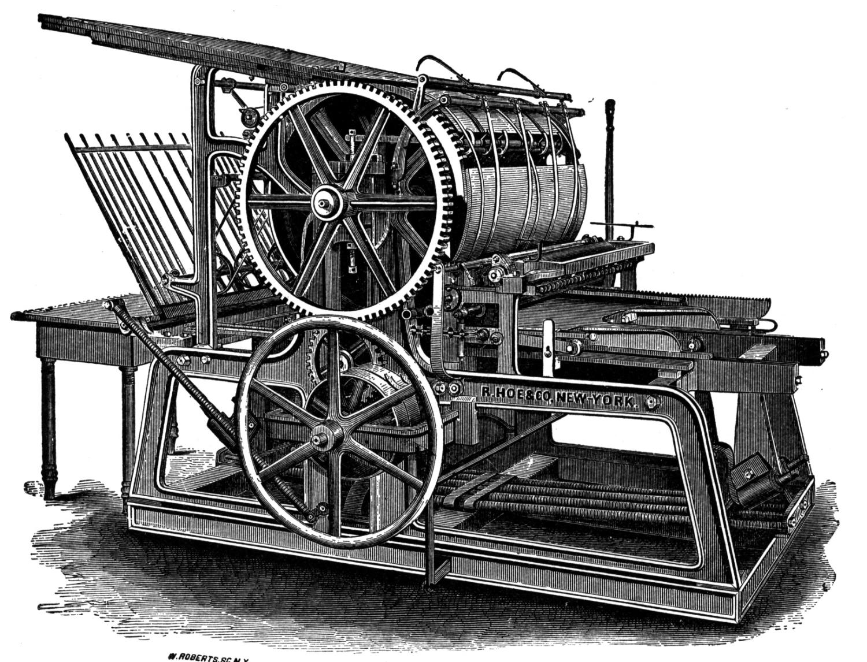
Who Owns Copyright?
Notes:
Faculty are in a unique position when it comes to copyright. In almost every profession in Canada your employer would own the rights to your work.
Most universities have agreements stating that faculty will retain copyright in their scholarly works.
The first thing faculty do when a paper is accepted is to sign away all of their rights to a publisher in perpetuity.

Slide 9
Who Pays for Access?
$
Memorial Libraries =
$4 Million / Year

Slide 10
Who gets Paid?
Notes:
Faculty members do NOT get paid for articles that they publish in peer-review journals.

Slide 11
Current Situation
Publicly Funded Research
Faculty time & expertise
Rights given to commercial publisher free of charge
Academic community purchases the work back from publisher
Notes:
Governments, universities, tax-exempt organizations
Often at great expense!

Slide 12
Very Limited Access

Slide 13
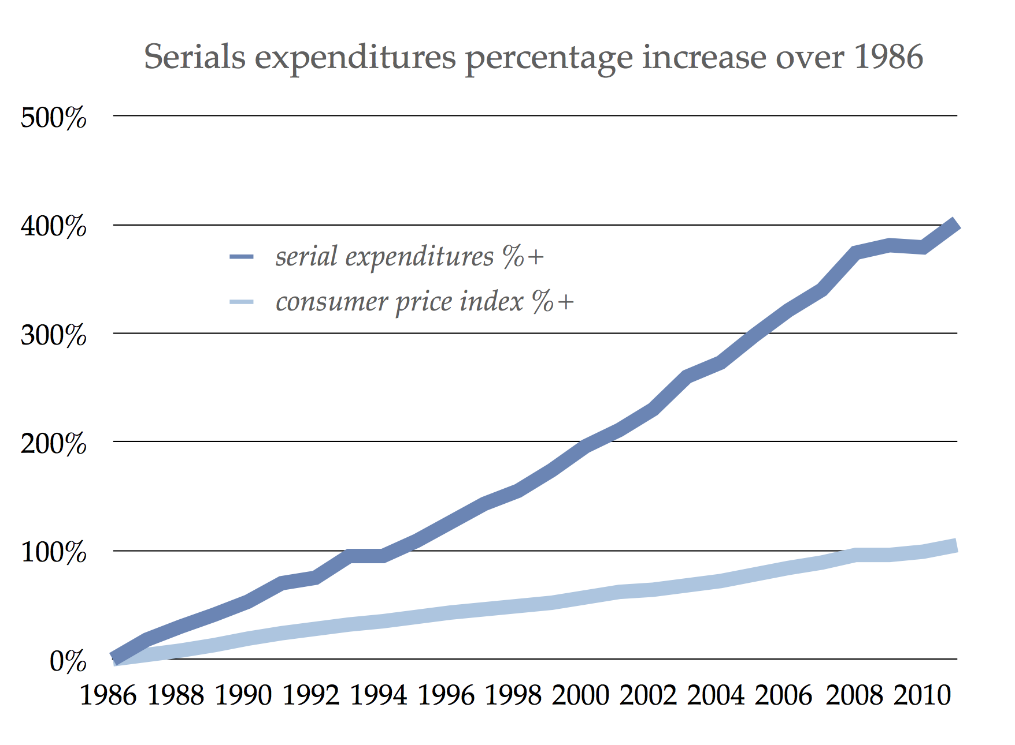
High Prices
Annual price increases of 7.6%
Notes:
Scholarly journal expenditures percentage increase 1986–2010 compared to consumer price index. Data from Association for Research Libraries.
http://blogs.law.harvard.edu/pamphlet/2013/01/29/why-open-access-is-better-for-scholarly-societies/
From 1986-2005, serial expenditures for the member libraries of the Association of Research Libraries (ARL) have increased 302% while the number of serial items purchased has increased only 1.9% on average per year [7]. The average annual percentage increase in price for all serials was 7.6%.
Libraries simply cannot sustain serial prices that increase at three times the rate of inflation. We have already decimated our monograph budgets in service to the journal market, and our institutions are not committing more money to collections budgets.
http://southernlibrarianship.icaap.org/content/v09n03/mcguigan_g01.html

Slide 14
Open Access Legislation

Slide 15
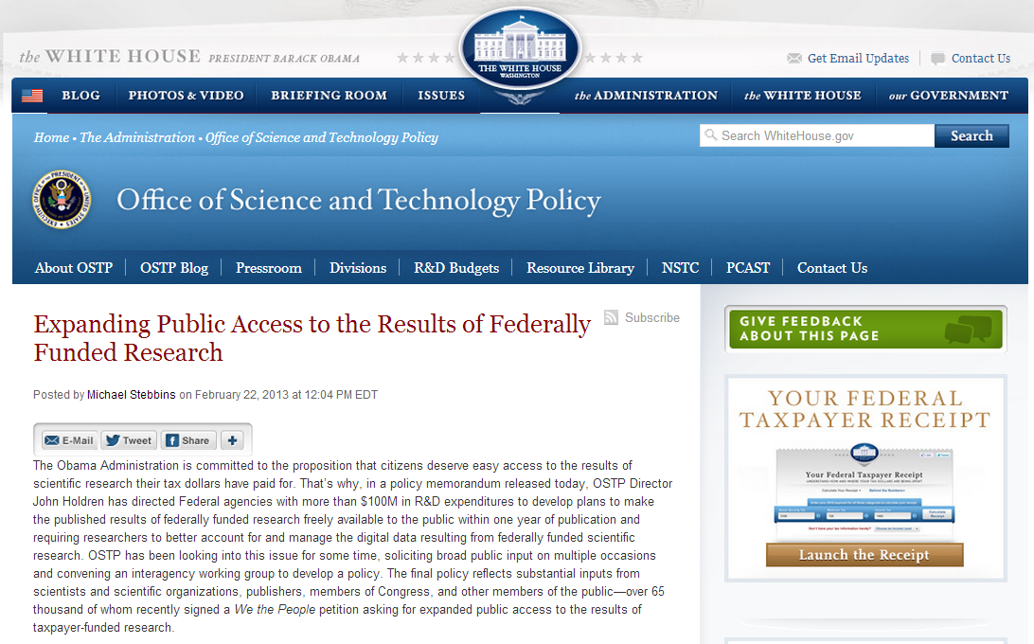
Government Policy - US
Notes:
In February of this year the Obama government issued a directive for large US funding agencies to prepare Open Access policies that will make funded research publicly available within 12 months of publication.
Although the directive frequently references innovation in Science and Technology, the policy will apply to all large federal funding agencies (> 100 million in R&D expenditures annually) SSH funders including the National Endowment for the Humanities and the Social Sciences Research Council.
This means that the National Endowment for the Humanities and the Social Sciences Research Council will be using mandates similar to the one that the National Institutes of Health has had in effect since 2008.
http://www.neh.gov/news/press-release/2013-02-26
I have issued a memorandum today (.pdf) to Federal agencies that directs those with more than $100 million in research and development expenditures to develop plans to make the results of federally-funded research publically available free of charge within 12 months after original publication. As you pointed out, the public access policy adopted by the National Institutes of Health has been a great success. And while this new policy call does not insist that every agency copy the NIH approach exactly, it does ensure that similar policies will appear across government.
http://www.whitehouse.gov/blog/2013/02/22/expanding-public-access-results-federally-funded-research
http://chronicle.com/article/White-House-Delivers-New/137549/

Slide 16
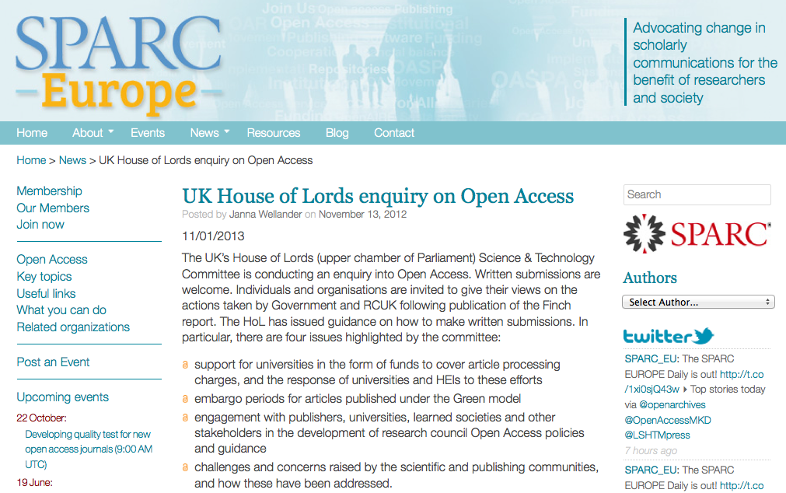
Government Policy - UK
Notes:
The UK government is having similar conversations about Open Access. An early policy out of the Research Councils UK embraced a fairly aggressive move to Gold OA publishing for publicly funded research.
A recent report from the House of Lords recommends a much more conservative approach that uses Green OA with a two year embargo.
http://sparceurope.org/uk-house-of-lords-enquiry-on-open-access/
http://www.rcuk.ac.uk/research/Pages/outputs.aspx
http://www.publications.parliament.uk/pa/ld201213/ldselect/ldsctech/122/122.pdf

Slide 17
Canada Tri-Council
CIHR – OA after 12 months
Harmonized OA Policy by 2014

Slide 18
Benefits of Open Access

Slide 19
Access for Research
Faculty and students do not have access to 20% of articles authored by Bucknell faculty.
Notes:
http://scholcomm.blogs.bucknell.edu/2011/02/03/bucknell-scholarly-communications-practices-survey-summary-results/

Slide 20
Access for Teaching
Notes:
Cannot distribute it within a learning management system.

Slide 21
Access for Alumni

Slide 22
Community Engagement
Memorial University is an inclusive community dedicated to creativity, innovation and excellence in teaching and learning, research and scholarship, and to public engagement and service. We recognize our special obligation to the people of Newfoundland and Labrador.

Slide 23
Social Justice
Notes:
And you can bet that when wealthy North American Universities are complaining about journal prices, most of the rest of the world is left completely out in the cold. This means that educators, policy makers, health care providers, and agriculturalists in the world’s poorest countries have no access to research that could help them solve the problems facing them.

Slide 24
Library Still Pays
Pay once for perpetual access
Pay for global access rather than local access

Slide 25
Terms: Green vs. Gold
OA Journals
Immediate global access to content
May have APCs
OA Repositories
Subscription journals
Author self-archiving
May have embargo
Notes:
There are two basic ways to implement Open Access. The “Gold” route where journal content is made freely available immediately on publication, and the “Green” route whereby authors publish in traditional journals, but share a copy of the article in a Research Repository.
In the green model authors publish in subscription journals, and submit copies of their works to open access repositories. They may have to wait for some period of time after initial publication – a 12 month embargo period, for example.
In the gold model journals make their content immediately, globally accessible. These journals may or may not be funded through author processing fees.

Slide 26
Open Access Journals

Slide 27
What are Gold OA Journals?
The “Gold Standard”
Free of charge for readers
Materials openly accessible across the internet
Financed by payments for article publication, not subscription

Slide 28
Gold Standard, Not “Author Pays”
Payment can come from grants, funds and is often included in the cost of research

Slide 29
With better Google results, higher impact of work
Increased citation impact
Private sector access

Slide 30
Scholars retain the copyright on their work
Can submit it to an institutional repository
Scholars don’t give copyright to publisher

Slide 31
Library Involvement
Author Funds
Not passing fees on to authors instead of a subscription model
Toronto, Ottawa, Manitoba, SFU, MUN, Concordia, Calgary, Ryerson
Journal Hosting
Open Journal Systems

Slide 32
Memorial OA Funding Criteria
Available to:
All faculty, graduate students, staff, post-docs, emeriti, and honorary research profs who have an peer-reviewed article accepted to an OA journal
Up to $3000 a year for each researcher, and a maximum of $3000 per article

Slide 33
What does it cover?
Only fund those articles accepted to the Gold Standard
Journal is peer reviewed
No subscription fees for any content
Available online immediately, no cost to the reader
Author maintains copyright, using Creative Commons licensing or similar
A copy of the funded paper made available though the Memorial University Research repository

Slide 34
Open Journal System (OJS)
Create and host online-journals
Article submission
Peer review workflow
Journal layout
Reader access
Archiving
Creative Commons licensing

Slide 35
Faculty Journal
Analecta Hermeneutica
Annual refereed journal of the International Institute for Hermeneutics (IIH). It provides an intellectual forum for interdisciplinary, inter-religious, and international hermeneutic research. The journal publishes research in the form of articles, reviews, and other scholarly contributions in all hermeneutically related fields, with a particular focus on philosophy, theology, and comparative literature.

Slide 38
Journals for Emerging Scholars
Proto-type
online journal of undergraduate research and scholarship for the Faculty of Engineering and Applied Science at Memorial University of Newfoundland

Slide 39
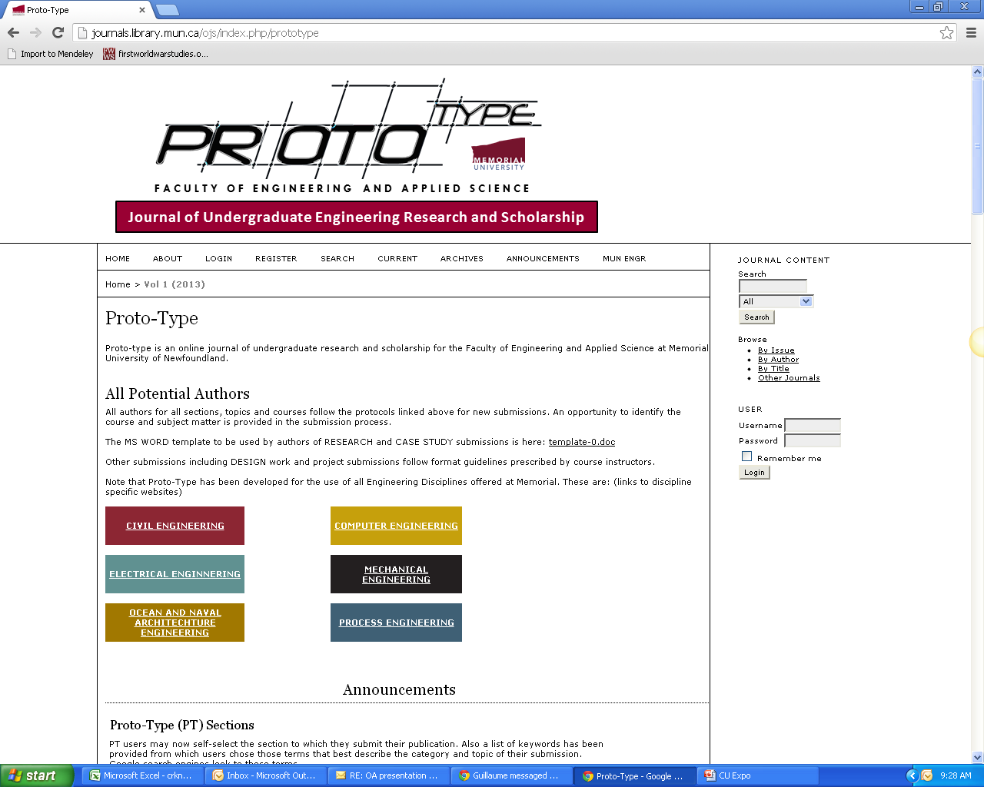

Slide 40
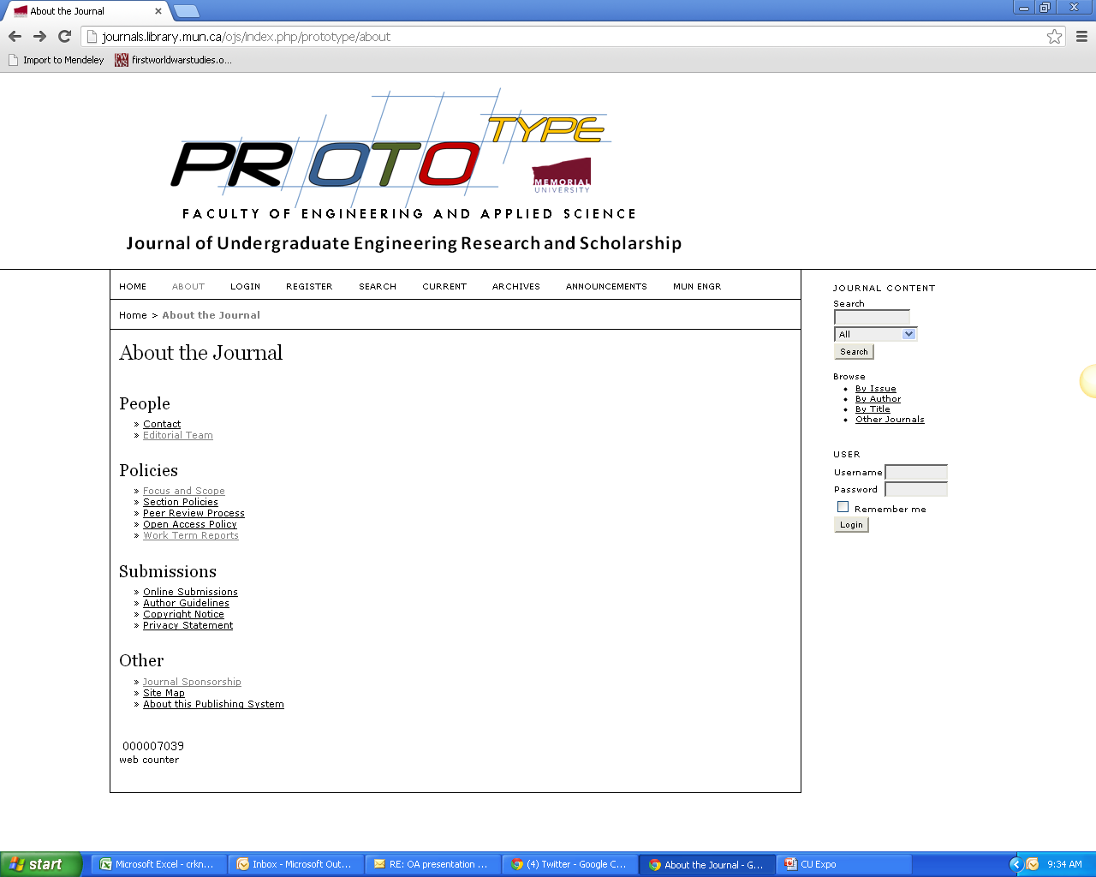

Slide 41
Open Access Repositories

Slide 42
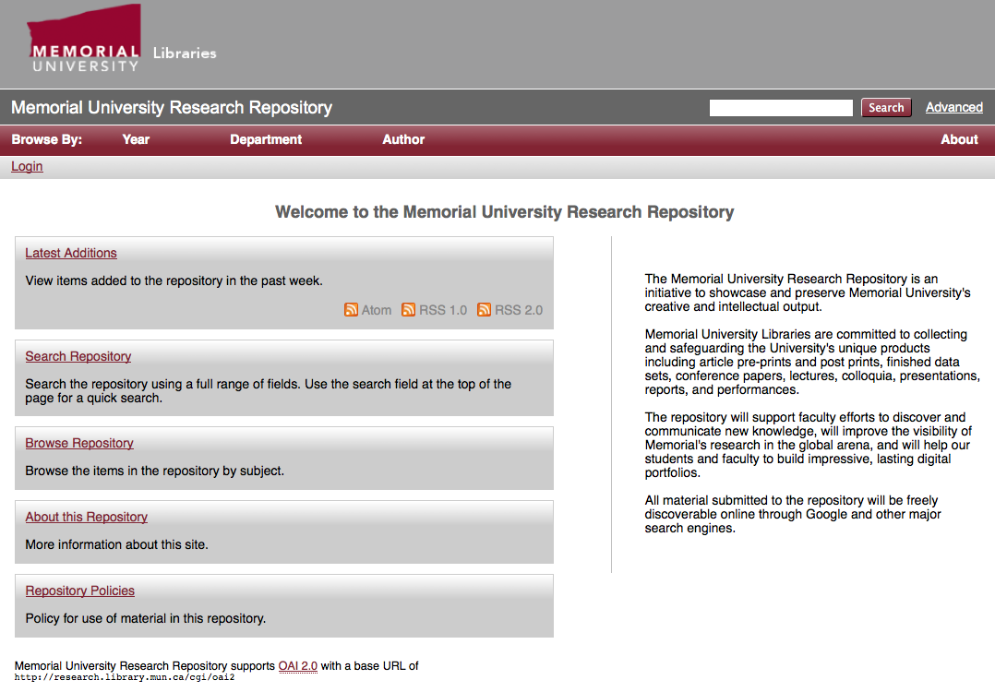
Research Repository
Publish in traditional journals
Put an open access copy online

Slide 43
Archiving Published Works
Published Works
Peer-reviewed articles Book chapters
Is that legal?
Notes:
The ability to easily share unpublished material is one of the major benefits of the research repository.

Slide 44
Publisher Archiving Policies
Notes:
What are the publisher’s copyright and archiving policies?
Even though OA repositories exist, you have have to obtain permission to do so if you’ve published in a traditional journal. Your archiving MUST be legal. I.E. you can’t just do this on a whim. That being said, “most journals (now about 70%) already allow postprint archiving.” http://www.earlham.edu/~peters/fos/overview.htm
Keep in mind that “Authors need no permission for preprint archiving. When they have finished writing the preprint, they still hold copyright. If a journal refuses to consider articles that have circulated as preprints, that is an optional journal-submission policy, not a requirement of copyright law. (Some journals do hold this policy, called the Ingelfinger Rule, though it seems to be in decline, especially in fields outside medicine.)”
The key is to know our rights as a researcher and SHERPARoMEO is the ideal source for this kind of information. It is a searchable database of publisher's copyright & archiving policies. Each entry provides a summary of the publisher's policy, including what version of an article can be deposited, where it can be deposited, and any conditions that are attached to that deposit. http://www.sherpa.ac.uk/romeo/romeofaq.html
ROMEO covers peer-reviewed journals and serials, provided by feeds from the British Library service Zetoc, Entrez and DOAJ.
Participation: “…the inability to convince 100 per cent of authors to self-archive 100 percent of their articles” (Jacobs 31)

Slide 45
Publisher Archiving Policies
Notes:
What are the publisher’s copyright and archiving policies?
Even though OA repositories exist, you have have to obtain permission to do so if you’ve published in a traditional journal. Your archiving MUST be legal. I.E. you can’t just do this on a whim. That being said, “most journals (now about 70%) already allow postprint archiving.” http://www.earlham.edu/~peters/fos/overview.htm
Keep in mind that “Authors need no permission for preprint archiving. When they have finished writing the preprint, they still hold copyright. If a journal refuses to consider articles that have circulated as preprints, that is an optional journal-submission policy, not a requirement of copyright law. (Some journals do hold this policy, called the Ingelfinger Rule, though it seems to be in decline, especially in fields outside medicine.)”
The key is to know our rights as a researcher and SHERPARoMEO is the ideal source for this kind of information. It is a searchable database of publisher's copyright & archiving policies. Each entry provides a summary of the publisher's policy, including what version of an article can be deposited, where it can be deposited, and any conditions that are attached to that deposit. http://www.sherpa.ac.uk/romeo/romeofaq.html
ROMEO covers peer-reviewed journals and serials, provided by feeds from the British Library service Zetoc, Entrez and DOAJ.
Participation: “…the inability to convince 100 per cent of authors to self-archive 100 percent of their articles” (Jacobs 31)

Slide 46
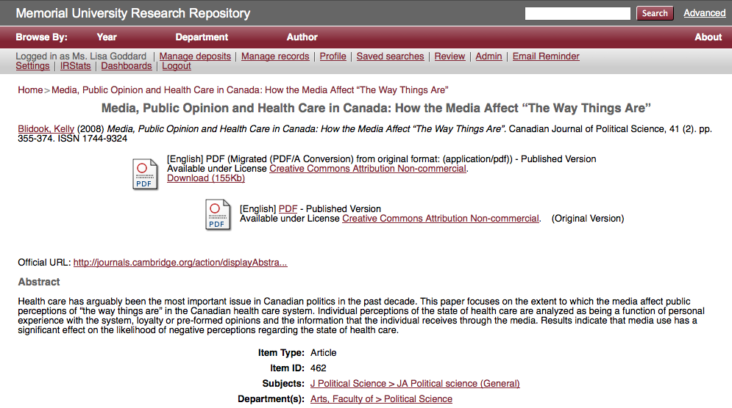
Research Repository
Notes:
Remember that Green OA allows your authors to put a copy of their work into an Open Access repository like the one pictured here from Memorial. There are 58 Open Access Repositories in Canada, and many of those are run by universities. These repositories are typically implemented and maintained by the University Library.
This particular example is an article from the Canadian Journal of Political Science that was written by one of our faculty members. You can see that the record includes a full citation, a DOI if it exists, and link to the article at the original publisher site. These links can help drive traffic to your journals, and ensure that the works are properly attributed to the original publisher.
OpenDOAR currently reports 58 Open Access Repositories in Canada.
http://www.opendoar.org/find.php

Slide 47
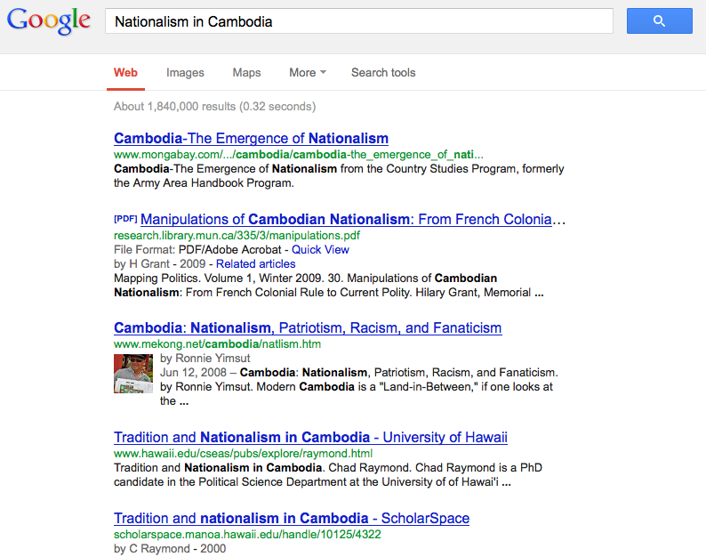
Visibility in Google

Slide 48
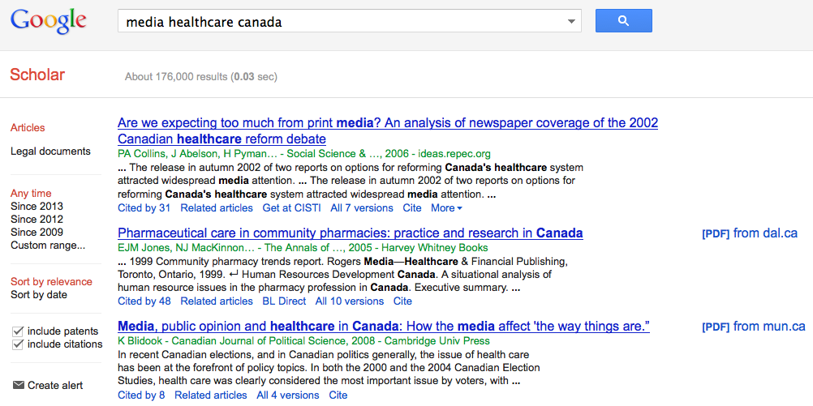
Google Scholar

Slide 49
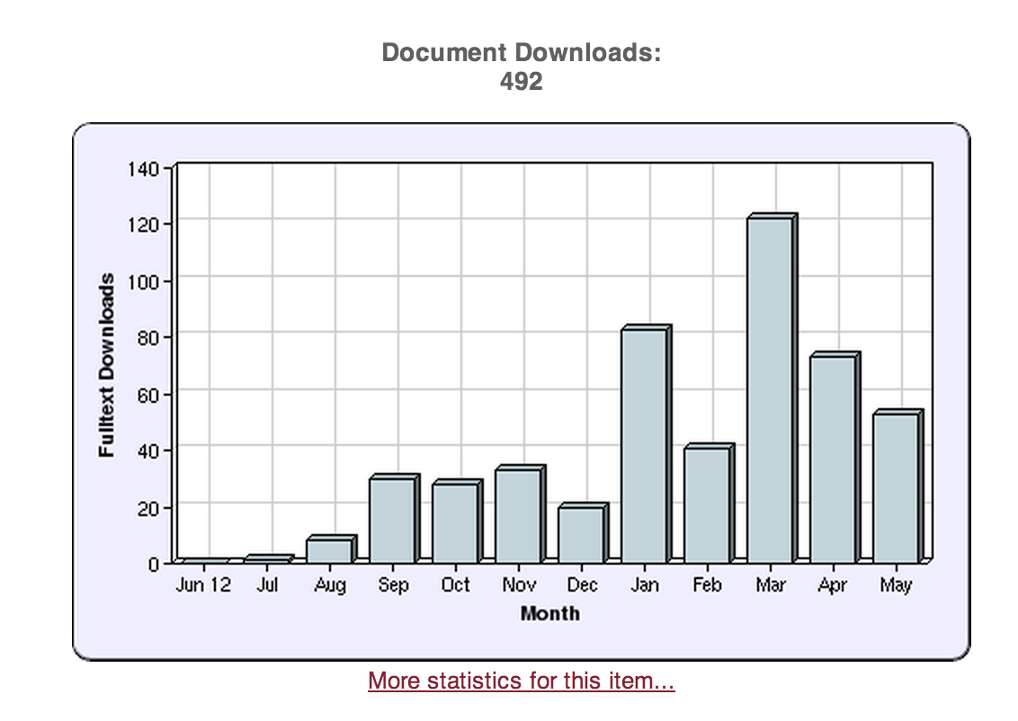
Download Stats
Notes:
So do people find these articles? As a matter of fact, they do. This particular article has had hundreds of downloads since last August, so we know that Repositories do increase the visibility of research papers.

Slide 50
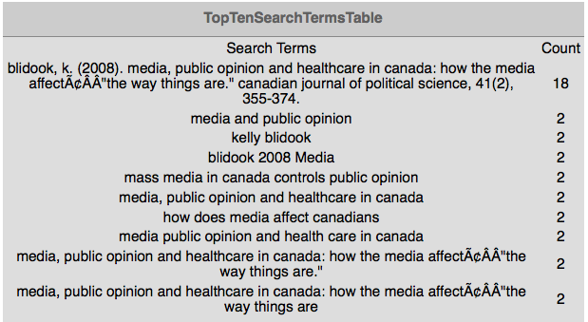
Research Repository

Slide 51
Conference Presentations

Slide 52
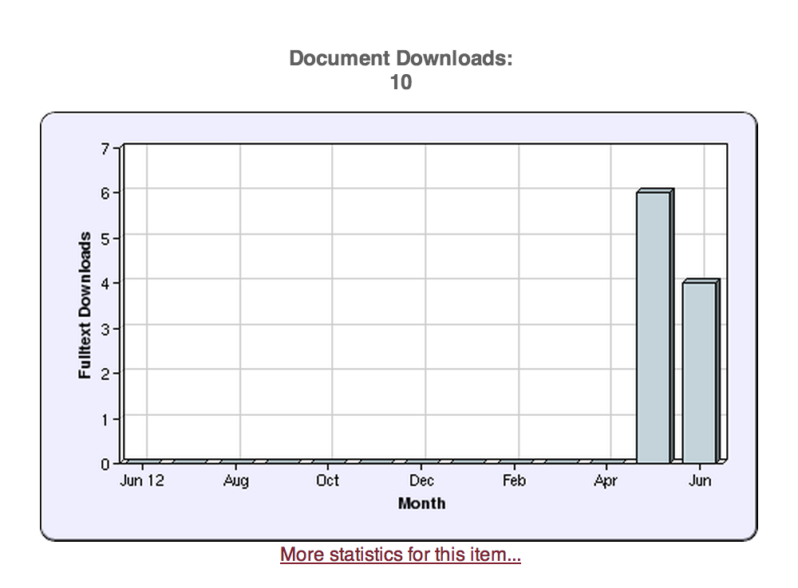
10 downloads for Budd!

Slide 53
Share Your CU Expo Presentation!
Heather Strickland
hstrickland@grenfell.mun.ca

Slide 54
Canadian University Repositories
U Toronto
U Alberta
U Laval
Brock U
Simon Fraser
Concordia
Dalhousie
Guelph
McMaster
U Calgary
UNB
UPEI
McGill
among others …

Slide 55
Thank you!
http://research.library.mun.ca/1831
http://guides.library.mun.ca/openaccess

