Slide 1
Exploring Innovation in Corner Brook- Assessing its networks
Marion McCahon, Office of Public Engagement, Government of Newfoundland and Labrador
Jose Lam, Grenfell Campus, MUN
CUEXPO 2013
Corner Brook, June 12-15

Slide 2
Office of Public Engagement
Part of the new Office of Public Engagement
Work with partners to engage the public in dialogue
related to the future of rural NL
Assist partners including Provincial Government
departments to collaborate more effectively for
sustainability
Work with partners to conduct and facilitate research that helps inform policy‐/decision‐making
Support 10 advisory councils who develop policy‐advice for the Provincial Government

Slide 3
Networks for Business Innovation
Partners
Rural Secretariat
Department of Advanced
Education and Skills
Department of Innovation,
Business and Rural Development

Slide 4
Introduction
Corner Brook is an economy in transition
moving away from a primarily resource‐based
towards a more knowledge‐based economy
Knowledge‐based economies are grounded in
highly‐integrated networks
Investigating local & global knowledge flows in
Corner Brook using social network analysis

Slide 5
Building on Past Research
Business Retention & Expansion Report (Greater
Corner Brook Board of Trade 2008)
Social Foundations of Innovation Project (Greenwood, Pike & Kearley 2011, Wolfe 2009)
Network Weaving for Regional Development on the Tip of the Northern Peninsula (Tucker et al. 2011)

Slide 6
Networks
Models agree on importance of networks
Market, non‐market and mutual dependence on public institutions and policies
Networks as knowledge diffusers
Networks help foster innovation and regional economic growth

Slide 7
Social Network Analysis
Lack of clarity on what networks look like, how
knowledge flows and interdependencies occur
– networks as “invisible and immeasurable”
(Krugman 1991); “dark matter” (Storper 2009)
SNA – methods for tracking and understanding local and external connections and their roles

Slide 8
Methodology
Phase I – Interviews (21 innovators)
Phase II – Online Survey (111, 71%)
Phase III – Data Analysis (SNA & UCINET)
Phase IV – Community Mobilization

Slide 9
Interview Insights
Business turns to business ‐ project or industry
specific peers or mentors (competitors, suppliers, other
franchisees, company managers, staff, industry publications
and associations)
Few turn to customers for ideas
Most have mentors
Success stories: Coleman's and Peter Ollerhead (Brewed
Awakenings and Cycle Solutions)
Range of agencies providing support, including post‐secondary institutions

Slide 10
Map of Ideal Network
Holley, J. (2011)

Slide 11
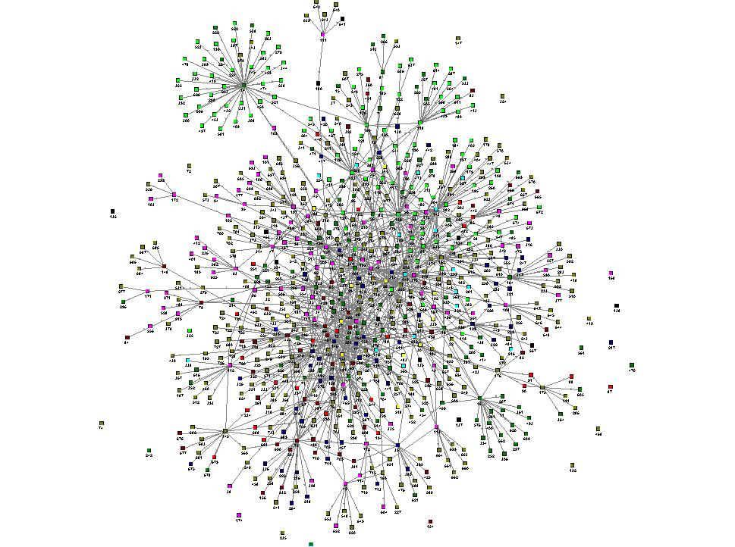
Map 2: Complete Network – Organization
Legend
 | Arts and Culture
 | Municipal Government
 | Provincial Government
 | Federal Government
 | Post Secondary
 | NFP/Community Development
 | Local Business
 | Media
 | Other/No Data
11
Notes:
Slide 2:
3) Sectors are not clustered in CB as much as expected. However, there are still some sectors that are more tightly interwoven. For example, Arts and government/NFP are not tightly integrated. So, we can can ask why is this the case, especially when arts and gov are very keen to enhance community network.
This slide shows the same network, everyone that was mentioned, according to “Organization” which is how we initially coded participants, not necessarily how they self-identify.
Green – Arts and Culture;
Dark Green – Post Secondary
Red – Federal Government
Maroon – Provincial Government
Pink – Local Business
Yellow – Municipal Government
Deep Blue – Not for Profit / Community Org
Black - Media
Olive – No Data/Other

Slide 12
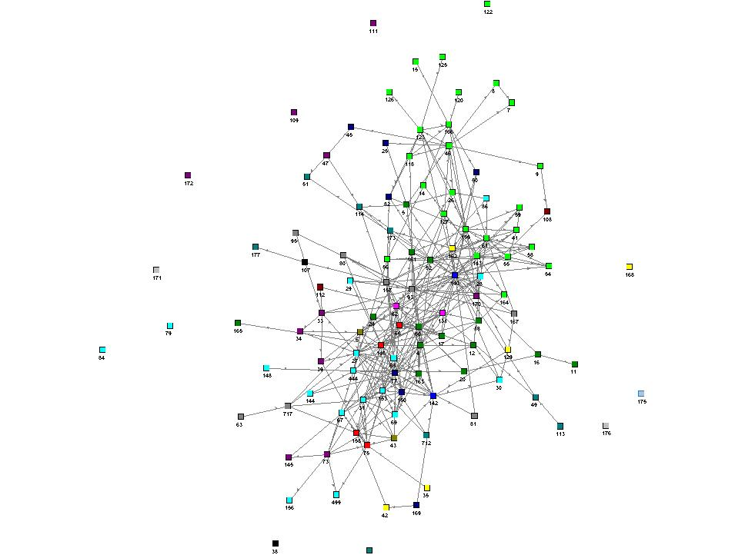
Map 3a: Survey Respondents
– Sector
Legend
 | Arts
 | Healthcare
 | Primary Harvesting
 | Environmental
 | Government
 | Post Secondary
 | Media/Comm
 | Service
 | Retail
 | Tourism/Hospitality
 | Professional Service
 | Other
12
Notes:
Slide 3
So, now we move to look at those who completed the survey.
These are coloured according to sector – self identified
Bright Green – Arts
Aqua – Government
Purple – Service
Pink – Environmental
Royal Blue – Communications/Media
Yellow – Healthcare
Forest Green – Post Secondary Ed
Olive – Professional Service
Maroon – Primary Harvesting
Teal - Retail
Deep Blue – Other
Here we can see an interesting pattern in the map. There is a cluster of government and NFP/community development people linked together, and seperate, in may ways, from a loose network of those who work in the Arts. PSE peppered throughout.
Why are these groups not integrated?
What are some strategies to connect them? Who links these groups?
In talking to June, she has suggested that a focus on developing art and cultural events, etc., could be the starting place for a 'local renaissance' both culturally and economically. You don't have to convince me. I am on the ground doing this stuff, see the benefit, and the resistance.

Slide 13
Map 3a: Survey Respondents
– Sector
Legend
 | Arts
 | Healthcare
 | Primary Harvesting
 | Environmental
 | Government
 | Post Secondary
 | Media/Comm
 | Service
 | Retail
 | Tourism/Hospitality
 | Professional Service
 | Other
13
Notes:
Slide 3
So, now we move to look at those who completed the survey.
These are coloured according to sector – self identified
Bright Green – Arts
Aqua – Government
Purple – Service
Pink – Environmental
Royal Blue – Communications/Media
Yellow – Healthcare
Forest Green – Post Secondary Ed
Olive – Professional Service
Maroon – Primary Harvesting
Teal - Retail
Deep Blue – Other
Here we can see an interesting pattern in the map. There is a cluster of government and NFP/community development people linked together, and seperate, in may ways, from a loose network of those who work in the Arts. PSE peppered throughout.
Why are these groups not integrated?
What are some strategies to connect them? Who links these groups?
In talking to June, she has suggested that a focus on developing art and cultural events, etc., could be the starting place for a 'local renaissance' both culturally and economically. You don't have to convince me. I am on the ground doing this stuff, see the benefit, and the resistance.

Slide 14
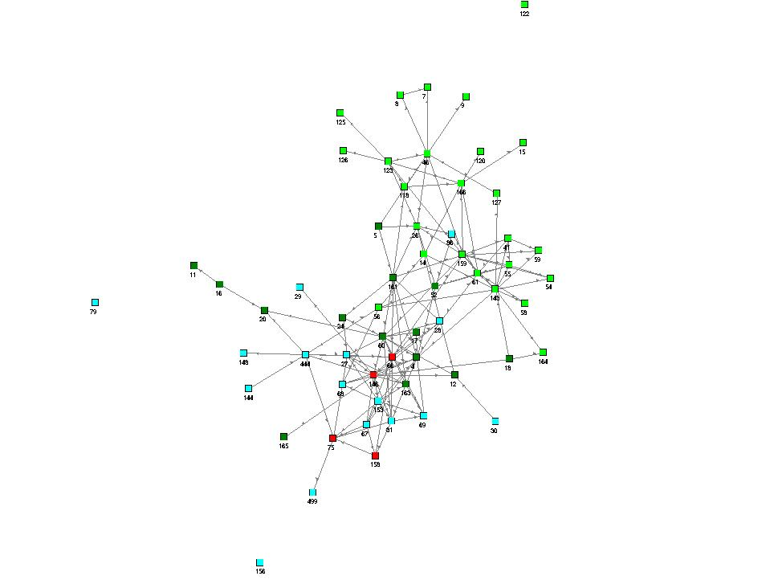
Map 3b Government/Arts Connected by PSE
Legend
 | Arts
 | Government
 | Post Secondary
 | Community Development
14
Notes:
Slide 16
Same map coded for sector.

Slide 15
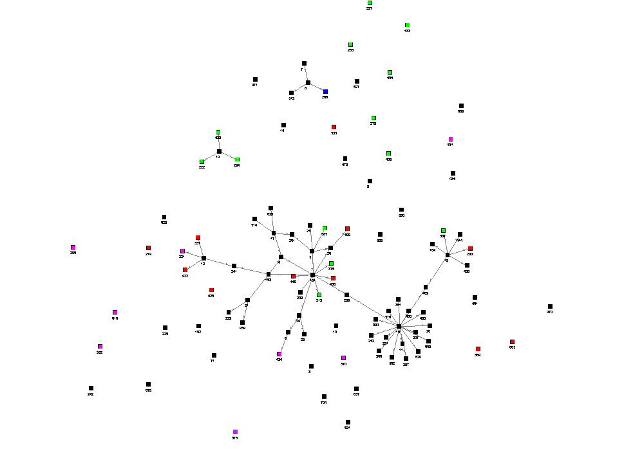
Map 7b: Whole Network – Working in PSE - Location
Legend
 | Western Region
 | Newfoundland
 | Canada
 | Internatial
 | No data
15
Notes:
Slide 11:
Then we can look back at the whole network – all names mentioned included, and see those working in Post Secondary Ed. They are coloured here according to location, so we can see who is working in PSE on the west coast. Black - Western NL, Red – Rest of NL, Green – Canada, Blue – International, Pink – Unknown.
Can 289 (Dave Peddle) introduce 161 (Louise) and 16 (CP); Can 469 (MK) introduce 16 and 18 (Robert Leamon), etc.to close triangles and help those looking for assistance in research and ed, be connected more deeply with those working in the area (shorten distances of connection).
What are the overlaps in these graphs?
That is a sample of how to look at the different support priorities. They can also be graphed, and the most pertinant ones addressed by business support agencies.

Slide 16
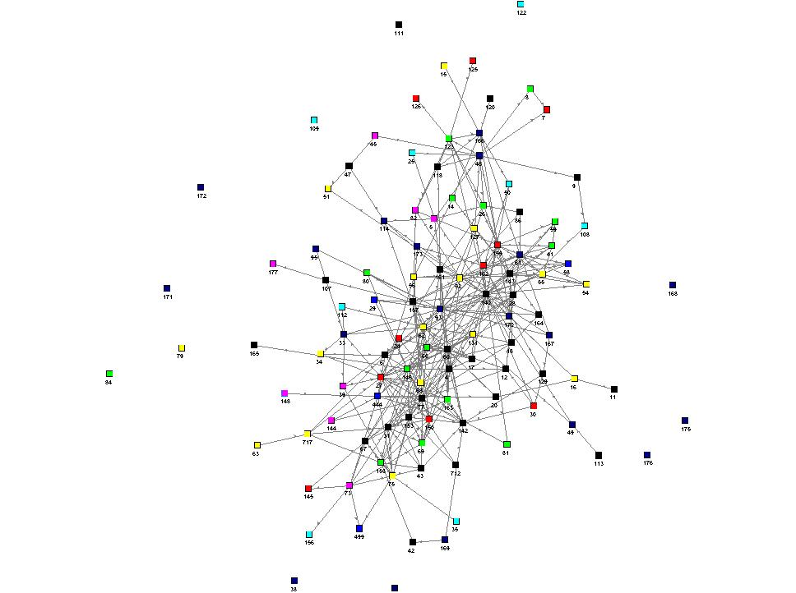
Map 4a - Innovation Priority
Legend
 | Networking In Person
 | Mentorship
 | Knowledge-based transfer
 | Networking Online
 | Sources of Financing
 | none
16
Notes:
Slide 5:
So that is a really easy way to look at the data on the map to show how it is representative of the network, now let's get a little more specific.
Here is our same network map of respondents again. This time they are coloured according to their response to this question: Which of the following initiatives would you like to be involved with developing within the next year? This is their business priority, or perhaps more accurately their innovation priority.
Pink – Networking Online
Red – Mentorship
Black – Networking in Person
Yellow – Sources of Financing
Aqua – None
Deep Blue – No Data
That's fine, we can see a diversity of priorities peppered throughout. But, what if we narrowed it down furthere to look at just one priority.

Slide 17
Next Steps – Community Mobilization and Network Weaving
Connecting community
Sector based initiatives
Promoting business networking
Mentoring support
Expand use of technology and social media as a networking tool

Slide 18
Conclusion
Opportunities – strengthen local and broaden external connections, build cross‐sectoral linkages, innovation strategy

