Slide 1
The Evolution and Impacts of the CUExpo Movement
Part of a Panel Presentation
CUExpo 2013
Joanna Ochocka
Centre for Community Based Research
Waterloo, Ontario
June 14, 2013

Slide 2
Centre for Community Based Research
30 years of social innovation in Canada
350 community based research projects
Balancing academic excellence with community relevance
Based on an entrepreneurial spirit in collaboration with its many partners to initiate new projects
Notes:
As social inovation

Slide 3
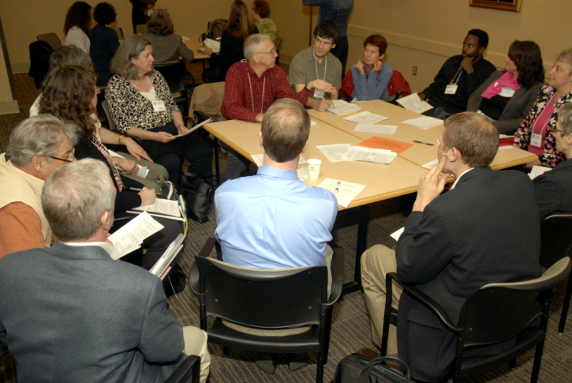
Motivations for CUExpo 2011: My Recollections
CCBR played a strong role in CUExpo2008
It was time to bring CUExpo to Eastern Canada
To strengthen the “C” in CUExpo
Hosted by communities of Waterloo
Demonstrated the potential for successful collective project
Start branding and sustaining CUExpo a movement
Formal partnership with CCPH

Slide 4
A Brief Summary of the “Facts”: CUExpo 2011
550 registered participants and 100 local volunteers
40% of community delegates
22 Canadian universities
16 countries
250 sessions across eight themes inspired by the UN Millennium Development Goals and organized by three streams: Community Voice and Relevance, Partnership and Collaboration, and Action and Change
Pre and post-conference Roundtable Series.
Free bus tickets, site visits and a large community “Night in the Park! A Community Cultural Fair” social event (attended by over 400 people)
Engagement of Art Sector (theatre productions, musical and art improvisations, etc.)

Slide 5
Reflections on Impacts and Outcomes
Fostering CU local, national and international partnerships
Creating opportunities for student and broader community involvement (making funding available)
Engaging stakeholders through sponsorship and exhibitor opportunities
Raising public awareness of Community-University partnerships
Viewing CU Expo as a movement, not as a single event
Mobilizing knowledge through art – Art activism
Leaving a conference legacy, establishing a process for sustainability and strengthening the CU movement
Reducing the environmental footprint of the conference – Link between environmental and social justice
Renewing sense of commitment to social action
Notes:
To listen to the voices of people who have lived experience with the challenges we are working to overcome.

Slide 6
Future Contact
Joanna Ochocka
Centre for Community Based Research
73 King Street West, Suite 300
Kitchener, ON, Canada N2G 1A7
Phone: (519) 741-1318 Fax: (519) 741-8262
E-mail: joanna@communitybasedresearch.ca
Website: www.communitybasedresearch.ca

