Slide 1
What Everyone’s Yakkin About!
or Why Your Library Should be on Yik Yak
Crystal Rose
Public Services Librarian Memorial University Libraries
crose@grenfell.mun.ca
Notes:
Presented at APLA Annual Conference, on May 30, 2016 in Halifax, NS

Slide 2
Notes:
-Grenfell Campus is on the West coast of NL in Corner Brook (about 8 hours away from the St. John's Campus)
-approximately 1200 students
-Grenfell Library has Facebook, Twitter, Instagram, Pinterest, & Flickr, and MUN Libraries has a YouTube channel

Slide 3
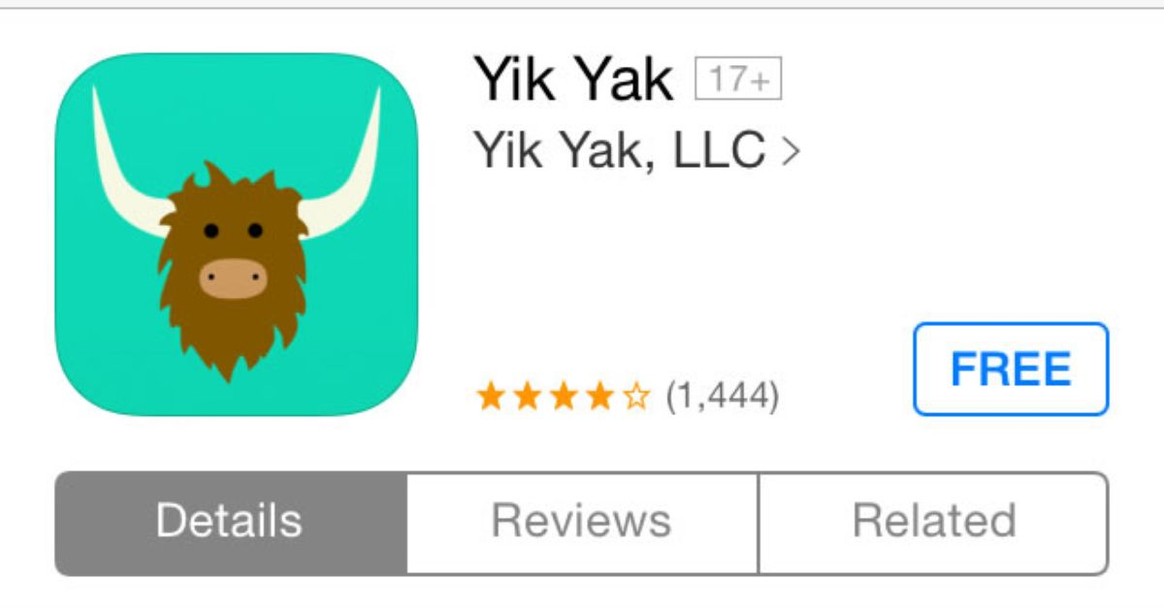
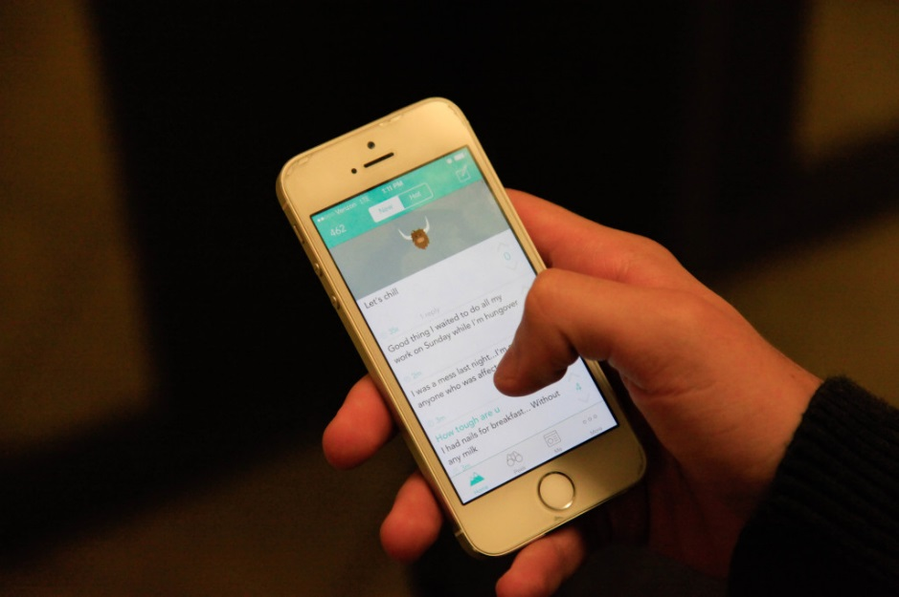
Notes:
What is Yik Yak?
-Free app for your phone available for iOS and Android (not blackberry)
-released in November 2013
-Developed by two 23 year old recent university grads

Slide 4
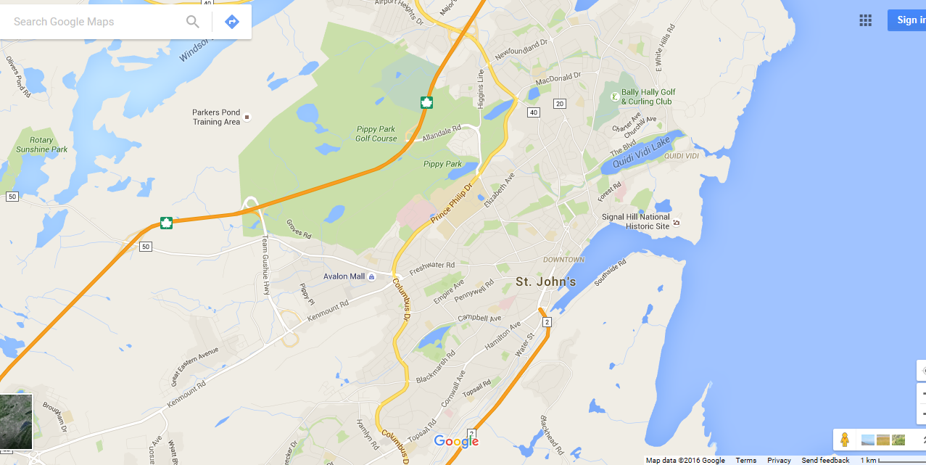
5 mile radius
Notes:
Allows you to anonymously post comments or “yaks” or 200-character messages that can be seen by anyone else with Yik Yak within a 5 mile radius (8 km)
Yik Yak only has your phone number (not visible to anyone)
Completely anonymous
Get a live feed of what people are saying around you
Similar to an online bulletin board where people can anonymously post things
Yaks expire – you only see the most recent (depending on how active your Yik Yak feed is, you night only see yaks from the past 24 hours

Slide 5
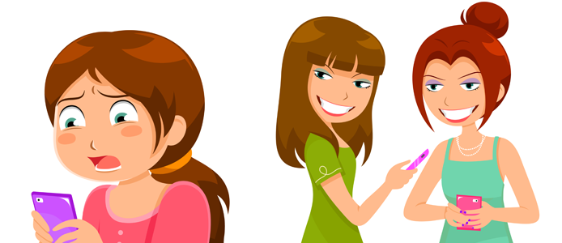
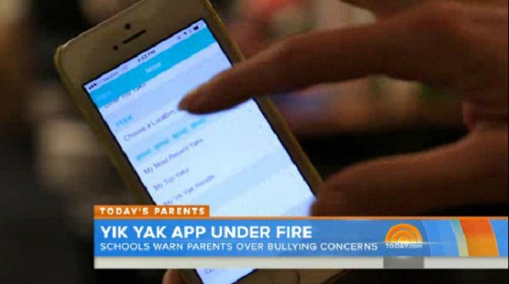
Notes:
At this point, is when people usually say “what a terrible idea – won’t this just get used for cyberbullying!”
Yik Yak’s developers’ intended audience was university campuses
They were actually taken aback when the app took off at middle schools and highschools and was in fact used in some fairly nasty ways
So there were several famous cases in the US where middle schoolers or high schoolers got ahold of Yik Yak and were using it to write really mean things about their classmates
Lapowsky, I. 2014. How Yik Yak keeps its anonymity app from ruining people’s lives. Wired. http://www.wired.com/2014/05/yik-yak/

Slide 6
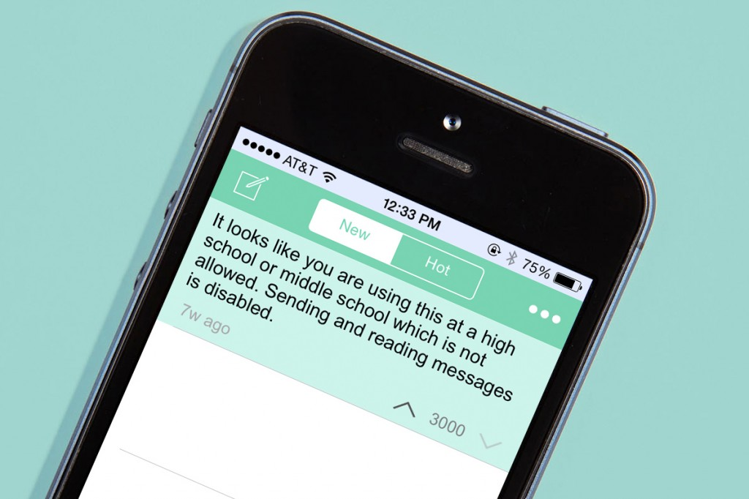
Notes:
In response, Yik Yak immediately used geofencing to block the app at middle schools and highschools
Not the intended audience (app is 17+)
Lapowsky, I. 2014. How Yik Yak keeps its anonymity app from ruining people’s lives. Wired. http://www.wired.com/2014/05/yik-yak/

Slide 7
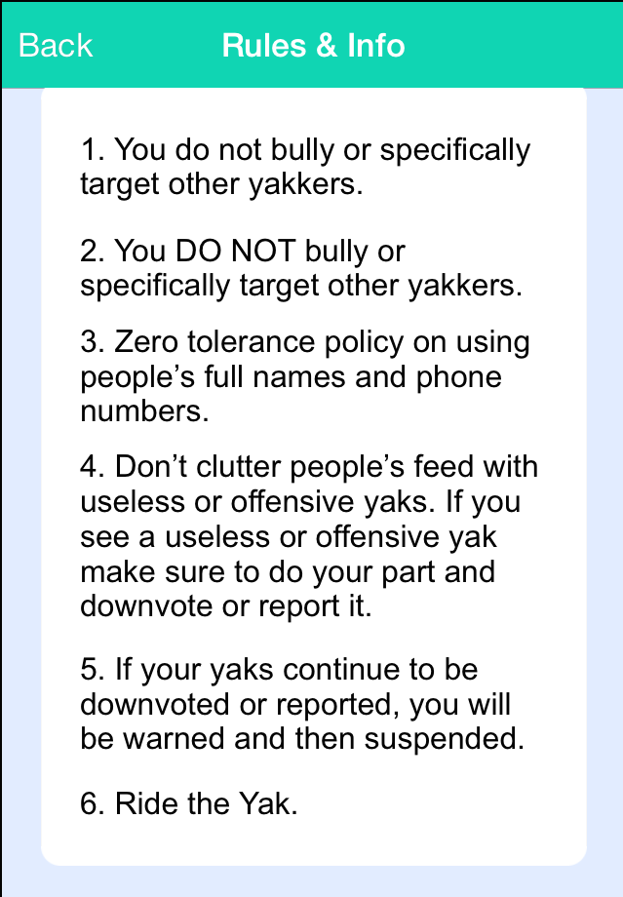
Notes:
Yik Yak policy

Slide 8
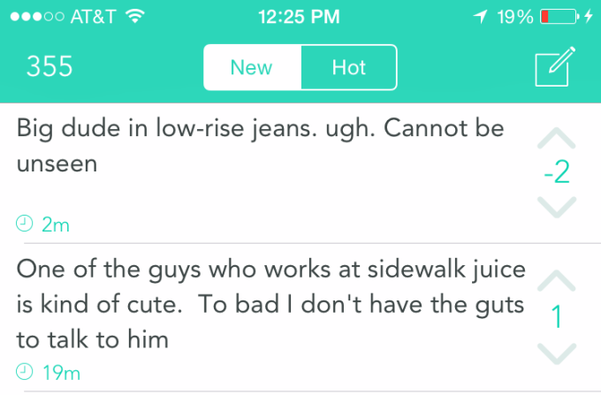
Notes:
Yik Yak is also self-policing
users can flag or down-vote posts they find offensive
If a post gets five down-votes, it’s automatically removed
There’s a word filter - posts with “egregious” language are removed by Yik Yak
Repeat offenders can have their account suspended or be completely banned
Both bomb threats & shooting threats have been posted on the app. In those cases, Yik Yak has worked with law enforcement to both report the threats and to share information about the user’s location when the threat was posted. In several cases, that has led to arrests of those users. The Yik Yak team has now developed protocol on how to handle similar situations.
So I think Yik Yak has gotten a bad rap – the company endeavours to act responsibly
Lapowsky, I. 2014. How Yik Yak keeps its anonymity app from ruining people’s lives. Wired. http://www.wired.com/2014/05/yik-yak/
Parkinson, H. J. 2014. Yik Yak: The anonymous app taking US college campuses by storm. The Guardian. https://www.theguardian.com/technology/2014/oct/21/yik-yak-anonymous-app-college-campus-whisper-secret

Slide 9
Notes:
Yik Yak is mainly used by university students
As I’ve travelled over the past year, I check out Yik Yak
In places where there isn’t a university or where I’m farther than 5 miles from a campus, there are hardly any yaks
But when you’re near a university – Yik Yak is on fire
they primarily yak about campus life
Yik Yak promotes its service by saying - “Always know what's going on around you.”
So as an academic library I thought I needed to check out Yik Yak and see if anyone was yakking about the library
I have been monitoring it since last September, and whenever the library got mentioned, I would take a screen shot
As I mentioned, Yaks expire
So you do have to monitor it regularly – you can’t go back and search through Yaks
And part of the appeal of Yik Yak is its immediacy, as I will talk about shortly so it is something you want to be checking frequently
So do you want to know what they yakked about us?
I have divided the types of Yaks I recorded into 7 categories (I totally made them up myself)
Shontell, A. 2015. How 2 Georgia fraternity brothers created Yik Yak, a controversial app that became a $400 million business in 365 days. Business Insider. http://www.businessinsider.com/the-inside-story-of-yik-yak-2015-3

Slide 10
Category #1: Umm…
Notes:
First category of Yaks I observed were Yaks that although they may reference the library, really aren’t super helpful

Slide 11
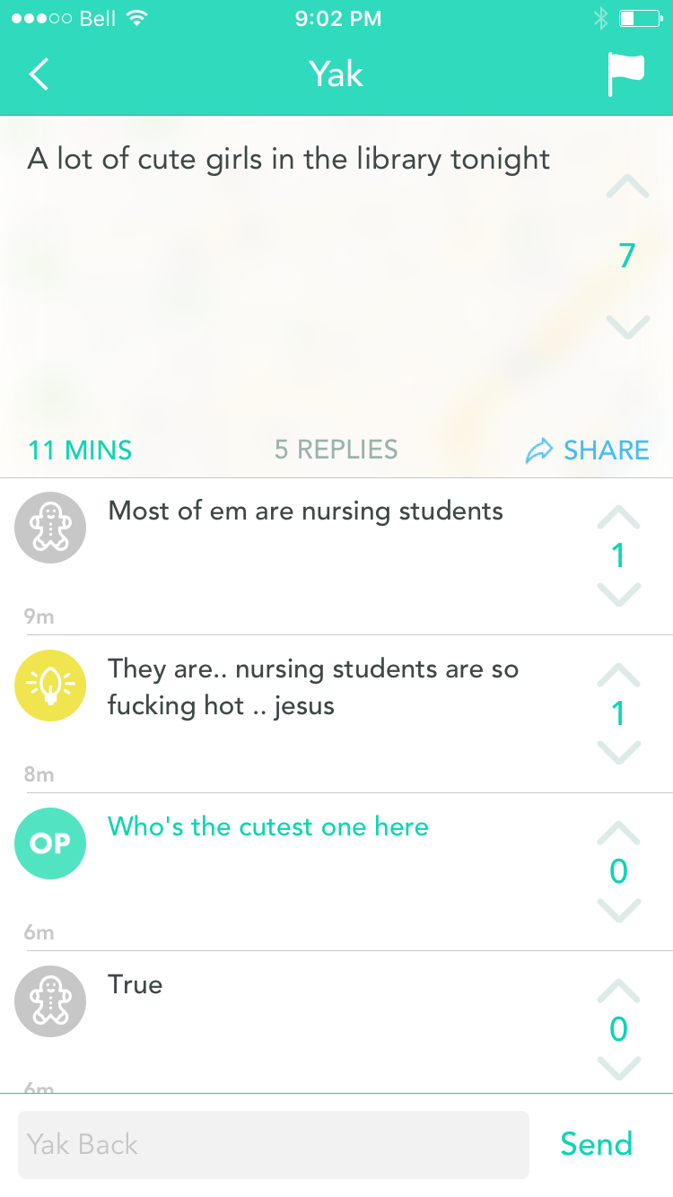
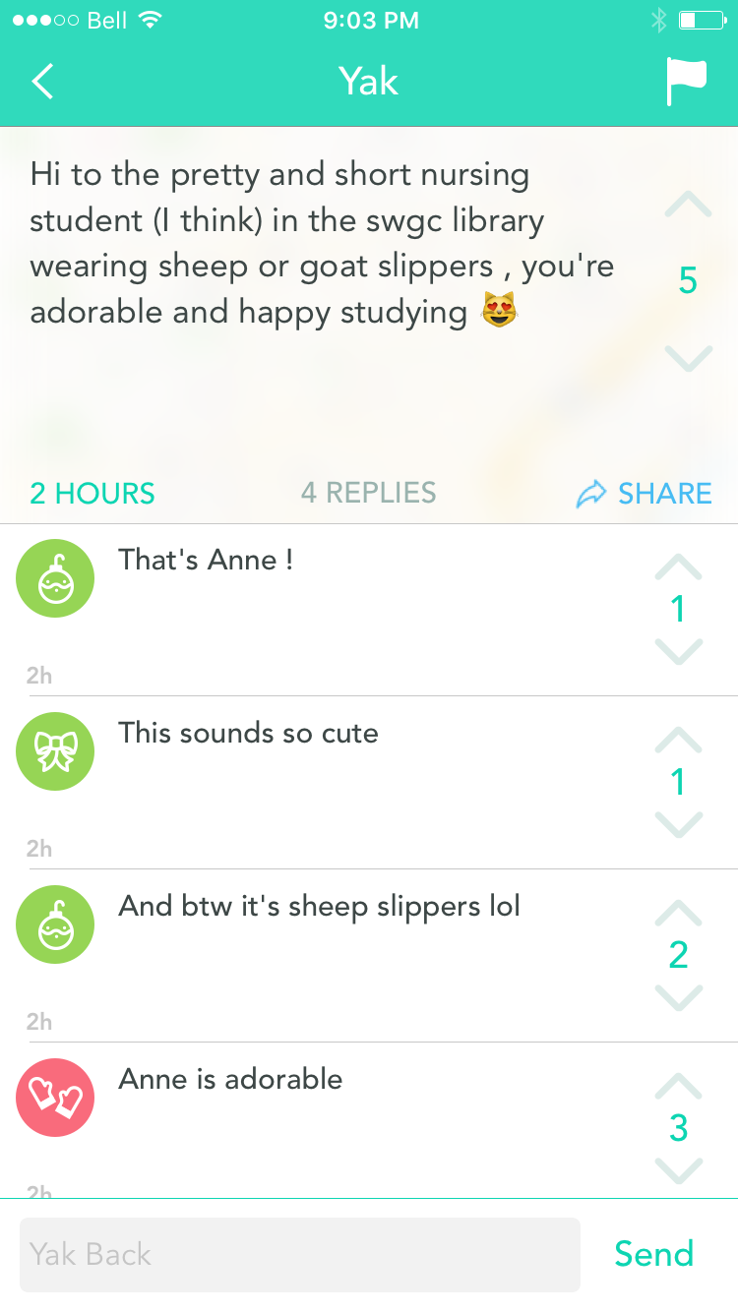
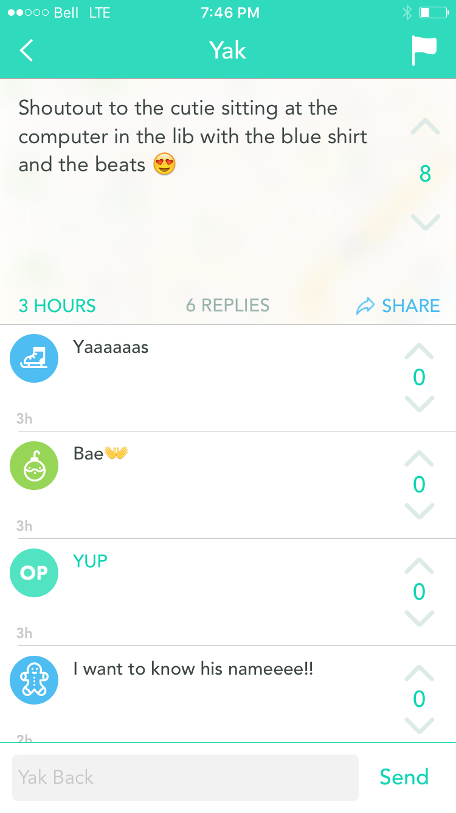
Notes:
like shout-outs to library cuties
Keep in mind, they’re not all gems

Slide 12
Category #2: Humorous Yaks
Ha!

Slide 13
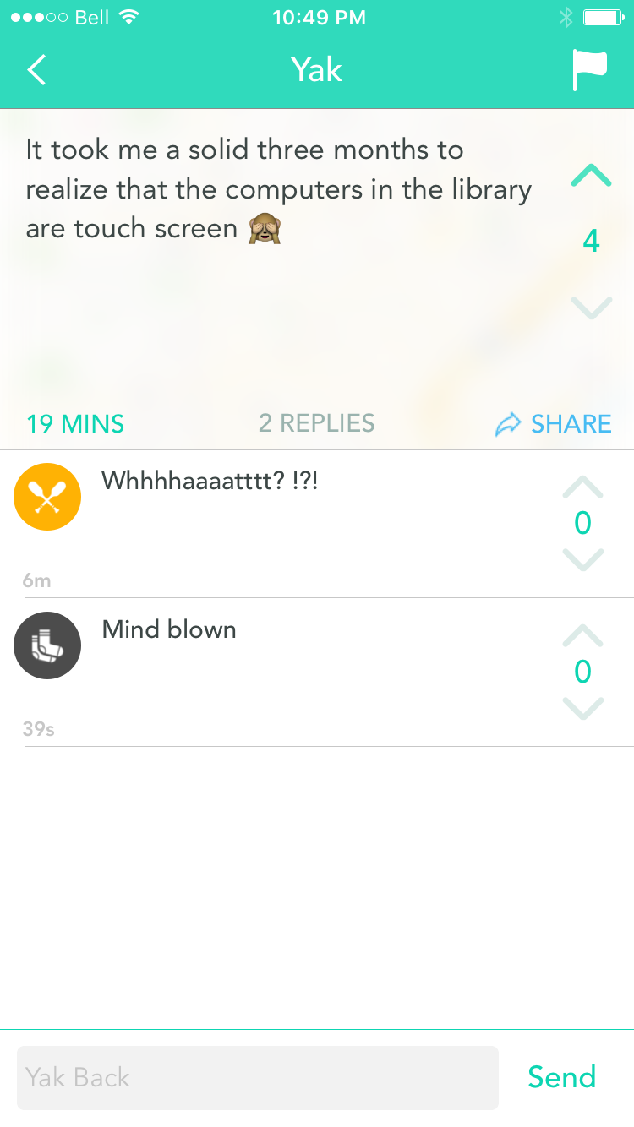
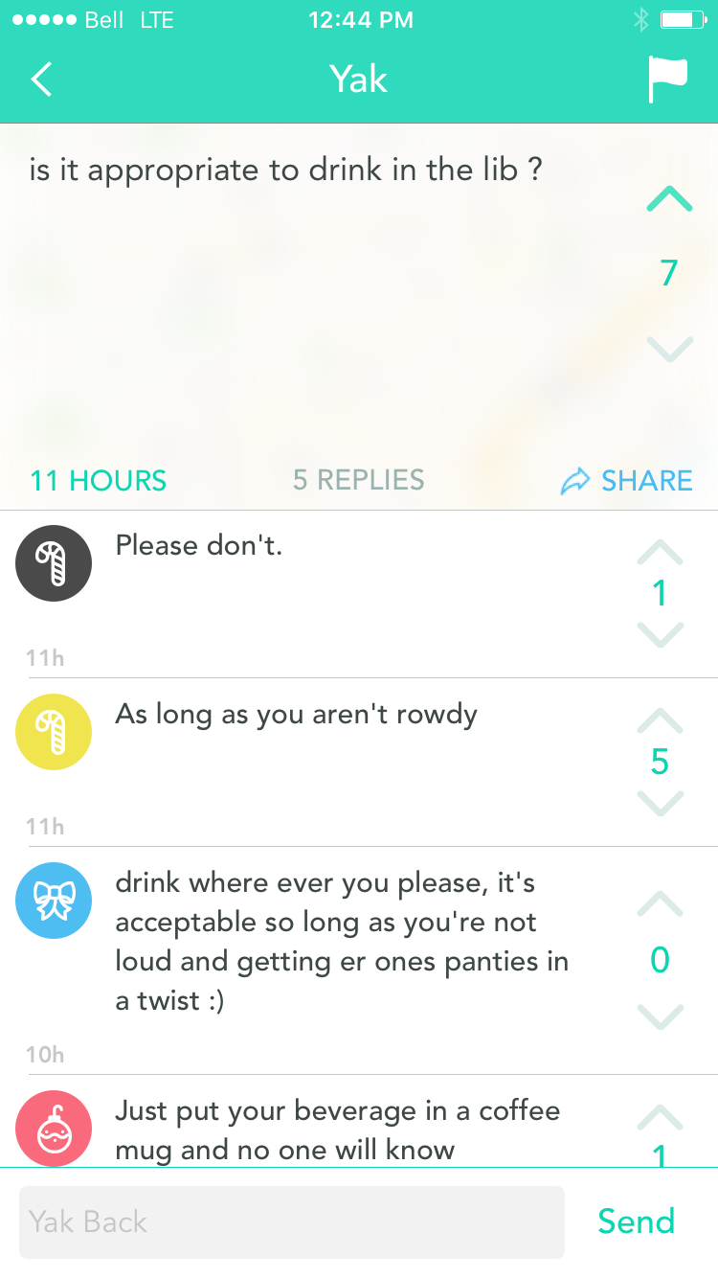
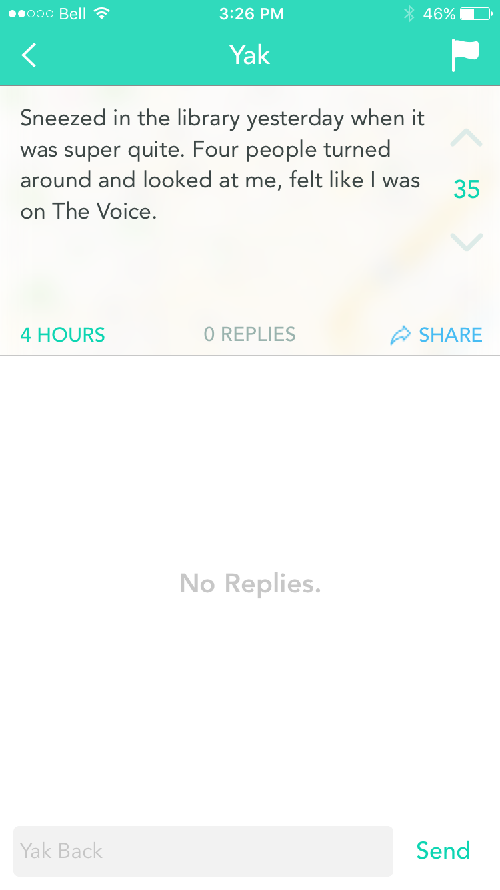
Notes:
And some are just funny

Slide 14
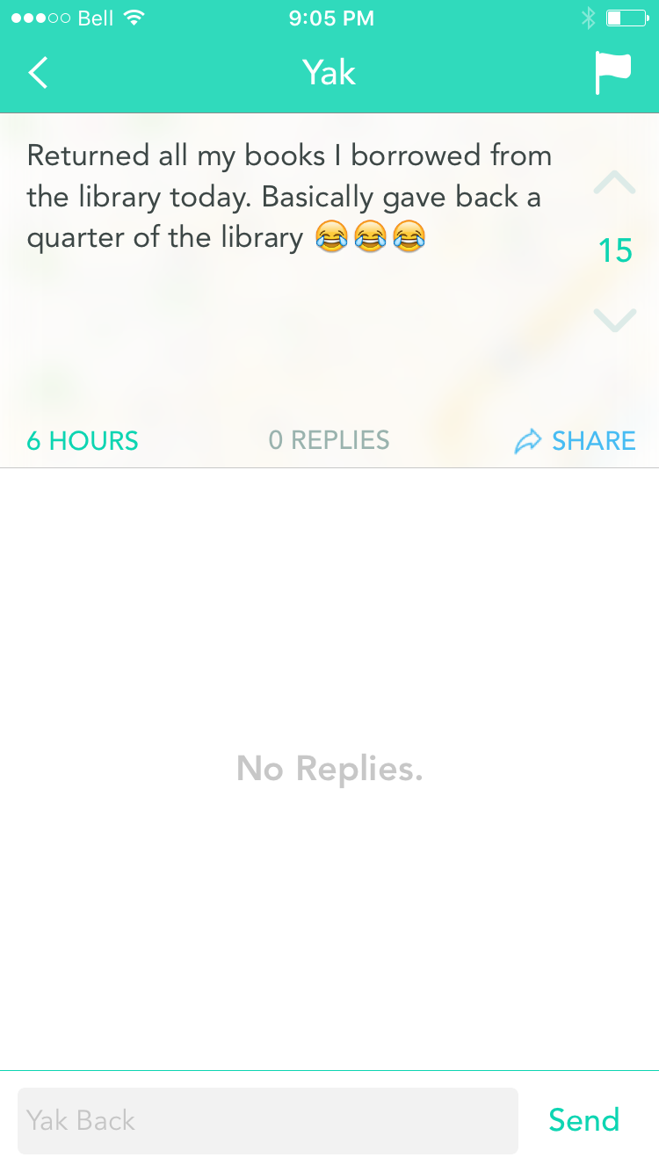
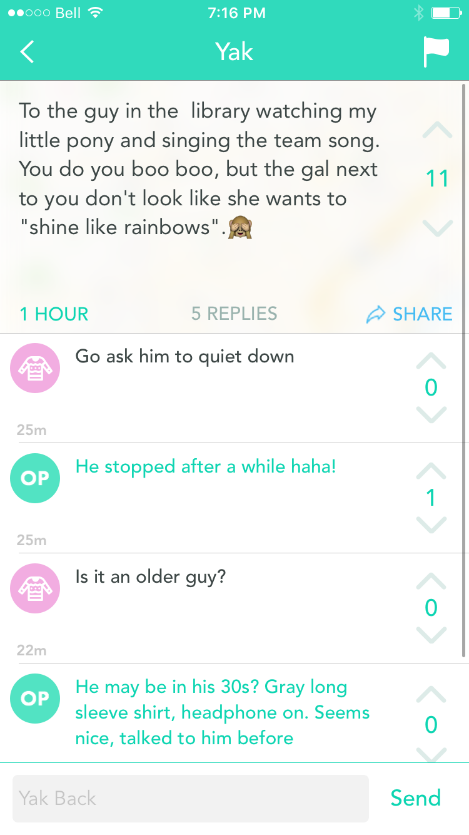
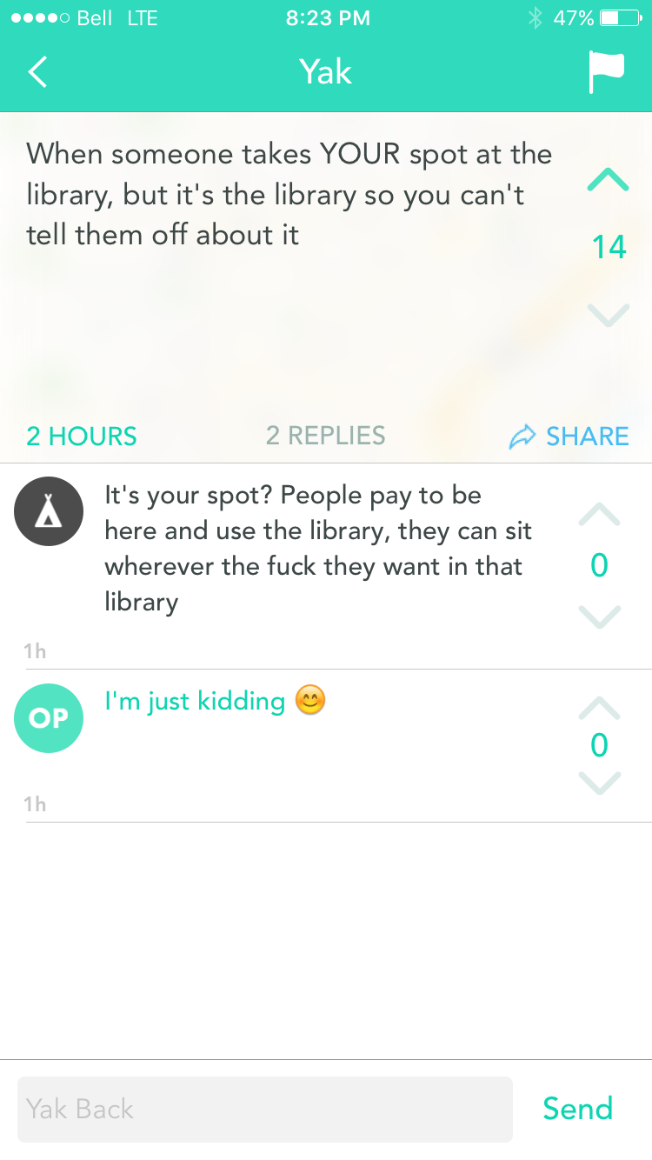
Notes:
But its interesting to realize that the library is an important part of campus life, because it does get yakked about a lot

Slide 15
Category #3: Stress & Anxiety
Notes:
On the flip side of that – other yaks are serious and can tell us a lot about the mental state of our students and when they are feeling particularly stressed or overwhelmed

Slide 16
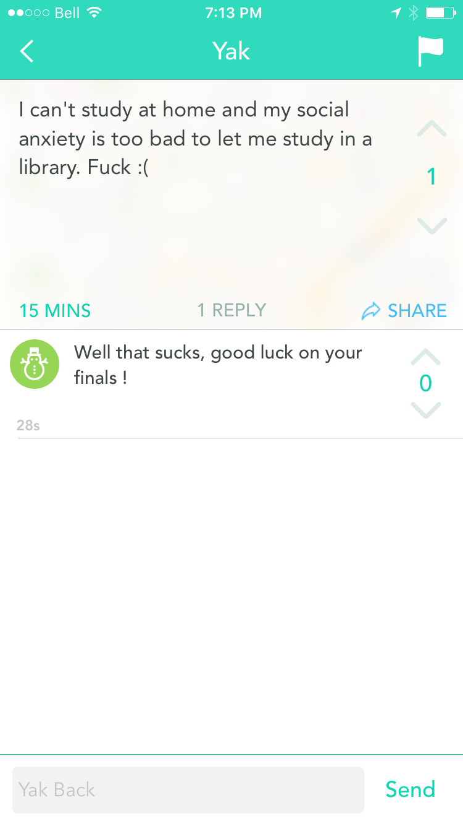
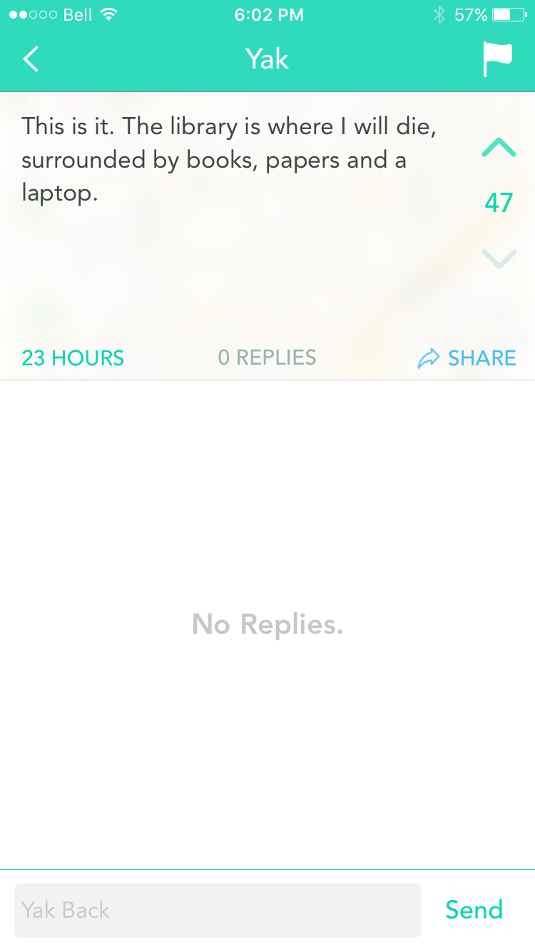
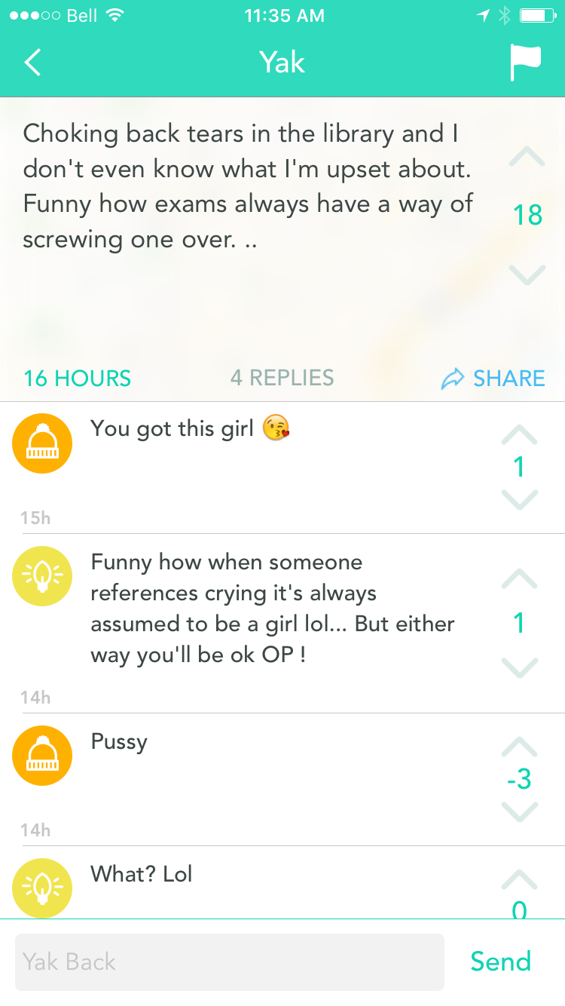
Notes:
Especially towards the end of semester

Slide 17
Category #4: Questions
Notes:
Many of the yaks are people asking questions about the library
I was really surprised at how frequently Yik Yak is used this way

Slide 18
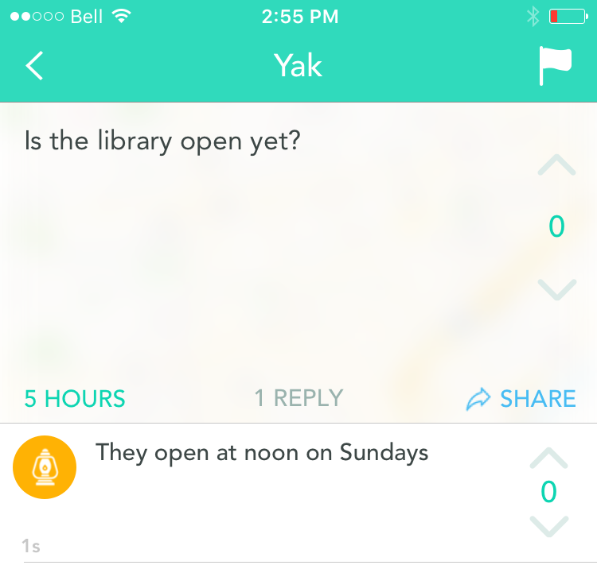
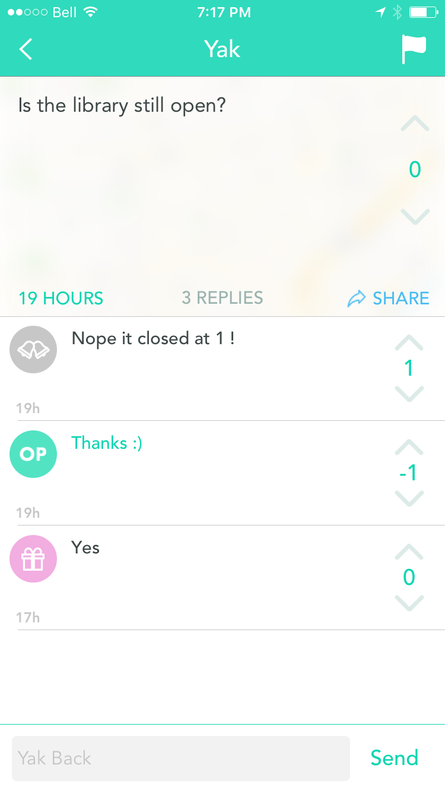
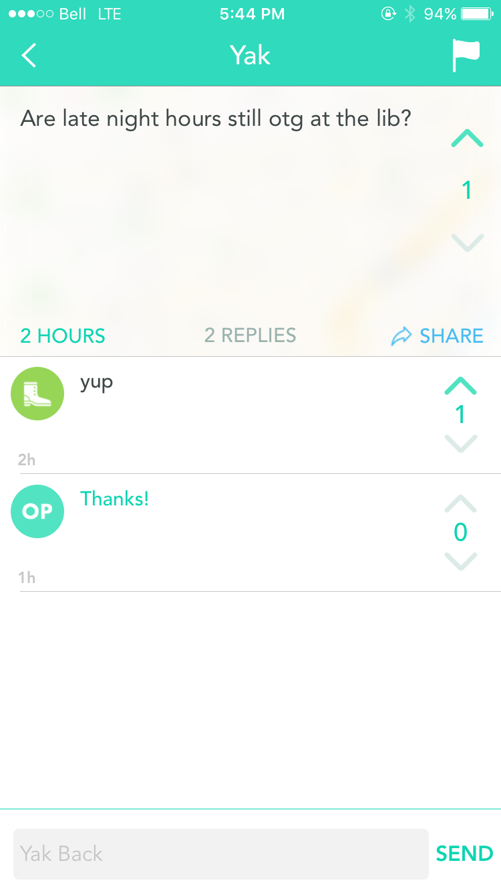
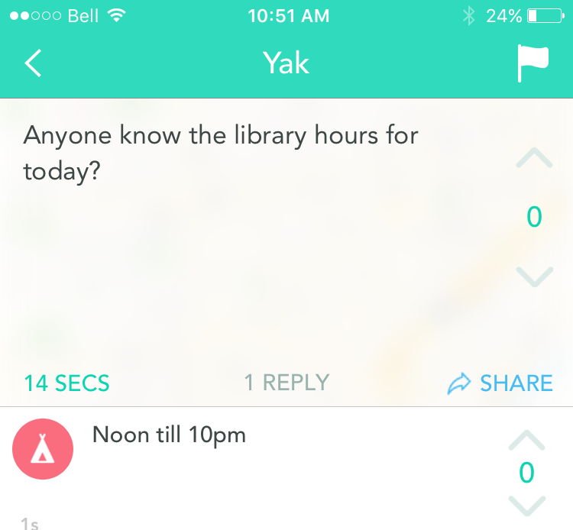
Notes:
Questions about Library hours being the most popular

Slide 19
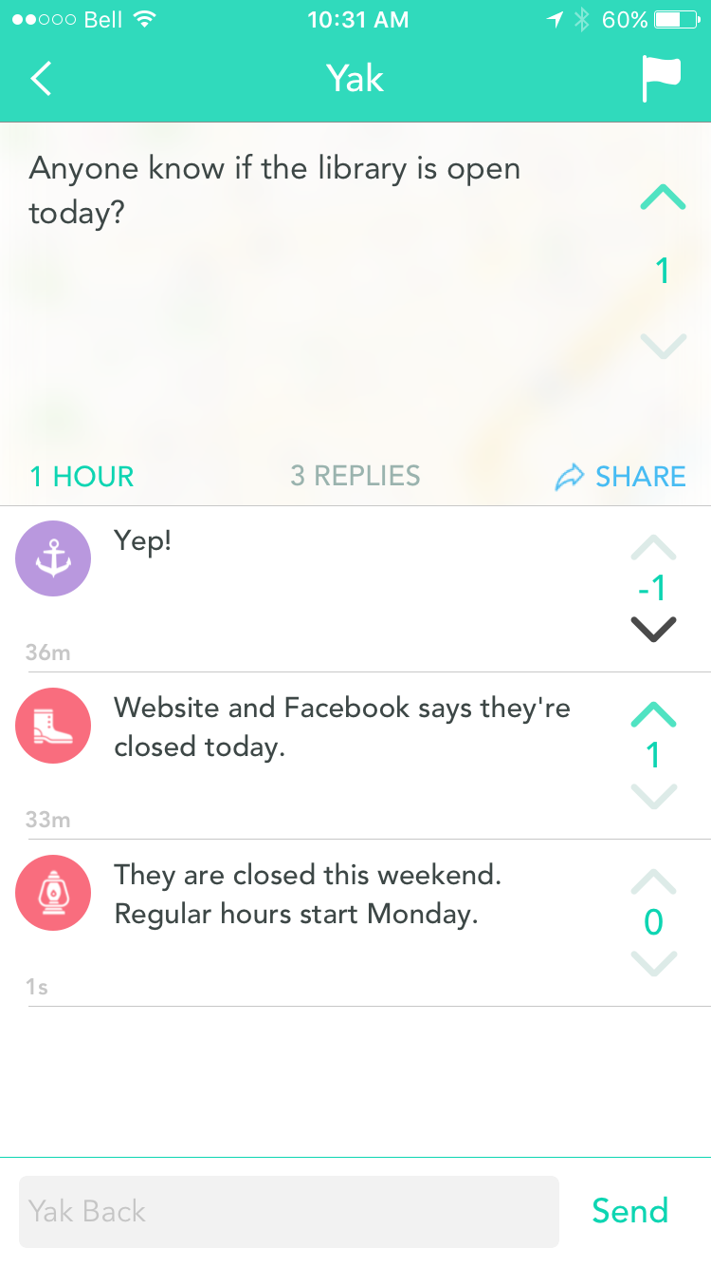
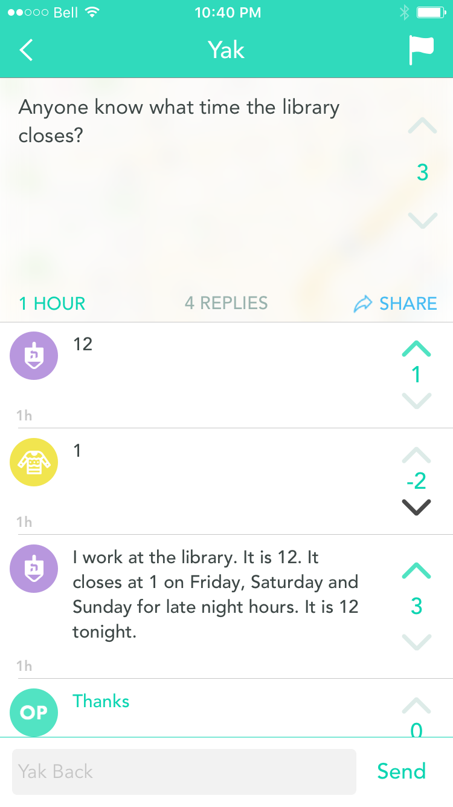
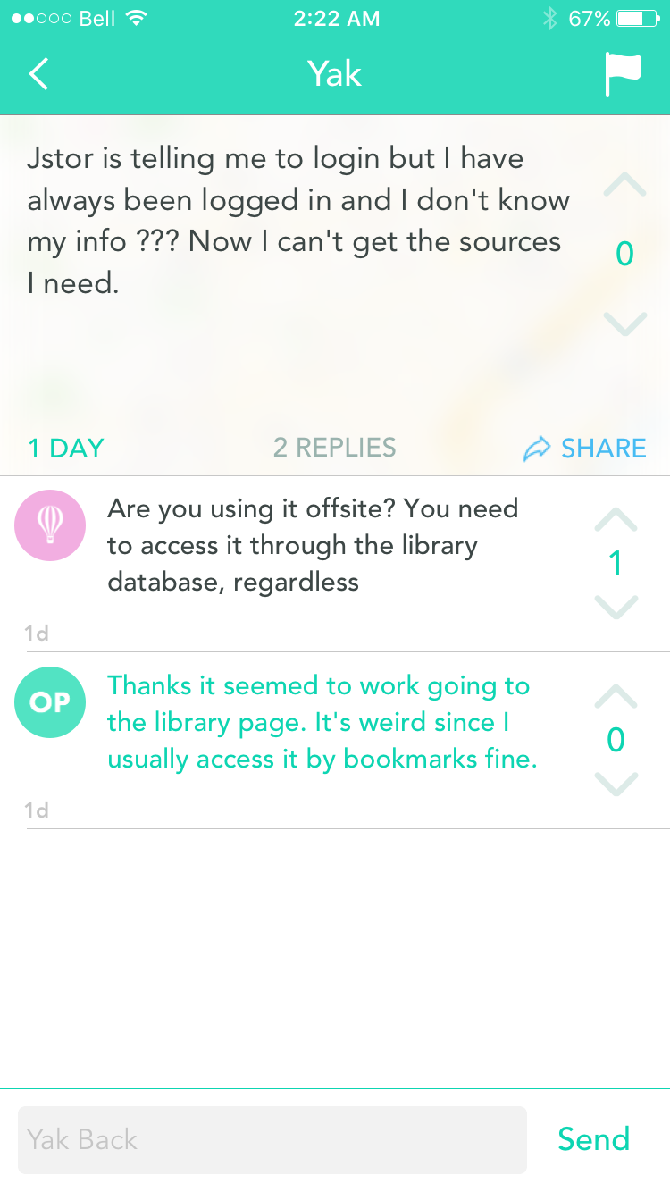
Notes:
I like how the wrong answer got downvoted and corrected by other Yik Yak users
The community is quick to answer questions, and surprisingly accurately

Slide 20
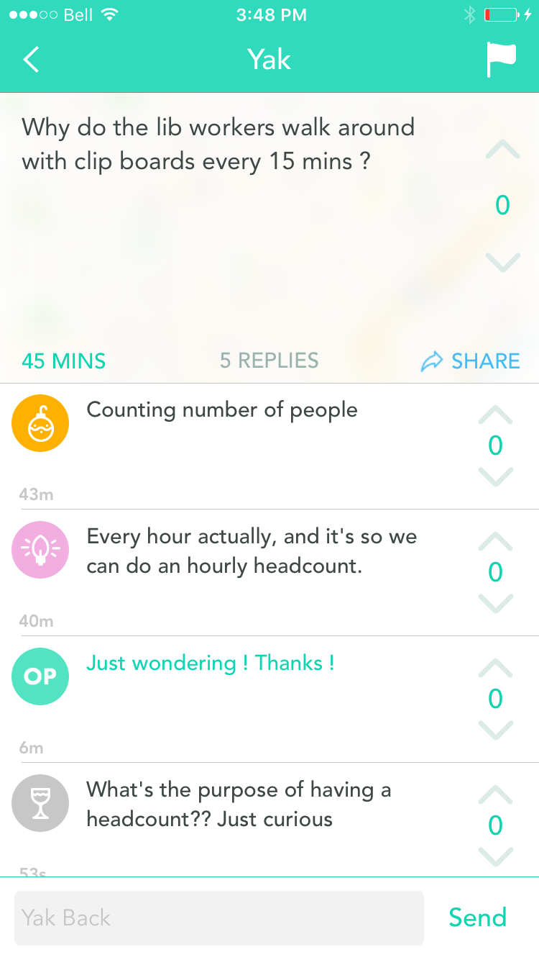
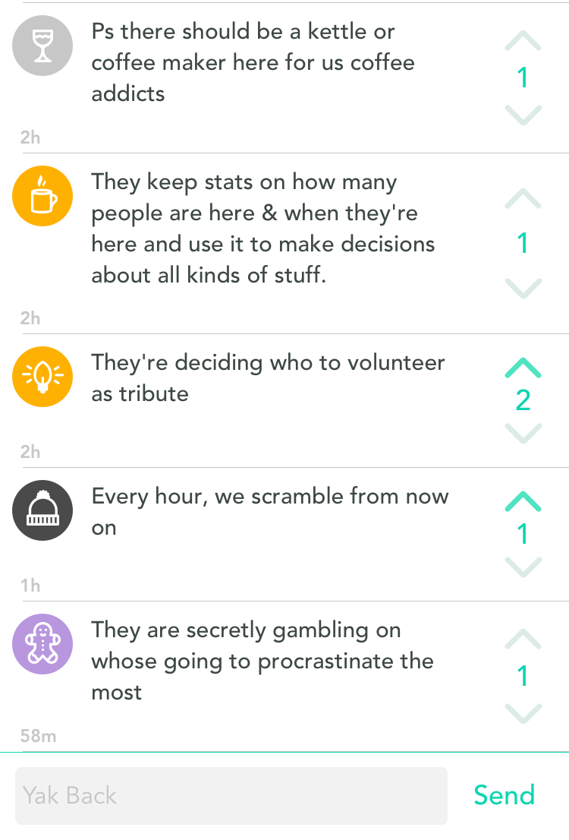
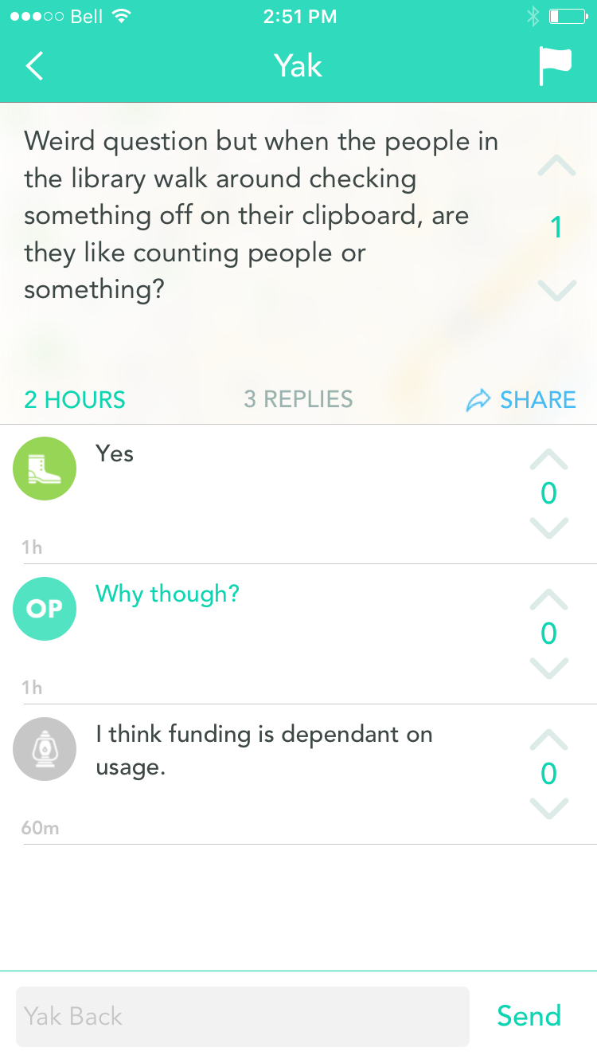
Notes:
particularly curious about the library workers taking stats

Slide 21
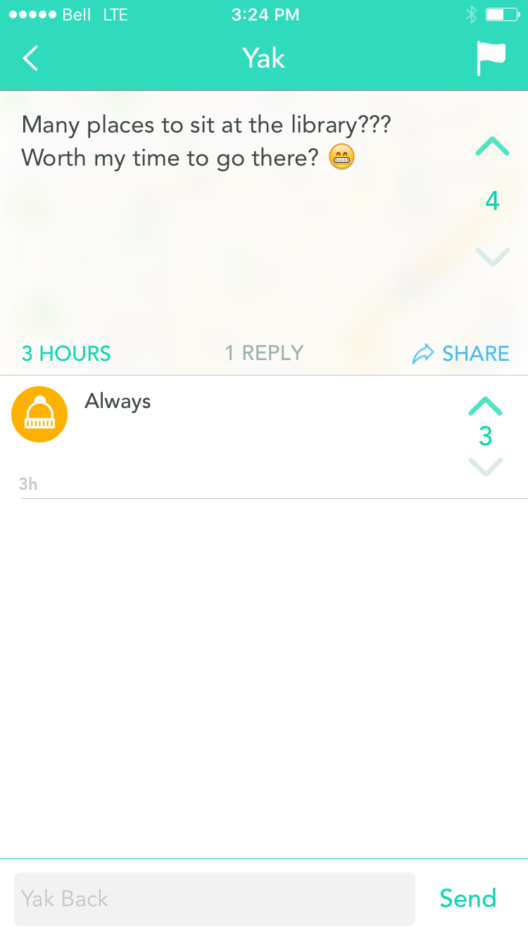
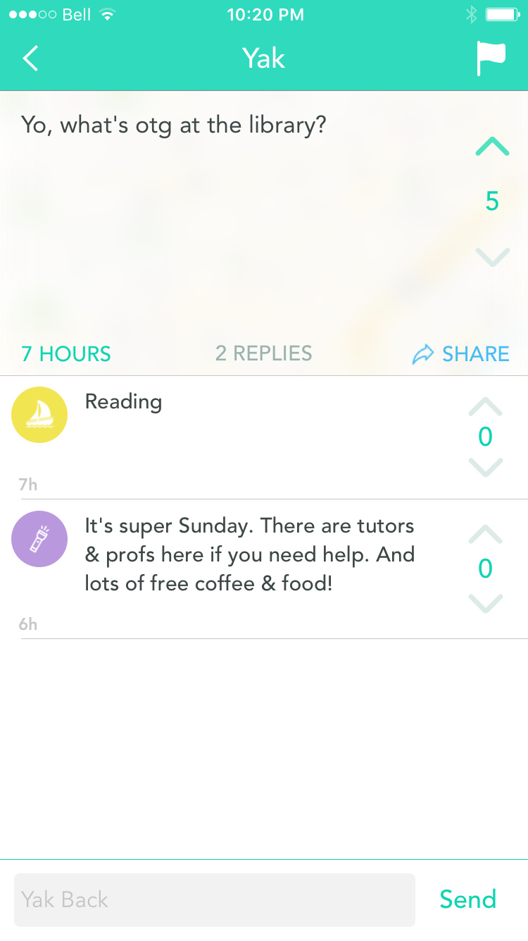
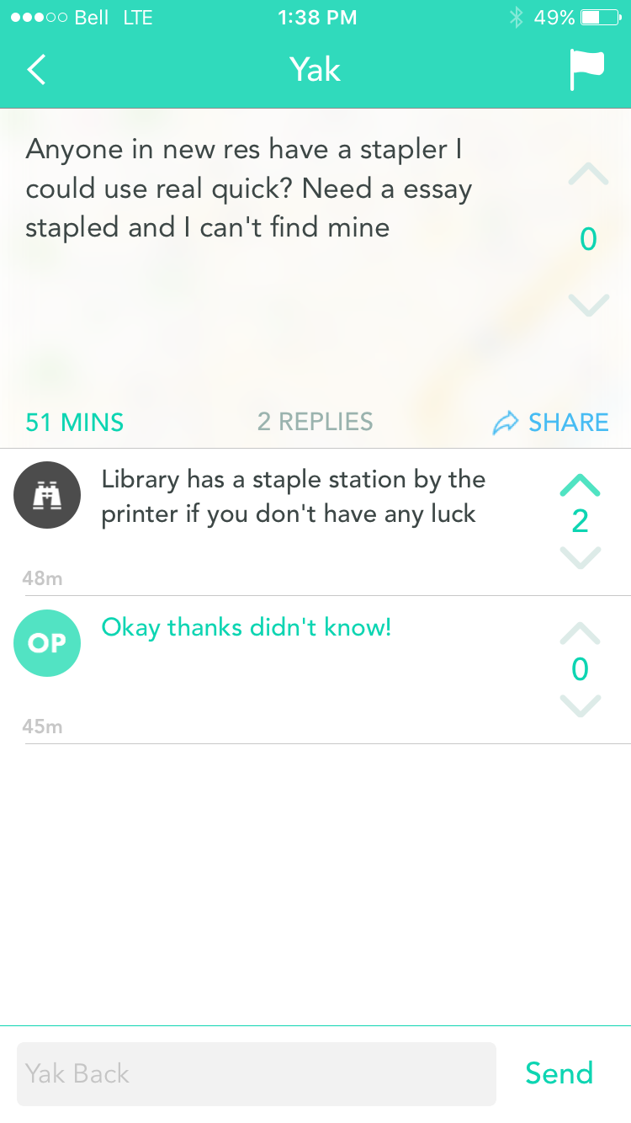
Notes:
In the third example, a Yik Yak user suggests the library’s Staple Station where they can access free supplies!

Slide 22
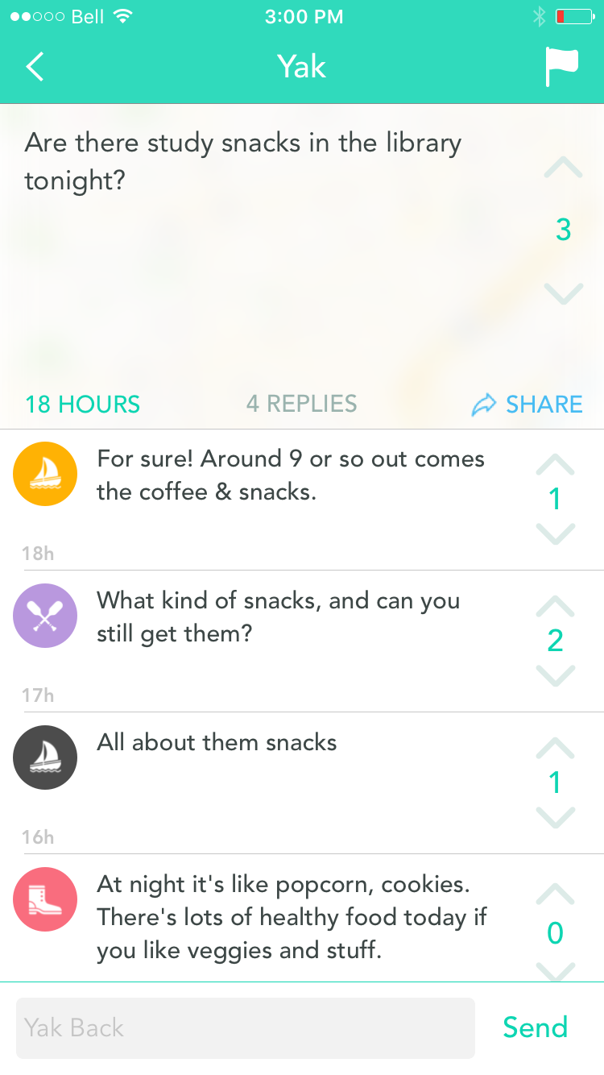
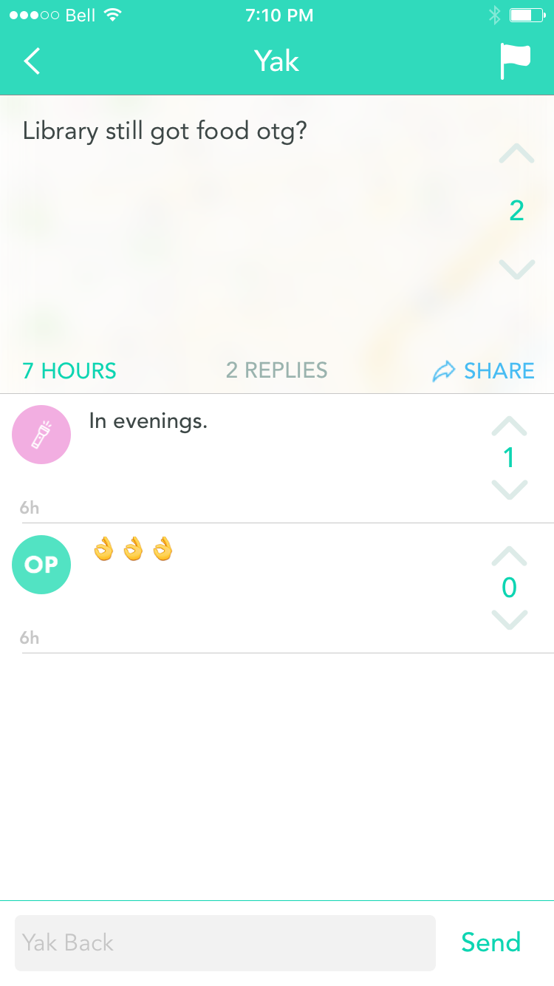
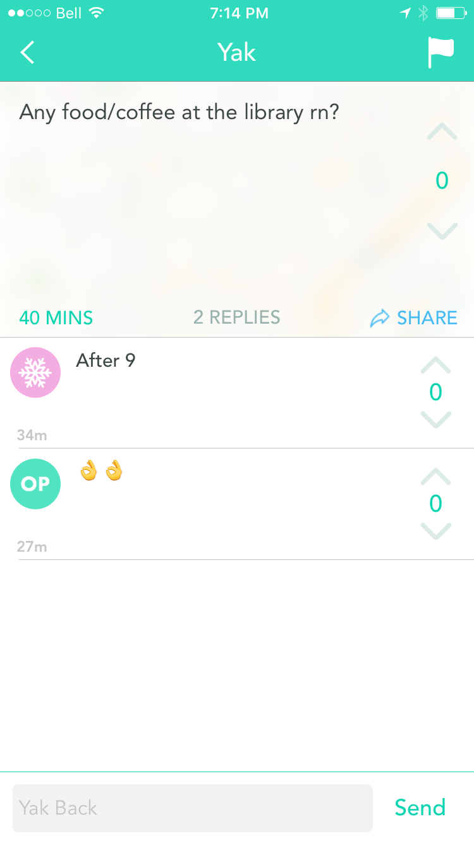
Notes:
lots of questions about the very important topic of free snacks

Slide 23
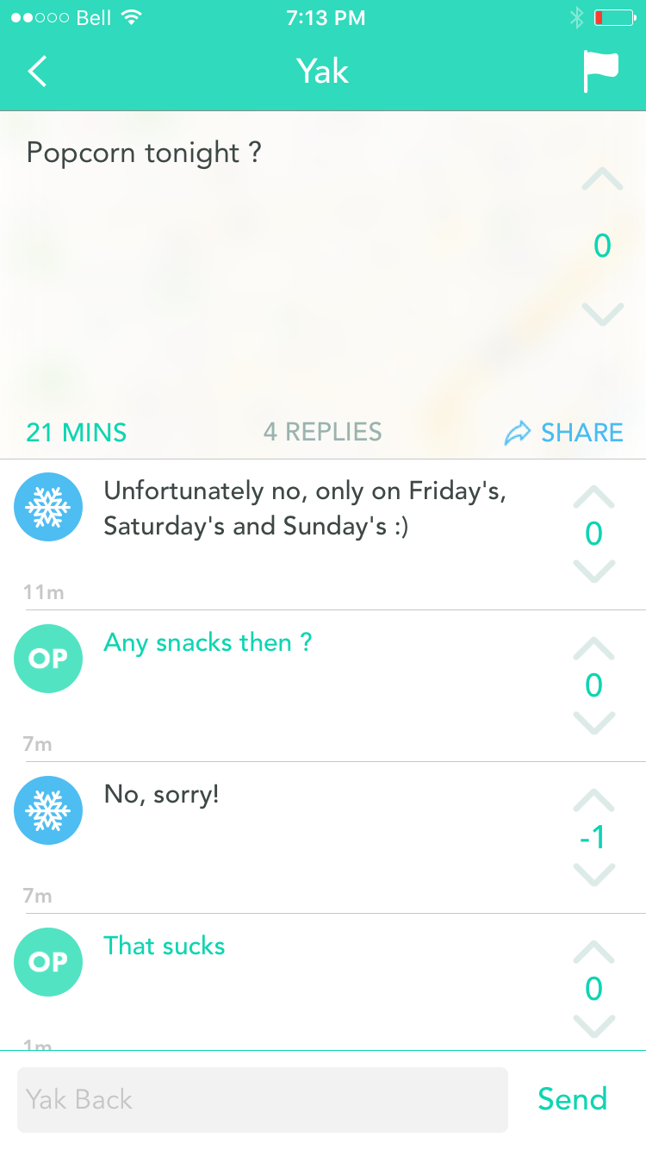
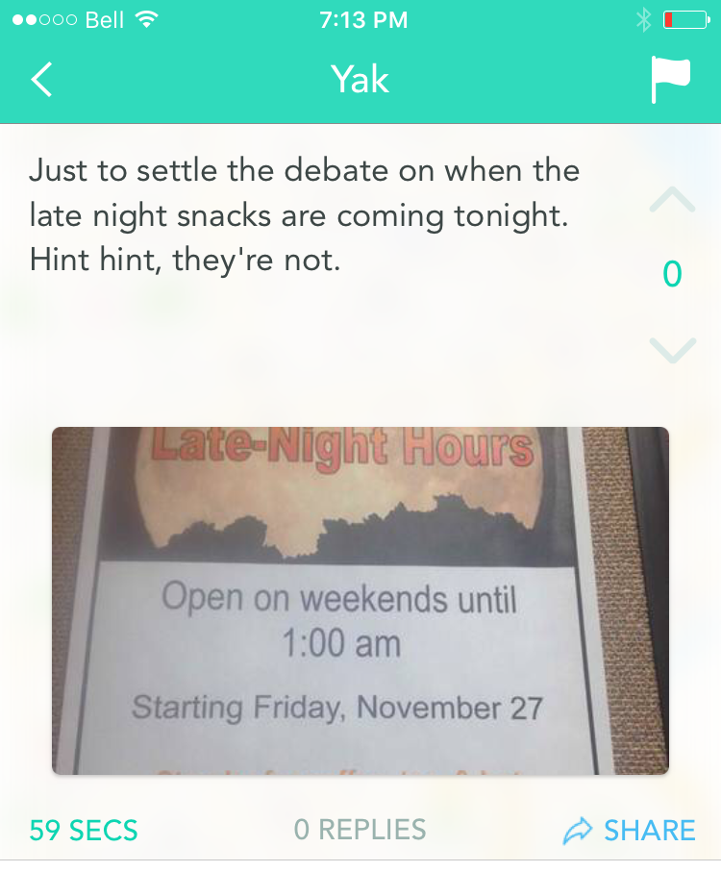
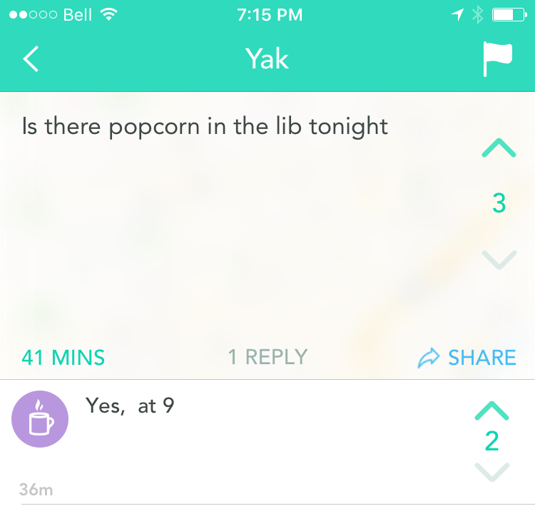
Notes:
Again, the questions get answered
One Yik Yak user actually took a photo of one of our posters to settle the question

Slide 24
Category #5: Suggestions
Notes:
Sometimes there’s suggestions or comments
Yik yak can be like a virtual suggestion box

Slide 25
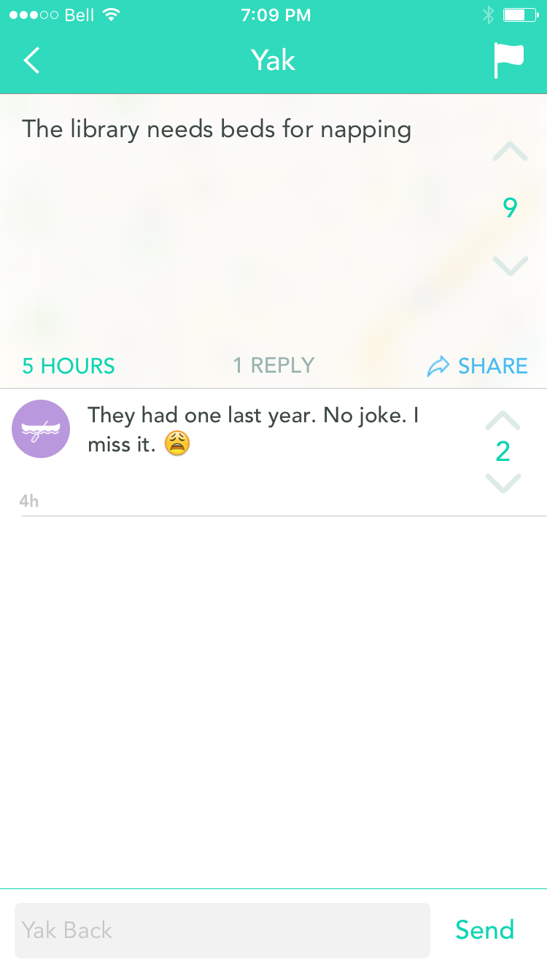
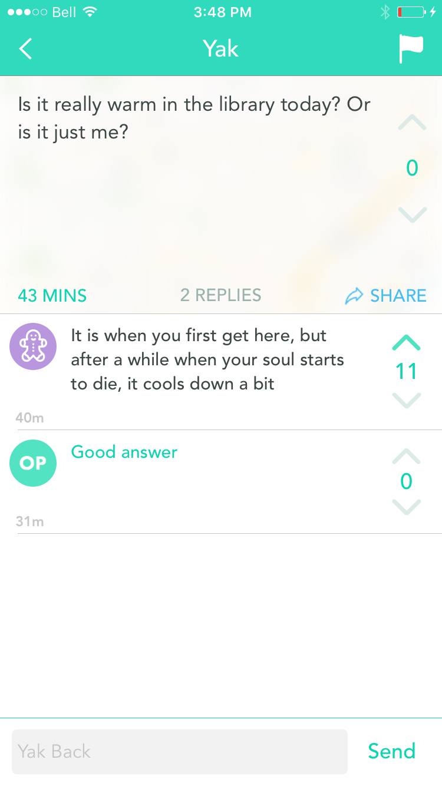
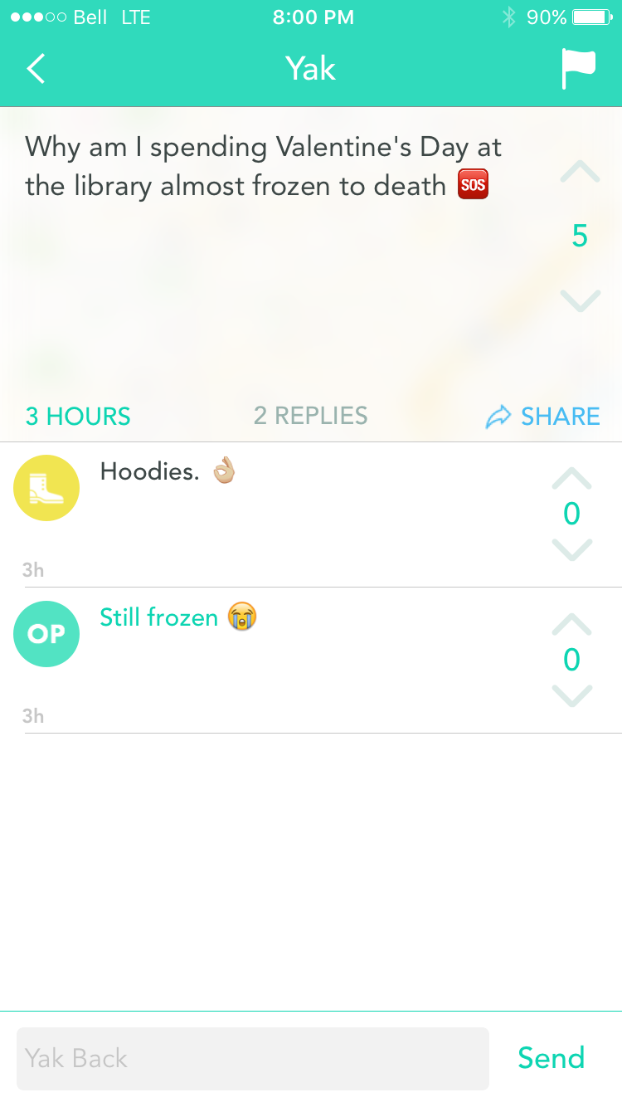
Notes:
Yaks about the temperature were very helpful as we were accessing the building’s heating and cooling system at the time
I was supposed to report times when the temperature was too hot or too cold to facilities and this was a great way to monitor how students were feeling about the climate control in our space

Slide 26
Category #6: Criticism
Notes:
And of course you see criticism and negative comments – that’s a part of it

Slide 27
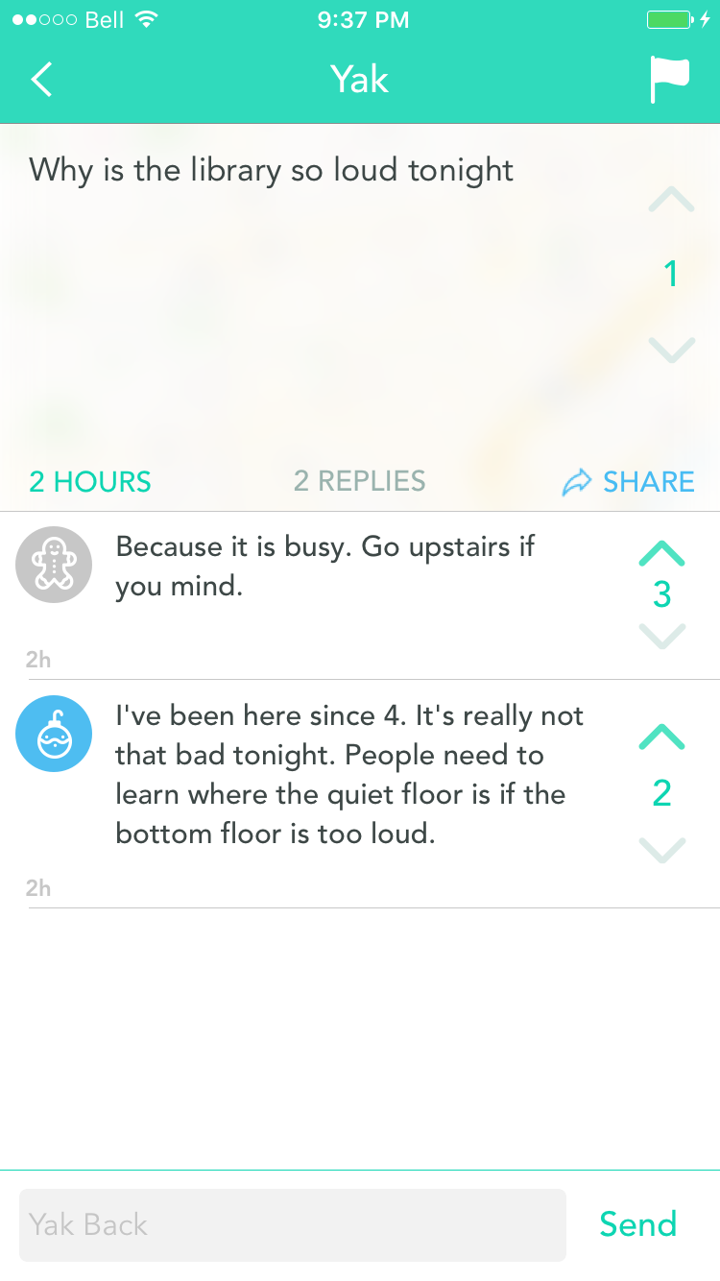
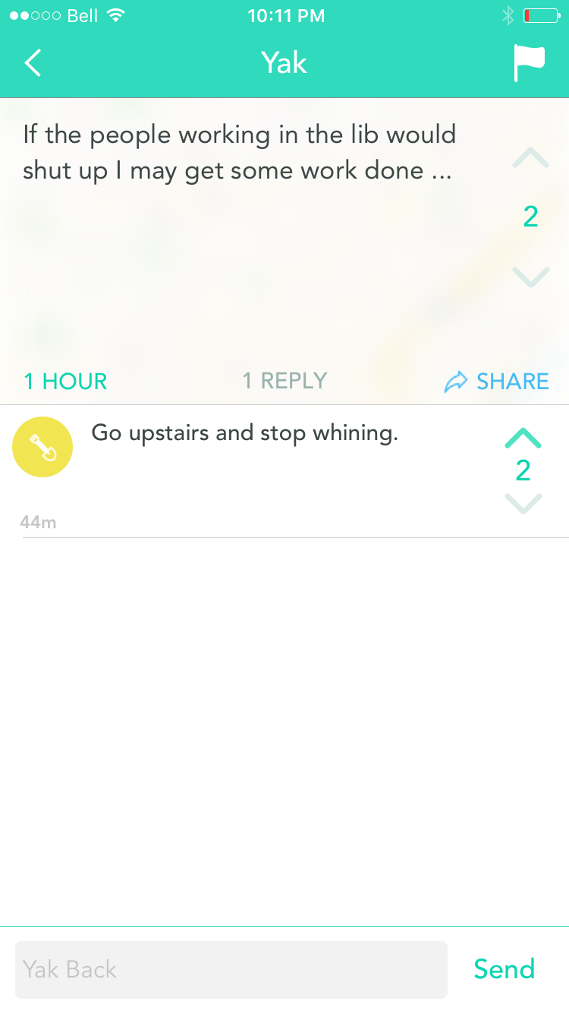
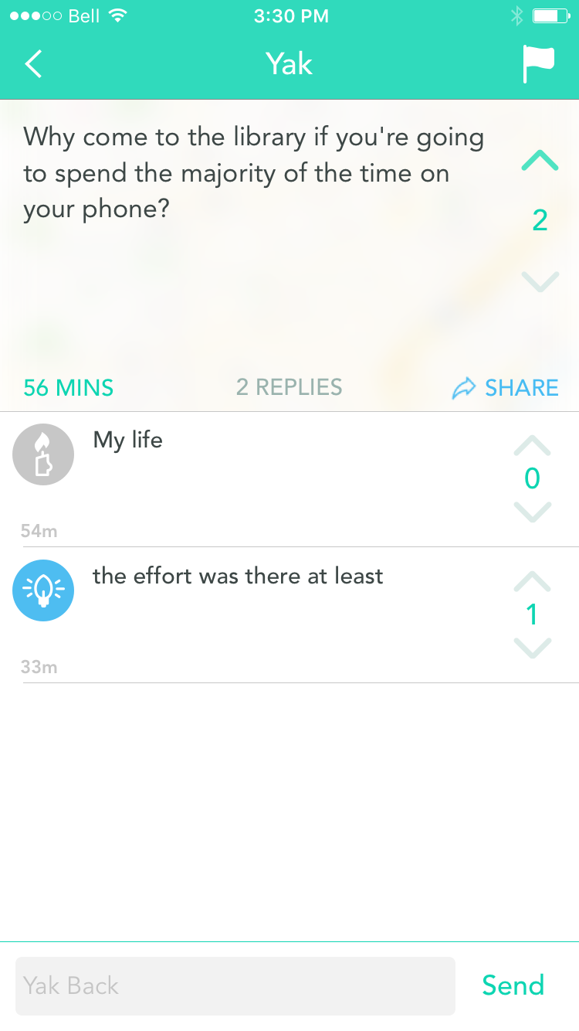
Notes:
All of ours are about noise and are usually students complaining about other specific students

Slide 28
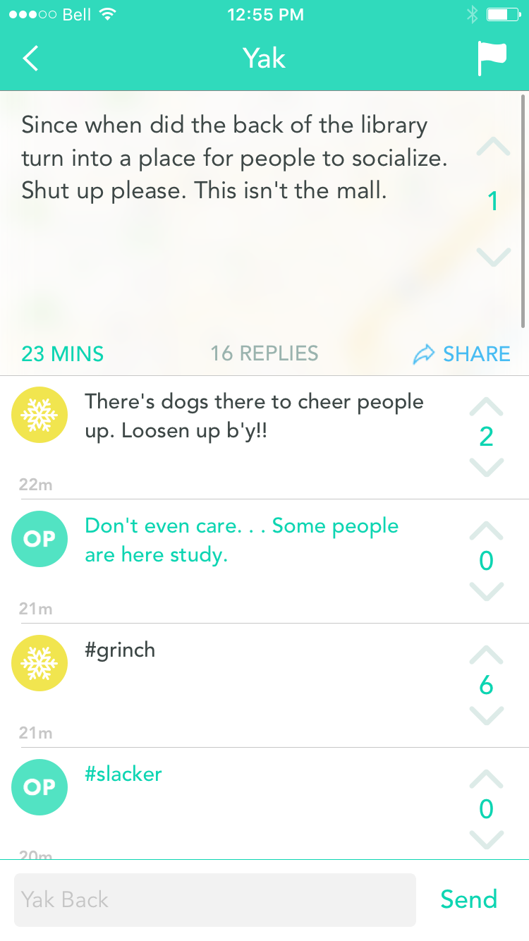
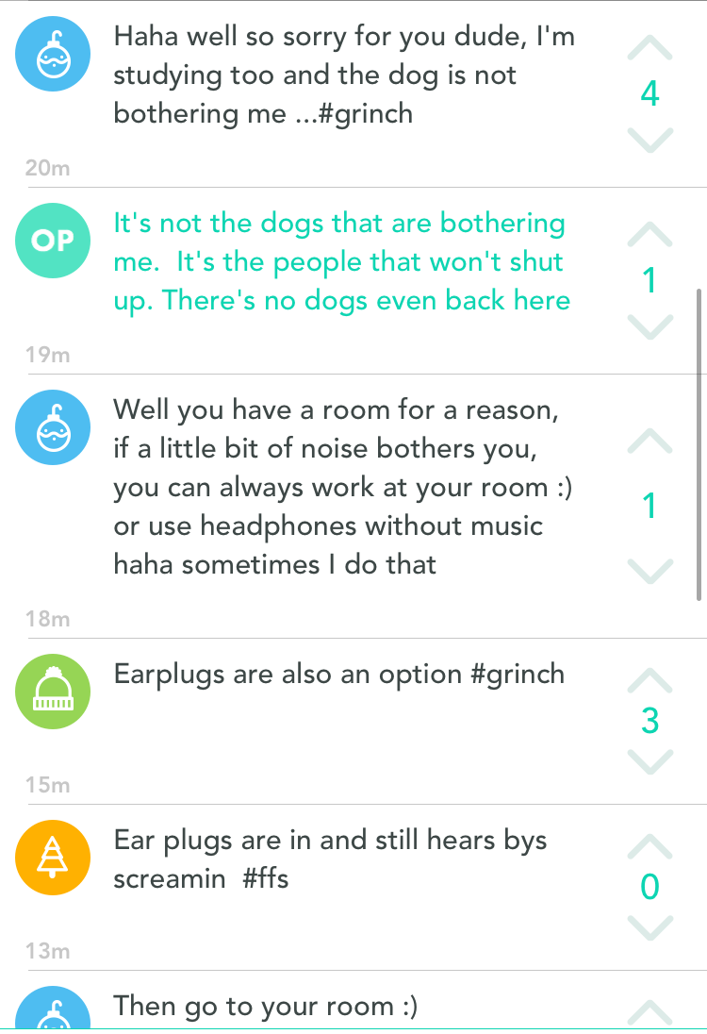
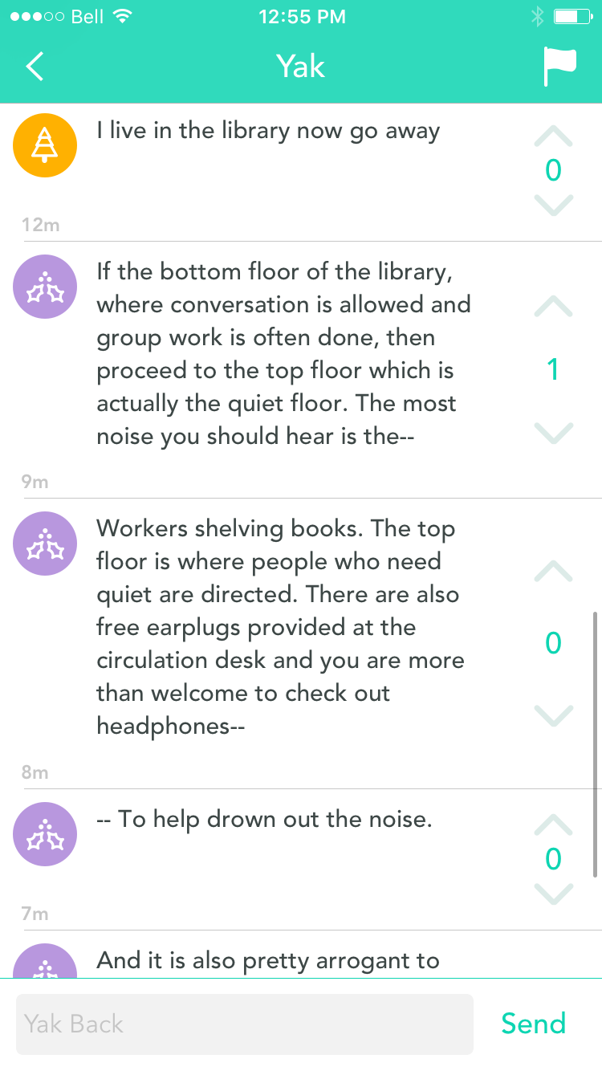
Notes:
What frequently happens with this type of complaint (someone yakking about noise) is a whole comment chain starts with students defending the library, reminding the person of our noise policy (third floor our silent study floor)

Slide 29
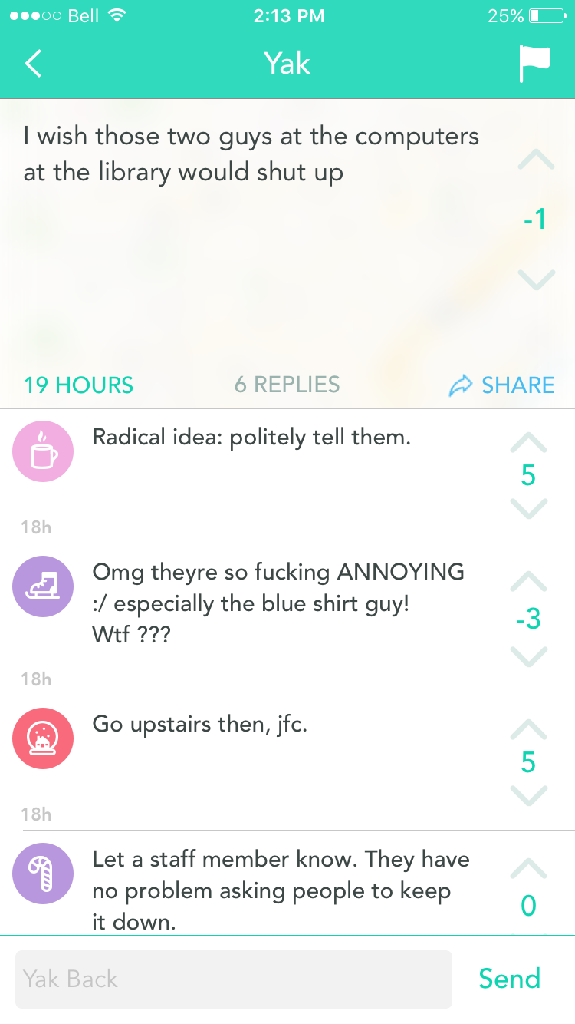
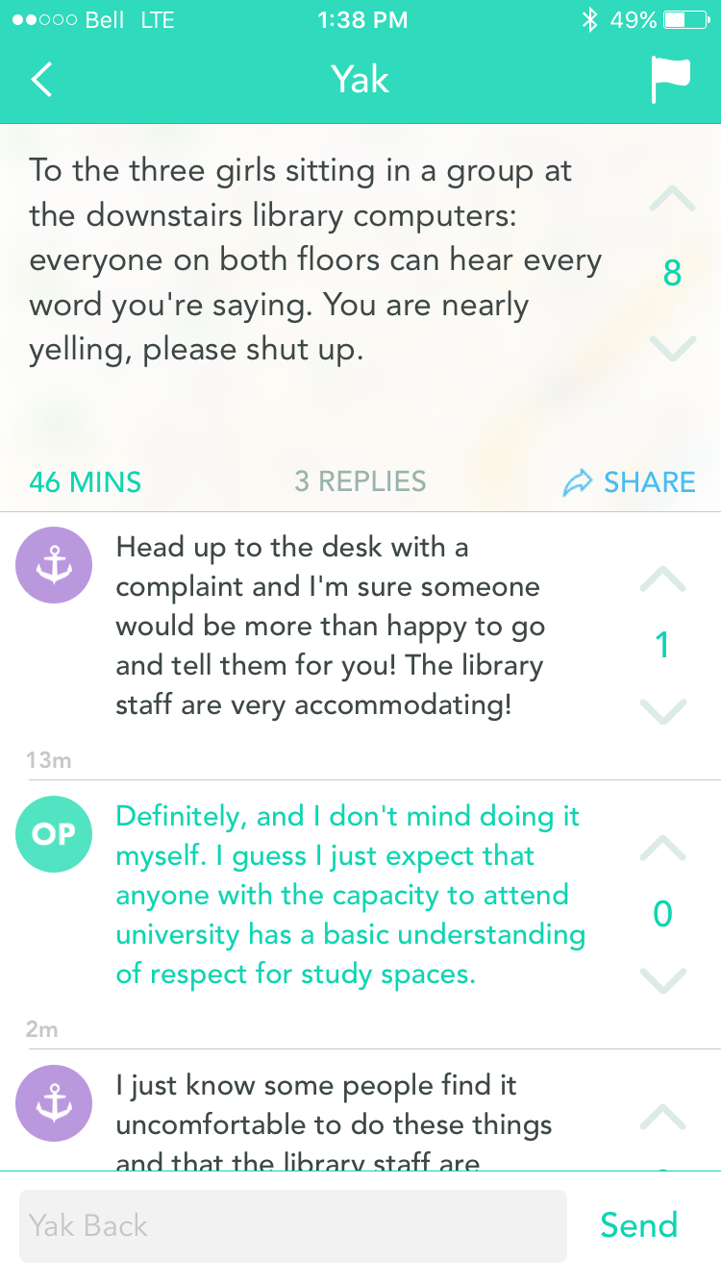
Notes:
sometimes students will suggest going to library staff to resolve it
It was often a good opportunity for us to address noise issues
We would see the Yak and could then try to locate and approach that person (remind them of out rules about cell phones, etc..)

Slide 30
Category #7: Yak Love <3
Notes:
But many of the yaks were also really positive feedback!

Slide 31
Notes:
What students yak about can provide information about what programs or services are really successful with students
For example -They especially love free food
Even took a photo of the dietician’s booth we had at end of semester

Slide 32
Notes:
Positive yak about Super Sunday program

Slide 33
Notes:
They really liked our holiday decorations

Slide 34
Notes:
Lots of yaks about our chocolate easter egg hunt in the stacks

Slide 35
Notes:
Positive yaks about the therapy dog visits

Slide 36
Notes:
Positive yak about the library’s therapy guinea pigs

Slide 37
Notes:
One Yik Yak user was promoting our Happy Lights for us!

Slide 38
Notes:
Positive yaks about specific library staff

Slide 39
Notes:
Positive yaks that can remind you that everything you do is appreciated

Slide 40
What’s everyone Yakkin about you?
Notes:
Now I hope you’re curious to know what everyone’s yakkin about you!
I’d really encourage you to get on Yik Yak and see what your library users are saying about you
It’s a unique way to gain insight into how people are using your library, what they really think of your space, your services, and it gives you a chance to Yak back!

