Slide 1
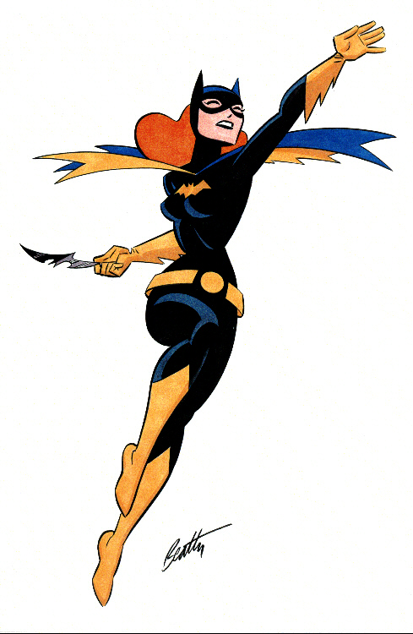
Biff!
Zounds!
Kablam!
or…
How I Started a Graphic Novel Collection at My Academic Library
Crystal Rose
Public Services Librarian
Ferriss Hodgett Library
Memorial University
Notes:
Presented at the Atlantic Provinces Library Association Annual Conference, St. John, NB, May 14, 2010
Contact Info:
Crystal Rose
Public Services Librarian
Grenfell Campus
Memorial University of Newfoundland
crose@grenfell.mun.ca
709-637-2183

Slide 2
What is a graphic novel?
Notes:
Many different definitions for “graphic novel” have been put forward, often by the artists and writers creating them
Alternate terms have been suggested instead: “graphic narratives”, “sequential art”, “graphic literature”, “graphic story"

Slide 3
Let’s start at the very beginning…
Notes:
Q. When did the term “graphic novel” first appear? A. 1970s

Slide 4
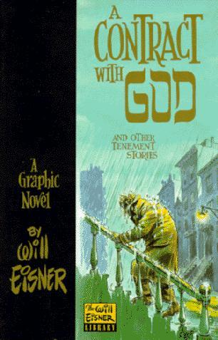
William Eisner’s A Contract with God (1978)
Notes:
The term “Graphic Novel” was popularized by Will Eisner’s 1978 A Contract with God, and Other Tenement Stories
Eisner claims to have come up with the term, but that’s incorrect
A Contract with God is often referred to as “the first graphic novel”, or the first work to describe itself as a graphic novel, but this is also incorrect (other publishers had been using the term)
Why did Eisner use the term “Graphic Novel” instead of “comic book” to describe A Contract with God?
In an interview Eisner said, “I tried to do a book that would physically look like a 'legitimate' book and at the same time write about a subject matter that would never have been addressed in comic form, which is man's relationship with God."
When promoting the book to potential publishers, he says “a little voice inside me said, 'Hey stupid, don't tell him it’s a comic or he'll hang up on you.' So I said, 'It's a graphic novel.'"
Eisner used the term "graphic novel" intentionally, to distinguish it from traditional comic books
What made A Contract with God different?

Slide 5
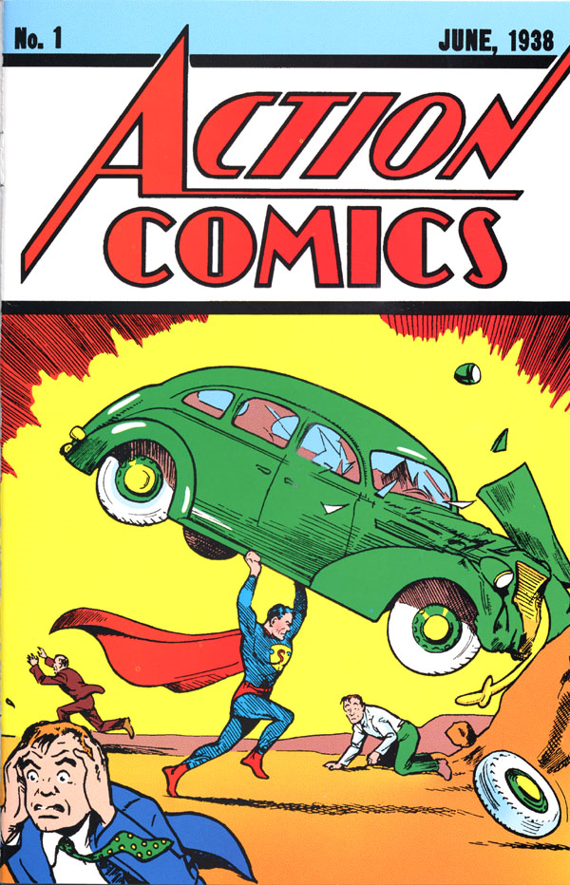
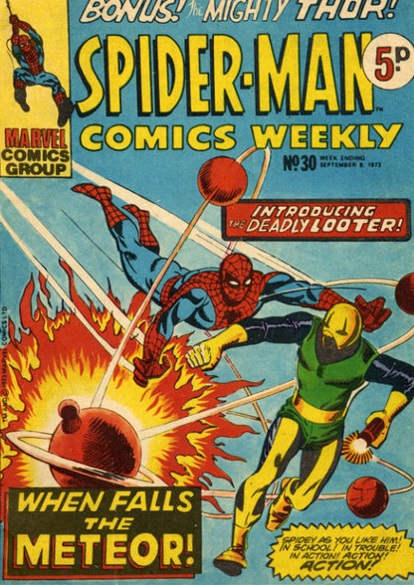
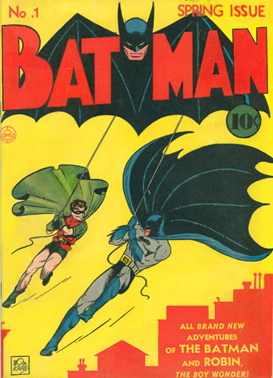
Notes:
To put A Contract with God, and other works from the 70s referring to themselves as graphic novels in context, we need to look at what had been happening in comics in North America prior to that
Comic strips in newspapers (dates back to the early nineteenth century)
Serialized comic books (1930s) dominated by “Superheroes”
This is what a lot of people think of when you say the word “comic”
Main audience was children and teens
The stories, art, and printing were often not great quality
In the 1950s, there was concern about the content of comic books
American psychiatrist, Fredric Wertham's 1954 book Seduction of the Innocent argued that comics were harmful to children and contributed to juvenile delinquency
In the US, in 1954, the Comics Code was instituted which restricted the content of comic books, limiting language, violence, and depictions of crime, sex or drugs

Slide 6
Forbidden!
"excessive violence“
"lurid, unsavory, gruesome illustrations“
vampires, werewolves, ghouls, zombies
"policemen, judges, government officials, and respected institutions ... in such a way as to create disrespect for established authority."
"sex perversion", "sexual abnormalities", "illicit sex relations“, seduction, rape, sadism, masochism
Notes:
Characteristics of traditional comic books:
Content tended to be for kids
Formulaic
Commercial (produced cheaply with sole intention of making a profit)
Copyright of the characters was held by the publishers
Authors/artists were hired by corporations as part of a “work-for-hire” system
Artists literally copying a style or a character, not creating their own original work
“assembly line” production

Slide 7
Notes:
To put A Contract with God, and other works from the 70s referring to themselves as graphic novels in context, we need to look at what had been happening in comics in North America prior to that
Comic strips in newspapers (dates back to the early nineteenth century)
Serialized comic books (1930s) dominated by “Superheroes”
This is what a lot of people think of when you say the word “comic”
Main audience was children and teens
The stories, art, and printing were often not great quality
In the 1950s, there was concern about the content of comic books
American psychiatrist, Fredric Wertham's 1954 book Seduction of the Innocent argued that comics were harmful to children and contributed to juvenile delinquency
In the US, in 1954, the Comics Code was instituted which restricted the content of comic books, limiting language, violence, and depictions of crime, sex or drugs

Slide 8
COMIX
Notes:
Underground comics movement of the late 1960s/early 1970s
Reaction against “Comics”, or more specifically, against the comics code
“comix”- Chosen to set them apart from mainstream comics and the "x" emphasized that many were x-rated
Small press or self-published comic books
Depicted content forbidden by the Comics Code - drugs, sex, violence, language
Some tackled social and political subjects
Comix paved the way for the graphic novel movement of the 1970s

Slide 9
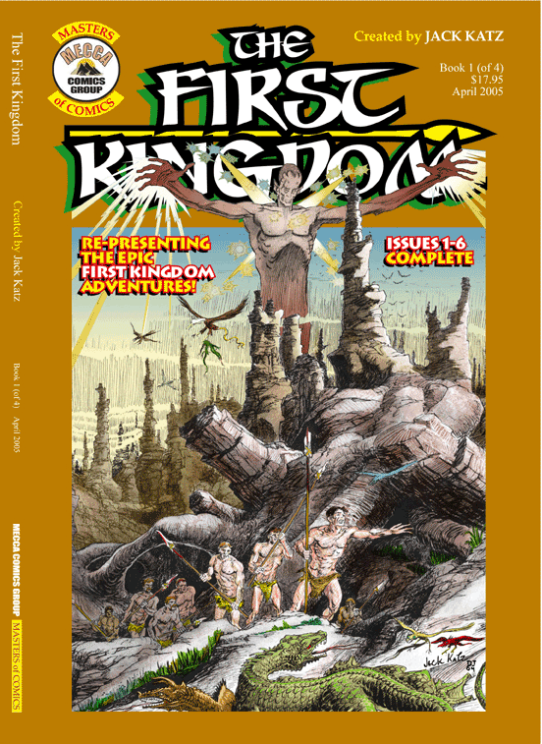
The Sinister House of Secret Love (1972)
The First Kingdom (1978)

Slide 10
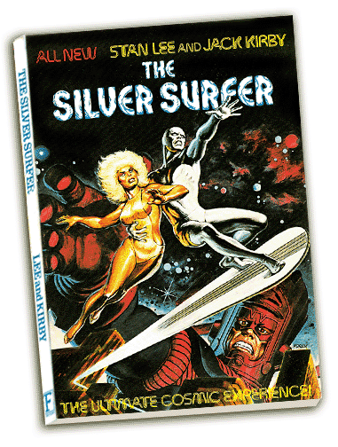
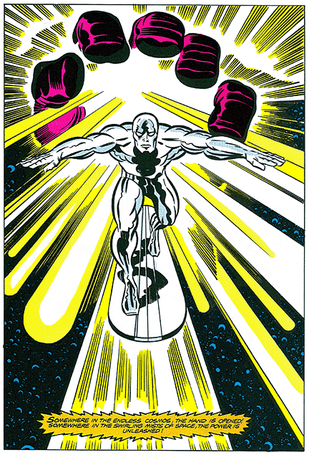
Lee & Kirby's The Silver Surfer (1978)
Notes:
The Silver Surfer began as a character in the 1960s comic Fantastic Four
In 1978, Stan Lee and Jack Kirby collaborated on a “graphic novel”
A self-contained story
100 page paperback
Published by a book publisher (Simon & Schuster/Fireside Books) and distributed through bookstores

Slide 11
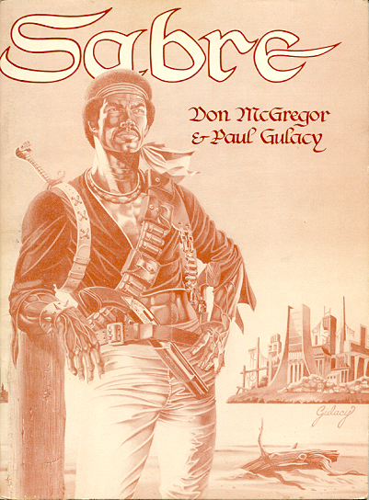
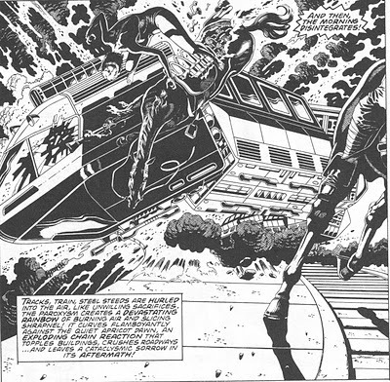
McGregor & Gulacy’s Sabre (1978)
Notes:
A trade paperback published in 1978
Described on the title page as a "comic novel"
Referred to as a "graphic album" by the authors
Set in a futuristic dystopia, and featured violence and homosexuality
Was the first graphic novel that granted full copyright ownership and sales royalties to its creators

Slide 12
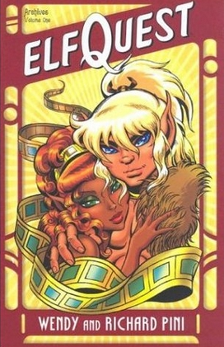
Wendy & Richard Pini’s ElfQuest (1978)
Notes:
First Elfquest story was published in 1978 in an underground comic book Fantasy Quarterly
Authors started their own company and self-published
First creator owned series to receive mass market distribution in mainstream bookstores

Slide 13
William Eisner’s A Contract with God (1978)
Notes:
How was it different?
Set in a Bronx apartment building in the 1930s, about the mainly Jewish tenants
Eisner was Jewish, and the graphic novel is semi-autobiographical (based on his experiences growing up in NY at that time)
Very mature content, complex, dark
Focused on the lives of ordinary people in the real world (not superheroes, fantasy or animal characters)
Dealt with serious and real themes
Opened up the story-telling potential of the genre of comics that hadn’t really been explored yet
Marketed to adults and sold in bookstores
May not have been “the first graphic novel”, but it was the first extremely popular, well-known graphic novel
Arguably the work that was responsible for getting the term out there in people’s consciousness

Slide 14
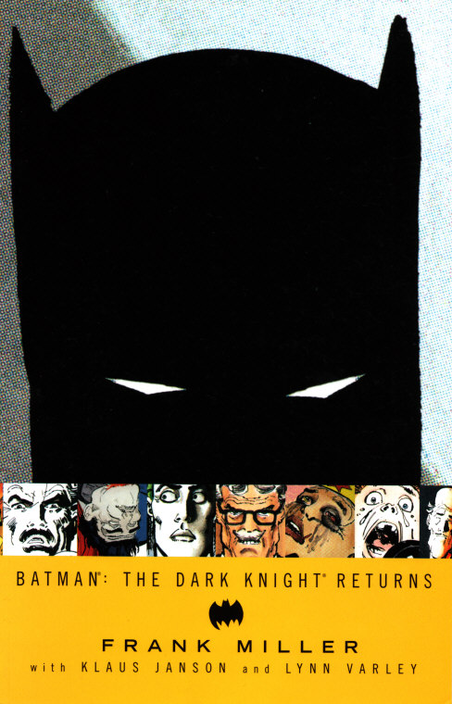
1986: A Good Year
Notes:
1986 saw the publication of 3 landmark graphic novels: Art Spiegelman’s Maus, Alan Moore’s The Watchmen, and
Frank Miller’s Batman: The Dark Knight Returns

Slide 15
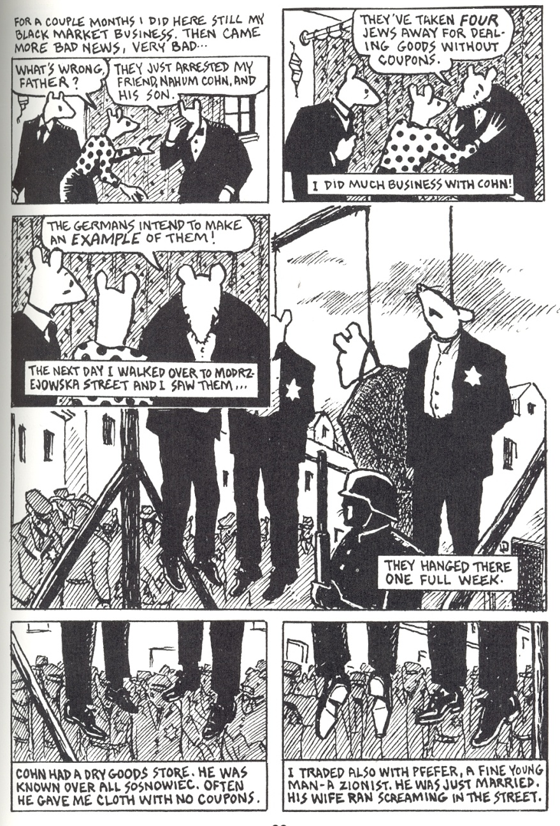
Art Spiegelman’s Maus (1986)
Notes:
Brilliantly told story of the Holocaust, where the Jews are depicted as mice, and the Nazis depicted as cats
Word maus is German for “mouse”
Spiegelman won the Pulitzer Prize for Maus
Single-handedly because of Maus, that graphic novels as a genre begin to gain critical recognition
Maus had literary value (nominated for several literary awards), historical value, and, for the first time, an issue like the holocaust was done using a “comics” format
Like A Contract with God, Maus was self-published
He is another artist who doesn’t quite know what to make of the term. Prefers ''comic book that needs a bookmark”

Slide 16
Characteristics of the Graphic Novel
Adult
Literary
Typically a self-contained story, or a limited number of volumes that have a story arc
Not a continuous, infinite run of issues
Typically written and drawn by the same person
Writers and artists hold the copyright
Format – physically like a book

Slide 17
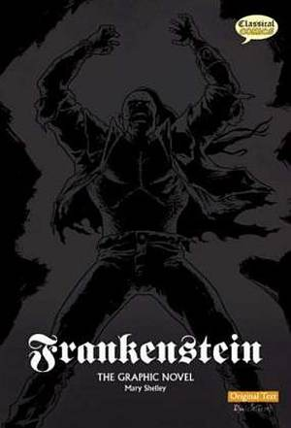
Frankenstein
Notes:
Many classic novels and plays have been turned into graphic novels
Relevant and useful for an academic library collection
Requested by faculty
Be careful! Many don’t use the actual text from the original works!
Avoid “quick text version”, or “updated text”, or “modernized text”

Slide 18
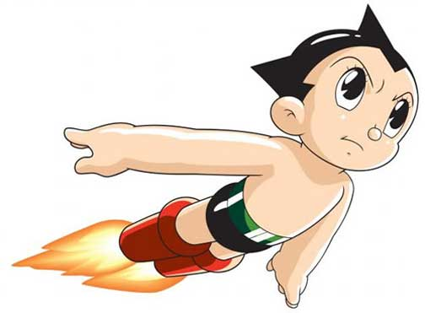
MANGA
Notes:
Manga are Japanese comics and graphic novels
Have a very different history than North American Comics (different conventions, different types of stories)
Main difficulty with Manga is there aren’t many self contained, 1 volume stories
A typical Manga series can be 20-30 volumes and up
One solution: Secondary sources about Manga and Manga anthologies
Another difficulty is that some of the important, classic Manga has never been translated to English and published in North America, or if it had been is no longer in print
Difficulty finding certain titles
Purchased several series second-hand

Slide 19
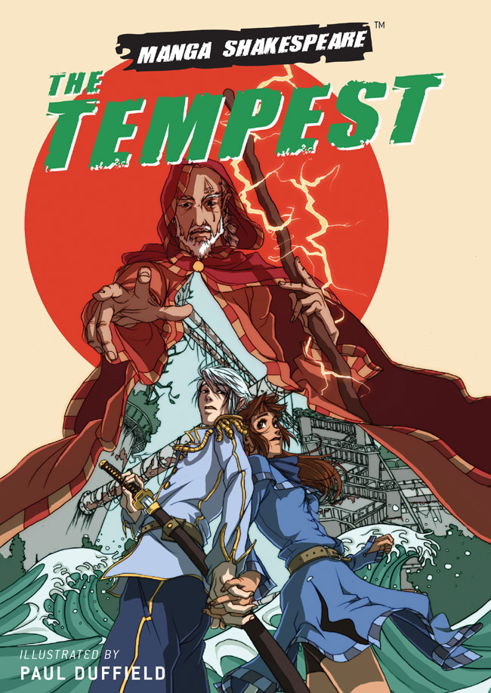
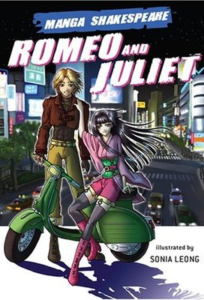
Manga Shakespeare

Slide 20
Why have a graphic novel collection?!

Slide 21
Journals
Journal of Graphic Novels & Comics
The Comics Journal
ImageTexT: Interdisciplinary Comic Studies
Studies in Comics
SIGNs: Studies in Graphic Narratives
Mechademia
Image [&] Narrative
The Believer
Notes:
To consider – Does my library have secondary sources about graphic novels and manga?
There are peer-reviewed and non-peer reviewed journals about comics and graphic novels, plus thousands of articles about in peer-reviewed English journals, Pop Culture journals, Art journals, etc.
Numerous scholarly books

Slide 22
Notes:
Some universities have citation guides for scholarly writing about graphic novels (Northern Kentucky University)
The new 2009 edition of the MLA Handbook for Writers of Research Papers (7th ed.) even included an entire section on how to cite graphic novels: 5.5.12. An Illustrated Book or a Graphic Narrative

Slide 23
“It is no longer necessary to prove the worthiness and literary potential of the medium of comics.”
Chute, Hilary, and Marianne DeKevon. “Graphic
Narrative.” MFS Modern Fiction Studies 52.4 (2006): 767-82. Print.
Notes:
Graphic novels are still in their infancy
A new genre, with a lot of unexplored potential
What's unique about them is that they are images that create a narrative either on their own, or when combined with text
The text on its own looses something or is entirely different, even incomprehensible, without the images
This combination creates a whole that’s greater than the sum of its parts
Graphic novels have been referred to as an entirely new medium

Slide 24
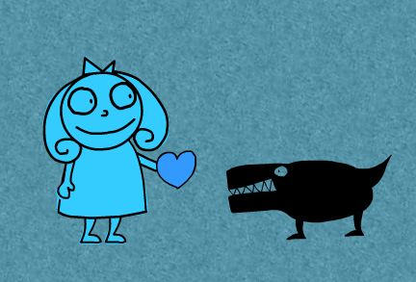
Faculty Collaboration
Notes:
I sent emails to each faculty who I thought would be particularly interested (Visual Art, English, Social/Cultural Studies) and received an excellent response
Faculty members excited and interested, and sent me suggestions for titles and authors
Were already incorporating graphic novels into their courses: English, Social/Cultural Studies, Folklore

Slide 25
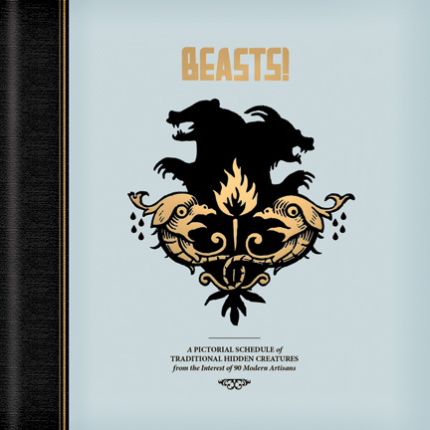
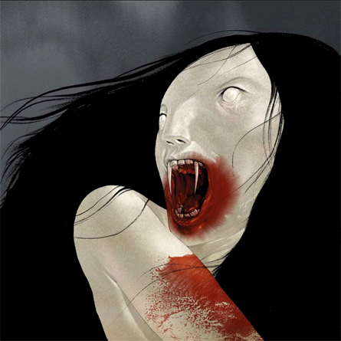
Jacob Covey’s Beasts (2009)
Notes:
A Folklore Professor teaching Supernatural Folklore used the 2-volume Beasts by Jacob Covey in his class
Beasts - An anthology of supernatural beings, only creatures that were thought at one time to actually exist, based on actual folklore
Many of the “beasts” were ones being studied in that class

Slide 26
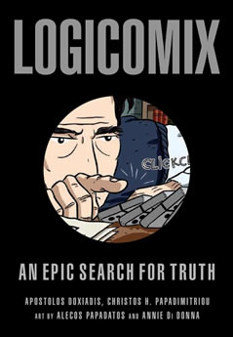
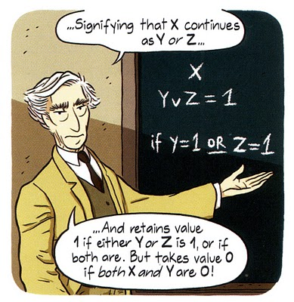
Logicomix (2009)
Notes:
Math Professor using Logicomix in one of his classes
Logicomix - A non-fiction book about the history of mathematics

Slide 27
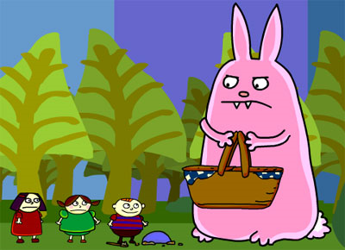
Selecting titles
Notes:
Annual Graphic Novel awards: Reubens, Eisners, Harveys, and Canadian Doug Wright Awards
Associations (like ALA) put out annual lists of “Great Graphic Novels” as do publications like Quill & Quire, Booklist
They also include regular reviews of Graphic Novels
Suggestion box in the library
Include Canadian Graphic Novels
Considering multi-volume Graphic Novels. How many do you buy? I have purchased complete series for some (Sandman, Sin City, Love & Rockets)
Because I was just starting the collection, I thought it was best to have as many different artists represented as possible, so for other series I’ve started by purchasing just the 1st volume, with the intention of purchasing additional volumes later

Slide 28
Cataloguing Graphic Novels
Comic Books, Strips, etc.
Caricatures and cartoons
Cartoons and comics
Stories without words
Graphic Novels
Notes:
Another challenge frequently encountered by libraries is cataloguing graphic novels
Range of different LC subject headings being used:
Comic Books, Strips, etc.
Caricatures and cartoons
Cartoons and comics
Stories without words
Graphic Novels
Solution: Cataloguing department at Memorial added 655 field - Genre/Form to each record and listed Genre/Form as “Graphic Novel”

Slide 29
Displays
Notes:
Because of LC classification they are not all shelved together
Students want to browse this collection particularly
Mostly in PN 6727-6790, but non-fiction are not (Maus is under D 810 for Holocaust)
Others with art books in the Ns
Solution: Displays!
Pull them from different sections and display them together
When I had a class come to the library, I pulled the graphic novels for them and placed them on carts

Slide 30
Promotion
Notes:
Since we had never had graphic novels in the library before, if we just bought them and put them in the bookstacks, how would anybody know about them?
Important to advertise outside the library, to potentially attract people who may not be heavy users of the library
Designed a poster and put them up around campus, and as part of in-library displays
Created to look like a graphic novel cover - eye-catching, used recognizable characters, and only characters from graphic novels library owned

Slide 31
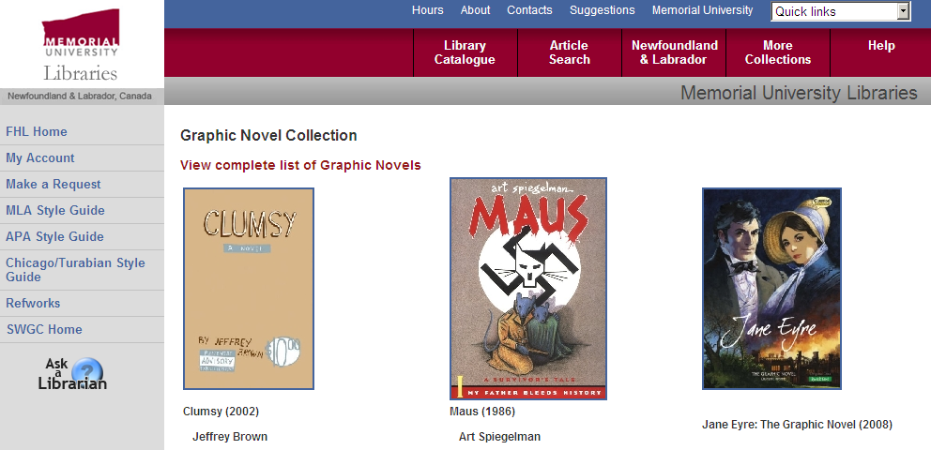
Library’s Graphic Novel page
What a delicious webpage
Notes:
“Featured graphic novels” (similar to book store website) change about every month or two
Link “View complete list of graphic novels” - Canned OPAC search with subject search string “comic books or graphic novels or stories without words or caricatures or cartoons or comics”
Suggestions are welcome!

Slide 32
What’s all this going to cost, anyway?

Slide 33
Stats
average price: $20.16
87% have circulated at least once
65% have circulated more than once
Notes:
Initially allocated $500 of the general book buying budget
Our budget is broken down into subject areas, so the funds were coming from English, Visual Art, or other areas depending on the call number
Now we have an actual “graphic novel” fund category
The average price of the graphic novels we’ve purchased is $20.16
However, I had been purchasing paperbacks, and I’ve found that several have terrible binding and almost instantly started to fall apart. We have had to send them to get bound which adds slightly to cost
Decided to start only purchasing hardcover when available
Still very affordable compared to the prices of other academic books
Common concern: Theft
We have not had a single theft
They aren’t particularly expensive, so not something to be overly concerned about
87% have circulated at least once
65% have circulated more than once
Combine with the low cost, you get a lot of bang for your buck!

Slide 34
Amy Winfrey’s Big Bunny: www.big-bunny.com
Amy Winfrey’s Making Fiends: www.makingfiends.com
Notes:
My little friends who helped with the presentation, courtesy of animator Amy Winfrey. Check out her websites!

Slide 35
Bibliography
Badman, Derik A. “Comics Studies: Resources for Scholarly Research.” College & Research Libraries News 70.10 (2009): 570-573. Print.
Baetens, Jan. “Graphic Novels: Literature Without Text?” English Language Notes 46.2 (Fall/Winter 2008): 77-88. Humanities International Complete. Web.
Bowman, Michael, Christine N. Paschild, and Kimberly Wilson-St. Clair. “How the Dark Horse Came In: Portland State University Library Acquires Dark Horse Comics Archives.” College & Research Libraries News 70.10 (2009): 570-573. Print.
Chute, Hilary, and Marianne DeKevon. “Graphic Narrative.” MFS Modern Fiction Studies 52.4 (2006): 767-82. Print.
Danky, James, and Denis Kitchen. Underground Classics: The Transformation of Comics into Comix. New York: Abrams, 2009. Print.

Slide 36
Bibliography
Drucker, Johanna. “What is Graphic About Graphic Novels?” English Language Notes 46.2 (Fall/Winter 2008): 39-55. Humanities International Complete. Web.
Eisner, Will. Comics & Sequential Art: Principles and Practices from the Legendary Cartoonist. New York: W.W. Norton, 2008. Print.
Gluibizzi, Amanda. “The Aesthetics and Academic s of Graphic Novels and Comics.” Art Documentation 26.1 (2007): 28-30. WilsonOmnifile. Web.
McCloud, Scott. Understanding Comics. New York: HarperPerennial, 1994. Print.
Meskin, Aaron. “Defining Comics?” The Journal of Aesthetics and Art Criticism 65.4 (Fall 2007): 369-379. Academic Search Premier. Web.

Slide 37
Bibliography
Nyberg, Amy Kiste. Seal of Approval: The History of the Comics Code. Jackson, Miss.: University Press of Mississippi, 1998. Print.
O’English, Lorena, Gregory Matthews, and Elizabeth Blakesley Lindsay. “Graphic Novels in Academic Libraries: From Maus to Manga and Beyond.” The Journal of Academic Librarianship 32.2 (2006): 173-182. WilsonOmnifile. Web.
Rosenkranz, Patrick. Rebel Visions: The Underground Comix Revolution, 1963-1975. Seattle: Fantagraphics Books, 2002. Print.
Weiner, Stephen. Faster than a Speeding Bullet: The Rise of the Graphic Novel. New York: NBM, 2003. Print.
Wolk, Douglas. Reading Comics: How Graphic Novels Work and What They Mean. New York: Da Capo Press, 2007. Print.

