Slide 1
Promiscuous Research: High Visibility for your Publications
Lisa Goddard
Scholarly Communications Librarian
March 21, 2014
Faculty of Business Administration, Memorial University

Slide 2
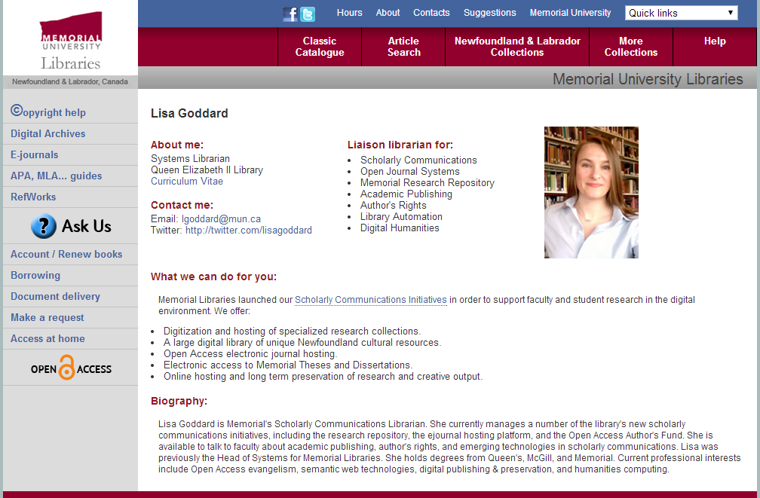

Slide 3
Social Media
Notes:
Social networks are acting as trusted recommender systems, but gated links are less likely to be shared in forums where many readers will not be able to gain access.

Slide 4
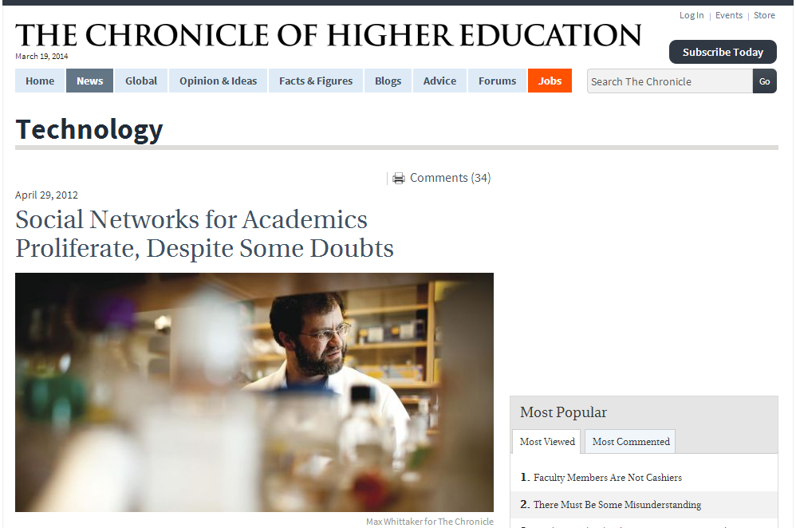
Notes:
https://chronicle.com/article/Social-Networks-for-Academics/131726/

Slide 5
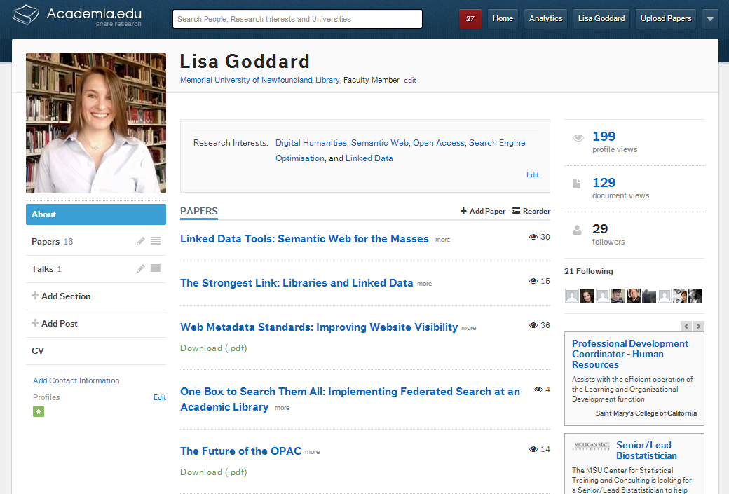
Notes:
http://academia.edu

Slide 6
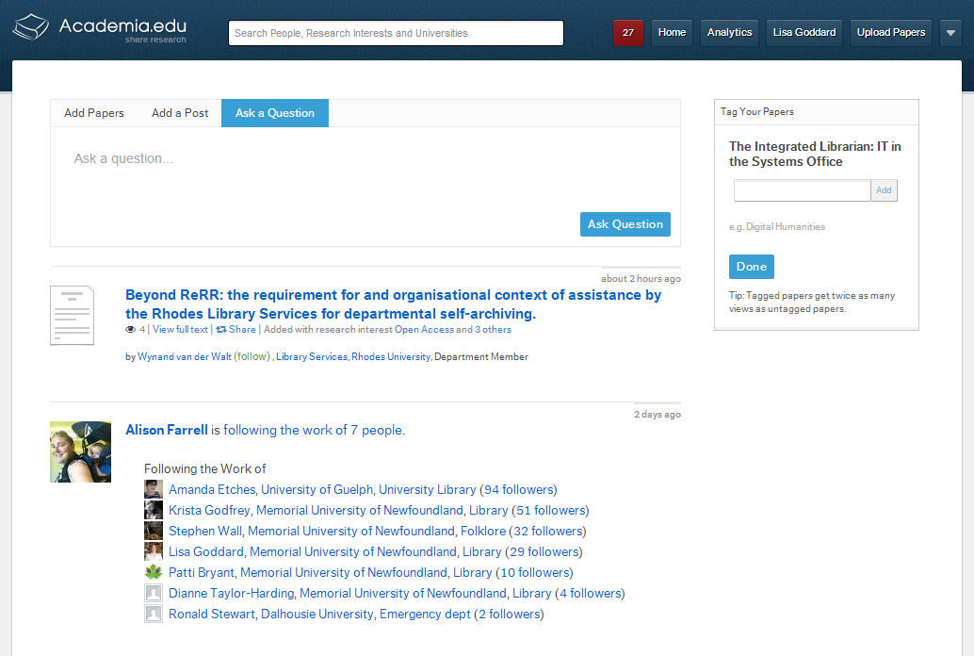
Notes:
Social and recommender system.

Slide 7
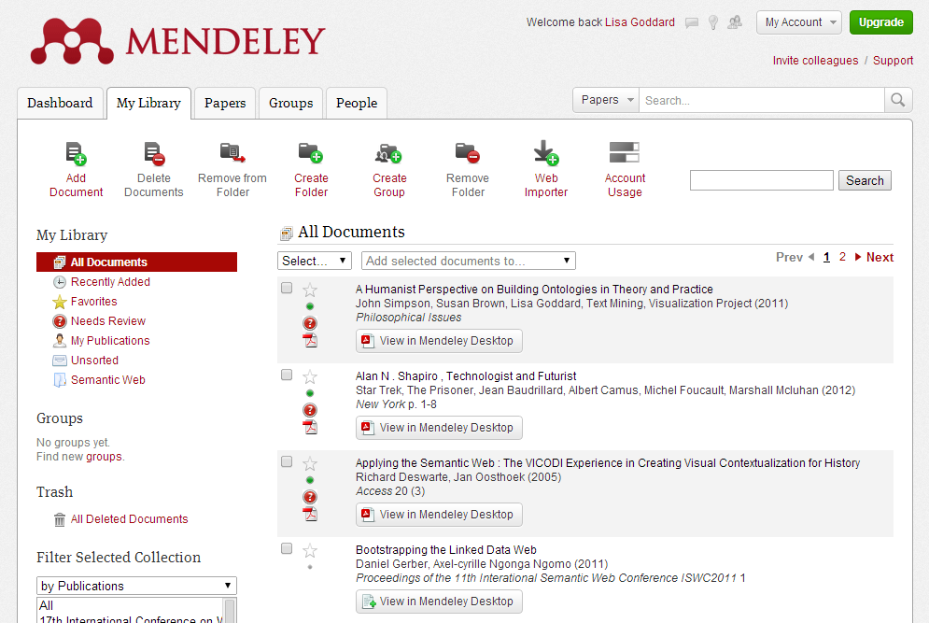
Notes:
http://www.mendeley.com

Slide 8
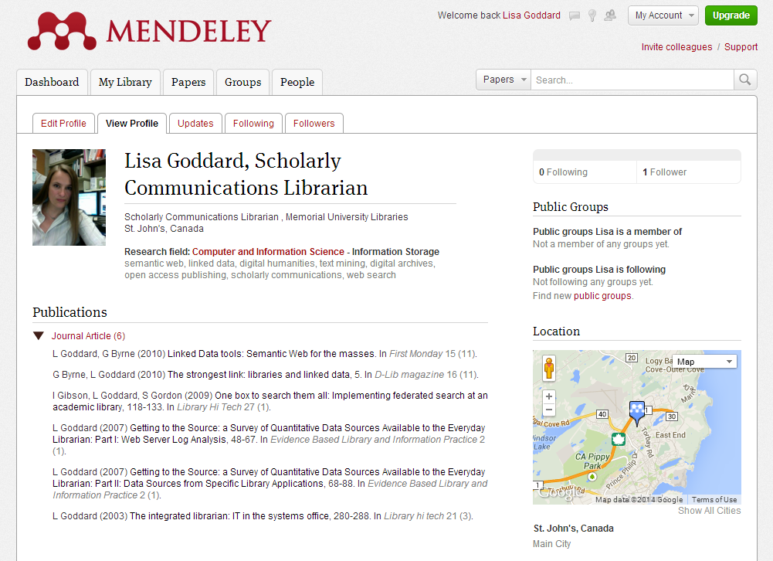

Slide 9
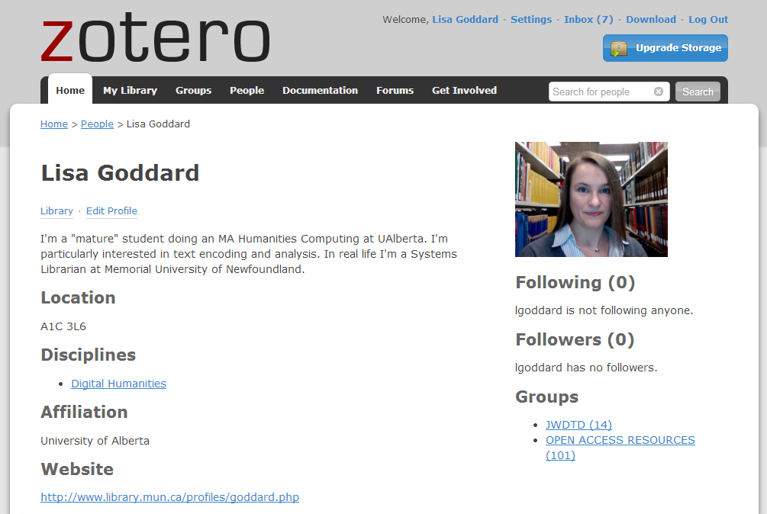
Notes:
https://www.zotero.org/

Slide 10
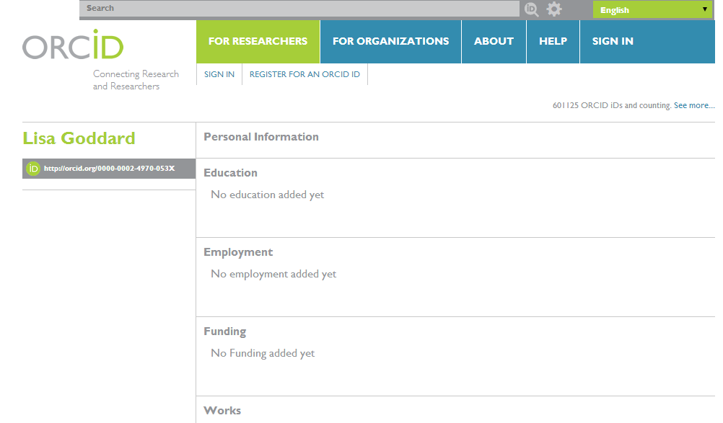
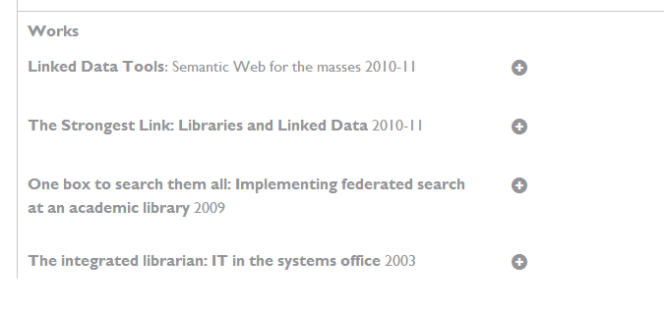
http://orcid.org/0000-0002-4970-053X
Notes:
http://orcid.org

Slide 11
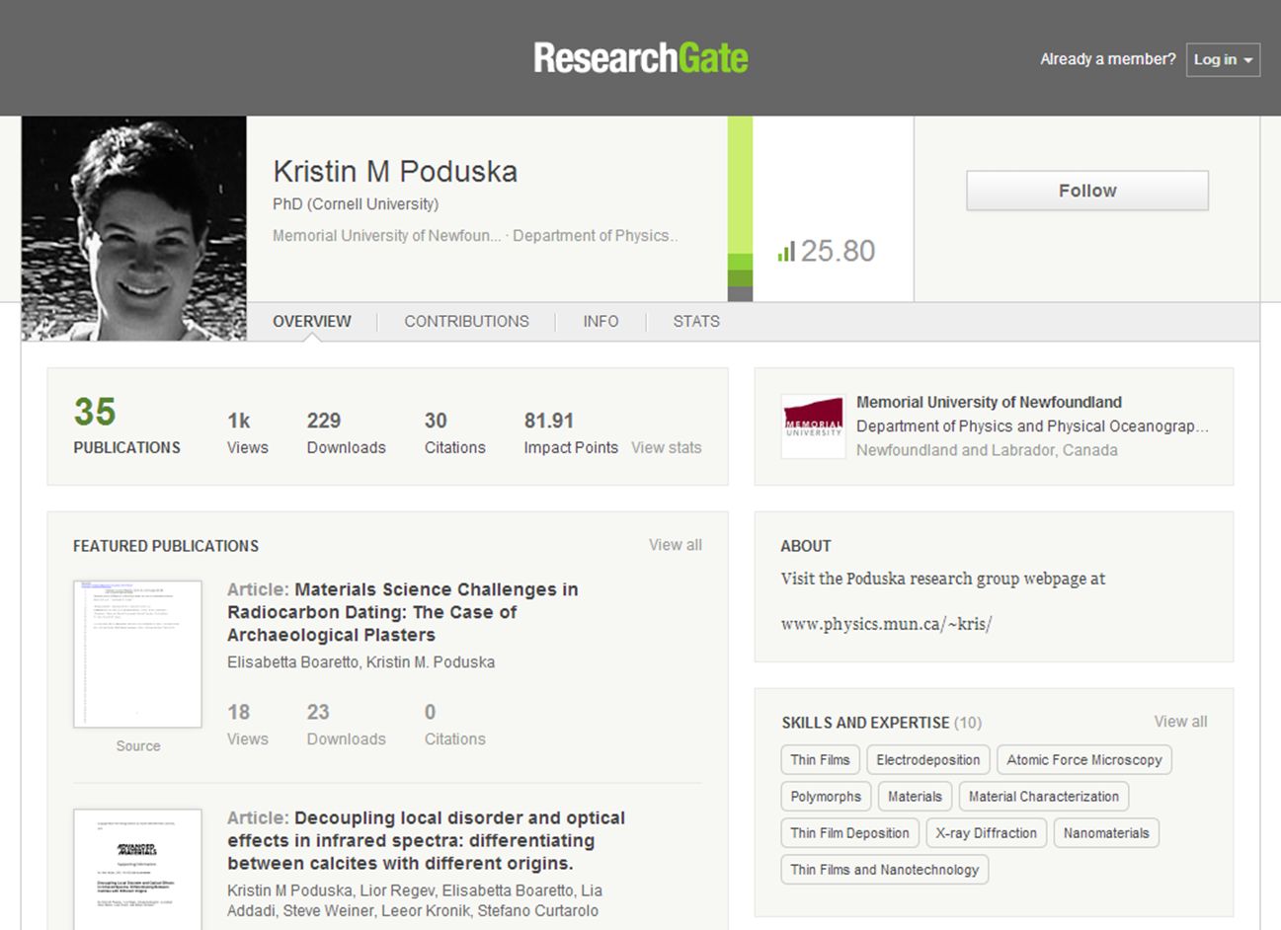
Notes:
http://researchgate.net

Slide 12
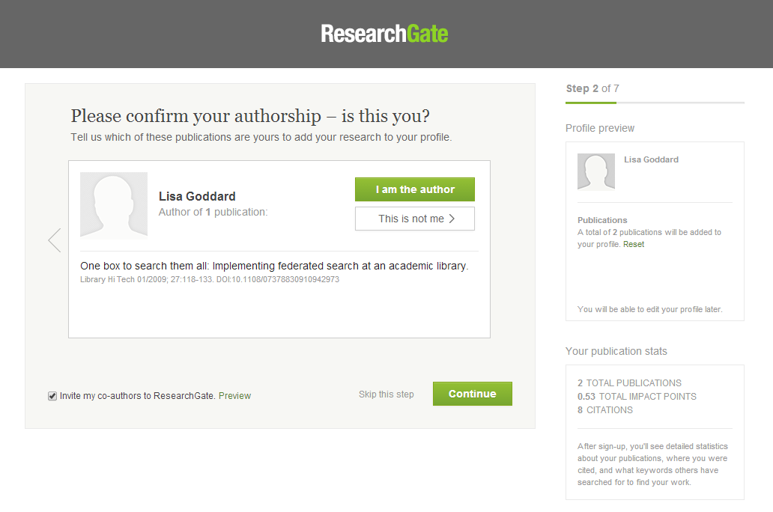

Slide 13
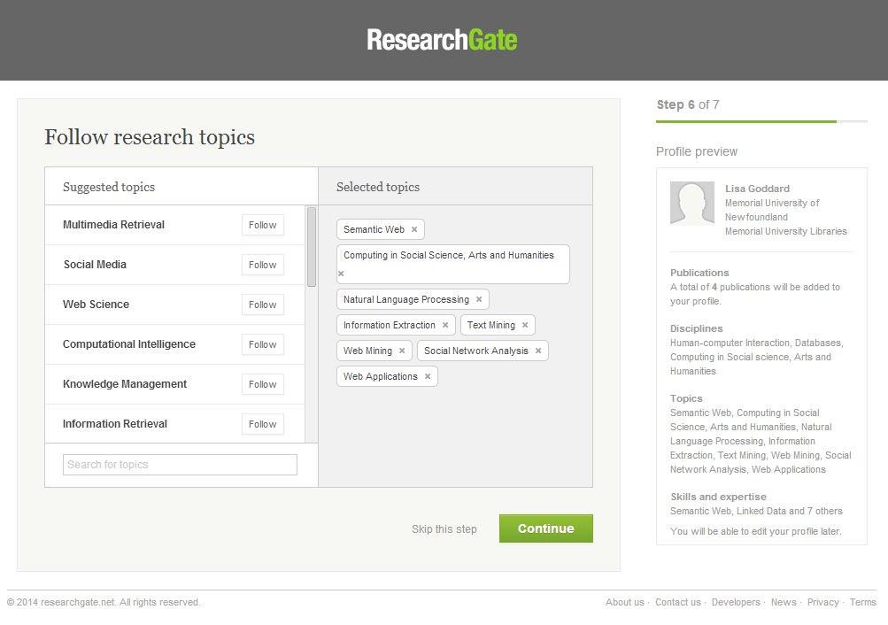

Slide 14
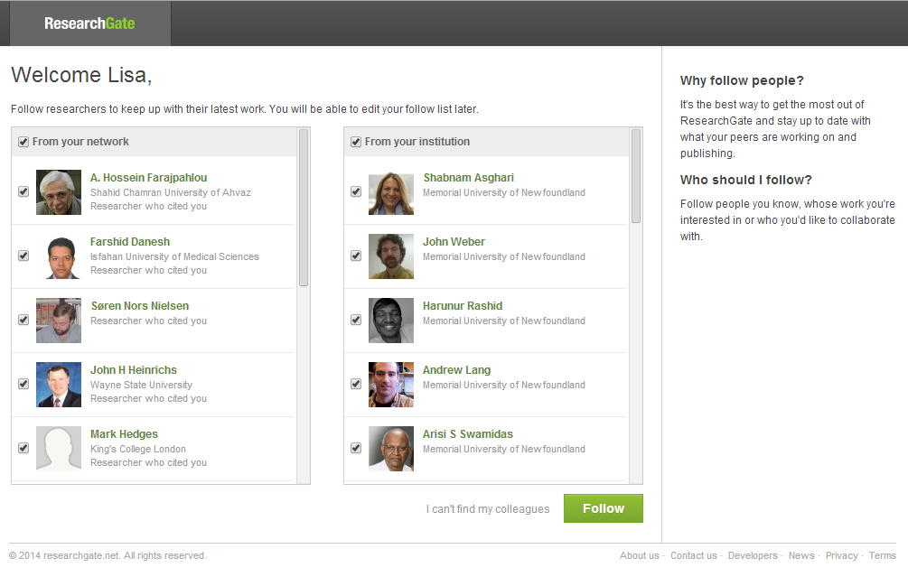

Slide 15
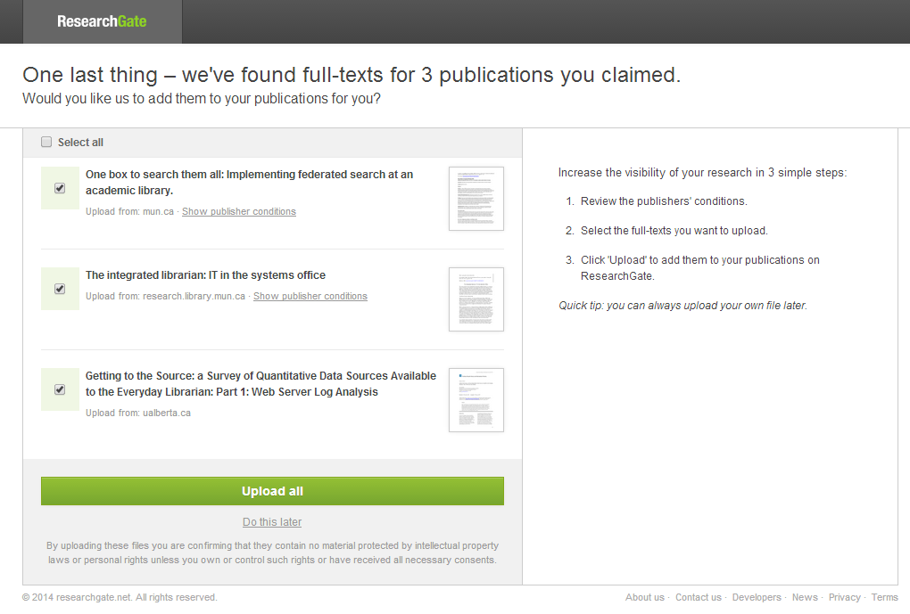

Slide 16
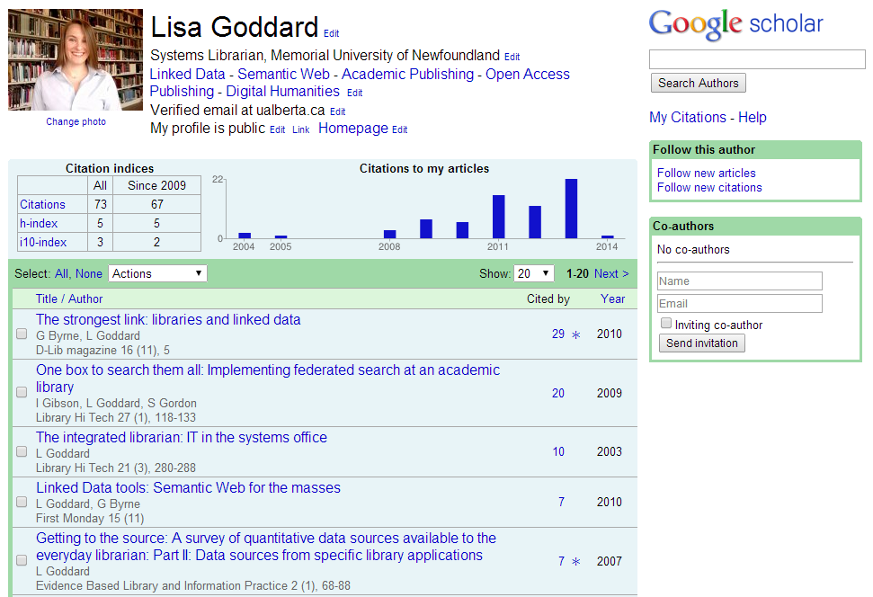
Notes:
http://scholar.google.ca/ - go to “my citations” at the top of the page.

Slide 17
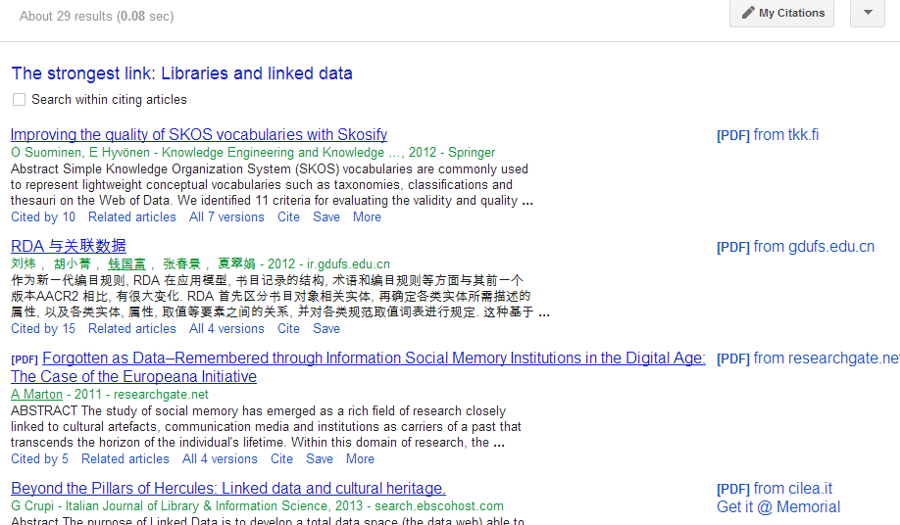

Slide 18
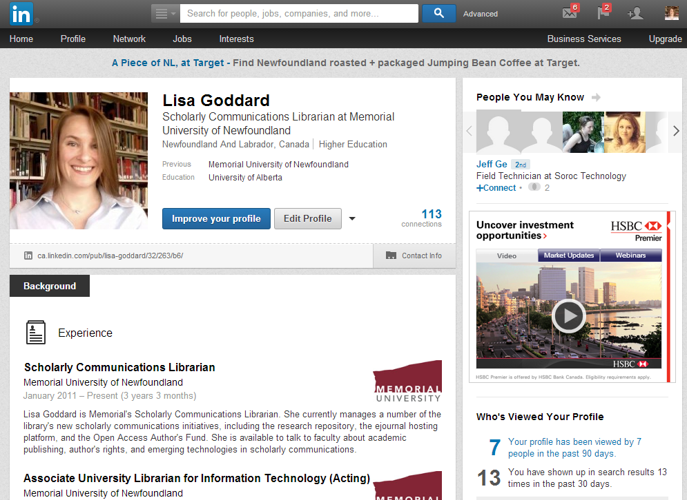

Slide 19
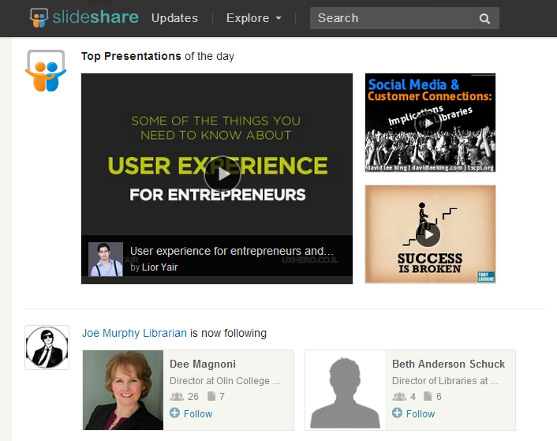

Slide 20
Why Bother?

Slide 21
Search Engine Visibility
https://www.google.ca/search?q=Lisa+Goddard+library

Slide 22
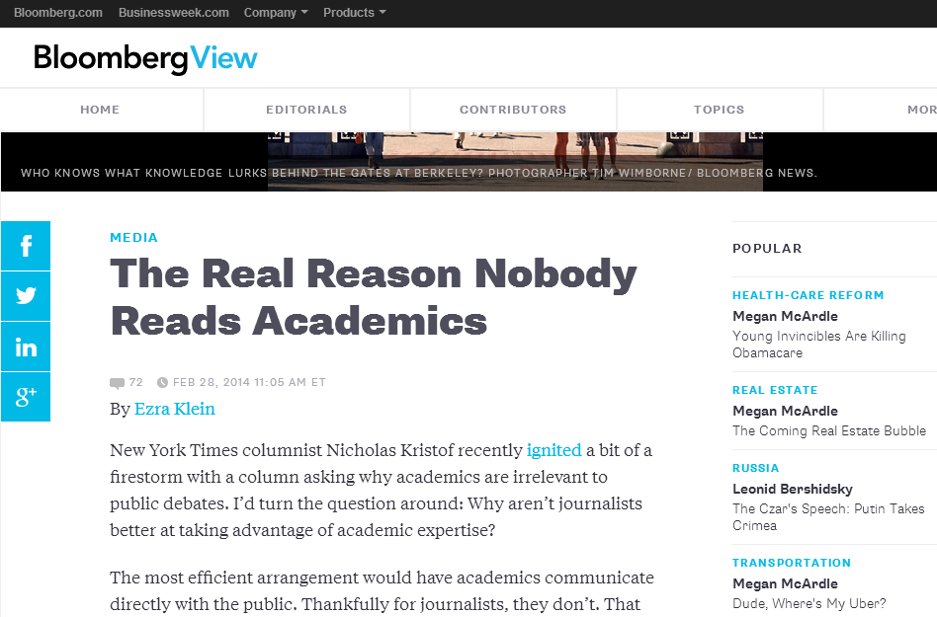
Notes:
http://www.bloombergview.com/articles/2014-02-28/the-real-reason-nobody-reads-academics

Slide 23
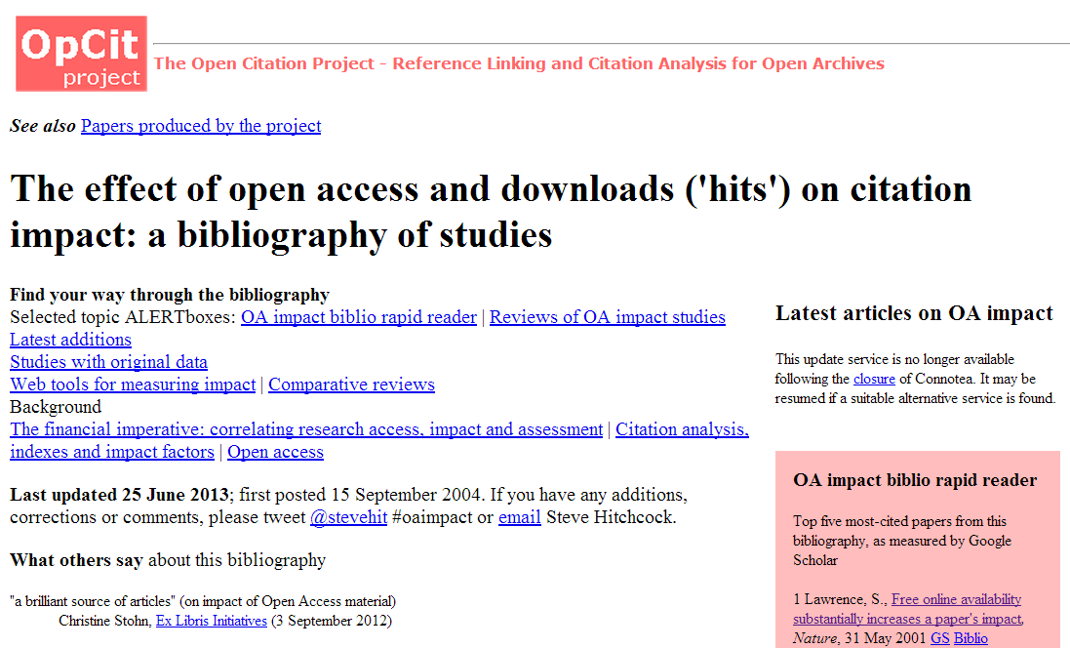
Notes:
http://opcit.eprints.org/oacitation-biblio.html

Slide 24
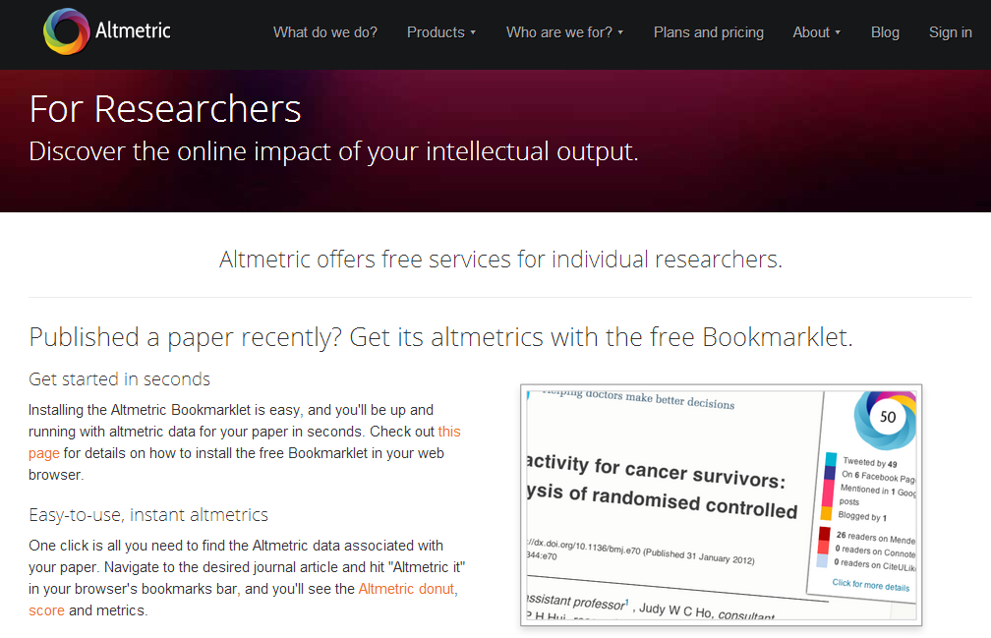
Notes:
http://www.altmetric.com/researchers.php

Slide 25
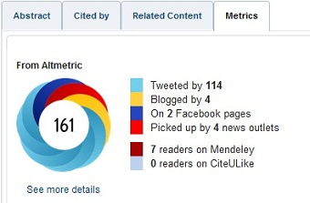
Altmetrics Badge

Slide 26
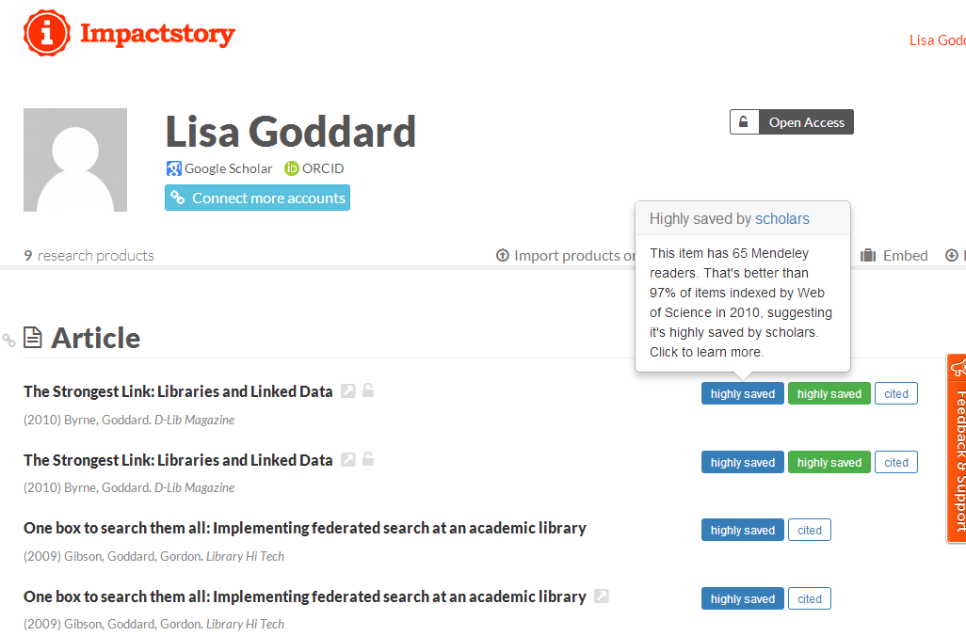

Slide 27
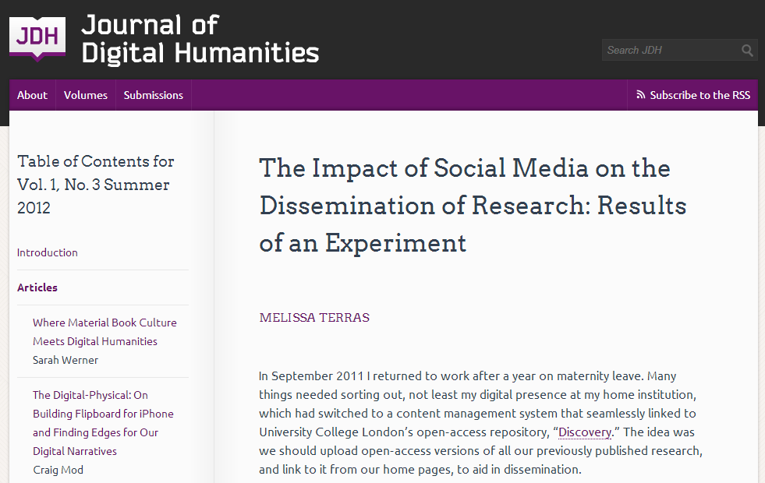
Notes:
http://journalofdigitalhumanities.org/1-3/the-impact-of-social-media-on-the-dissemination-of-research-by-melissa-terras/

Slide 29
What could possibly go wrong?

Slide 30
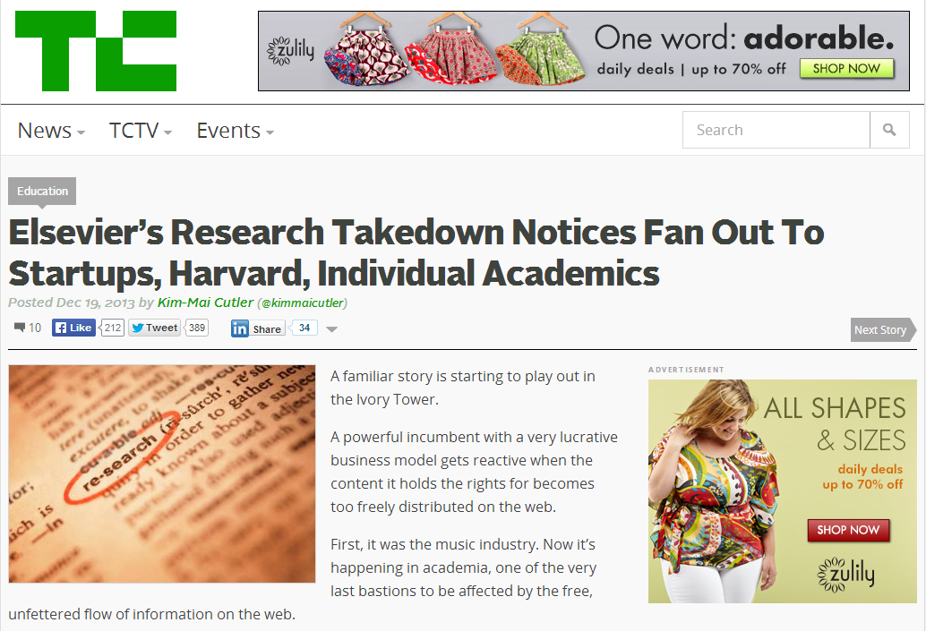
Notes:
http://techcrunch.com/2013/12/19/elsevier/

Slide 31
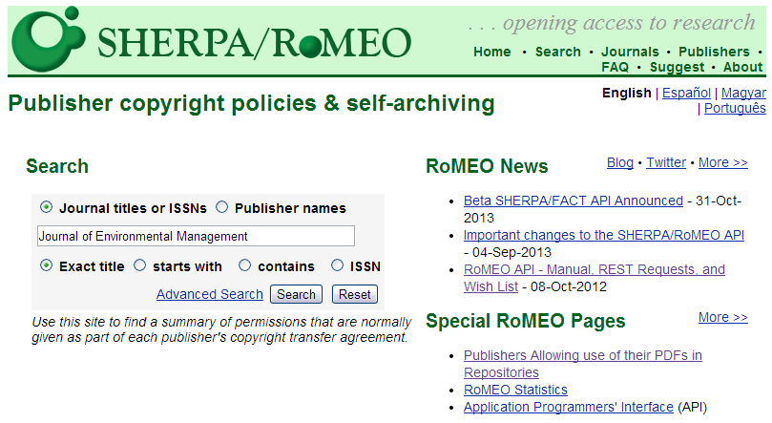
Publisher Archiving Policies
Notes:
What are the publisher’s copyright and archiving policies?
Even though OA repositories exist, you have have to obtain permission to do so if you’ve published in a traditional journal. Your archiving MUST be legal. I.E. you can’t just do this on a whim. That being said, “most journals (now about 70%) already allow postprint archiving.” http://www.earlham.edu/~peters/fos/overview.htm
Keep in mind that “Authors need no permission for preprint archiving. When they have finished writing the preprint, they still hold copyright. If a journal refuses to consider articles that have circulated as preprints, that is an optional journal-submission policy, not a requirement of copyright law. (Some journals do hold this policy, called the Ingelfinger Rule, though it seems to be in decline, especially in fields outside medicine.)”
The key is to know our rights as a researcher and SHERPARoMEO is the ideal source for this kind of information. It is a searchable database of publisher's copyright & archiving policies. Each entry provides a summary of the publisher's policy, including what version of an article can be deposited, where it can be deposited, and any conditions that are attached to that deposit. http://www.sherpa.ac.uk/romeo/romeofaq.html
ROMEO covers peer-reviewed journals and serials, provided by feeds from the British Library service Zetoc, Entrez and DOAJ.
Participation: “…the inability to convince 100 per cent of authors to self-archive 100 percent of their articles” (Jacobs 31)

Slide 32
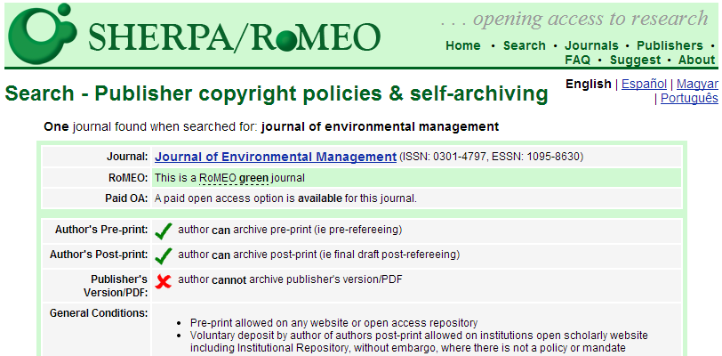
Publisher Archiving Policies
Notes:
What are the publisher’s copyright and archiving policies?
Even though OA repositories exist, you have have to obtain permission to do so if you’ve published in a traditional journal. Your archiving MUST be legal. I.E. you can’t just do this on a whim. That being said, “most journals (now about 70%) already allow postprint archiving.” http://www.earlham.edu/~peters/fos/overview.htm
Keep in mind that “Authors need no permission for preprint archiving. When they have finished writing the preprint, they still hold copyright. If a journal refuses to consider articles that have circulated as preprints, that is an optional journal-submission policy, not a requirement of copyright law. (Some journals do hold this policy, called the Ingelfinger Rule, though it seems to be in decline, especially in fields outside medicine.)”
The key is to know our rights as a researcher and SHERPARoMEO is the ideal source for this kind of information. It is a searchable database of publisher's copyright & archiving policies. Each entry provides a summary of the publisher's policy, including what version of an article can be deposited, where it can be deposited, and any conditions that are attached to that deposit. http://www.sherpa.ac.uk/romeo/romeofaq.html
ROMEO covers peer-reviewed journals and serials, provided by feeds from the British Library service Zetoc, Entrez and DOAJ.
Participation: “…the inability to convince 100 per cent of authors to self-archive 100 percent of their articles” (Jacobs 31)

Slide 33
Save your Post-prints
Post peer-review
Final Word Doc
Same content as published article
No publisher layout or branding

Slide 34
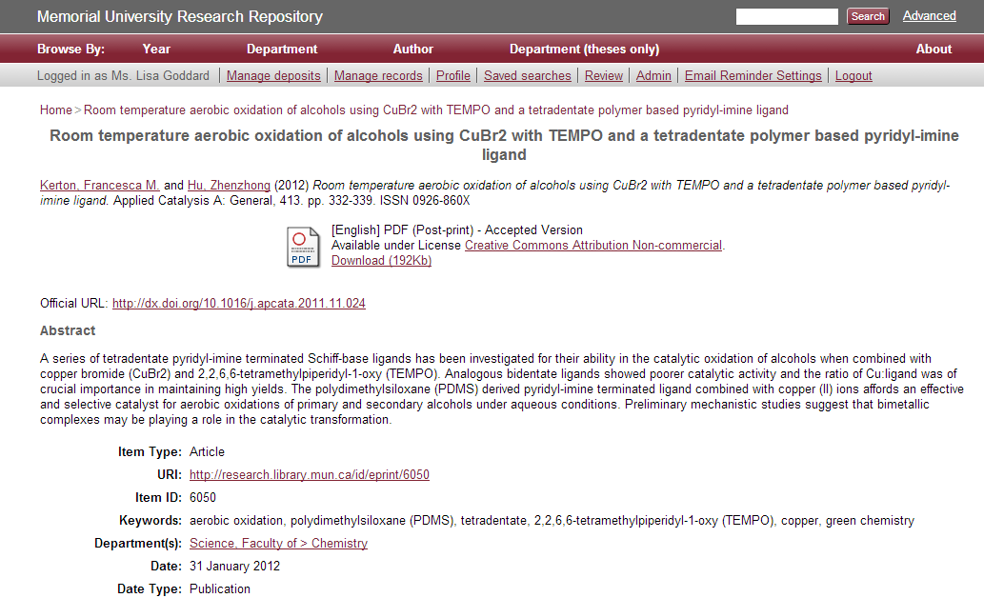
Library Rights Checking Service.

Slide 35
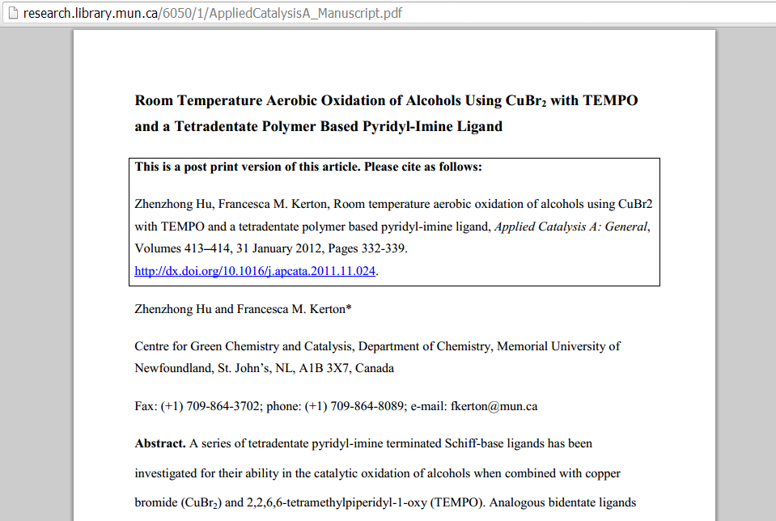

Slide 36
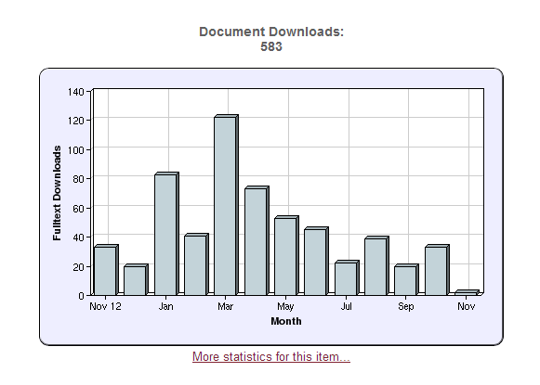
Statistical Reporting

Slide 37
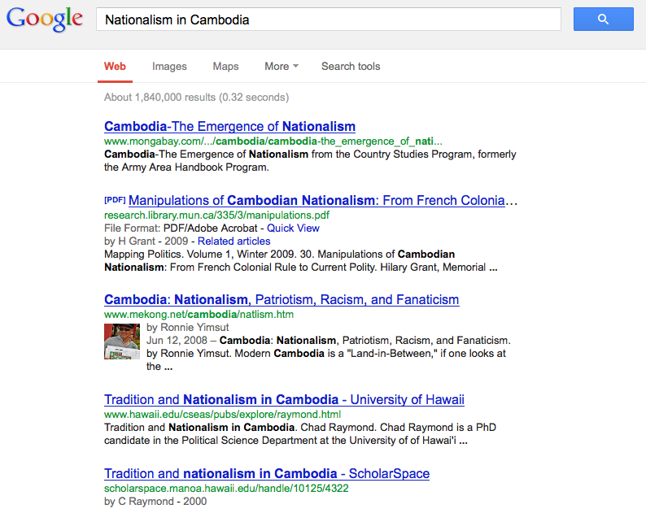
Visibility in Google

Slide 38
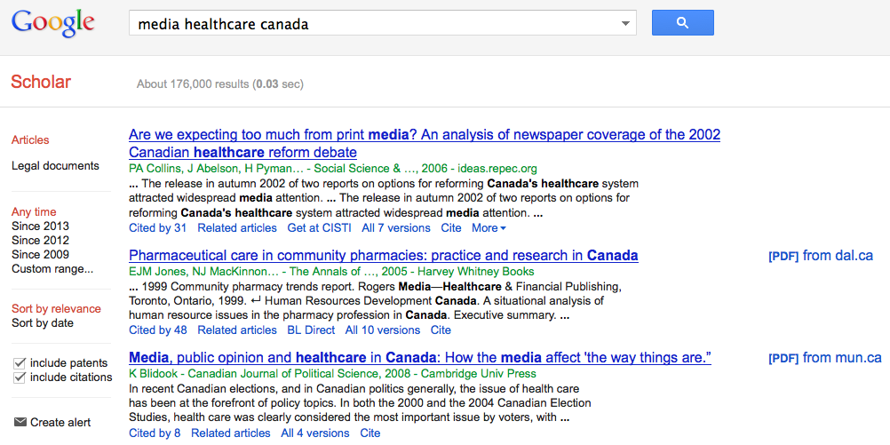
Google Scholar

Slide 39
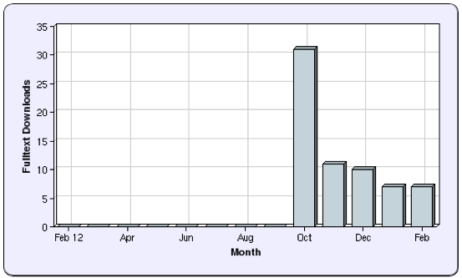
Conference Presentations

Slide 40
Thank you. lgoddard@mun.ca

