Slide 1
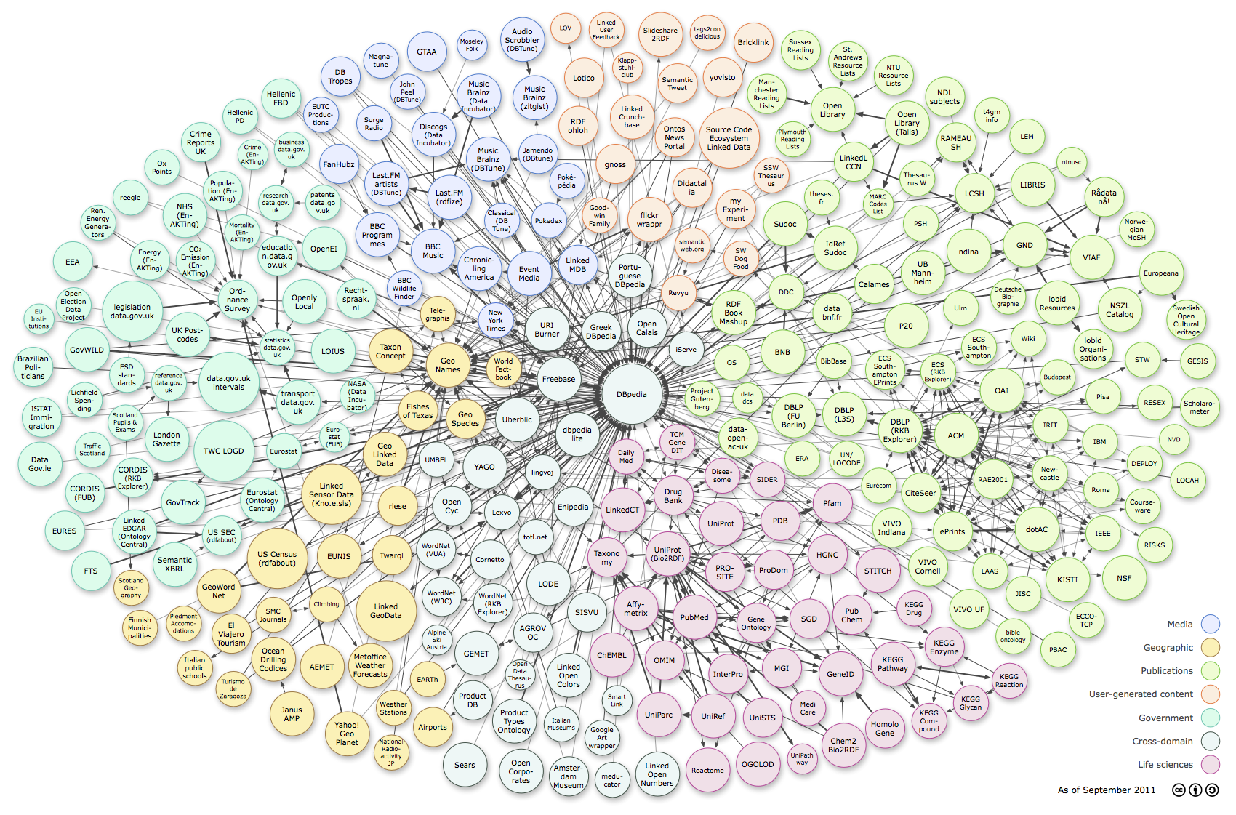
Everything is Connected: Linked Data and the Humanities
Lisa Goddard
University of Alberta
HUCON 2012, Edmonton AB
March 23rd, 2012
Notes:
I want to introduce you to some core linked data concepts, and also talk about why linked data will be particularly useful to the humanities.
First it may be useful to reflect on our current web search engines.
Google is so pervasive and familiar that we often overlook the things that it doesn’t do well.

Slide 2
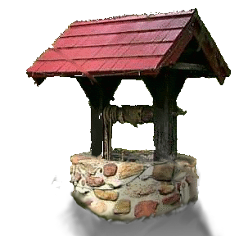
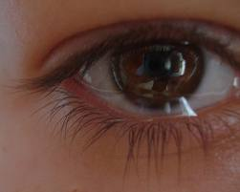
Ambiguity
“well”
Exclamation
Noun
Verb
Adjective
Adverb
Notes:
Many words have multiple meanings. Several ambiguous terms with common usage can lead to a very frustrating search.
Sanderson [9] reports that anywhere between roughly 7% and 23% of the queries frequently occurring in the logs of two search engines are ambiguous, with the average length of ambiguous queries being close to one.
http://www.cs.utexas.edu/~ml/papers/beyondSearch.pdf
http://muse.dillfrog.com/ambiguous_words.php

Slide 3
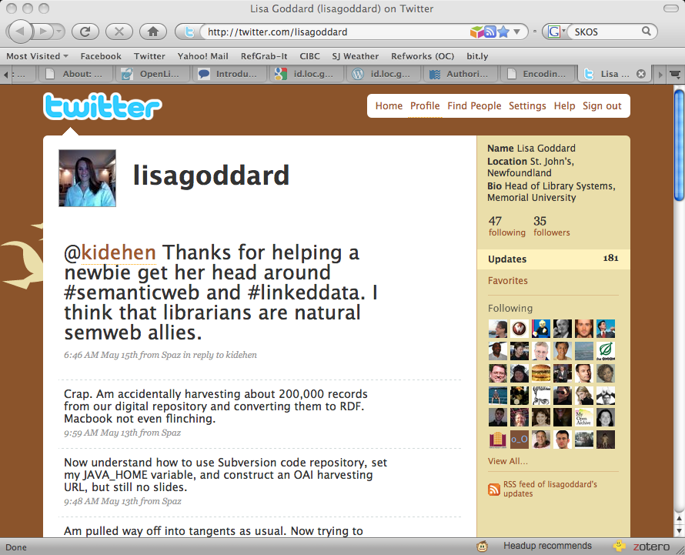
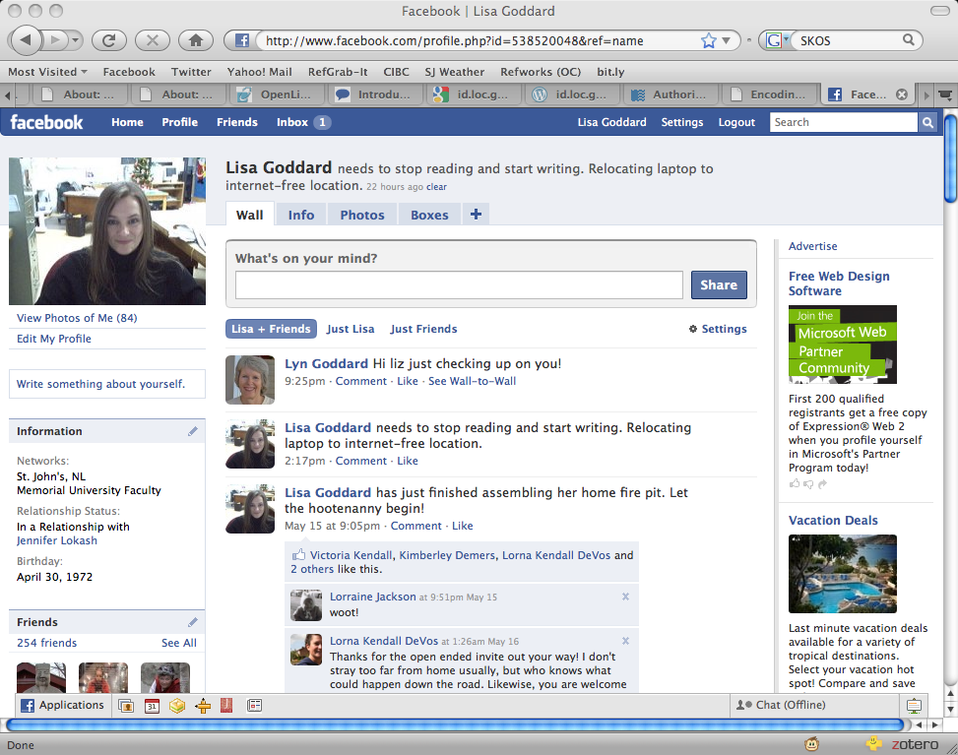
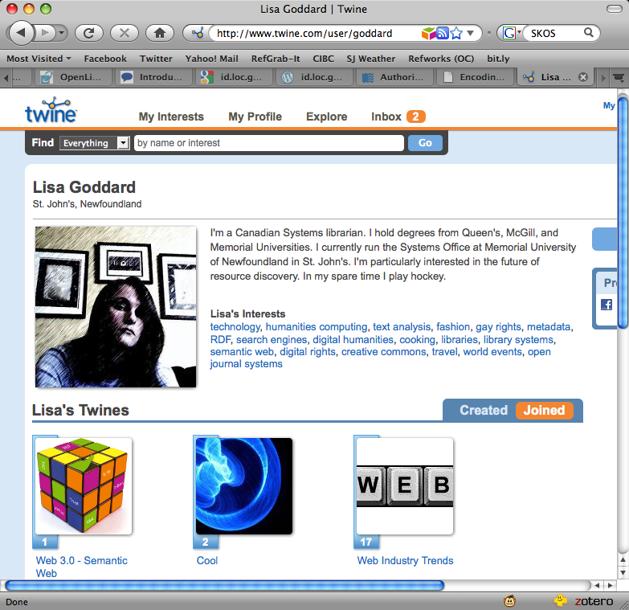
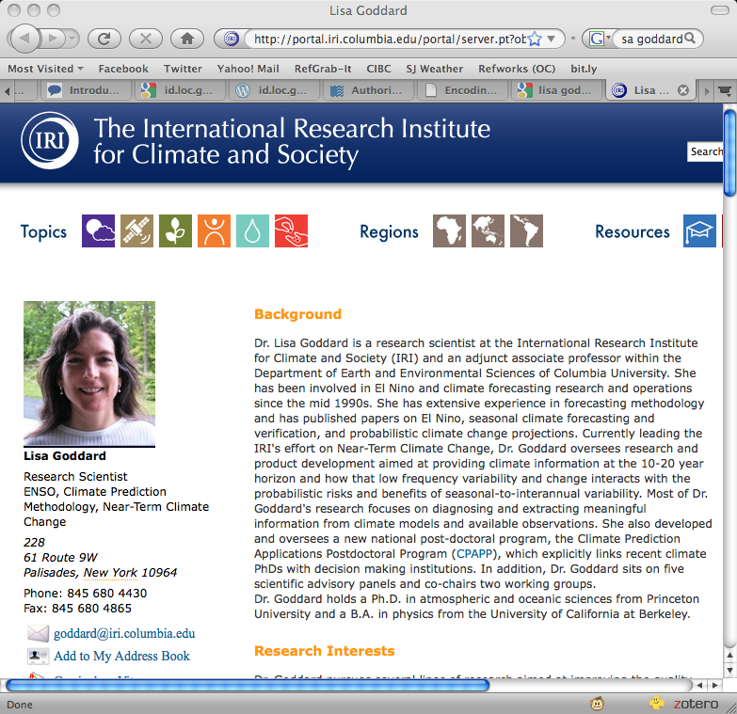
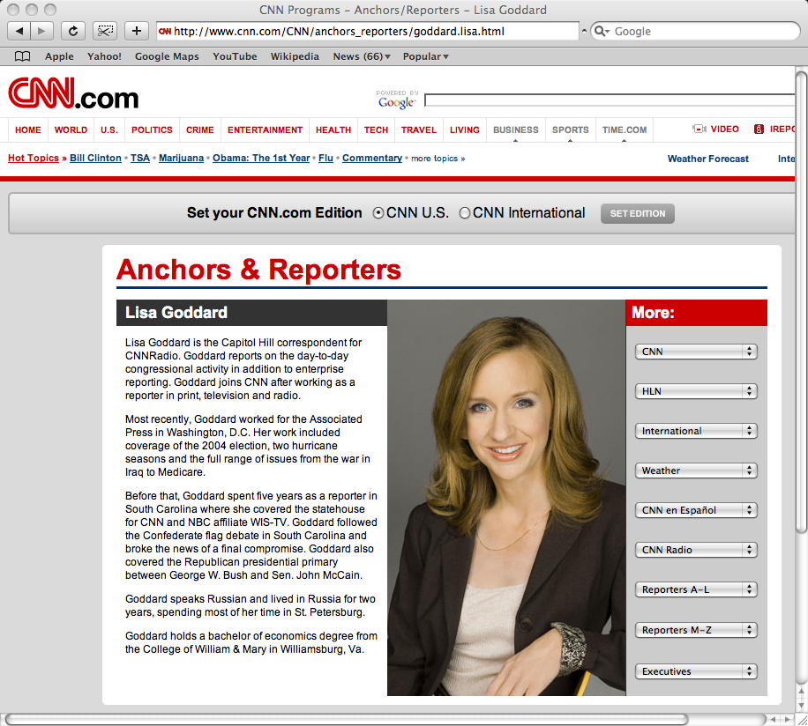
Identity
Notes:
Google can’t tell me whether these 5 web pages for Lisa Goddard represent one person, five different people, or somewhere in between.
Things are much worse when it comes to Asian names. In Korea 50% of the population share the same three last names.
Good luck finding a specific Kim Lee on the internet.

Slide 4
Related Terms
flood
lake
ice
rain
water
swim
bath
wash
damp
Notes:
Find all references to water in a specific poem.

Slide 5
Relationships
Notes:
Finding stuff where Steve Jobs is the author rather than the subject.

Slide 6
Comparisons
College (US)
Equivalent to?
College (Canada)
Equivalent to?
College (UK)
Notes:
Making comparisons between things with different labels/same labels.

Slide 7
Deep Web
How many households in Canada in 1916 had more than three rooms?
List of flights between St. John’s and Edmonton next Sunday.
Notes:
Many databases on the deep web are not indexed in Google.

Slide 8
Synthesis
Find all works from British authors born before 1900 who lived in Africa for some period of time, and who sold more than 5000 copies of at least one novel.
Notes:
Current web search engines operate on string matching. They have no way to extract meaning from unstructured masses of textual data.
Web of documents. Doesn’t organize, group, filter, or try to make sense of results in any way.
http://semanticweb.com/happy-birthday-wikipedia-but-dbpedia-has-reason-to-celebrate-too_b17320

Slide 9
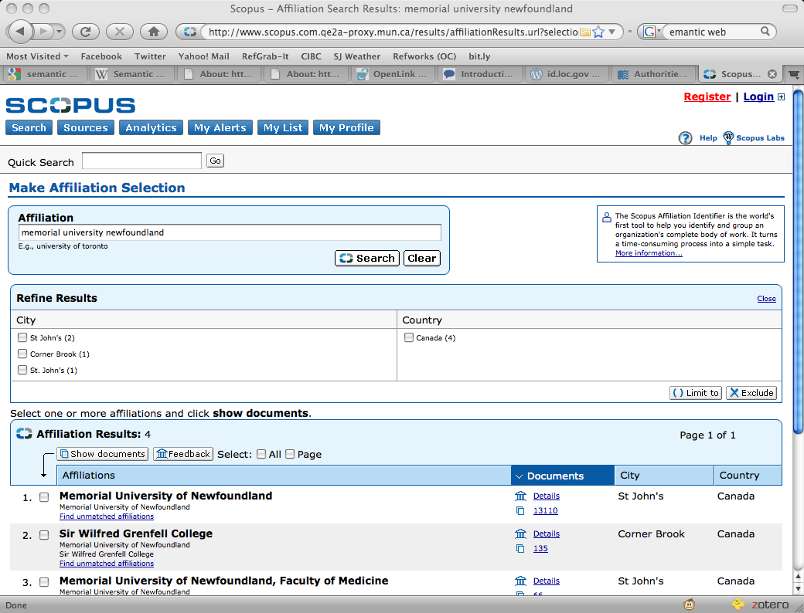
Structured Databases
Notes:
We already have tools that are better at handling complex queries like the previous example.

Slide 10
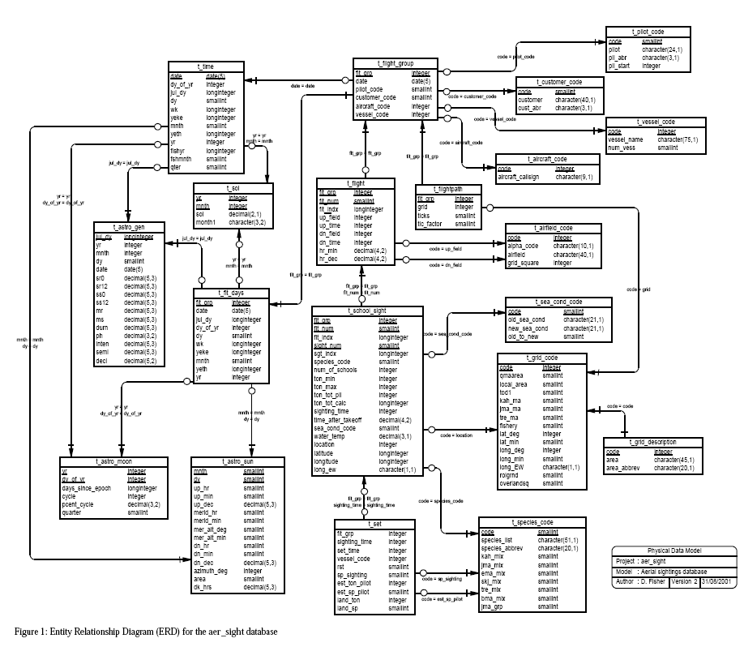
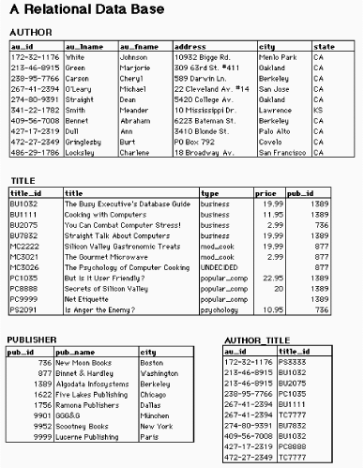
Notes:
The reason that our licensed search tools allow us to ask more granular questions, is because there are relational databases on the back end.
Data is structured into meaningful fields like “author” or “date of publication”. Explicit relationships are established between different types of objects.

Slide 11
The Semantic Solution
Structured data
Controlled vocabularies
Linking
Notes:
The semantic web envisions a solution that aims to make the web act more like a database.
The first thing that we need to do is to stop publishing big unstructured blurbs of HTML information, and provide better metadata.

Slide 12
Structured Data: RDF
Data model for writing simple statements about web objects.
RDF statements are written as “triples”.
Subject
Object
Predicate
Shakespeare
Macbeth
Wrote
V
Statement
Notes:
Resource Description Framework.
So if I’m creating a website about Shakespeare, one of my statements might be “Shakespeare wrote Macbeth”.

Slide 13
RDF Triples
Subject | Predicate | Object
Shakespeare Shakespeare Anne Hathaway Shakespeare Stratford Macbeth England Scotland | Wrote Wrote Married Lived in Is in Set in Part of Part of | King Lear Macbeth Shakespeare Stratford England Scotland UK UK
Notes:
My project would probably have lots of facts, each of which could be expressed as a triple.

Slide 14
RDF Graph: A Semantic Net
AnneHathaway
isIn
England
Stratford
married
partOf
livedIn
Shakespeare
UK
wrote
wrote
partOf
setIn
Macbeth
Scotland
KingLear
Notes:
In an RDF graph subjects and objects are represented as nodes, and the relationships between them (the predicates) are represented as lines.
This allows us to more easily discern the relationships between objects. For example, even though there is no explicit link between the term UK and the term Shakespeare, we can easily trace our way back through the degrees of separation between them to find a relationship.

Slide 15
Unique Identifiers: URIs
wrote
Shakespeare
Macbeth
http://www.mun.ca/project#shakespeare
http://www.mun.ca/project#macbeth
http://www.mun.ca/project#wrote
URIs should resolve.
Notes:
An important principle of linked data is that each element in a triple must have a unique URI, which for the purposes of this presentation you can think of as a URL.

Slide 16
RDF Description: FOAF
<rdf:RDF
xmlns:rdf="http://www.w3.org/1999/02/22-rdf-syntax-ns#"
xmlns:rdfs="http://www.w3.org/2000/01/rdf-schema#"
xmlns:foaf="http://xmlns.com/foaf/0.1/"
<foaf:Person rdf:ID="me">
<foaf:name>Lisa Goddard</foaf:name>
<foaf:title>Ms.</foaf:title>
<foaf:givenname>Lisa</foaf:givenname>
<foaf:family_name>Goddard</foaf:family_name>
<foaf:homepage rdf:resource="http://twitter.com/lisagoddard"/>
<foaf:workplaceHomepage rdf:resource="http://www.library.mun.ca"/>
<foaf:schoolHomepage rdf:resource="http://www.queensu.ca"/>
<foaf:knows>
<foaf:Person>
<foaf:name>Gillian Byrne</foaf:name>
<foaf:mbox rdf:resource="mailto:gbyrne@mun.ca"/>
</foaf:Person>
</foaf:knows>
</foaf:Person>
</rdf:RDF>
Notes:
Here is a real life RDF description of me written in XML It uses the Friend of a Friend Ontology, or FOAF which allows me to express biographical information about myself, like my name, my contact information, and people who I know.

Slide 17
Resolvable URIs
xmlns:foaf="http://xmlns.com/foaf/0.1/"
<foaf:Person rdf:ID="me">
<foaf:name>Lisa Goddard</foaf:name>
<foaf:workplaceHomepage
rdf:resource="http://www.library.mun.ca"/>
</foaf:Person>
http://xmlns.com/foaf/0.1/#term_workplaceHomepage
Notes:
One element in the FOAF ontology is “workplaceHomepage”. Like all RDF data, this element has it’s own unique URI, which you see in in pink at the bottom of the screen

Slide 18
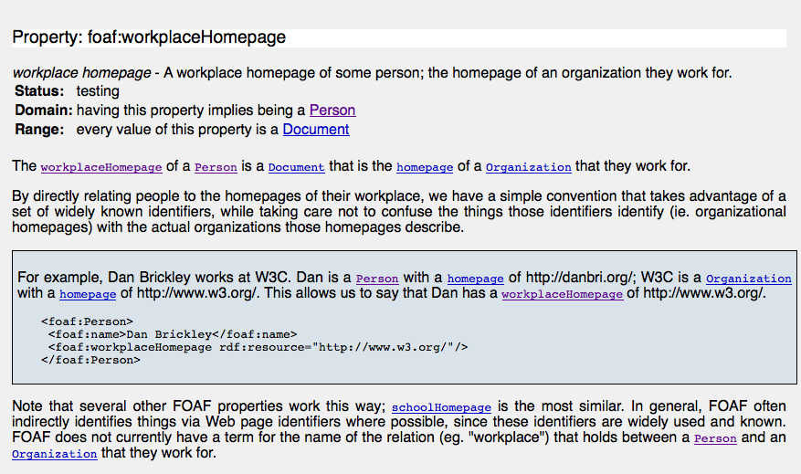
Resolvable URIs
Notes:
When I enter this URI in a browser, I get information back about the object. This includes a clear definition of the term.
The semantic web demands that I clearly define the terms that I use, and that I publish those definitions so that other people can use them.
http://xmlns.com/foaf/spec/#term_workInfoHomepage

Slide 19
Shared Ontologies
Namespaces allow us to combine several vocabularies while maintaining distinct meaning of each element.
#person
#wrote
#married
#play
#book
#birthdate
#setIn
#partOf
#poem
#narrated
#isIn
#deathdate
#country
http://mun.ca/lit.owl
#region
http://gmu.edu/bio.owl
#city
http://mit.edu/geo.rdf
Notes:
My Shakespeare project requires terms related to different knowledge domains like literature, geography, and biography.
Because in the linked data world other people must also post their vocabularies online, I can mix and match terms from a number of different ontologies.
The URL that identifies each element tells me which vocabulary is being used.

Slide 20
Ontologies: Relationships
Beauty, Personal
Manners & customs
Broader
Apparel
Clothes
Dress
Garments
Same As
Related
Fashion
Undressing
Clothing
Narrower
Aprons
Armbands
Belt toggles
Belts (Clothing)
Bodices
Breechcloths
Burial clothing
Buttonholes
Buttons
Caftans
Cloaks
Coats
Collars
Color in clothing
Costume
Coveralls
Darts (Clothing)
Dirndls
Doll clothes
Dresses
Footwear
Fur garments
Garters Gloves
Headgear
Hosiery
Jackets
Jumpsuits
Kilts
Kimonos
Knitwear
Lapels
Latex garments
Leggings
Neckwear
Overalls
Notes:
Ontologies are more than just shared vocabularies. They also describe relationships between entities.
If my ontology included the term “clothing” for example, then it might also indicate that the terms “apparel” and “garments” can be used interchangeably, that “fashion” is a related term, and that clothing has many narrower terms including aprons, caftans, garters, lapels, etc.
By leveraging this kind of rich data model, we will be able to ask questions like “show me all of the references to clothing that appeared in London newspapers in May 1905”.
http://id.loc.gov/authorities/subjects/sh85027160.html

Slide 21
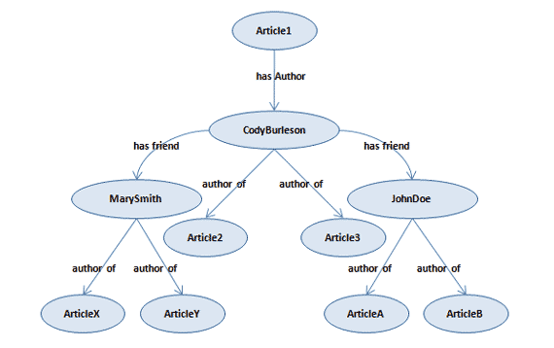
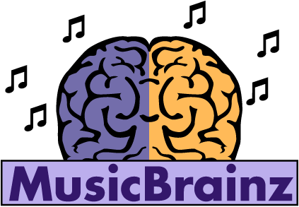
Linking Data
Notes:
So we’ve seen how RDF allows us to publish structured data on the web, and how ontologies provide a rich vocabulary to describe entities and their relationships.
Now we have a bunch of organizations that are publishing RDF data sets.
The final step in the linked data vision is to link these data stores together in as many ways as possible.

Slide 22
Linking Entities
foaf:made
Movies
Directors
dbpedia:director
Notes:
The last step is to link all of that data together in as many ways as possible.
One of the challenges is finding relevant RDF links from many different sources. You especially want to be connected with major linking hubs.

Slide 23
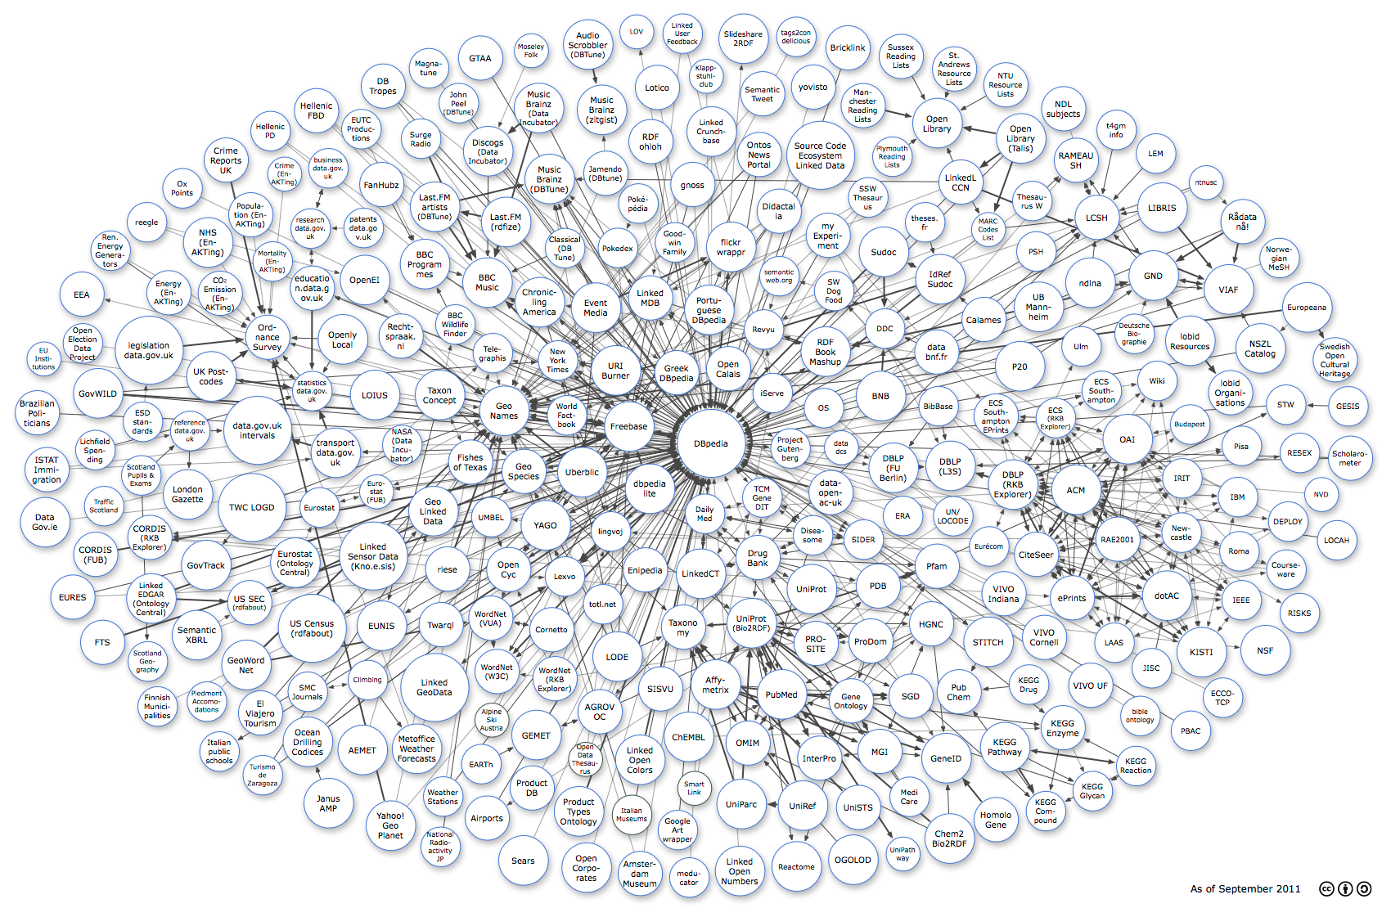
Linking Hubs
Notes:
This is a graphical representation of the linked data cloud. Every circle represents the RDF data set that has been exposed by a specific organization.
The lines shows how those datasets have been linked together.
Some of the circles have a lot of inbound and outbound links, and we refer to those nodes as linking hubs.

Slide 24
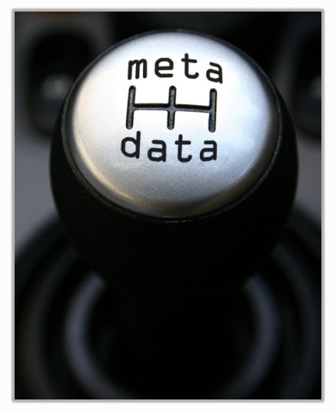
Machine-Actionable Data
“Our top two users are computers.”
- Martin Kalfatovic, Smithsonian
Notes:
Computers use the web as much as people do.
Computers have a disadvantage because they are human-language impaired. The semantic web is like an accessibility measure for computers.
When the web is composed of highly structured interlinked data then computers will be able to do a lot more filtering, grouping, and reasoning.

Slide 25
Linked Data in the Humanities
Notes:
Wrap up by taking about why linked data is a particularly good match for the humanities.

Slide 26
Language and Text
Find all references to food in Joyce’s Ulysses.
Notes:
The semantic web vision is specifically concerned with allowing computers to negotiate human language.
This framework holds huge promise for vastly more sophisticated search and analysis tools.

Slide 27
Interoperability
Notes:
Provides common global standards.
Cross sector adoption.

Slide 28
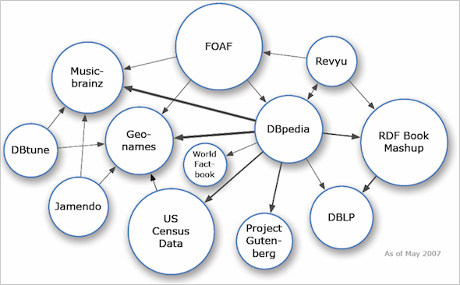
Collaboration
Notes:
Linked data is designed for sharing and reuse.
Assumes that you will want to incorporate data from external sources, and that you will expose your data for other people to use
Linked data vision does not just accommodate collaboration, it requires collaboration.

Slide 29
Interdisciplinarity
Language and terminology differences between disciplines are perhaps the most frequently cited barrier to interdisciplinarity.
(Borrego and Newswander, 2011)
Notes:
Forces us to formally define our terms, so makes the problem of language explicit
Provides a model that allows projects to explore terminology, and come to a common understanding.

Slide 30
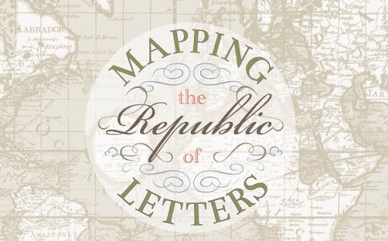
Big Text Data
“Linked data suits the often loose affiliations and conditional relationships represented by members of the Republic of Letters.”
Notes:
Not just big data, but big text data, which is different from numerical data.
It can’t easily be represented in relational databases or SPSS.
Big text data requires a container that is flexible enough to capture large amounts of heterogeneous information.

Slide 31
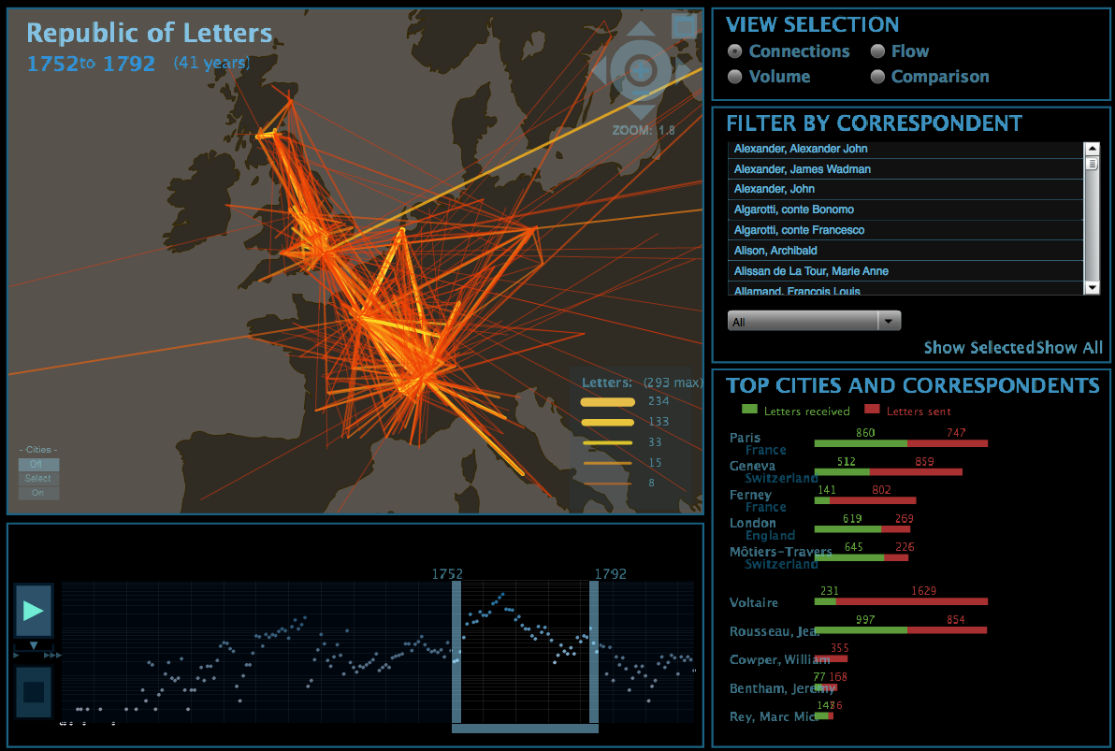
Connections and Relationships
Notes:
As the name implies linked data is largely about modeling the relationships between people, places, things, concepts.
Relationships and connections are also the theme of a great deal of investigation in the humanities.
Because RDF is a very graphable language linked data is also natural match for visualization.

Slide 32
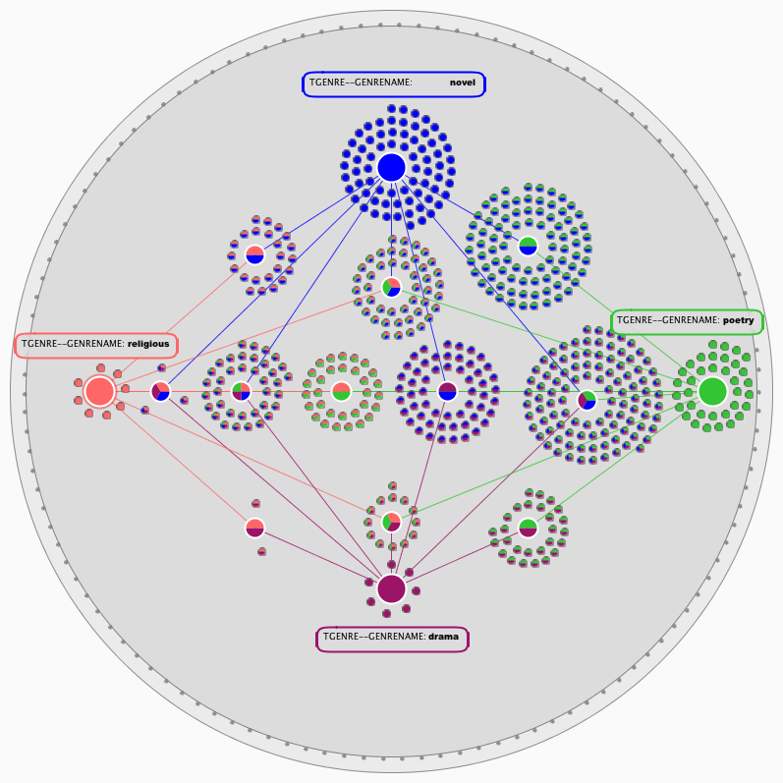
Multiplicity
Genre is a kinship network - no central root but an intertwined web of roots. (Dimock, 2006)
http://www.digitalstudies.org/ojs/index.php/digital_studies/article/viewArticle/191/237
Notes:
Another aspect of humanities research is that things don’t fit neatly into a single category.
Linked data allows you to put things in multiple categories, ascribe multiple characteristics, and create multiple annotations.
Like stand-off markup it allows us to layer many different interpretations over an entity.

Slide 33
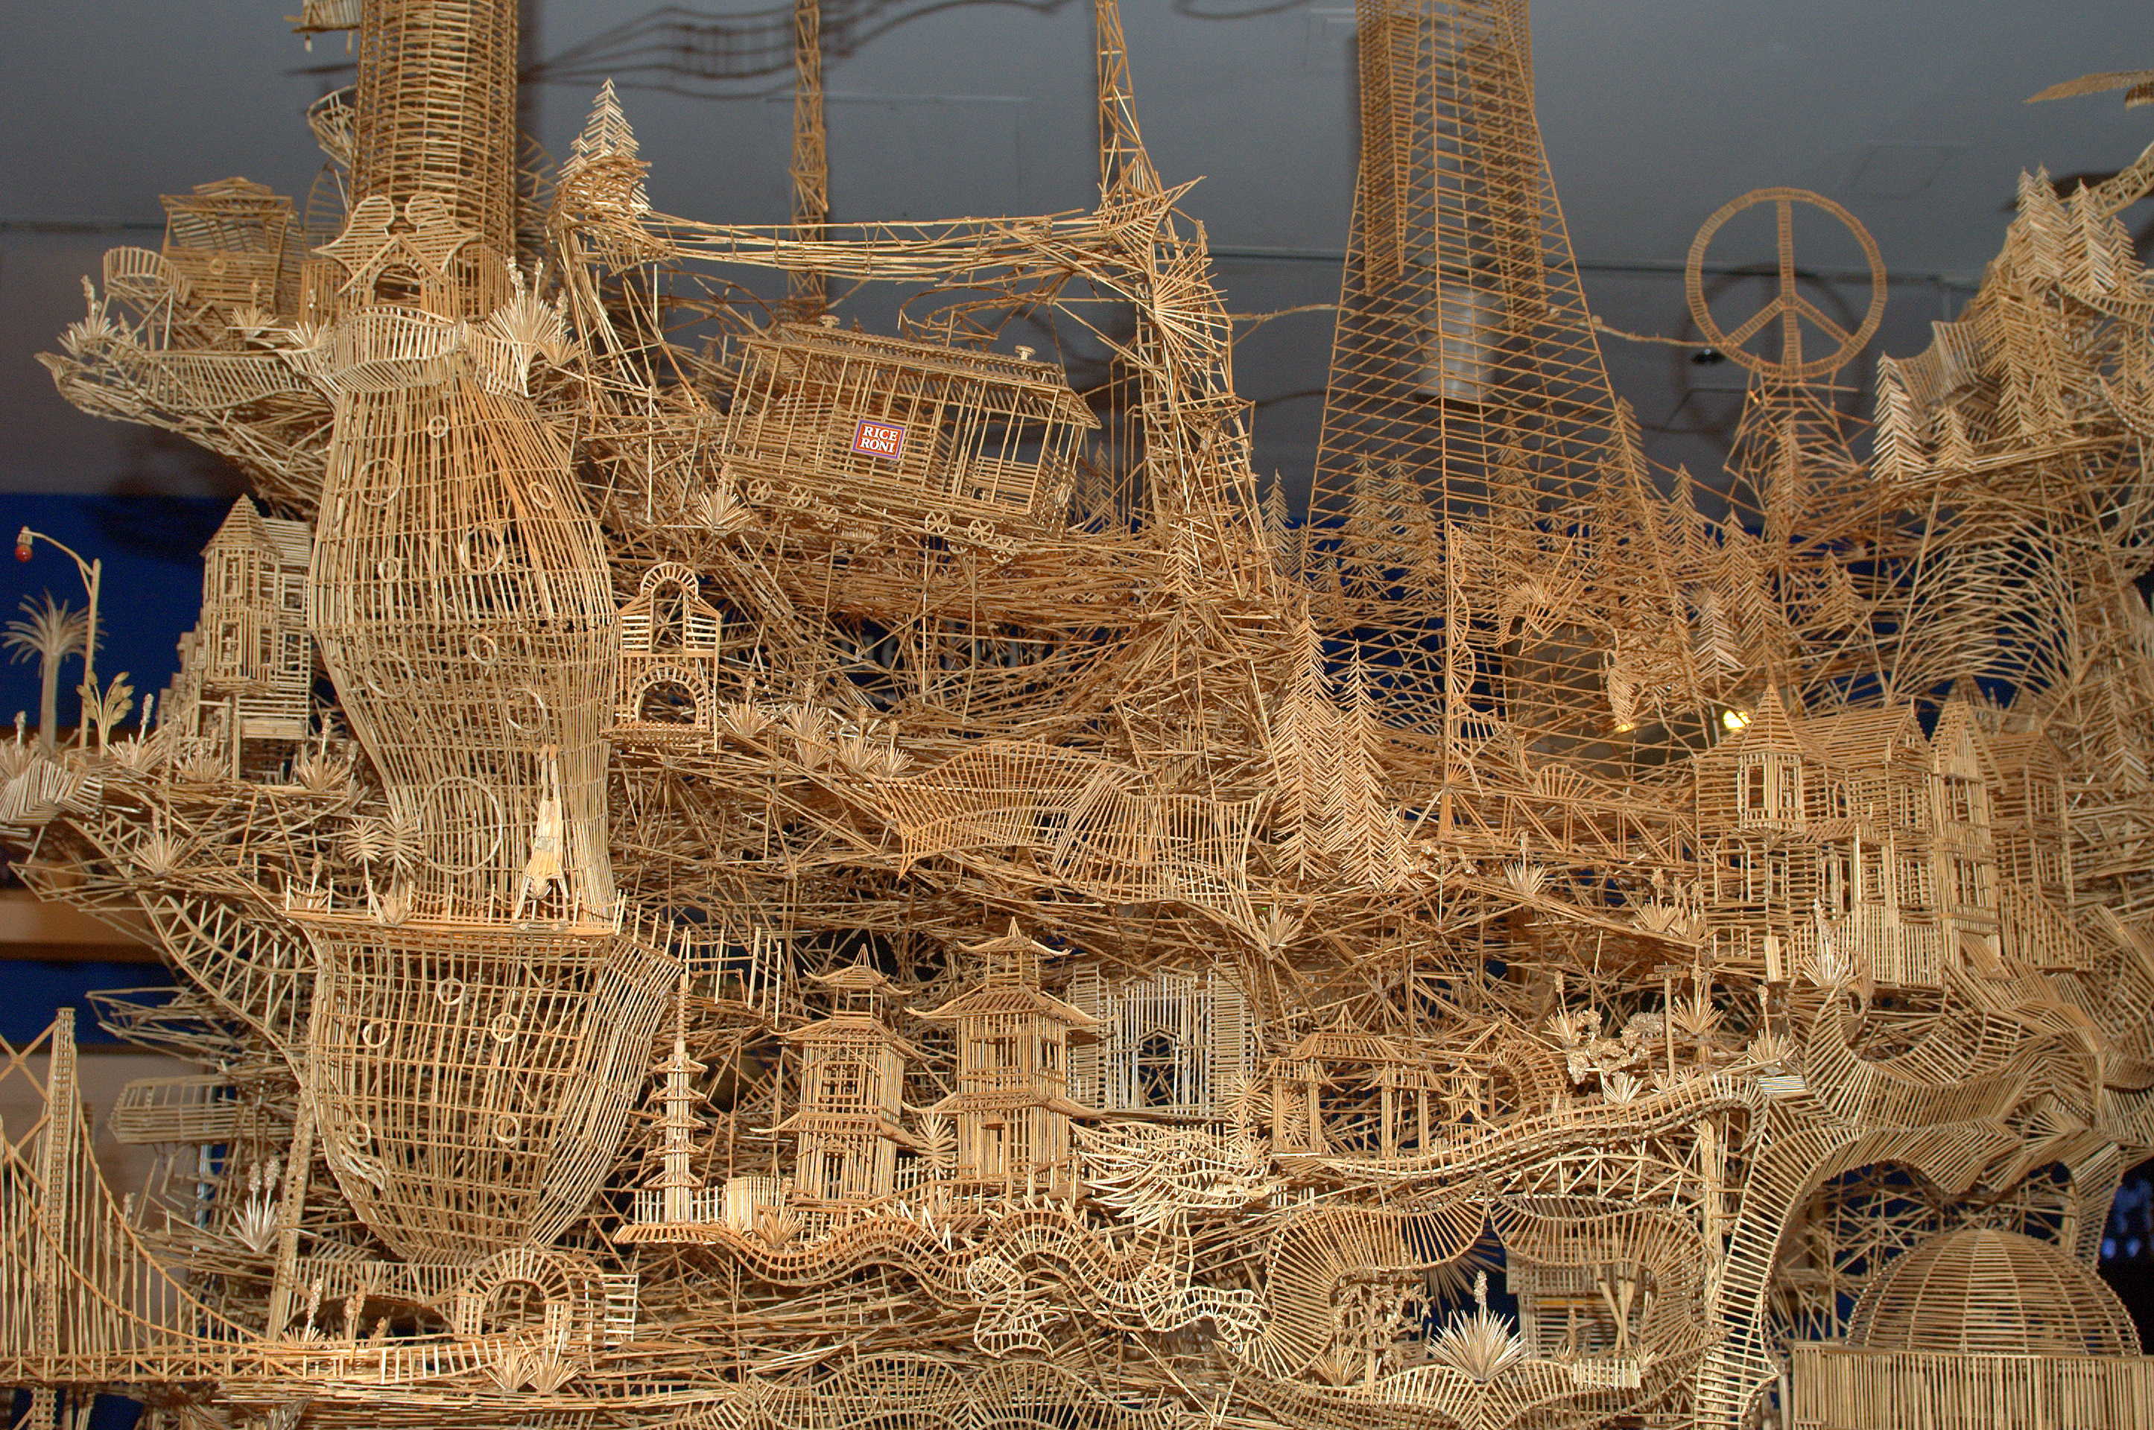
New Perspectives
Modelling anything is clearly an imaginative act. (McCarty, 2005)
http://roamingtheplanet.com/wp-content/uploads/2012/01/RTP_051_PNJean_04-DSC_4494.jpg
Notes:
Important intellectual exercise. Will force us look at our sources, our terms, and our theoretical frameworks through a different lens.
As we engage with our subject matter in this way, we will undoubtedly discover new perspectives.

Slide 34
Thank you. lgoddard@ualberta.ca

