Slide 1
Greater Reach for your Research: Author’s Rights & the Shifting Landscape of Scholarly Communication
Lisa Goddard & Shannon Gordon
Memorial University Libraries
February 19th, 2010
Notes:
I’m going to introduce the current copyright situation and discuss alternative models to rights management.
Shannon is going to talk about Open Access strategies that faculty can pursue including OA Journals & Repositories.

Slide 2
University Environment
Copyright is automatically granted to author upon the creation of an original work in a tangible medium.
Most universities have agreements stating that faculty own copyright in their scholarly works.
Notes:
"for copyright to exists in a 'work' it must be expressed to some extent at least in some material form, capable of identification and having a more or less permanent endurance.” Insufficient fixation in the live broadcast of a sports event. Any sort of broadcast, telecast, or display of a spectacle on its own is not sufficient to be fixed.
http://www.arl.org/sparc/publications/opendoors_v1.shtml

Slide 3
Copyrights
reproduce
distribute
publicly display
publicly perform
prepare derivative works

Slide 4
Transferring Rights
assign ownership of copyright
grant permission via license
all rights? exclusive? perpetual?
Notes:
Can give some or all rights, exclusive or non-exclusive.
A license to any or all of these rights can be supplemented by specific license limitations, such as the duration, geographical scope, revocability, and right to sublicense, or any other restrictions that the licensor wishes to specify.

Slide 5
Publisher Agreements
Academic authors traditionally transfer exclusive, full copyrights to the publishers of the journals in which their articles appear.
Many disadvantages to this approach…

Slide 6
Subscribers Only
Notes:
Subscribers can access, assuming that they can jump through the appropriate authentication hoops. Greatly reduces the number of people who will conceivably read & cite your article.

Slide 7
No Google
Notes:
Image of Google search.

Slide 8
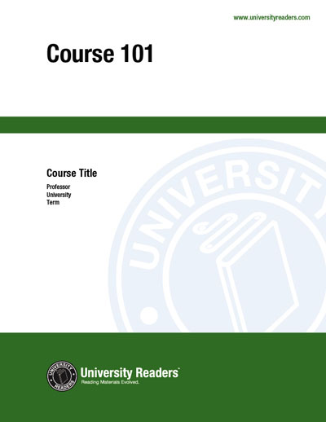
No Course Packs
Notes:
Not allowed to distribute it to your own class for teaching and learning purposes.

Slide 9
No Course Websites
Notes:
Cannot distribute it within a learning management system.

Slide 10
No Professional Websites
Notes:
Cannot link to it from online portfolio or academic c.v.

Slide 11
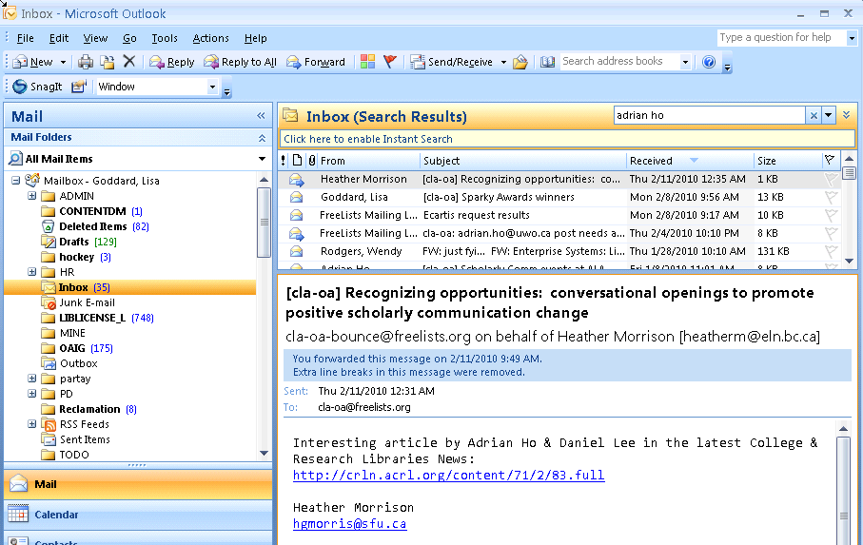
No Sharing with Colleagues

Slide 12
No Linking from Others
Notes:
Other authors who cite your work cannot provide accessible links directly from their own bibliographies, so less exposure for your article.

Slide 13
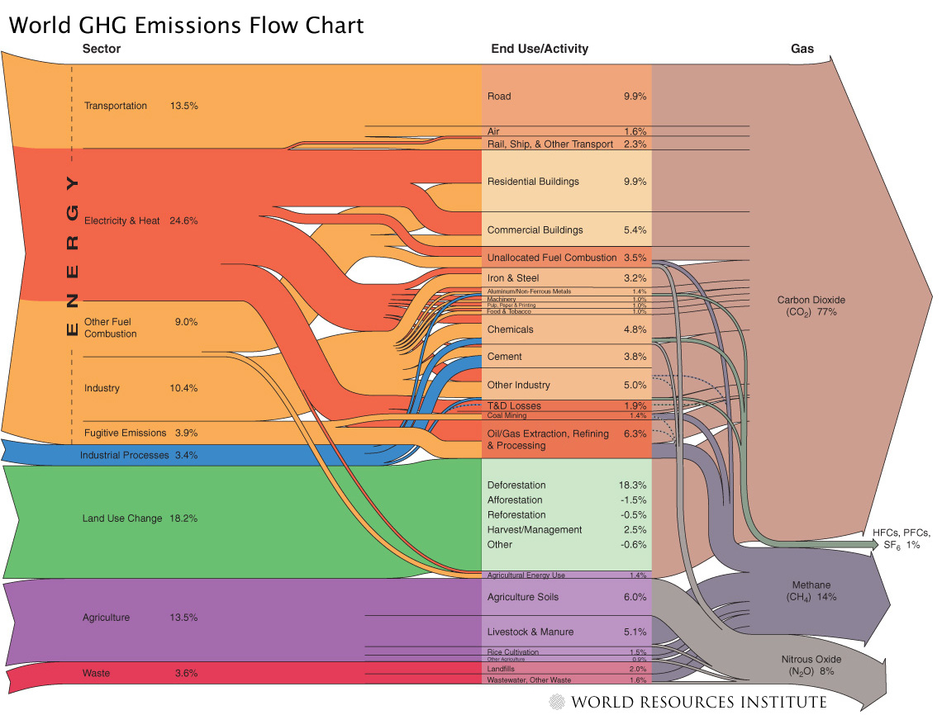
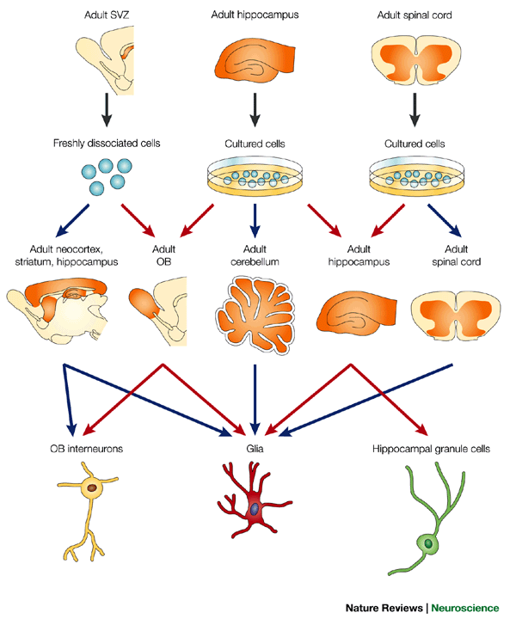
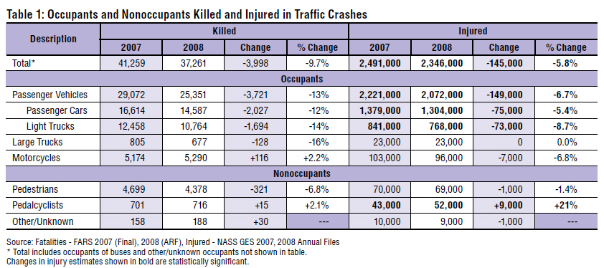
No Reuse
Notes:
Charts, tables, images take a long time to produce and format, but once you give up your copyright on these items, you cannot reuse or share them.
New York Times science writer Carl Zimmer demonstrated the distinction succinctly. He discusses a recent case where Wiley threatened legal action after a neuroscience graduate posted some figures from one of their journal articles on her blog (despite the fact that this is already permitted under terms of “fair dealing” or “fair use”). (When OA not OA, PLOS Bio, October 2007)

Slide 14
No Preservation Guarantee
Notes:
Publishers fold, merge, and reorganize around profit centres. There is no guarantee in the digital environment that your work will continue to be available over time.

Slide 15
No Institutional Archiving

Slide 16
Non-compliance with Funders
Each federal research funding agency should expeditiously but carefully develop and implement an explicit public access policy that brings about free public access to the results of the research that it funds as soon as possible after those results have been published in a peer‐reviewed journal.
- US Scholarly Publishing Roundtable, 2010
Notes:
http://science.house.gov/press/PRArticle.aspx?NewsID=2710

Slide 17
YOU may not have access

Slide 18
No Mashups
Notes:
Mashups are a common means of aggregating information about a topic from a number of different sites into a common site. Components of a mashup might include images, RSS feeds, videos, real-time conversations on blogs or on twitter.

Slide 19
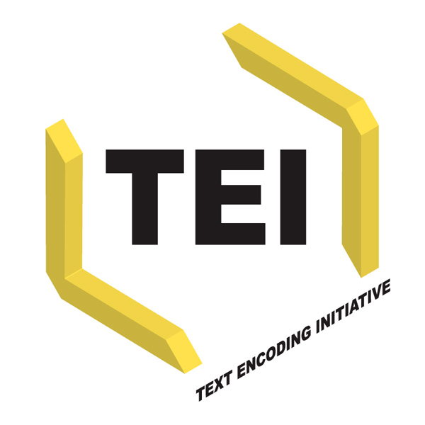
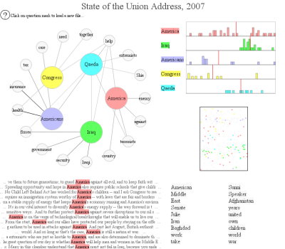
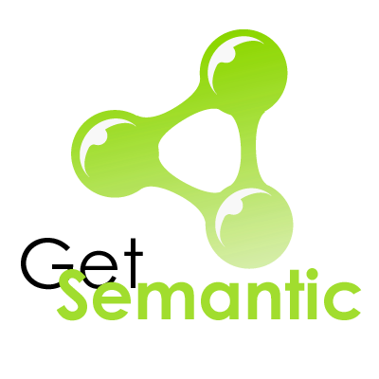
Transformative Technologies
Text Visualization
Notes:
Many projects exist to improve text mark-up, linking, analysis, and search capabilities. Without rights to your own work you have no control over whether your own work will benefit from transformative technologies.
http://www.neoformix.com/2007/ATextExplorer.html

Slide 20
Current Situation
Publicly funded projects
Faculty time & expertise
Rights given to commercial publisher free of charge
Academic community purchases the work back from publisher
Notes:
Governments, universities, tax-exempt organizations
Often at great expense!

Slide 21
Retain Your Rights: CAUT
To promote scholarly communication, autonomy, integrity and academic freedom, and education and research activities more generally, it is important for academic staff to retain copyright in their journal articles. (CAUT advisory, 2008)
Notes:
http://www.caut.ca/uploads/IP-Advisory1-en.pdf

Slide 22
Open Access Options
CARL Author Addendum
Creative Commons Licensing

Slide 23
Canadian Author Addendum
Publishers require only permission to publish an article, not a wholesale transfer of copyright.
Grant specific rights while holding back rights for yourself and others.
http://www.carl-abrc.ca/projects/author/EngPubAgree.pdf

Slide 24
Creative Commons Licenses
legally valid
no charge
prevents some uses of a work without permission, authorizes others.
Notes:
http://creativecommons.org/
http://creativecommons.ca/

Slide 25
Creative Commons Licenses
Attribution
Attribution Non-commercial
Attribution No Derivatives
Attribution Share Alike
Notes:
Anyone can do anything with your work, but must give you attribution.
Anyone can do anything with your work except make money from it.
Anyone can use your work in an unchanged way, as long as it is credited to you.
Anyone can do anything with your work, as long as they credit you and license their new creations under the identical terms.
Put a creative commons license on work that you post to the web. This allows you to grant permissions in a granular way, while retaining all of your own rights over the work.
The different license attributes can be mixed and matched in various ways.

Slide 26
Institutional OA Policies
Collective, university-wide action.
Faculty agreements to retain author rights, and allow open access to intellectual output.

Slide 27
Harvard
Notes:
The University License serves three purposes: (1) it covers all the faculty’s scholarly
articles, including those published in journals that have not to date permitted authors to post
articles in their institutional repositories; (2) it standardizes the terms of the Institution’s right to
host its faculty’s work and make it openly accessible; and (3) it grants the Institution the right to
make additional copies of articles – for permanent archiving, for example – and to permit others
to use the articles so long as the use is not done for profit. http://www.arl.org/sparc/publications/opendoors_v1.shtml

Slide 28
Stanford

Slide 29
MIT

Slide 30
Guelph

Slide 31
York

Slide 32
Benefits to Authors
visibility & citation
access to global research output
control over use and re-use of work
funding agency compliance
preservation & archiving
custom presentation layers

Slide 33
Benefits to Institution
reduced cost for journal access
less identity-management overhead
access to university research output
institutional mashups
greater transparency for data
higher research profile for university
Notes:
(i.e. in Yaffle, on departmental web sites, in faculty on-line profiles, in student portfolios)

Slide 34
Benefits to Scholarship
free access for all
reduce cost of academic publishing
improve interdisciplinarity
large scale storage and preservation efforts without intellectual property barriers
Notes:
vastly improved accessibility (esp. for economically challenged regions)
Greater ability to mash-up research in many different ways, improved ability to undertake cross-disciplinary research,

Slide 35
Your options
Publish in an OA journal
The “gold” road to OA
Submit to an OA repository
The “green” road to OA
Notes:
22 min each
As a researcher, you have 2 options:
1. OA journals…this is known as the ‘gold’ road to OA
2. OA repositories/archives…this is known as the ‘green’ road to OA
I will discuss both of these options by talking about what they are, exploring examples already in use and of course discuss support available from MUN Libraries.

Slide 36
Gold OA
Publishing in OA journals
You retain ownership/control
100% free access
There are no access barriers
What do OA journals look like?
Notes:
Gold OA focuses on publishing in OA journals.
Free access
There are 1000s of OA journals, and when we’re talking about free access, this means that the content in these journals is available for free to the entire world. There are no subscription fees (whether through the reader, or their institutional affiliation). As long as you can get online, you can access content in OA journals without paying for anything other than your internet connection.
“OA journals do not depend on subscription revenue because their costs are recovered up front through other revenue streams, such as publication fees, advertising revenue, sponsorships, institutional subsidies, grants, or some combination of these.” p 6 of http://www.aau.edu/policy/scholarly_publishing_roundtable.aspx?id=6894
But what do OA journals look like? Exactly the same as other online journals, only difference is that access is free.

Slide 37
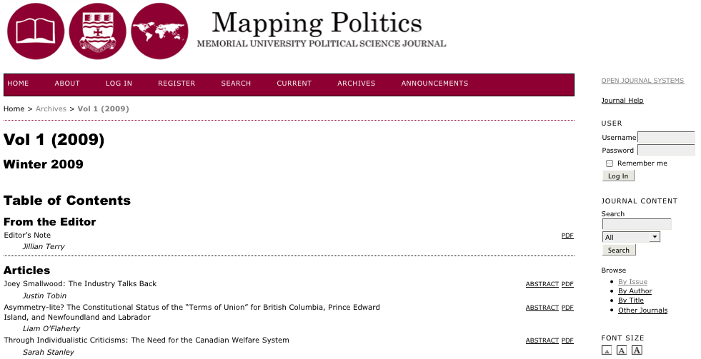
Notes:
This is one example of an OA journal hosted and supported by MUN Libraries
Mapping Politics is an annual peer-reviewed journal which started last year and is produced by students the Depart of POSC.

Slide 38
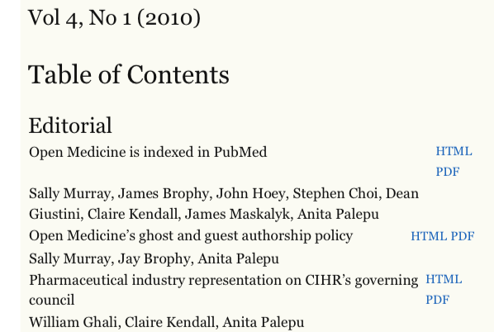
Open Medicine
Notes:
This journal started in 2007. This OA journal has Canadian roots and had a health and clinical medicine focus.

Slide 39
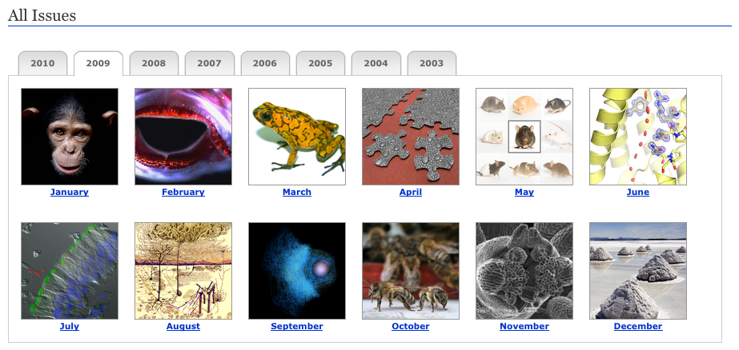
PLOS Biology
Notes:
This journal started in 2003 and is one of the several journals published by the Public Library of Science which I’ll be mentioning later on. As you can see, OA journals look the same as other online journals, the difference is that access is free.

Slide 40
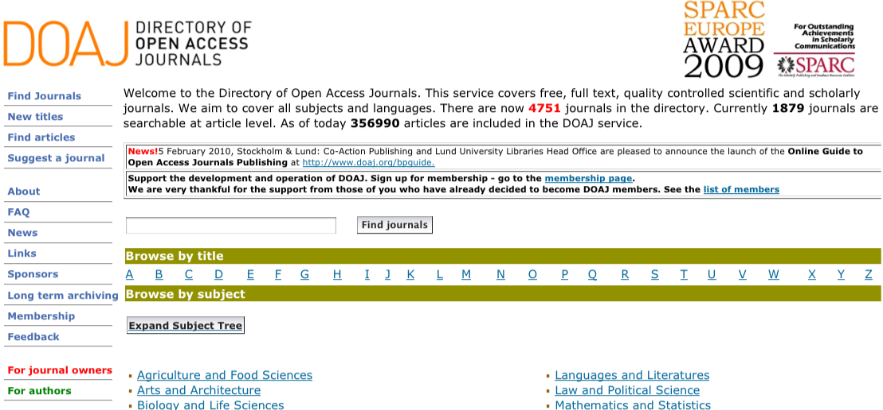
Where can I publish?
Notes:
If you’re wondering what OA journals exist in certain subject areas, the Directory of Open Access Journals (or DOAJ) is the source to use. It is a directory of more than 4000 OA journals from more than 100 countries. It links out to the OA journal and also provides information re: publisher, country of origin, language, keywords and journal start year.
Journals included must be free to access and they must be freely available from date of publication (i.e. no embargo period). And at least 5 articles must have been published. RSS feed available for daily/weekly/monthly update.s
“What is the SPARC Europe Seal for Open Access Journals? A Seal to Set Standards for Open Access Journals. SPARC Europe and DOAJ have entered an agreement about introducing a certification scheme for Open Access journals, the SPARC Europe Seal for Open Access Journals. To receive the "Seal" the journal has to choose the CC-BY license (Creative Commons license) and provide DOAJ with metadata on article level.
What are the advantages of having the SPARC Europe Seal? Improved information as to what users are allowed to do with papers published in an open access journal.
Possible long-term archiving of content, which makes publishing in the journal more attractive to authors.
Better exposure as a high-quality journal based on state-of-the art dissemination technologies.
The DOAJ team converts the metadata and makes it harvestable, which means the widest possible dissemination and thus increased usage and impact. http://www.doaj.org/doaj?func=loadTempl&templ=faq#seal

Slide 41
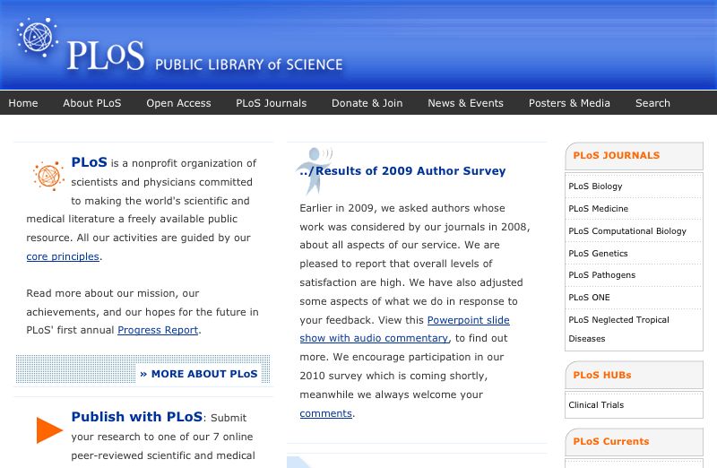
Do any fees exist?
Notes:
While access is free, fees sometimes do exist in the form of ‘author processing charges’ (APCs)
Author processing charges These fees are processing or publishing fees and means that rather than the subscriber paying to access the publication, a payment is made once the paper is accepted. This amount is often paid by the author’s institution, research grant or via a funding agency. The plot thickens as some OA journals require publishing fees BUT are able to waive them if the author is unable to pay. Fees exist to cover production/layout/copyediting/technical costs Open Medicine March 1, 2010: C$1200 for research and review articles and C$300 for commentary/analysis articles. http://www.openmedicine.ca/about/submissions#authorFees
OA for-profit publishers
Public Library of Science (PLOS): launched in 2002; is an organization of scientists and physicians committed to making the world's scientific and medical literature freely available. Publish 7 journal. Other examples include BioMed Central, Hindawi. Medknow, and Optics Express.
pe157:” OA journals and hybrid journals like PNAS, as well as traditional publishers like Blackwell Publishing (‘‘Online Open’’), Oxford University Press (‘‘Oxford Open’’), and Springer (‘‘Springer Open Choice’’) are now offering authors an immediate OA option if the author pays a fee.” Eysenbach, Gunther. "Citation Advantage of Open Access Articles." PLoS Biology 4.5 (2006): 692-8. <http://www.pubmedcentral.nih.gov.qe2a-proxy.mun.ca/picrender.fcgi?artid=1459247&blobtype=pdf>.
Fact “…many more TA journals charge author-side fees than OA journals, both in percentages and absolute numbers. The Kaufman-Wills report in October 2005 found that 75% of TA journals charged author-side fees, compared to only 47% of OA journals. Stuart Shieber's study in May 2009 lowered the number for OA journals to 29.7%. But as far as I know, no new study has updated the number for TA journals.” http://www.earlham.edu/~peters/fos/newsletter/10-02-09.htm#challenges Stuart’s 2009 study: http://blogs.law.harvard.edu/pamphlet/2009/05/29/what-percentage-of-open-access-journals-charge-publication-fees/

Slide 42
OA author funds
University of Calgary
Simon Fraser University
University of Ottawa
Compact for OA Publishing Equity
Notes:
Due to the existence of author processing fees, the great news is that universities are now starting to create central funds specifically designed to pay OA publication fees for OA publishers working within this business model.
U of Calgary
1st one in Canada, is worth $100,000 CAN and is a multi-year commitment http://library.ucalgary.ca/services/for-faculty/open-access-authors-fund-0 Simon Fraser University Starts Feb 2010. This OA author fund is $50,000 fund and if more money is needed, the same amount is available from library’s endowment fund http://www.lib.sfu.ca/node/10281
U of Ottawa http://www.oa.uottawa.ca/uo-initiatives-afund.jsp?language=en York University Harvard Open-Access Publication Equity (HOPE) fund http://osc.hul.harvard.edu/HOPE/ Cornell Open-Access Publication (COAP) fund http://www.earlham.edu/~peters/fos/2009/09/cornell-launches-oa-fund.html
Compact for OA Publishing Equity This is an agreement between participants to commit to creating funds to cover APCs on behalf of their faculty for fee-based OA journals. 7 institutions are signatories to the Compact (Harvard, MIT, Cornell, Columbia, University of California at Berkeley, Columbia University, and U of Ottawa http://www.oacompact.org/ COPE “…is a commitment that a university makes to the timely establishment of durable mechanisms for underwriting reasonable publication charges for open-access journals.”
These “durable mechanisms” really refer to STABLE sources of funding
““…is a commitment that a university makes to the timely establishment of durable mechanisms for underwriting reasonable publication charges for open-access journals.”
In December 2009 the University of Ottawa announced it was the first Canadian university to sign the Compact for Open Access Publishing Equity (COPE).”
SPARC published case studies of the OA journal funds at the University of Calgary and the University of California - Berkeley. http://www.arl.org/sparc/publications/articles/mp-berkeley-calgary.shtml

Slide 43
Green OA
Self-archiving in an OA repository
Preprints, postprints, or both
Institutional
Disciplinary
Notes:
**Submission process/form**
You’re already aware of one avenue to OA: publishing in OA journals. The second option is submitting your work to an OA repository or archive which in turn makes the item accessible to anyone in the world.
Preprint = manuscript before peer review
Postprint = manuscript after peer review
What is a repository?
“…digital collection of an organization’s intellectual output. Institutional repositories centralize, preserve, and make accessible the knowledge generated by academic institutions.” http://www.carl-abrc.ca/projects/institutional_repositories/about-e.html
This definition is for one type of repository, and there are 2 kinds you should be aware of: institutional and disciplinary/subject-based. An OA repository can contain preprints, postprints, or both.
80% of OA repositories are institution based, yet despite this number, most are still in early stage (Pinfield article p 172)
Overseer is often the LIBRARY! Have skills and expertise needed to make repositories work
CARL Repository Program: As of early Feb, CARL reports that 31 IRs exist. MUN and CISTI are under development. CARL Open Archives Metadata Harvester: pilot project, lets you search across Canadian IRs in the CARL IR Program

Slide 44
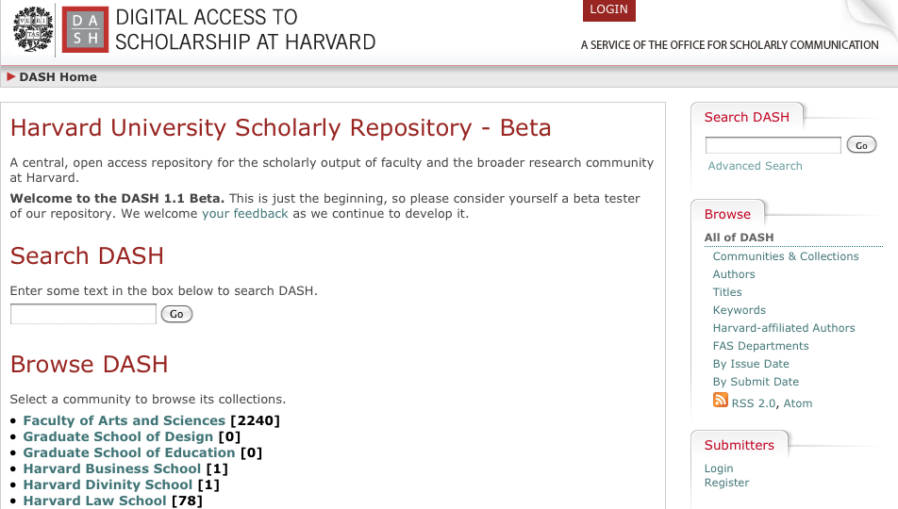
Harvard

Slide 45
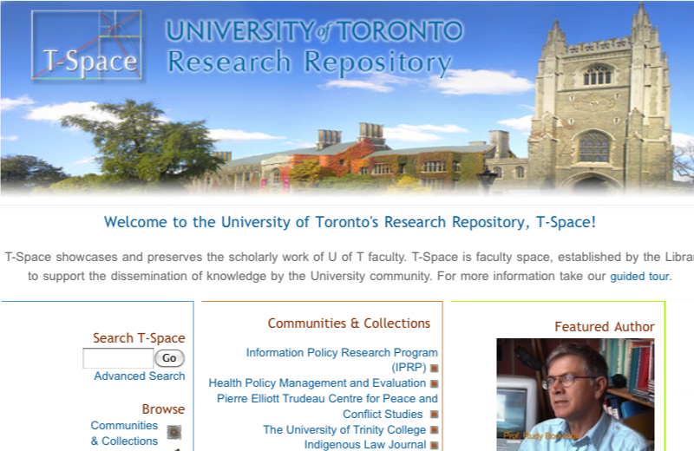
University of Toronto

Slide 46
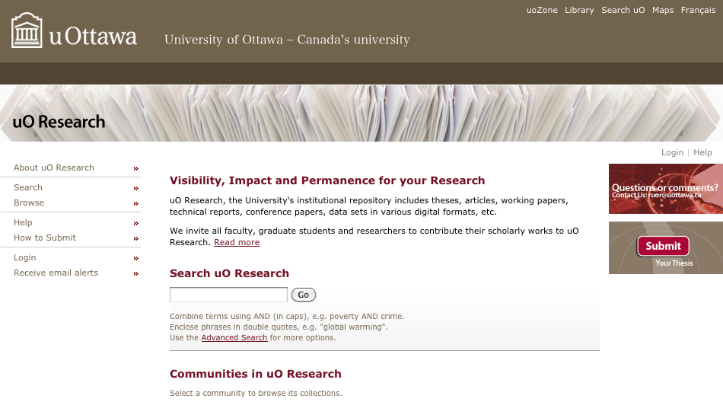
University of Ottawa

Slide 47
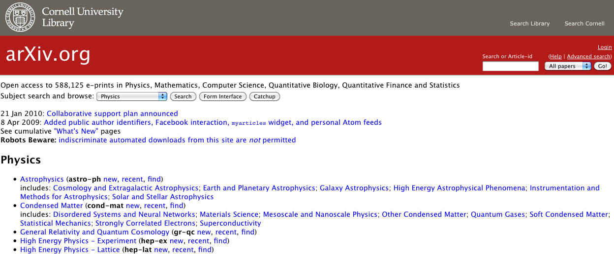
arXiv
Notes:
Begun as a preprint archive for the physics community, it’s now an e‐print service in the fields of physics, mathematics, nonlinear science, computer science, quantitative biology and statistics; is housed at Cornell University.

Slide 48
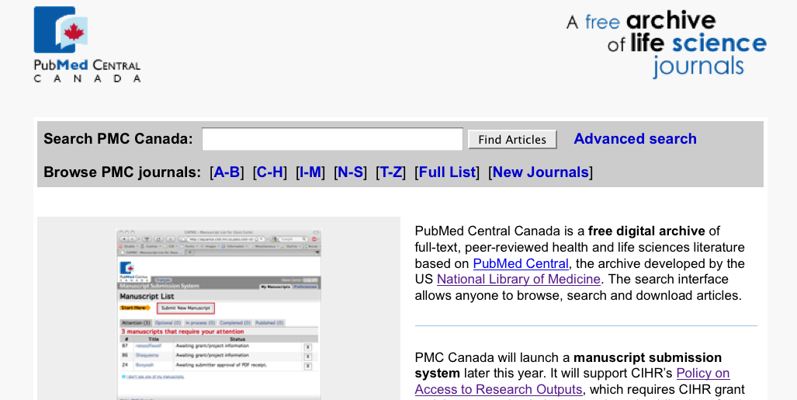
PubMed Central Canada
Notes:
This is a fairly new repository.
Two other examples are:
EconPapers: focus is mostly working papers & articles; Orebro University
CogPrints: cognitive sciences eprint archive, University of South Hampton?

Slide 49
What repositories exist?
Notes:
OpenDOAR is the Open Directory of Open Access Repositories.
It is an authoritative, comprehensive directory of academic open access repositories. Also lets you search content of the repositories via a beta version of Google’s custom search engine. Developed and maintained by the University of Nottingham. Indexes about 1500 repositories from around the world; 52 are Canadian. You can search by repository type and of course is a great tool if you want to see what IRs are available to you as an author.
ROAR: Registry of Open Access Repositories

Slide 50
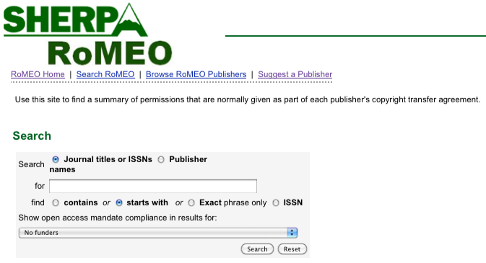
Can I archive my work?
Notes:
What are the publisher’s copyright and archiving policies?
Even though OA repositories exist, you have have to obtain permission to do so if you’ve published in a traditional journal. Your archiving MUST be legal. I.E. you can’t just do this on a whim. That being said, “most journals (now about 70%) already allow postprint archiving.” http://www.earlham.edu/~peters/fos/overview.htm
Keep in mind that “Authors need no permission for preprint archiving. When they have finished writing the preprint, they still hold copyright. If a journal refuses to consider articles that have circulated as preprints, that is an optional journal-submission policy, not a requirement of copyright law. (Some journals do hold this policy, called the Ingelfinger Rule, though it seems to be in decline, especially in fields outside medicine.)”
The key is to know our rights as a researcher and SHERPARoMEO is the ideal source for this kind of information. It is a searchable database of publisher's copyright & archiving policies. Each entry provides a summary of the publisher's policy, including what version of an article can be deposited, where it can be deposited, and any conditions that are attached to that deposit. http://www.sherpa.ac.uk/romeo/romeofaq.html
ROMEO covers peer-reviewed journals and serials, provided by feeds from the British Library service Zetoc, Entrez and DOAJ.
Participation: “…the inability to convince 100 per cent of authors to self-archive 100 percent of their articles” (Jacobs 31)

Slide 51
Why self-archive?
Funding agency policies
Canadian Cancer Society
6 months
Canadian Institute of Health Research
6 months
National Institute of Health
12 months
Scholarly Publishing Roundtable
Notes:
One reason to self-archive your work in an OA repository is due to many recently implemented funding agency policies over the last few years. Policies obviously vary by funding agency.
Scholarly Publishing Roundtable The report of the Scholarly Publishing Roundtable was recently released which explores access to federally funded research literature. The report itself is an interesting read and is a series of recommendations from the US House of Representatives Committee on Science and Technology.
The Roundtable’s core recommendation is that each federal research funding agency should expeditiously but carefully develop and implement an explicit public access policy that brings about free public access to the results of the research that it funds as soon as possible after those results have been published in a peer‐reviewed journal. Core part of this is to: create OA policies/determine embargo periods between publication and access.
*http://science.house.gov/press/PRArticle.aspx?NewsID=2710

Slide 52
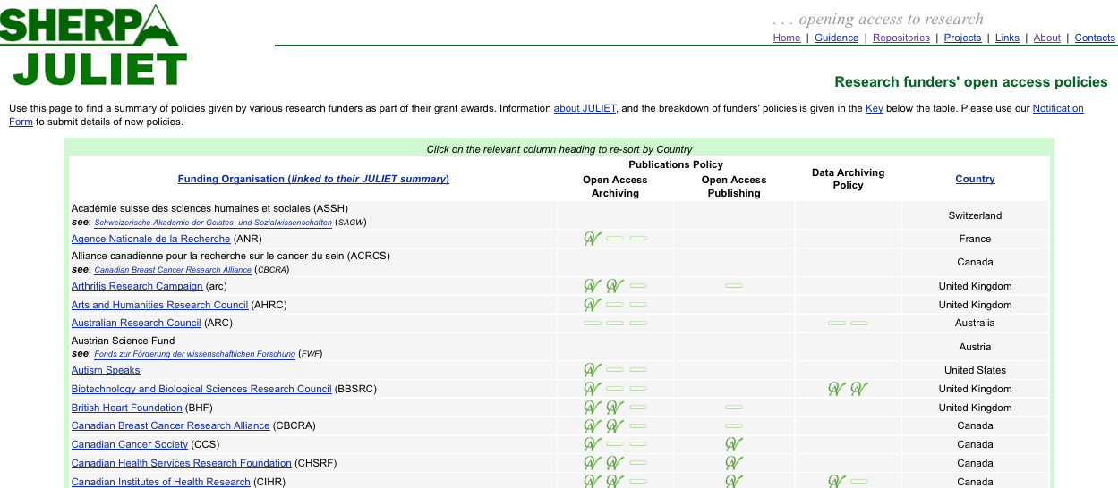
Funding requirements
Notes:
Wondering what the open access policy is for particular research funder? Consult this database of research funders archiving mandates and guidelines. Due to the recent recommendations of the Scholarly Publishing Roundtable, this is very likely going to experience an increase in content!

Slide 53
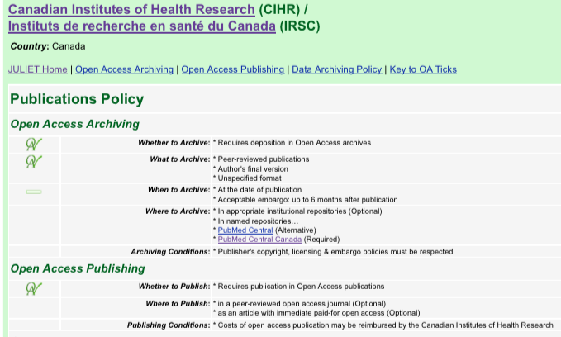
The details

Slide 54
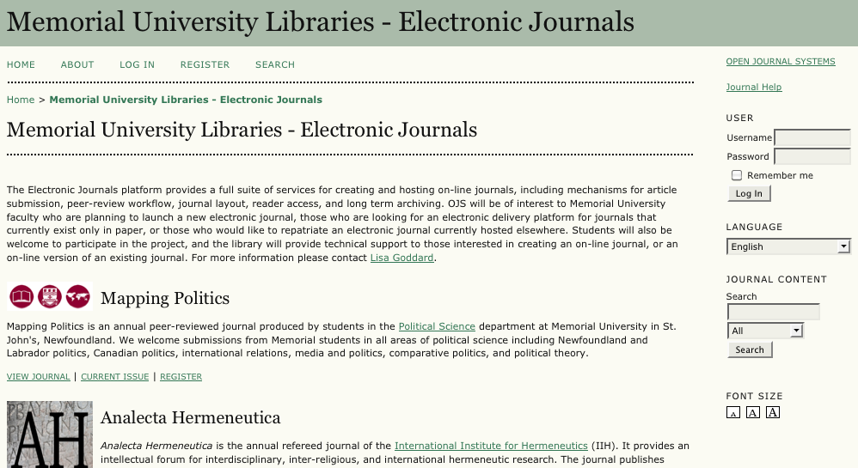
Publishing service
Notes:
****What support do people usually want? How does getting an ISSN work******
Memorial University Libraries are now hosting a free publication service for OA journals. Open Journal systems (OJS) Launching a new online journal?
Want to move an existing journal to OA?
Currently have 2 active journals and 1 is in progress
Two examples of journals we’re already hosting are: Mapping Politics (annual peer-reviewed journal produced by students in the Department of POSC) and Analecta Hermeneutic (annual refereed journal of the Int’l Institute of Hermeneutics. Editor is a MUN faculty member.)
Journal content will be added to our digital archive to ensure accessibility over time.
Provides support for: creating/hosting online journals, mechanisms for article submission, peer-review workflow, journal layout, reader access, and long term archiving. We’ll also provide OJS training and technical support.
No need to worry about access or maintenance issues (Ho article good quotes p 84). “Library publishing services can cover a variety of campus-based scholarly publications, such as peer-reviewed journals, faculty monographs, and technical reports. These services illuminate the library’s changing role in the scholarly communication process6 and reinforce the library’s status as a crucial partner in supporting learning and advancing scholarship.”
“Case 3: Student research reportsProfessor Schulz teaches journalism at the graduate level. Her students have to conduct independent studies and write reports based on their investigations. She wants to make the students’ reports widely available in order to highlight the value of student jour- nalism, so she asks the librarian for ideas.OpportunityThis is a great opportunity to call attention to open access digital repository services, both institutional and disciplinary.7 Local or shared repositories provide dissemina- tion and preservation services that enhance the visibility and accessibility of the institu- tion’s intellectual output. “ (Ho 84)
Open Journal Systems: open source journal management and publishing software
We are actually partners in the Synergies project, a nationally funded effort to create a distributed publishing platform for electronic journals. We recently received grant money from Atlantic Synergies to fund the implementation of an Open Journal System here at MUN
Interested in being involved? Lisa is contact for any inquiries
***Going with DAI, or other software? Who is working on it?***
MUN IR will include all metadata from MUN hosted journals Available in next yr
HRR is a recently launched initiative b/t HSL and Faculty Medicine. This repository showcases/preserves published (only this in Phase 1) and unpublished work Memorial University's health sciences researchers. It will also assist researchers affected by the recently instituted CIHR and NIH policies that require Open Access to funded research. Memorial University applies a Creative Commons Licence to archived work, meaning that authors retain copyright
All information in HRR exists as the HRR Collection in the Digital Archives Initiative (DAI)
Submission form: grant permission (Sherpa); formatting (PDF); uses Creative Commons Attribution Noncommerical No Derivative Works Canada 2.5 License

Slide 55
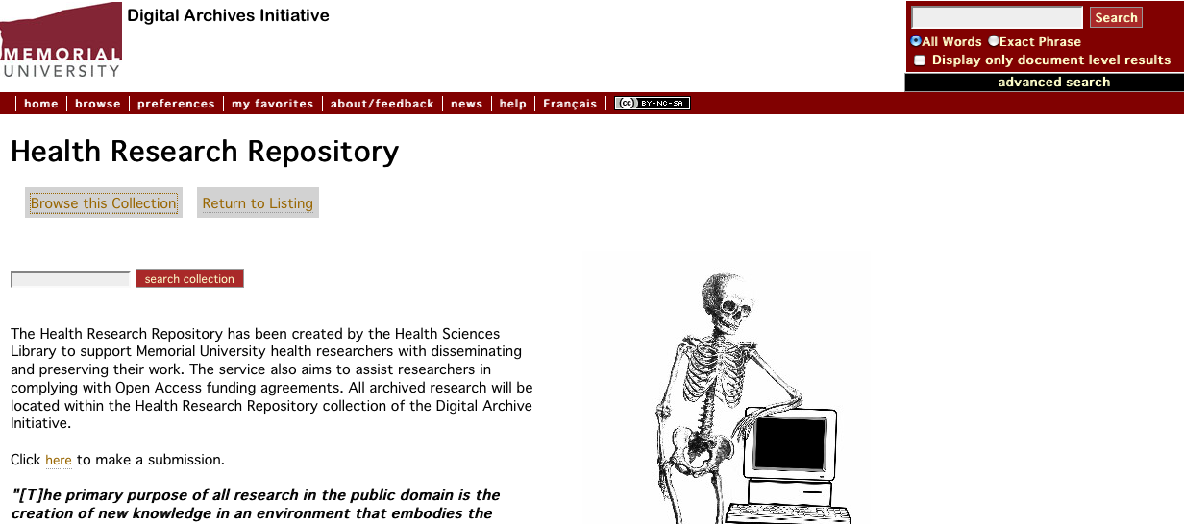
Health Research Repository
Notes:
The Health Research Repository is a new library service made possible by the HSL and Faculty of Medicine.
This repository exists to showcase, preserve and distribute the published and unpublished scholarship of Memorial University's health sciences researchers. Major bonus is that it helps researchers meet the criteria of the new open access policies in force by the CIHR and NIH. Permanent links
Research documents are assigned permanent links and can be "Googled"
Online visibility facilitates access to research, fosters a citation impact advantage, and improves scholarly communication
In Phase I of this project only published documents will be accepted. Unpublished documents may be accepted when the Health Research community at Memorial has created appropriate criteria

Slide 56
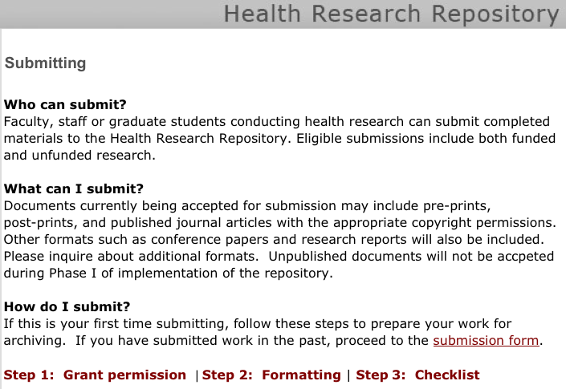
Submission process
Notes:
*Links to submission form*
Important part is confirming that you are not violating any copyright agreements due to submission of PDF.
Uses a Creative Commons License so that the author retains copyright of work.

Slide 57
Why the fuss?
More exposure
Increased impact
Universal access
Easier information discovery
Persistent access
Long-term preservation
Meet conditions of grant agencies
Notes:
There are many advantages to publishing within the OA philosophy:
more exposure (research supports higher citation rates; higher profile for MUN research)
universal access (increase research impact; immediate access)
Increased impact *Recent studies have begun to show that open access increases impact: cited more and earlier on compared to non-OA journals http://opcit.eprints.org/oacitation-biblio.html easier information discovery (visibility in Google. Google/Yahoo give priority to metadata harvested from IRs; harvesting metadata into indexes like OAIster)
persistent access (permalink, ‘reference URL’, no dead links, permanent access; especially useful for CV, website, online portfolios, lets departments showcase work of their researchers, etc)
long-term preservation (and access) *these points are taken from CARL greater reach PDF…p 2 (except for ‘increased impact’ quote)
http://www.earlham.edu/~peters/fos/newsletter/10-02-09.htm <http://www.earlham.edu/%7Epeters/fos/newsletter/10-02-09.htm>
“Journals are not even eligible for IFs until they are two years old, and after that Thomson Scientific only computes IFs for a select subset of journals. …Alternative impact metrics could solve the problems left by IFs, including the discrimination against new journals…….A related challenge is to make clear that we're not looking for new metrics biased in favor of OA journals. We're looking for less biased or unbiased metrics. Only unbiased metrics can help the cause of OA journals and get the buy-in from other stakeholders needed to make them fly…..For example, in the 2008 Journal Citation Reports, Thomson Reuters reports that five OA journals had the highest IFs in their fields: http://thomsonreuters.com/content/press_room/sci/448197

Slide 58
Looking ahead
OA is here to stay
New funding policies
New OA author funds
MUN institutional repository
Notes:
Anything else?

Slide 59
Questions?
lgoddard@mun.ca
sgordon@mun.ca

Slide 60
Recommended readings
Canadian Association of Research Libraries. (2005). CARL institutional repository program. Retrieved from http://www.carl-abrc.ca/projects/institutional_repositories/institutional _repositories-e.html.
Harnad, S. (February 2010). The effect of open access and downloads ('hits') on citation impact: a bibliography of studies. The Open Citation Project – Reference linking and citation analysis for open archives. Retrieved from http://opcit.eprints.org/oacitation-biblio.html.
Scholarly Publishing Roundtable. (2010). Report and recommendations from the Scholarly Publishing Roundtable. Retrieved from http://www.aau.edu/policy/scholarly_publishing_roundtable.aspx?id=6894.

