Slide 1
Creating the visual book through the integration of the divergent technologies of photogravure and digital processes – or – what happens when photogravure collides with digital technology
Marlene MacCallum
Presented on March 29, 2011 at the fourth annual Grenfell Campus Research Showcase, Memorial University, Corner Brook, NL

Slide 2
The research project: Creating the visual book through the integration of the divergent technologies of photogravure and digital processes was generously funded by the Social Sciences and Humanities Research Council of Canada’s Research/Creation Grant Program and Grenfell Campus, Memorial University of Newfoundland. The artist gratefully acknowledges this support and the assistance of her two research collaborators, David Morrish and Pierre LeBlanc.

Slide 3
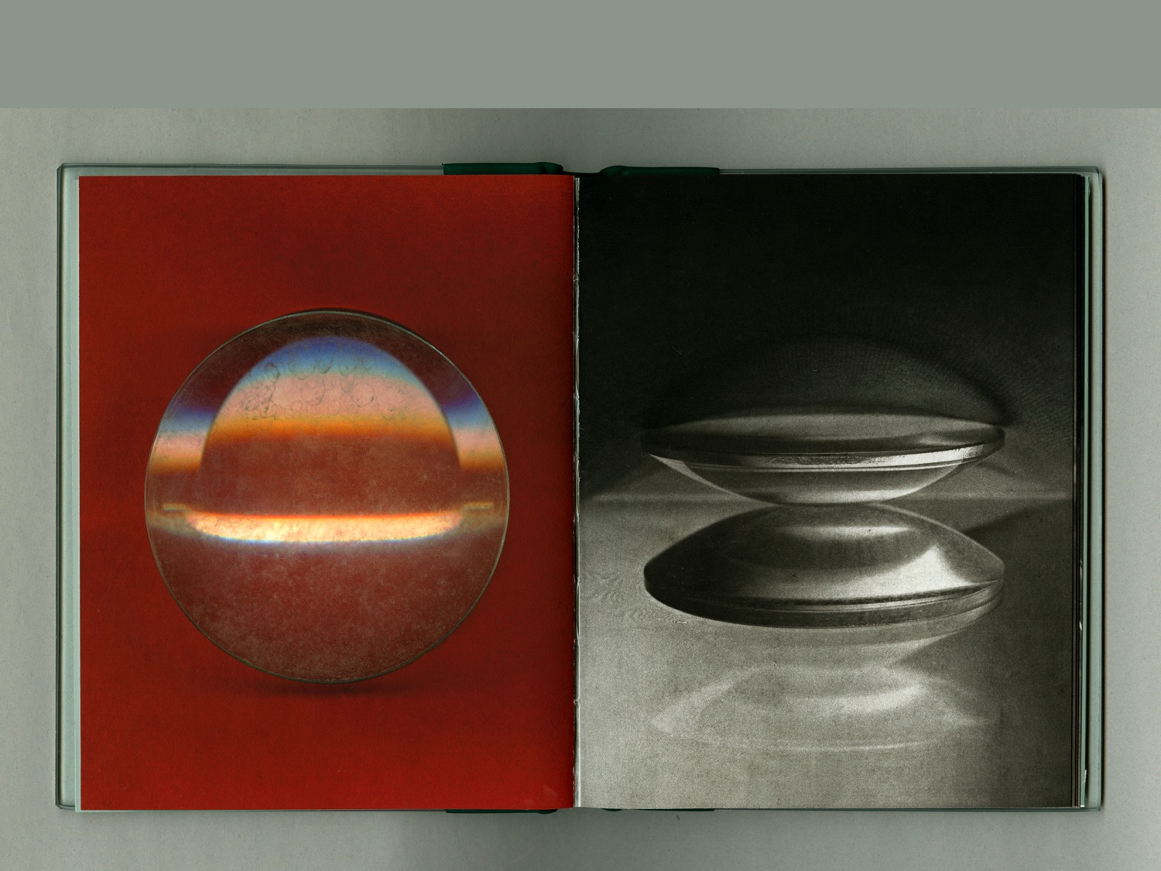
What happens when photogravure collides with digital technology?
1839: the Daguerrotype is announced
1879: Klic perfects the photogravure process
1839: Daguerre announced the Daguerrotype producing one-of-a-kind fragile photographic images and then inventors proceeded to search for ways to create durable photographs that could be produced in multiples.
1969: Smith & Boyle invent the CCD
1996: Epson markets its first inkjet printer

Slide 4
What happens when photogravure collides with digital technology?
1839: the Daguerrotype is announced
1879: Klic perfects the photogravure process
1879: Karl Klic perfected one solution, photogravure, a hybrid method that combined traditional copper etching with the new photographic technology.
1969: Smith & Boyle invent the CCD
1996: Epson markets its first inkjet printer

Slide 5
What happens when photogravure collides with digital technology?
1839: the Daguerrotype is announced
1879: Klic perfects the photogravure process
2007: I began my investigation into the unlikely combination of photogravure and digital processes. My first step was to explore how digital tools create a visual record that is distinct from analogue cameras.
1969: Smith & Boyle invent the CCD
1996: Epson markets its first inkjet printer

Slide 6
These two images were created from the same situation.
On the left, a digital scanner gives us this colour image of two lenses.
The photogravure on the right presents the camera lens view of these same objects as they are being scanned.
1839: Daguerre announced the Daguerrotype producing one-of-a-kind fragile photographic images and then inventors proceeded to search for way to create durable photo-graphs that could be produced in multiples.
After finding new ways to make images using digital tools, the next step was to integrate digital output into the making of four-colour photogravures.

Slide 7
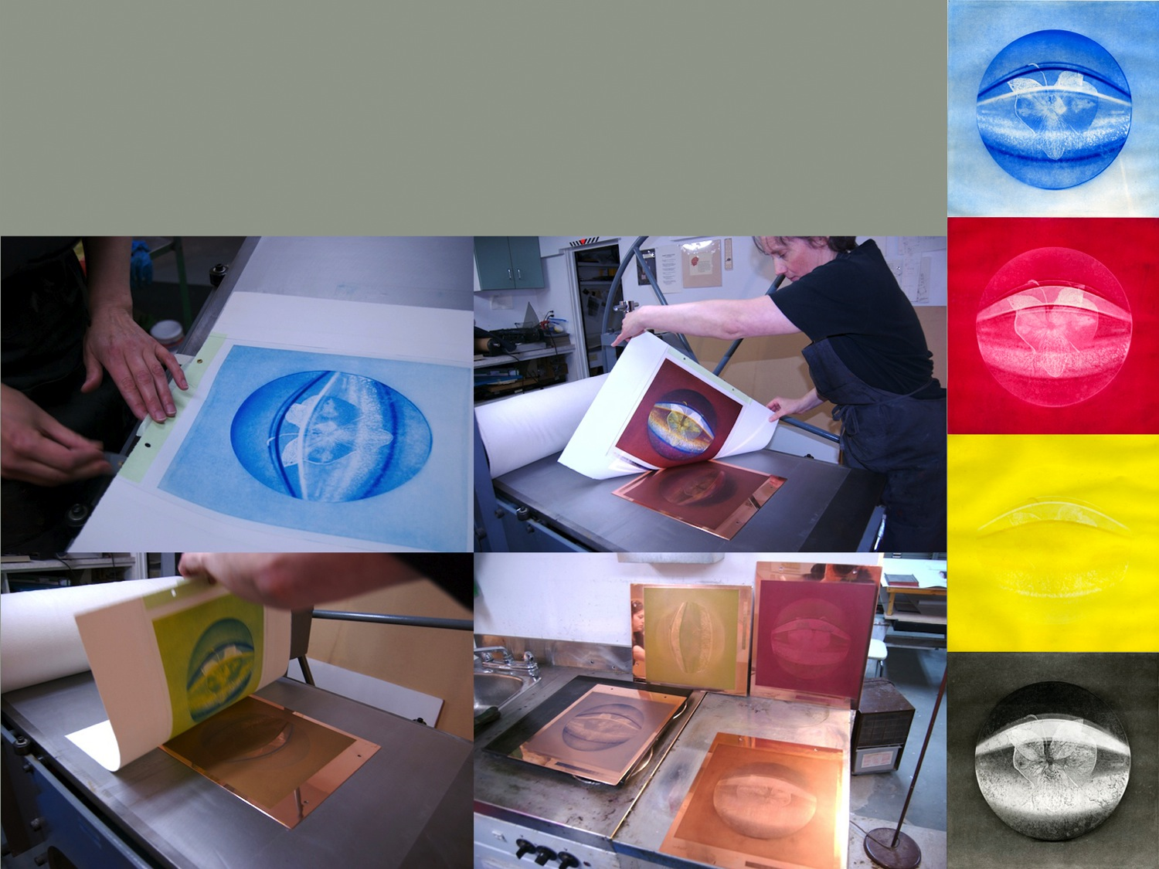
There are six distinct steps in making a photogravure:
create an image source -> print it as a transparent positive ->
Expose this to a photosensitive gelatin resist layer -> adhere it to a prepared copper plate ->
etch the copper plate -> ink and print it by hand onto paper
When you create a four-colour image, you do it four times in perfect registration.
Key steps in making a photogravure:
create image source -> generate a transparent positive ->
expose to gelatin resist layer -> adhere to copper plate ->
etch the copper plate -> and print
\
⬇

Slide 8
Four-colour process printing is ubiquitous, present in almost every printed colour image.
The commercial process presupposes a specific result, the reproduction of an existing image source. As an artist working with a hand-produced version, I can experiment with any aspect of the process and end up with unexpected images.
Key steps in making a photogravure:
create image source -> generate a transparent positive ->
expose to gelatin resist layer -> adhere to copper plate ->
etch the copper plate -> and print
\
⬇

Slide 9
Here you see the process of printing the four plates: cyan, magenta, yellow and key-line black.
Key steps in making a photogravure:
create image source -> generate a transparent positive ->
expose to gelatin resist layer -> adhere to copper plate ->
etch the copper plate -> and print
\
⬇

Slide 10
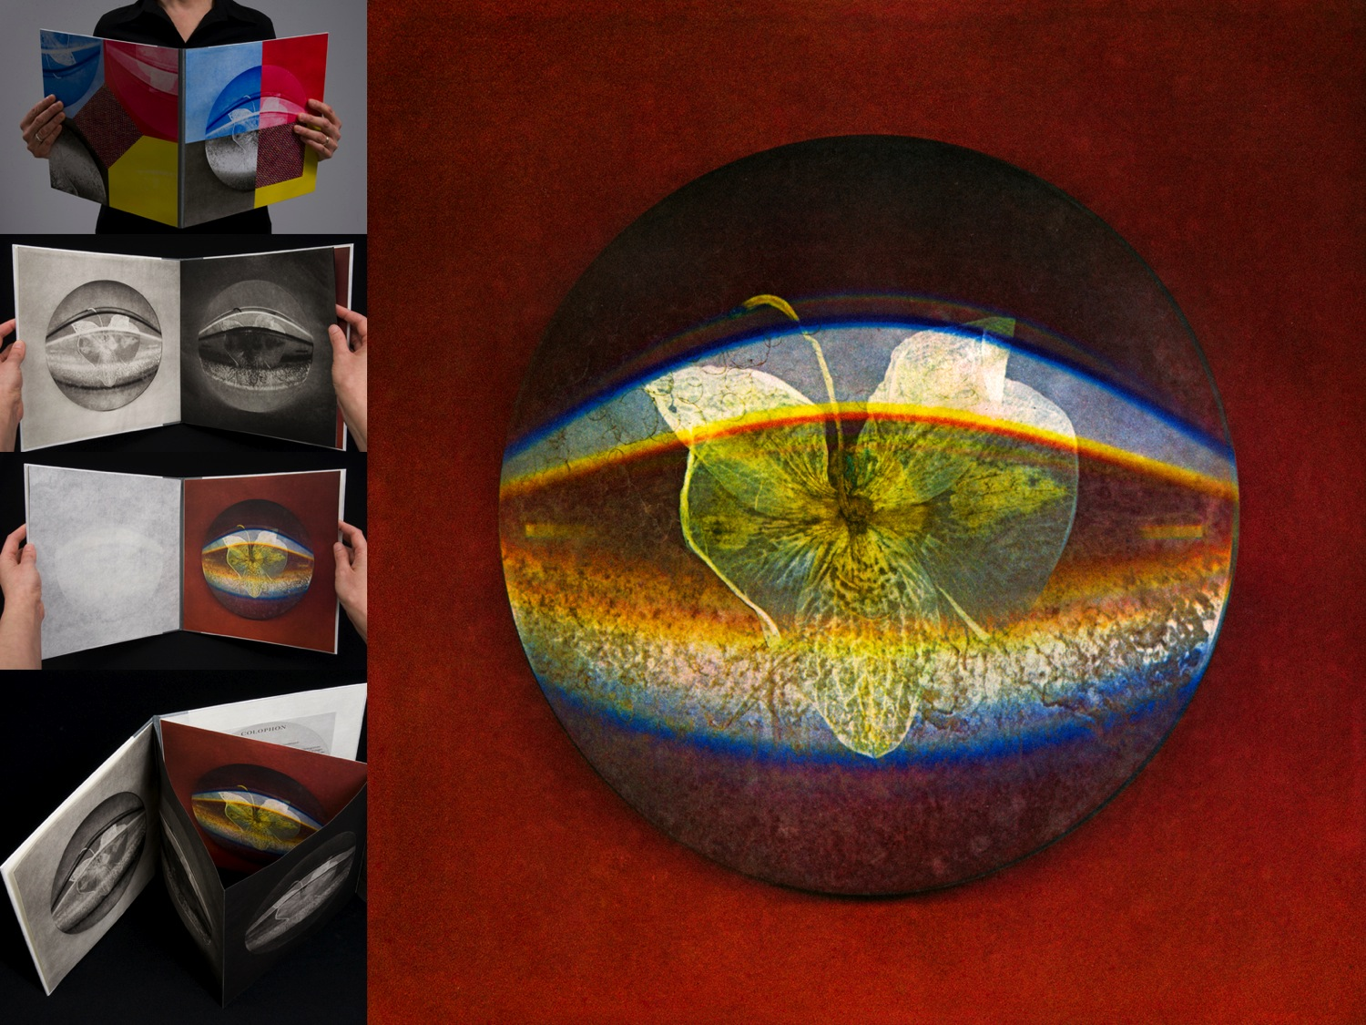
The book work Quadrifid
is the result of the collision of gravure and digital means.
I started with digital tools then resolved through analogue photogravure processes. Why would anyone use an obscure labour-intensive process when easier methods are available? The answer lies in what can be discovered in the process.

Slide 11
In parallel to the impulse that resulted in the invention of photogravure, the most current version of imagemaking is now being used in conjunction with a historical form of photography. Contemporary artists are motivated to make these discoveries because we are seeking ways to personalize the default surface of a digital image.

Slide 12
What happened when I combined two divergent systems?
I expanded my knowledge of the ways visual recording devices transform our representations of the physical world.

