Slide 1

How do community stakeholders and researchers come together to develop health policy?
Lessons from the Kahnawake Schools Diabetes Prevention Project (KSDPP) on developing a school-based physical activity policy.
Lindsay Hogan Jon Salsberg
Judi Jacobs Dr. Ann C. Macaulay
Dr. Enrique Bengoechea Garcia
June 15th, 2013
Notes:
Mention Kahnawake Schools Diabetes Prevention Project will be referred to as KSDPP

Slide 2

KSDPP Context & History
Kahnawake
  Identity: Kanien'kehá:ka - Mohawk
  Location: Southwest of Montréal, Québec
  Population: ~8000
KSDPP - A community identified need
Notes:
https://www.youtube.com/watch?v=k4EyeJXOSk0

Slide 3
Mission Statement of KSDPP
The Kahnawake Schools Diabetes Prevention Project (KSDPP) designs and implements intervention activities for schools, families and community to prevent type 2 diabetes through the promotion of healthy eating, physical activity and positive attitude for present and future Kahnawakero:non and for other Aboriginal communities.
KSDPP conducts community based research on these activities, trains community intervention workers and academic and community researchers and reports all research results to the community.

Slide 4
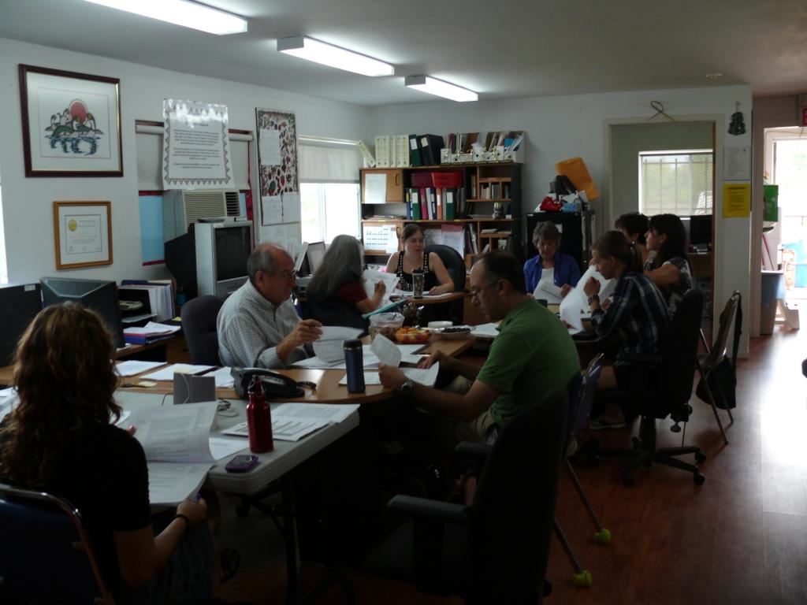
KSDPP Structure
Notes:
Describe roles of each and how decisions are made
– need each part to function, with the community (CAB) having the final say on everything

Slide 5
KSDPP Code of Ethics
The purpose of the KSDPP Code of Research Ethics is to establish a set of principles and procedures that will guide the partners to achieve the goals and objectives of the KSDPP.
The KSDPP Code of Research Ethics outlines the obligations of the partners throughout all phases of the research process.
Can be found at WWW.KSDPP.ORG
Notes:
Jointly created by researchers and community advisory board

Slide 6
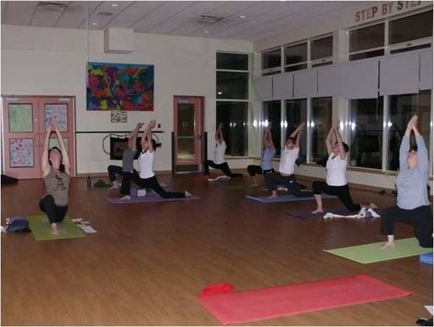
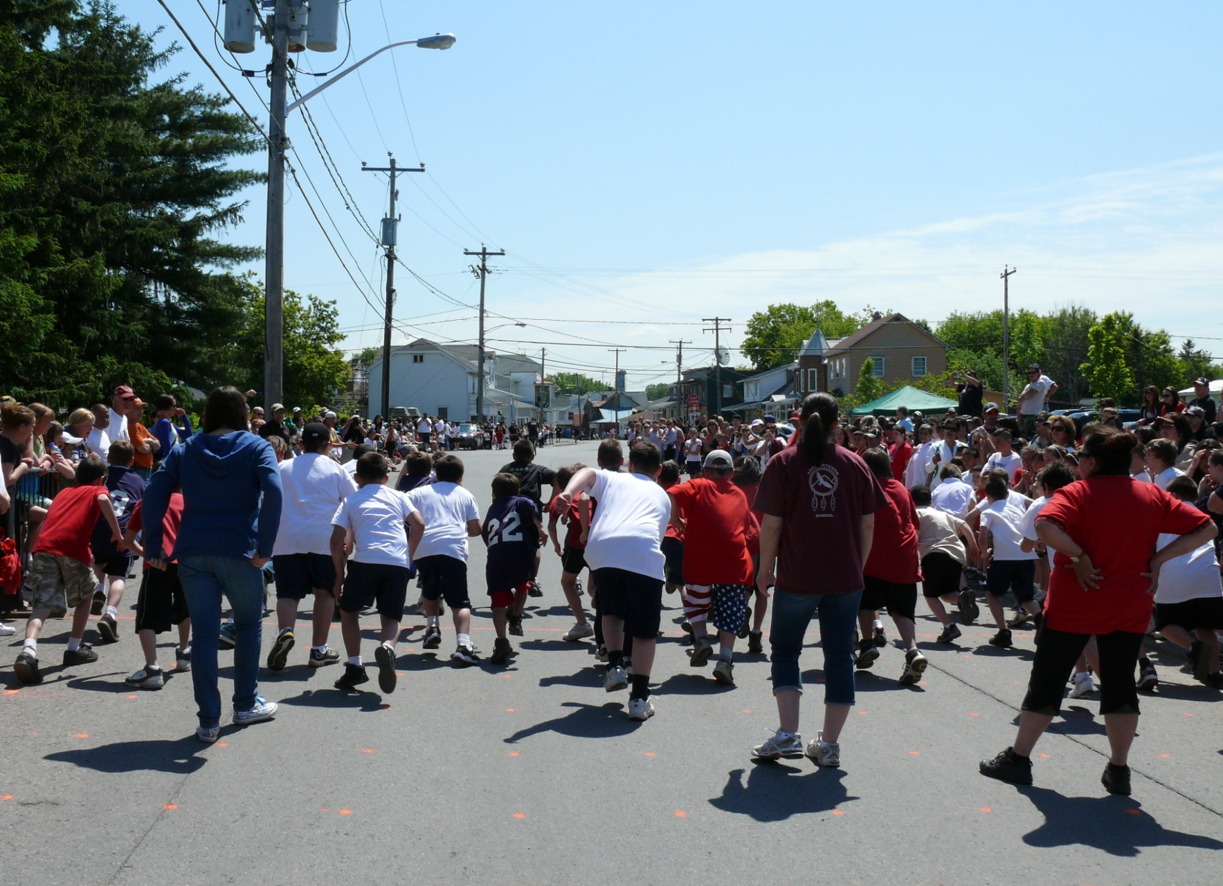
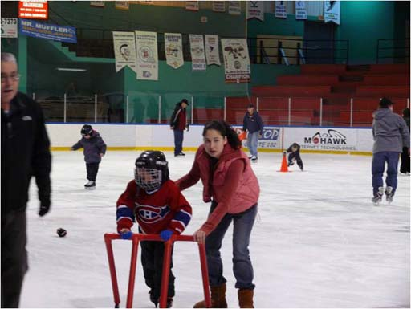
KSDPP Accomplishments
19 years old
CIHR Partnership Award in 20??
Community capacity building- PhDs, Post Docs, Master’s, summer students, Band Council

Slide 7
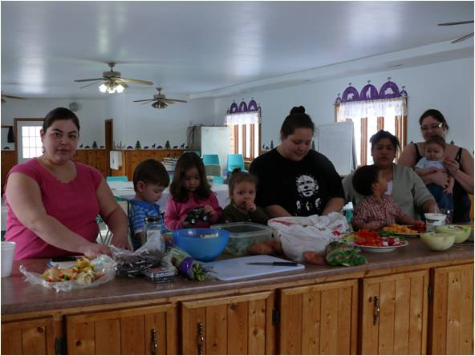
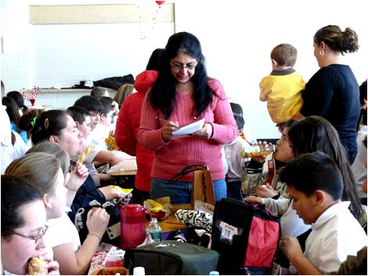
KSDPP Accomplishments
Intervention work
  School events, programs, policies & curricula
  Recreation path
  Community programs & events
  Reorientation of health services
Notes:
School Events: Racers for health, brown bag lunch, etc
Programs: after school sports league, project playground
Community programs & events: fitness classes, warrior challenge, Sadie’s & Mother’s day walk, workshops
Reorientation of health services: diabetes treatment and prevention services on new committee together

Slide 8
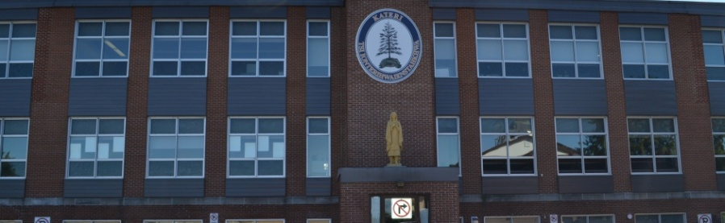
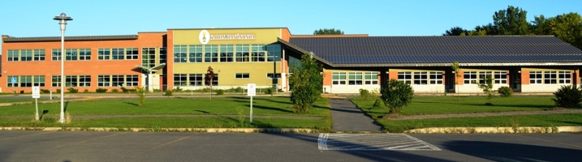
Participatory Policy Intervention to Promote School-Based Physical Activity
Kateri Elementary School
Karonhianonhnha Elementary School
Notes:
1. Provide school context - Kateri = english Karon = mohawk immersion population: 410
2.Why a PA policy?
-PA policies have been endorsed by major health organizations such as the US dept health and human services, WHO
-Research on school based interventions to date show only minor or short term effects and that many of these interventions focused solely on using education as the main intervention component and that perhaps, due to this, more whole-school multicomponent approaches should be used : HPS. Coordinated/comprehensive school health (all see policy as important part of the puzzle)
-a Health Promoting School adopts a holistic framework that seeks to use all available resources and various leaders to improve the health of the entire school community through many means including health education, adapting environments, adopting health supporting policies and practices, and the provision of health services, programs, and opportunities
-Nutrition policy implemented in 2009
-Community identified need for PA component
3.RT & CAB, with consultation from school administrators, worked together to plan policy project, received CIHR funding

Slide 9
Project Objectives
To develop and implement the physical activity component of a school-based wellness policy,
evaluate the facilitators and barriers to implementation, uptake and application of the findings among a wide range of stakeholders, and
disseminate the findings to a wide range of stakeholders (internally & externally).
Notes:
Internally to Kahnawake and then externally to other aboriginal and non-aboriginal communities

Slide 10
Baseline Evaluation Phase
School Health Action Planning and Evaluation System (SHAPES)
7-day physical activity recall
Physical Activity Interactive Recall (PAIR)
Adult Focus groups
Child Photovoice project
Notes:
Discuss purpose of baseline evaluation – both for follow up evaluation purposes and as a sort of needs assessment
SHAPES: completed by principals/phys ed teachers
7-day: parents completed with children at home for gr1-3, in-class for gr 4-6
Pair: 4-6 in class, explain tool – 24h culturally tailored interactive computer survey
Adult focus groups: variety of stakeholders – parents, principals, teachers, pe teachers
Photovoice: gr5&6

Slide 11
Forming the Committee
Introductory dinner
Goal was to fill stakeholders roles
Committee:
a parent,
a classroom teacher,
a teacher’s assistant,
a health ed. teacher,
a P.E. teacher/parent,
2 principals,
a hospital nutritionist,
3 KSDPP intervention staff,
2 academic researchers,
and 1 research assistant
Notes:
Stakeholders:
-Our goal was to have 1-2 stakeholder roles filled from each school (parent, classroom teacher, principal, PE teacher) as well as other relevant community stakeholders..
-Introductory/invitational dinner – 20 people
-Our core policy team consisted of: 1 parent, 1 classroom teacher, 1 health ed. teacher, 1 P.E. teacher/parent, 2 principals, 1 hospital nutritionist, 3 KSDPP intervention staff workers (including 1 playground animator), 1 community student teacher, 2 academic researchers, 1 research assistant

Slide 12
The Process
Eight 1-2 hour dinner meetings over three months
Collaborative relationship
Initial meetings – value focused
Later meetings – reviewing information/results and drafting policy statements
Notes:
Every session, the committee members engaged in a roundtable dialogue that was essentially a negotiation between what was ideal in terms of policy statements and what was feasible in terms of policy implementation. Initial meetings focused on discussing community health values and using a positive approach to health promotion as well as what would work and what would not work in their community. Later meetings focused on drafting a suitable policy considering everything viewed and discussed. The diverse group used their personal knowledge and experience, results from the policy’s baseline evaluation, evidence-based information from the literature, and any additional requested materials (such as policy examples) in order to develop the PA policy.

Slide 13
Information Used
SHAPES & Literature Review (Lagarde & Leblanc)
Example policies
Photovoice Results
Adult Focus Groups

Slide 14
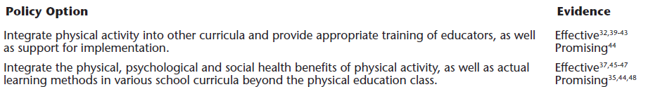
Daily, quality, safe physical activity
SHAPES
Both schools reported taking action towards integrating physical activity into various school subjects, but more consistent incorporation is needed.
Notes:
Example of SHAPES/lit review presentation for committee

Slide 15
Photovoice Results
Barriers
How and why they get active
Recommendations
Facilitators
Notes:
Example of PV presentation for committee

Slide 16
Increase Recess Time
Increase Movement in Classroom
Equipment Provision
Increase Activities Offered
School Rule Changes
Changes to Physical Education
Changes to Built Environment
Recommendations

Slide 17
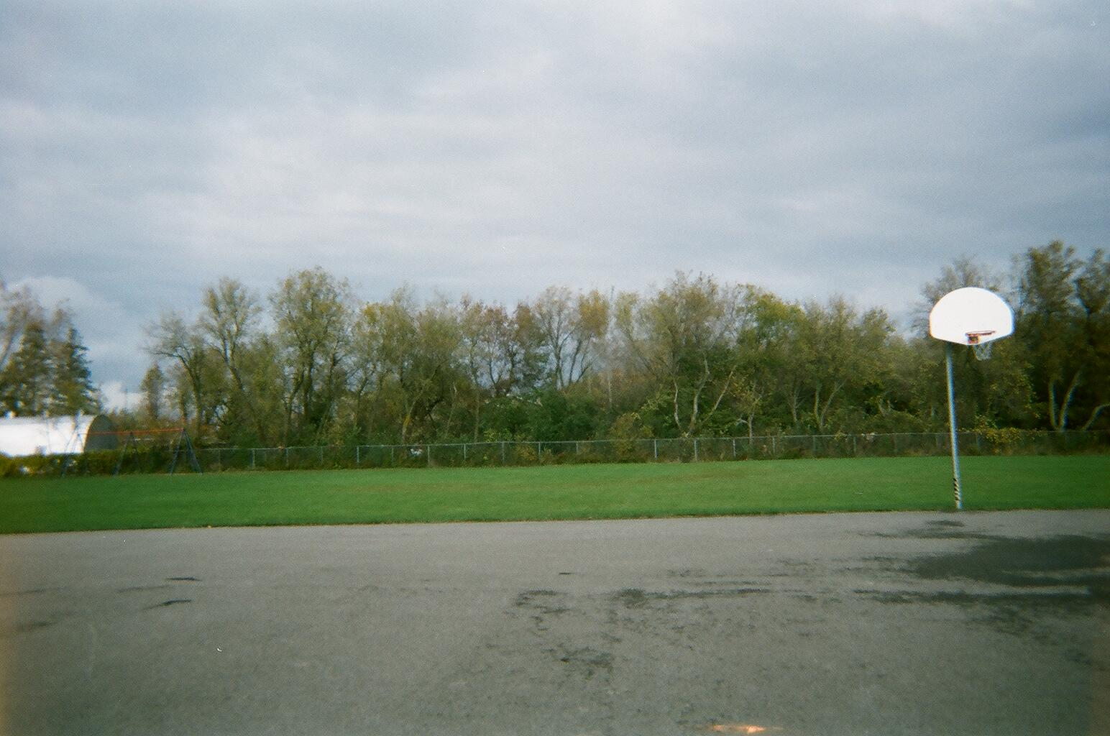
Sport Surfaces
Students expressed interest in more sport surfaces both at school and in the community:
Soccer field
Tennis court
Baseball field
Ice surface
I would like a soccer field in our school yard to kick on the net.
Notes:
Examples of children’s suggestions for the built environment

Slide 18
Information Used
Adult focus groups
  Need to use locally relevant data
  PA opportunities are limited, need to diversify
  Policy needs to be flexible and formed by those who will apply it
  Need more human resources for PA programming
  Other school policies may not support extracurricular work of the P.E. teacher
Notes:
Example of adult focus group results
The main findings of this focus group were that locally relevant data would be needed to form the policy, current child PA opportunities are limited and need to be diversified, the policy needs to be flexible and formed by those who will apply it, there is a need for more human resources for PA programming, and that other school policies may not be supporting the extracurricular work of the physical education teacher.

Slide 19
The Product – A New PA Policy
The produced policy document is prefaced by a philosophical statement and outlines guiding principles and recommendations to create or increase opportunities for physical activity in the following target areas:
1) Physical education
2) Lunch and recess
3) Extracurricular physical activities
4) Classroom
5) Family
6) Community
7) Staff
8) Active transportation
9) Safety
Recommendations for implementation and evaluation of the policy are also included in the document.

Slide 20
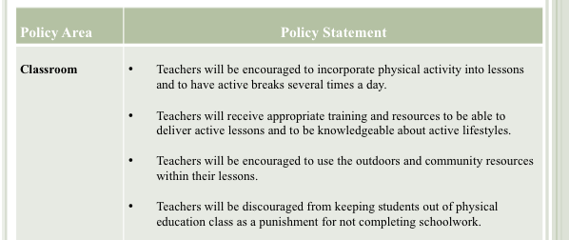
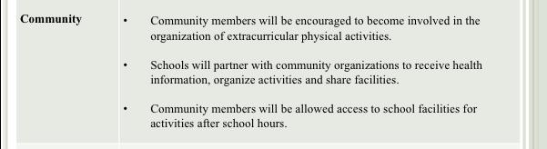
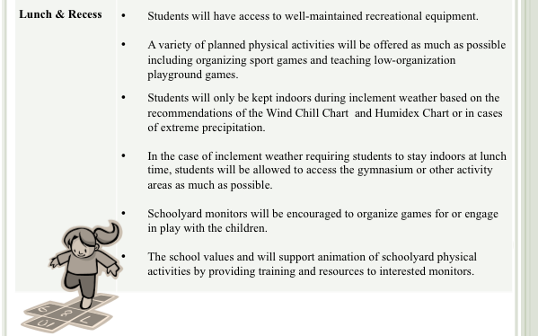
The Product

Slide 21
Barriers & Facilitators
Working within existing structures of KSDPP
Well established in community
Schools committed
Secured grant
Notes:
The policy development process was influenced by a variety of factors, some of which helped move the process along more smoothly and others that made decision-making and progress more difficult. These factors included the existing structures of KSDPP, appropriate stakeholders, and school contextual factors.
-Having this positive community reputation made recruiting and retaining policy committee members for this project much easier.
-Grant allowed funds for catered meetings, research assistants, and the collection of baseline data

Slide 22
Barriers & Facilitators
Appropriate stakeholders
Including end-users maximizes likelihood of implementation
Can’t make decisions without the right people at the table
Notes:
Having many end-users of the product (teachers, administrators, and parents) helped to both maximize its appropriateness and likelihood of implementation.
However, several questions were raised during the policy’s development that were difficult to address without the appropriate people at the table. This refers either to stakeholders who were absent for the particular meeting or to stakeholders we did not secure to be on the committee. For example, the school principals involved in this project understandably had a busy schedule and were not able to attend all meetings. When this was the case, the group felt it was inappropriate to address school level policies such as allowing skateboards at school to promote more active commuting to and from school.
-nobody from KEC – couldn’t discuss compensation policies for PA leaders
-Few parents – became a troublesome area
-active transportation – tricky area..need public works rep or police

Slide 23
Barriers & Facilitators
Existing school programs and practices
Schools already run many PA programs, have daily recess, and partner with community organizations
School schedule remained rigid, greater focus on academics rather than extra PA
Notes:
Existing school programs and practices served both to help and constrain the work of the policy group.
-On the one hand, the schools already do a lot to promote PA like running a number of afterschool or lunchtime sports, providing daily recess, and teaming up with community recreation organizations. The policy committee simply had to find ways to build on these promising programs and practices.
-On the other hand, some school programming and practices restricted the ideas of the committee. Several committee members suggested the possibility of increasing physical education minutes, time devoted to being active in the classroom and/or time spent outside for lunch and recess in order for the children to have more time to move during the day. The complexity of changing the school schedule raised a lot of concerns. If the schools were able to redistribute or extend school time, extra PA would not necessarily be the first priority. Instead, certain academic subjects might get more attention. One principal noted in reference to the school day, “I know if ours got extended, we’re sticking in more math.” Further, if they were to extend outdoor recess or lunch, they would need to find room in the budget to pay the schoolyard monitors for their added time. As one committee member put it, “Everything has a domino effect on something else.” So, because of the complexity of school programs and practices, the schedules were considered to be inflexible and the committee had to instead find ways to fit PA opportunities into current ways of doing things.

Slide 24
Implementation
Informal communication between KSDPP intervention team and school staff
Parent & teacher feedback forms
Administrator policy tracking forms
Various promotion activities
Committee meetings
Notes:
Key to have KSDPP intervention staff as link to school community –perfect example of how RT & intervention work together
Promotion activities: radio, pamphlets at parent-teacher nights and other events, facebook, etc

Slide 25
Future Steps
Continued implementation support
Wellness Committee: school travel planning & sleep projects
Follow up evaluation Fall 2013
New grant

Slide 26
Questions?
Check out more from the Kahnawake Diabetes Prevention Project at www.ksdpp.org

