Slide 1
Community-university partnership programmes: being ProActive
John Boughey & Lulama (Lulu) Cele
University of Zululand and Sinomonde Agricultural Co-operative
CU Expo 2013, Corner Brook
14/06/13

Slide 2
Departing from the original script……………..

Slide 4
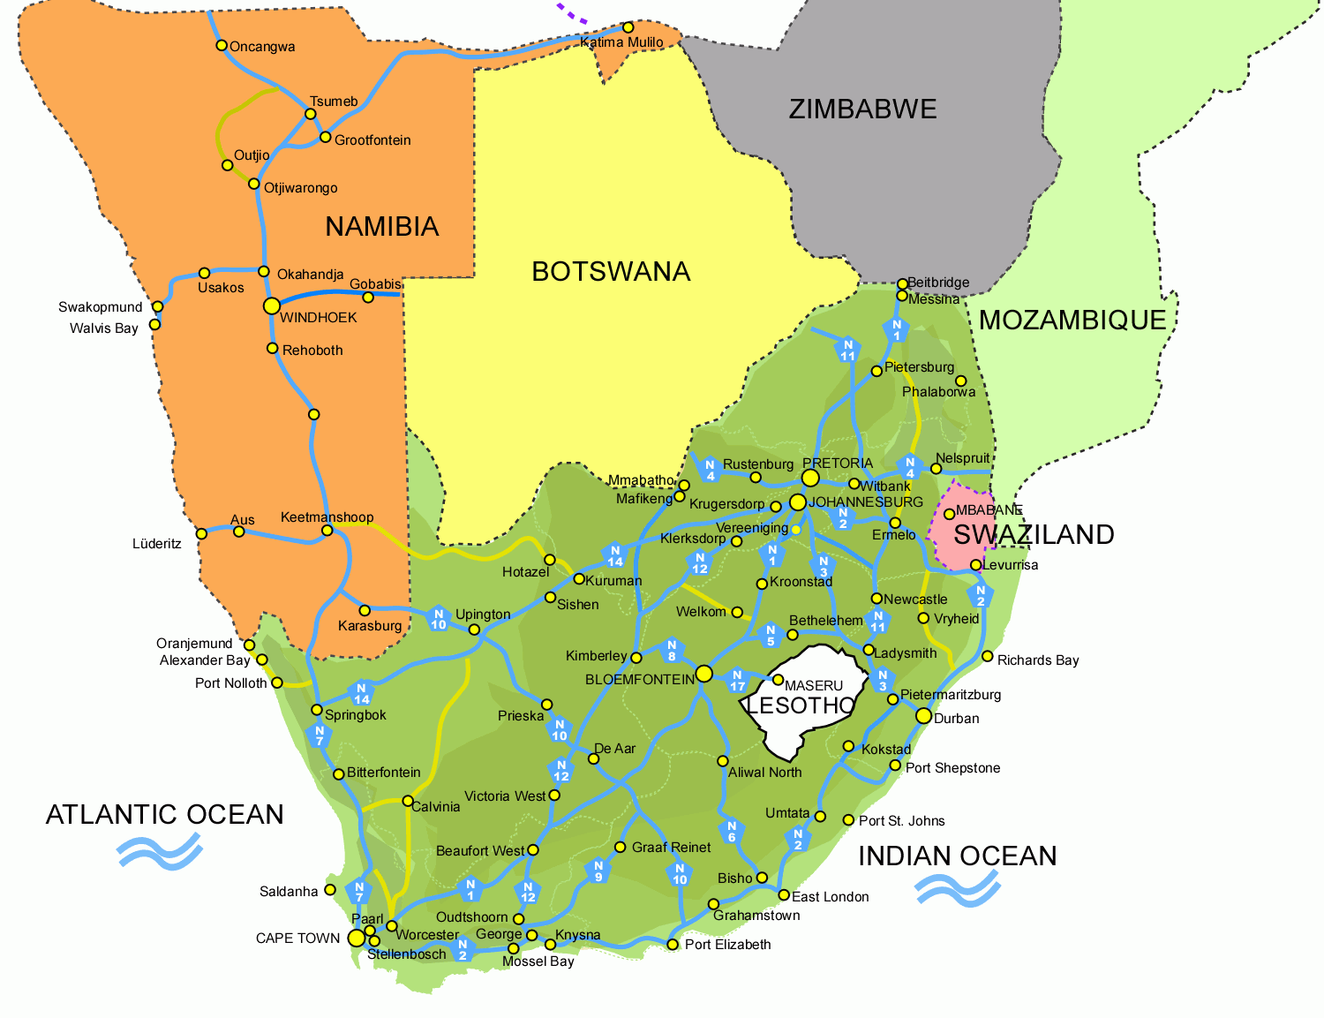

Slide 5
Zululand

Slide 6
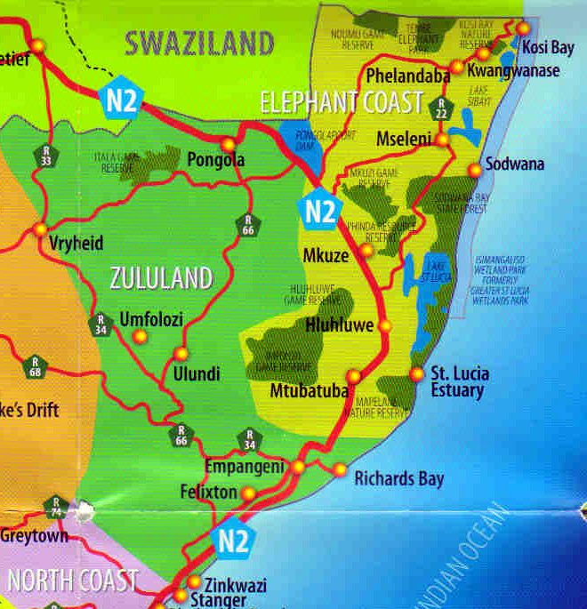

Slide 7
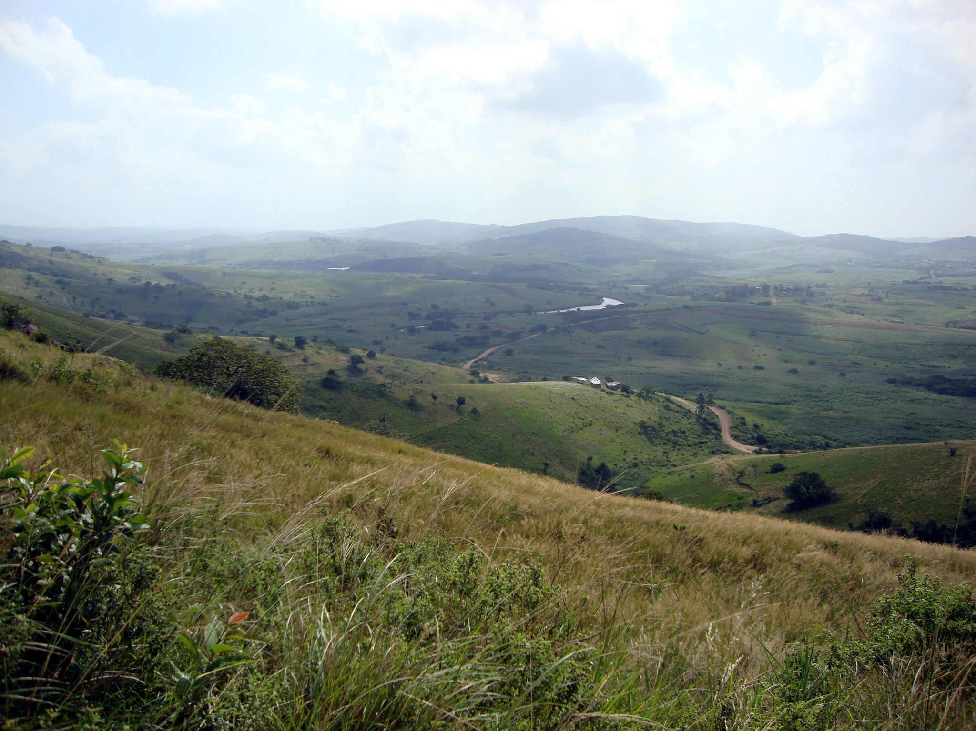

Slide 8
The University of Zululand
A rural-based campus (1960)
A city campus (2009)
16,000+ students (2013)
Four Faculties
Arts
Commerce, Administration & Law
Education
Science & Agriculture

Slide 9
The Community-University Partnership Programme (CUPP)
Equal and fair partnerships between HEIs and communities, are an effective vehicle for:
solving problems
facilitating development
sharing lessons
generating knowledge
adopting new techniques and innovations

Slide 10
A little bit of theory……
Equal and fair partnerships between HEIs and communities, explored through the notion of ‘participation’ and the continuum between ‘relationships’ and ‘partnerships’.

Slide 11
Adapted from Wals & Jickling 2002
Being ‘Participatory’
Pretty’s (1995) Typology of
Participation
Integrated
participatory
democratic
Self-mobilisation and
connectedness
Emancipatory
People participate by taking initiatives independently to change systems. They develop contacts with external institutions for resources and technical advice they need, but retain control over how resources are used.
+
Interactive participation
+
Transformational
With
People participate in joint analysis, development of action plans formation or strengthening of local groups or institutions. Learning methodologies used to seek multiple perspectives, and groups determine how available resources are used.
For
Community input
Functional participation
Transactional
Negotiability of goals
Participation seen by external agencies as a means to achieve their goals, especially reduced costs. People participate by forming groups to meet predetermined objectives.
Bought participation
Univer sities
doing things…
To
People participate in return for food, cash or other material incentives. Local people have no stake in prolonging technologies or practices when the incentives end.
Participation by consultation
Exploitative
People participate by being consulted or by answering questions. Process does not concede any share in decision-making, and professionals are under no obligation to take on board people’s views.
Enos & Morton 2003
In Bringle et al 2009
Instrumental
Passive participation
People participate by being told what has been decided or has already happened. Information being shared belongs only to external professionals.
John Boughey
2011
hierarchical
authoritative
technocratic

Slide 12
From “Relationships” to “Partnerships”
Development = “creative collaboration around an emergent agenda” built on a foundation of “relationships with individuals and communities” (Dazé et al (2009)
‘relationship’ - a general and broad term to refer to all types of interactions between persons
‘partnership’ – a relationship in which the interactions possess three particular qualities: closeness, equity, and integrity. (Bringle et al 2009)

Slide 13
What is an appropriate methodology for “Equal and fair partnerships between HEIs and communities” ?

Slide 14
ProAct: the AR and PM cycles, with PM templates
(5) Project Wrap-up
Report
(6)Project Lessons
Learned
FINISH
(1) Project Charter
PLAN
(4) Scope Change
Request
Identify
Design
REFLECT
ProAct
ACT
Implement
(2) Project Scheduling
Evaluate
OBSERVE
= Action Research Cycle
(3) Project Status
Report
= Project Management Cycle
John Boughey
2011
ABC
= selected PM tools/templates

Slide 15
Sinomonde Project
Sinomonde (a Xhosa word meaning ‘we have patience’) is an all-woman vegetable farming Co-operative located in Mbonambi, in the University of Zululand’s local community.
It is one of the Community-University Partnership Programme’s (CUPP) projects selected for installation of an organic vermiculture (worm farm) unit.
The co-operative is currently growing cabbages for their own consumption and for sale through an MoU with Massmart.

Slide 16
First objective of the project was to use a piece of land to grow produce initially for the consumption of co-op members but, in time, for sale to generate income for co-op members

Slide 17
The choice of organic fertilizer on the land (from a worm farm) stemmed from a general desire to be part of the ‘greening’ of the economy in the fight against global warming. The choice was also affected by health and business issues. Organic food is generally considered to be more healthy, and there is a growing market for food produced in this way.

Slide 18
This is a research project. One of the aims is to see if the production of organic fertilizer is sustainable.

Slide 19
A second aim is to ascertain whether the system produces a higher yield of crop, both in size and quantity.

Slide 20
Sinomonde Agricultural (Primary) Co-operative

Slide 21
Reflections on the (Participatory) Action Research process
It is important to consciously and systematically plan, act on that plan and observe how the plan unfolds, reflect on whether it has worked or not, and then change your plan if necessary.
Being required to consciously and systematically reflect helps us make more thoughtful decisions.
Realisation of the importance of identifying and working with other stakeholders, and moving from simple ‘relationships’ to more powerful ‘partnerships’.
Nothing goes according to plan! So be prepared to be creative and flexible.
As the next slide indicates, the concept of Action Research is best negotiated with non-academics by building from participant conceptions and going back to pencil-and-paper.

Slide 22
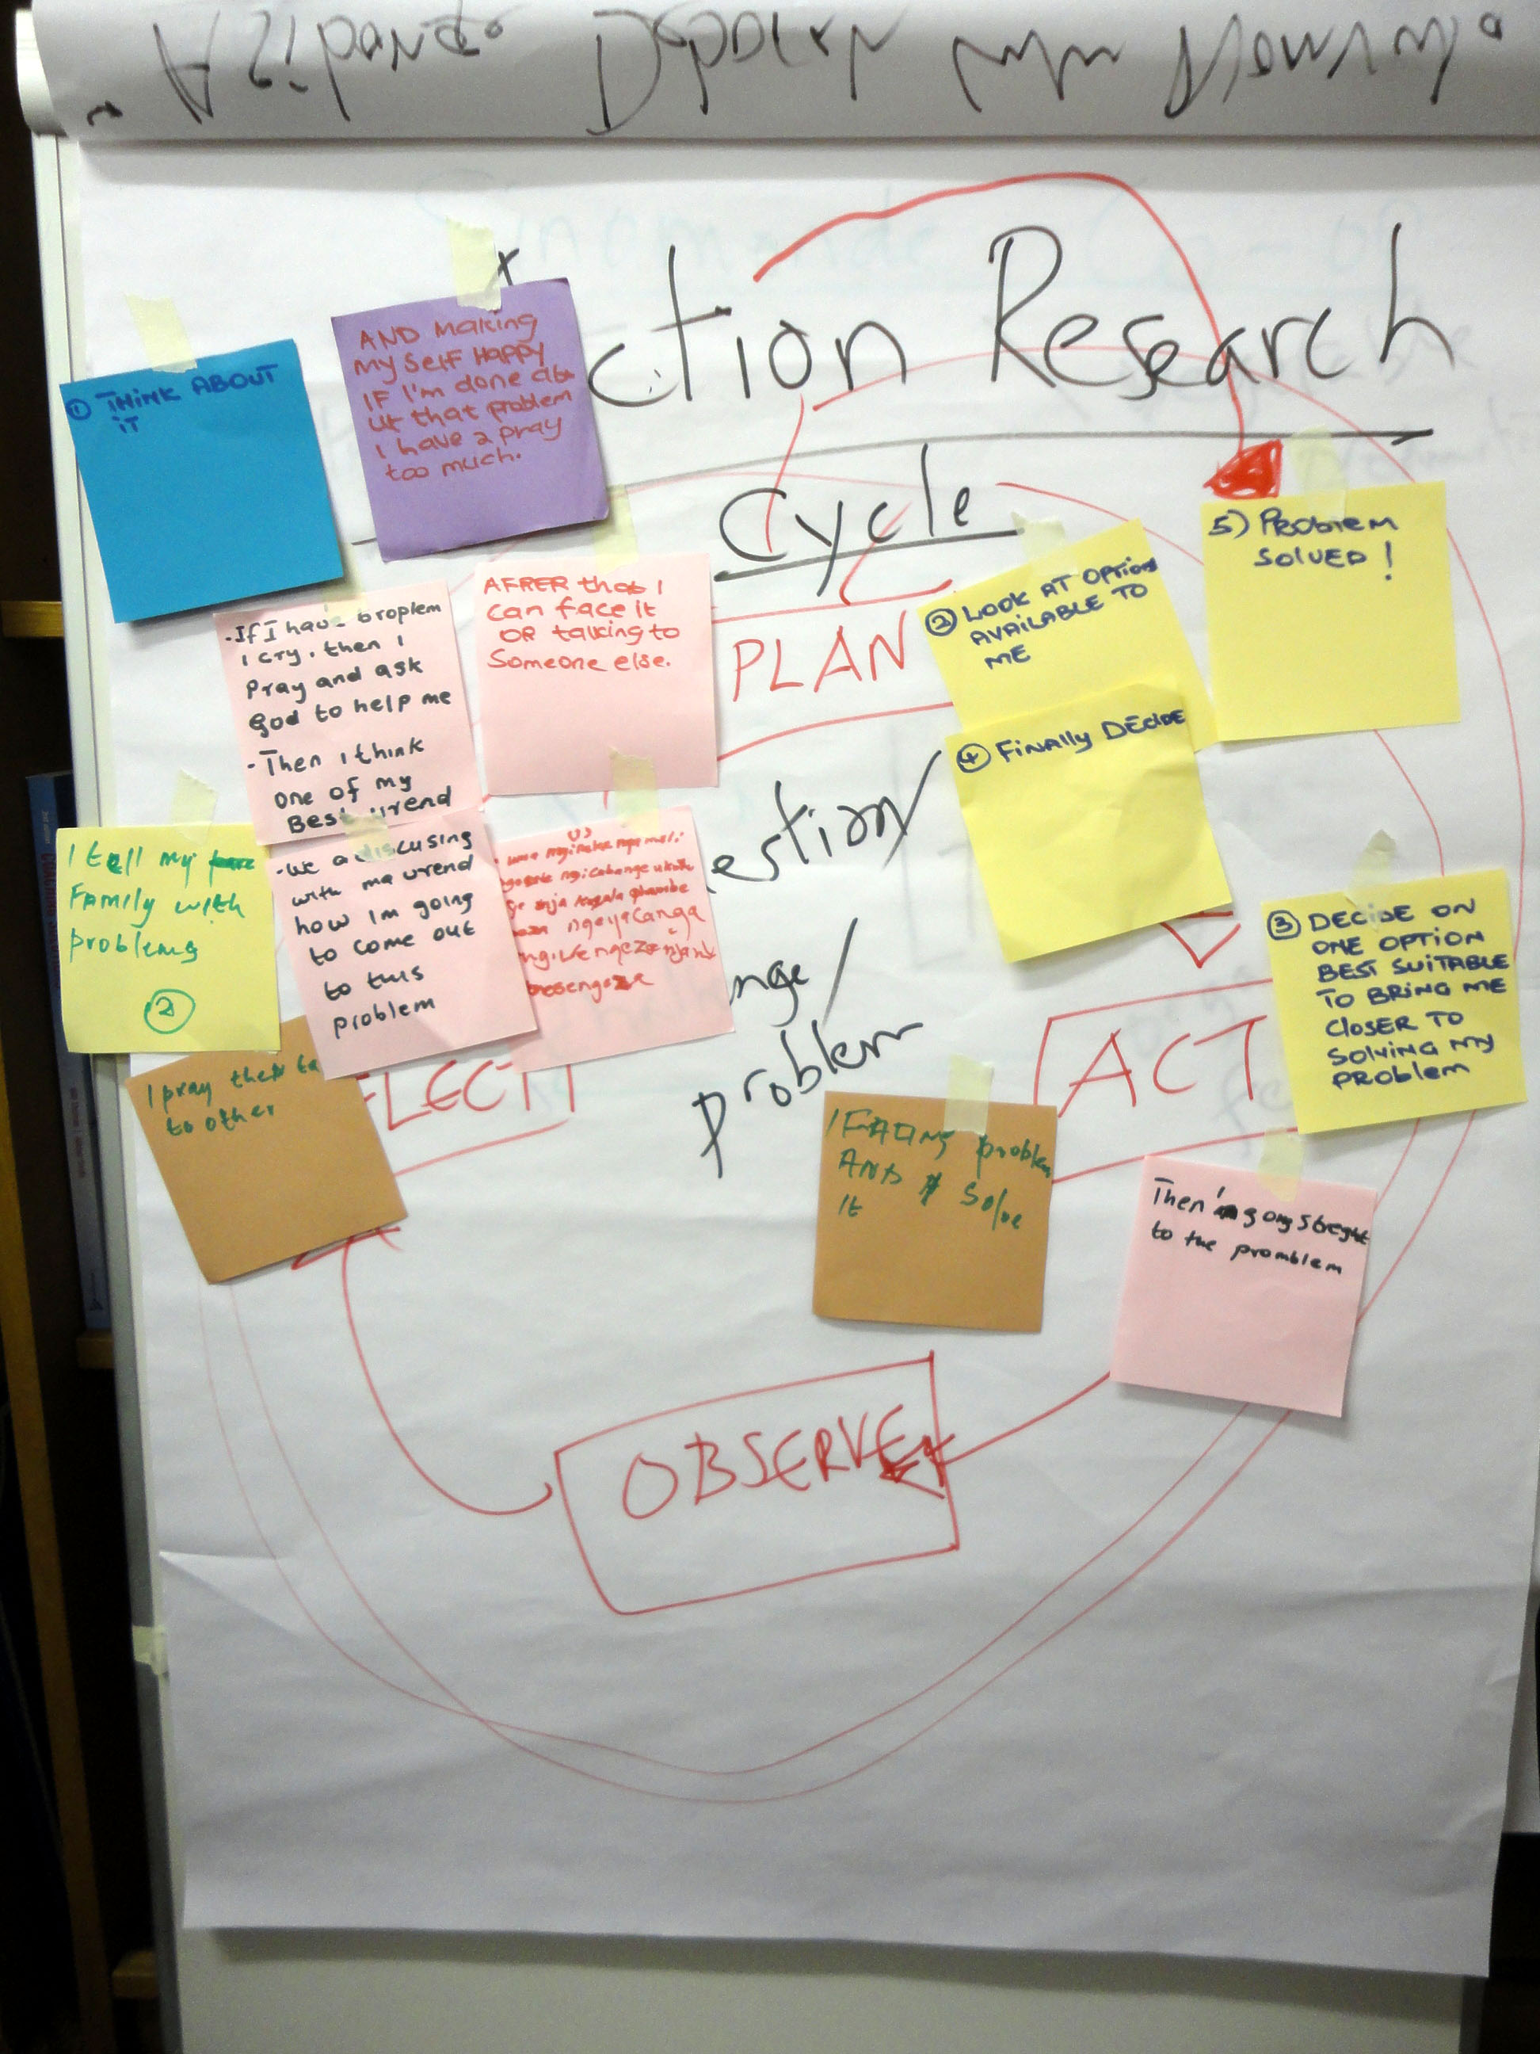

Slide 23
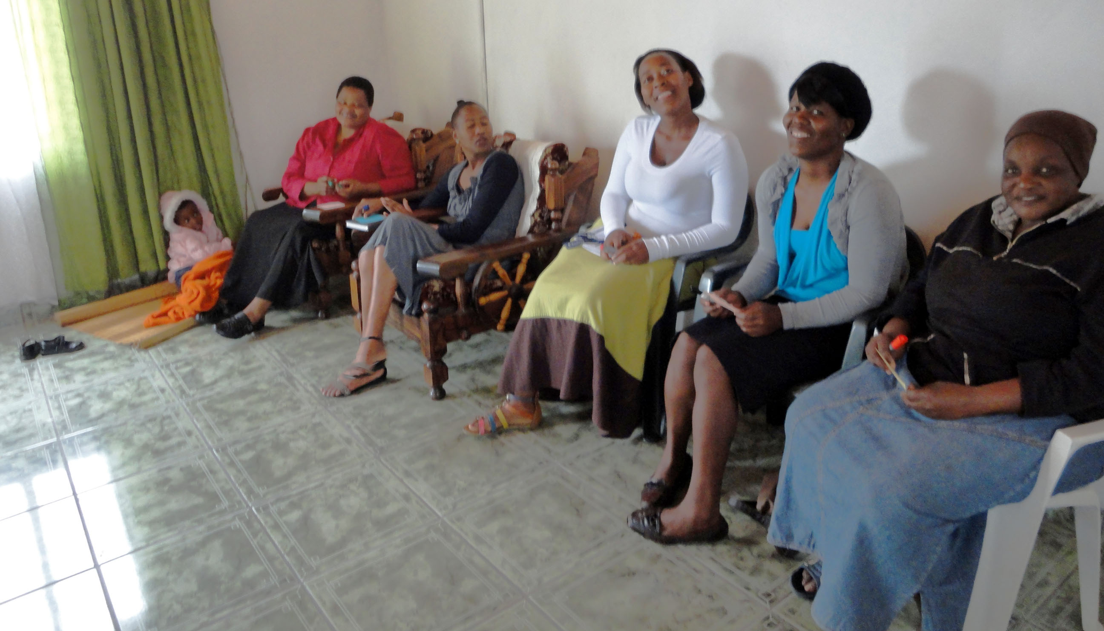

Slide 24
Seed funding
As a result of a visit by the University to the COP 17 exhibition in Durban (Dec 2010) it was decided to install organic (worm) farms in two of the CUPP projects – one of which was ours, the Sinomonde project.

Slide 25
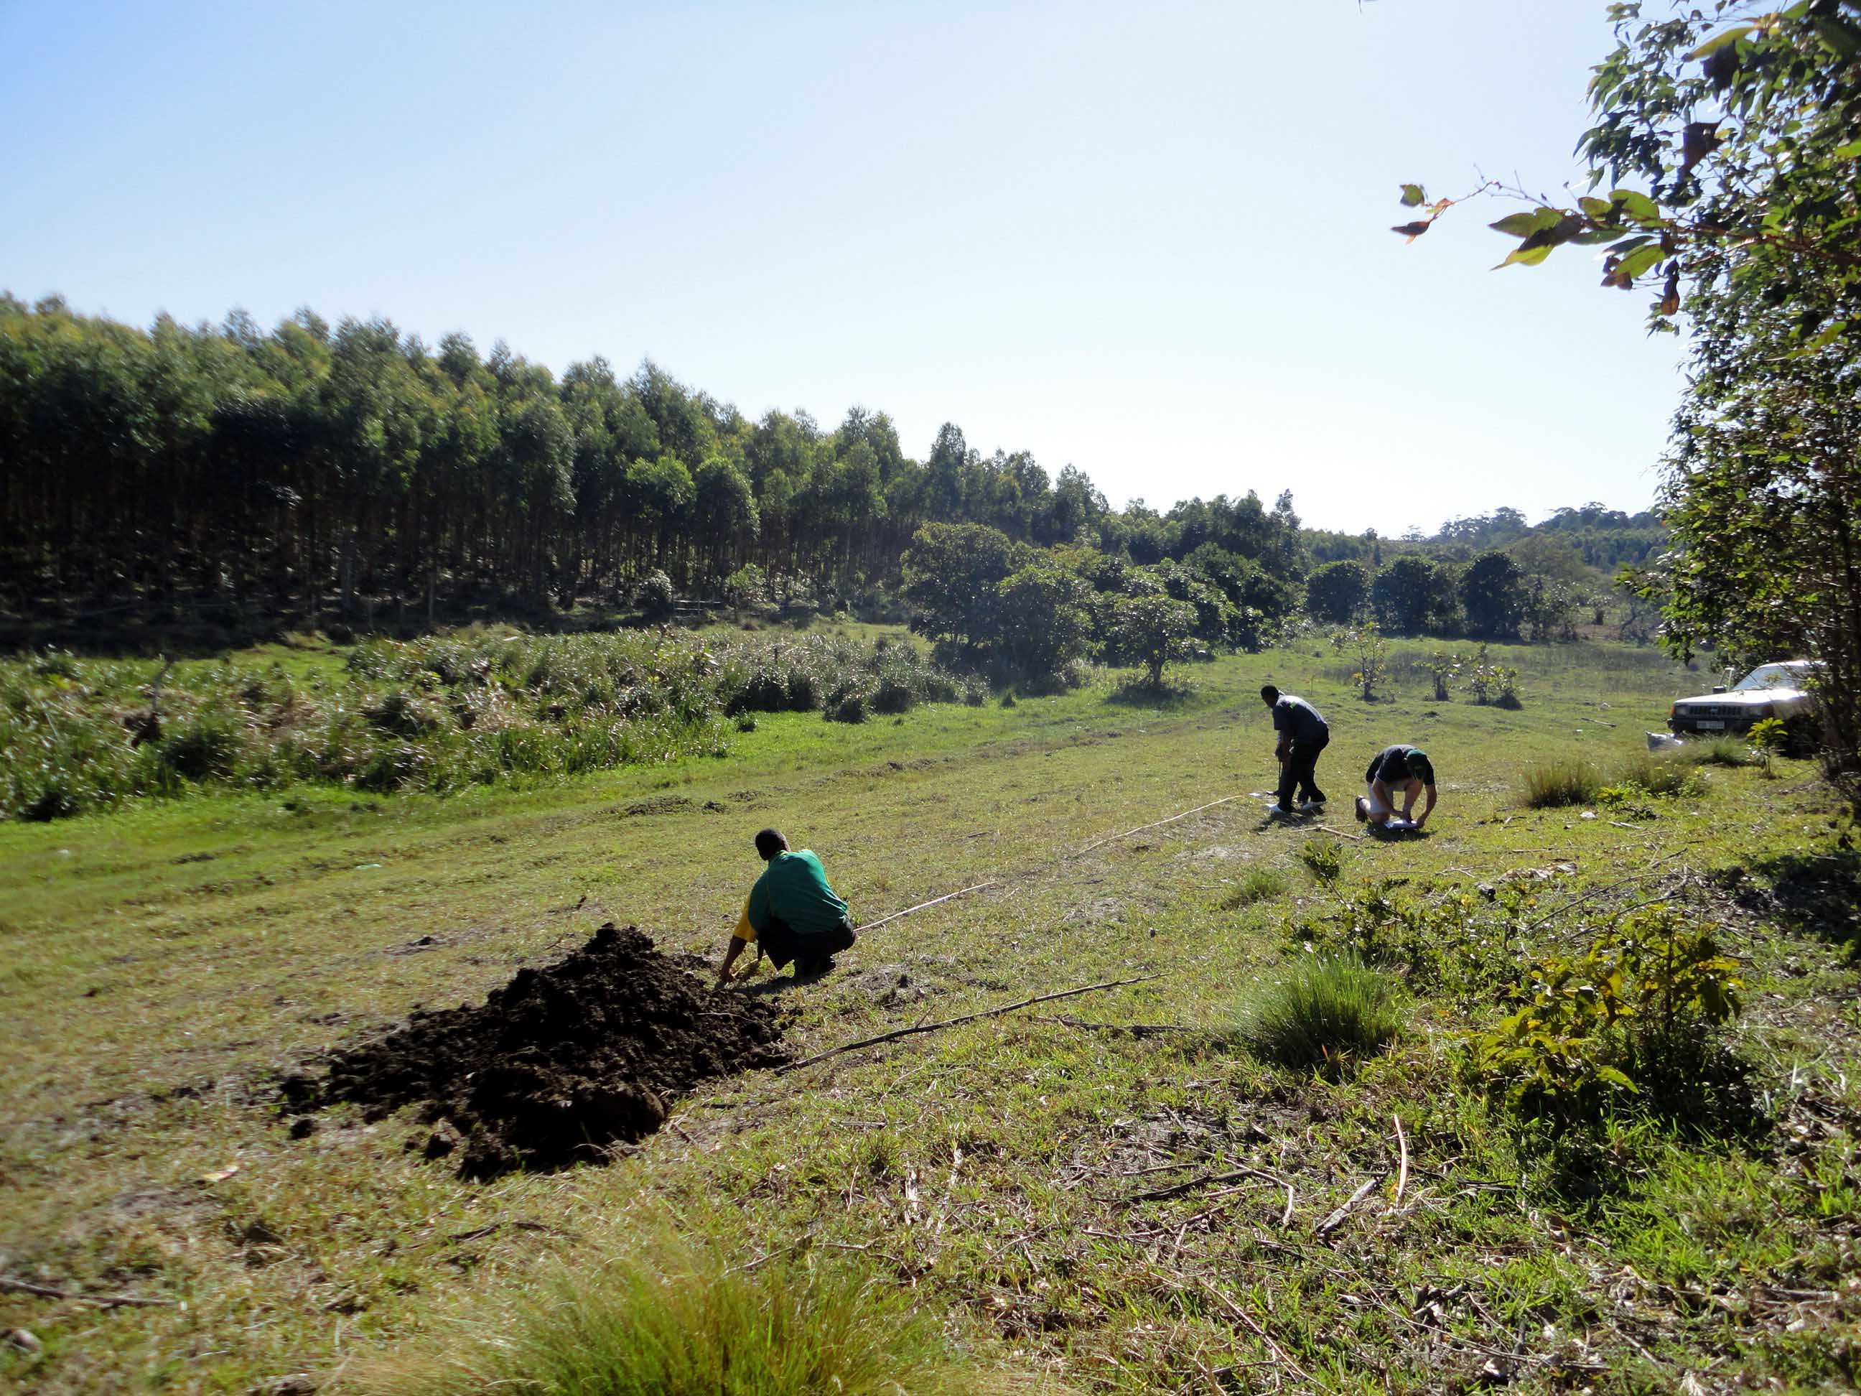

Slide 26
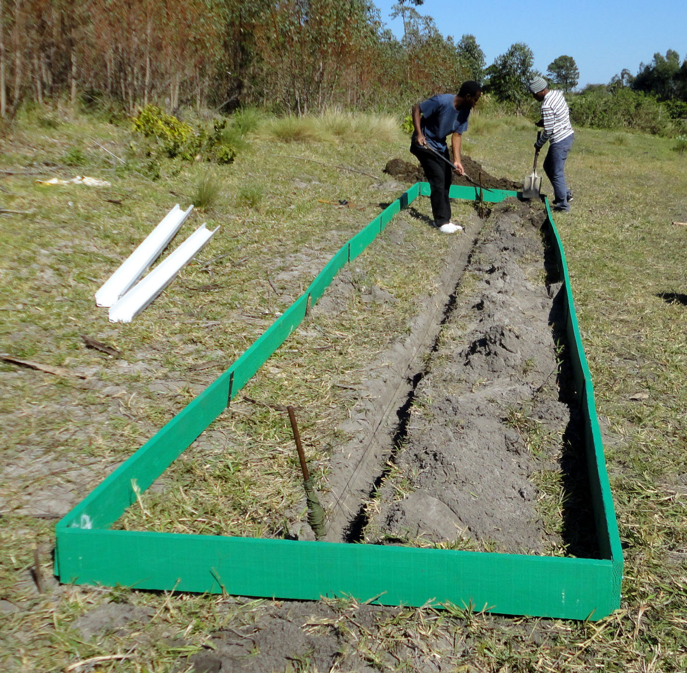

Slide 27
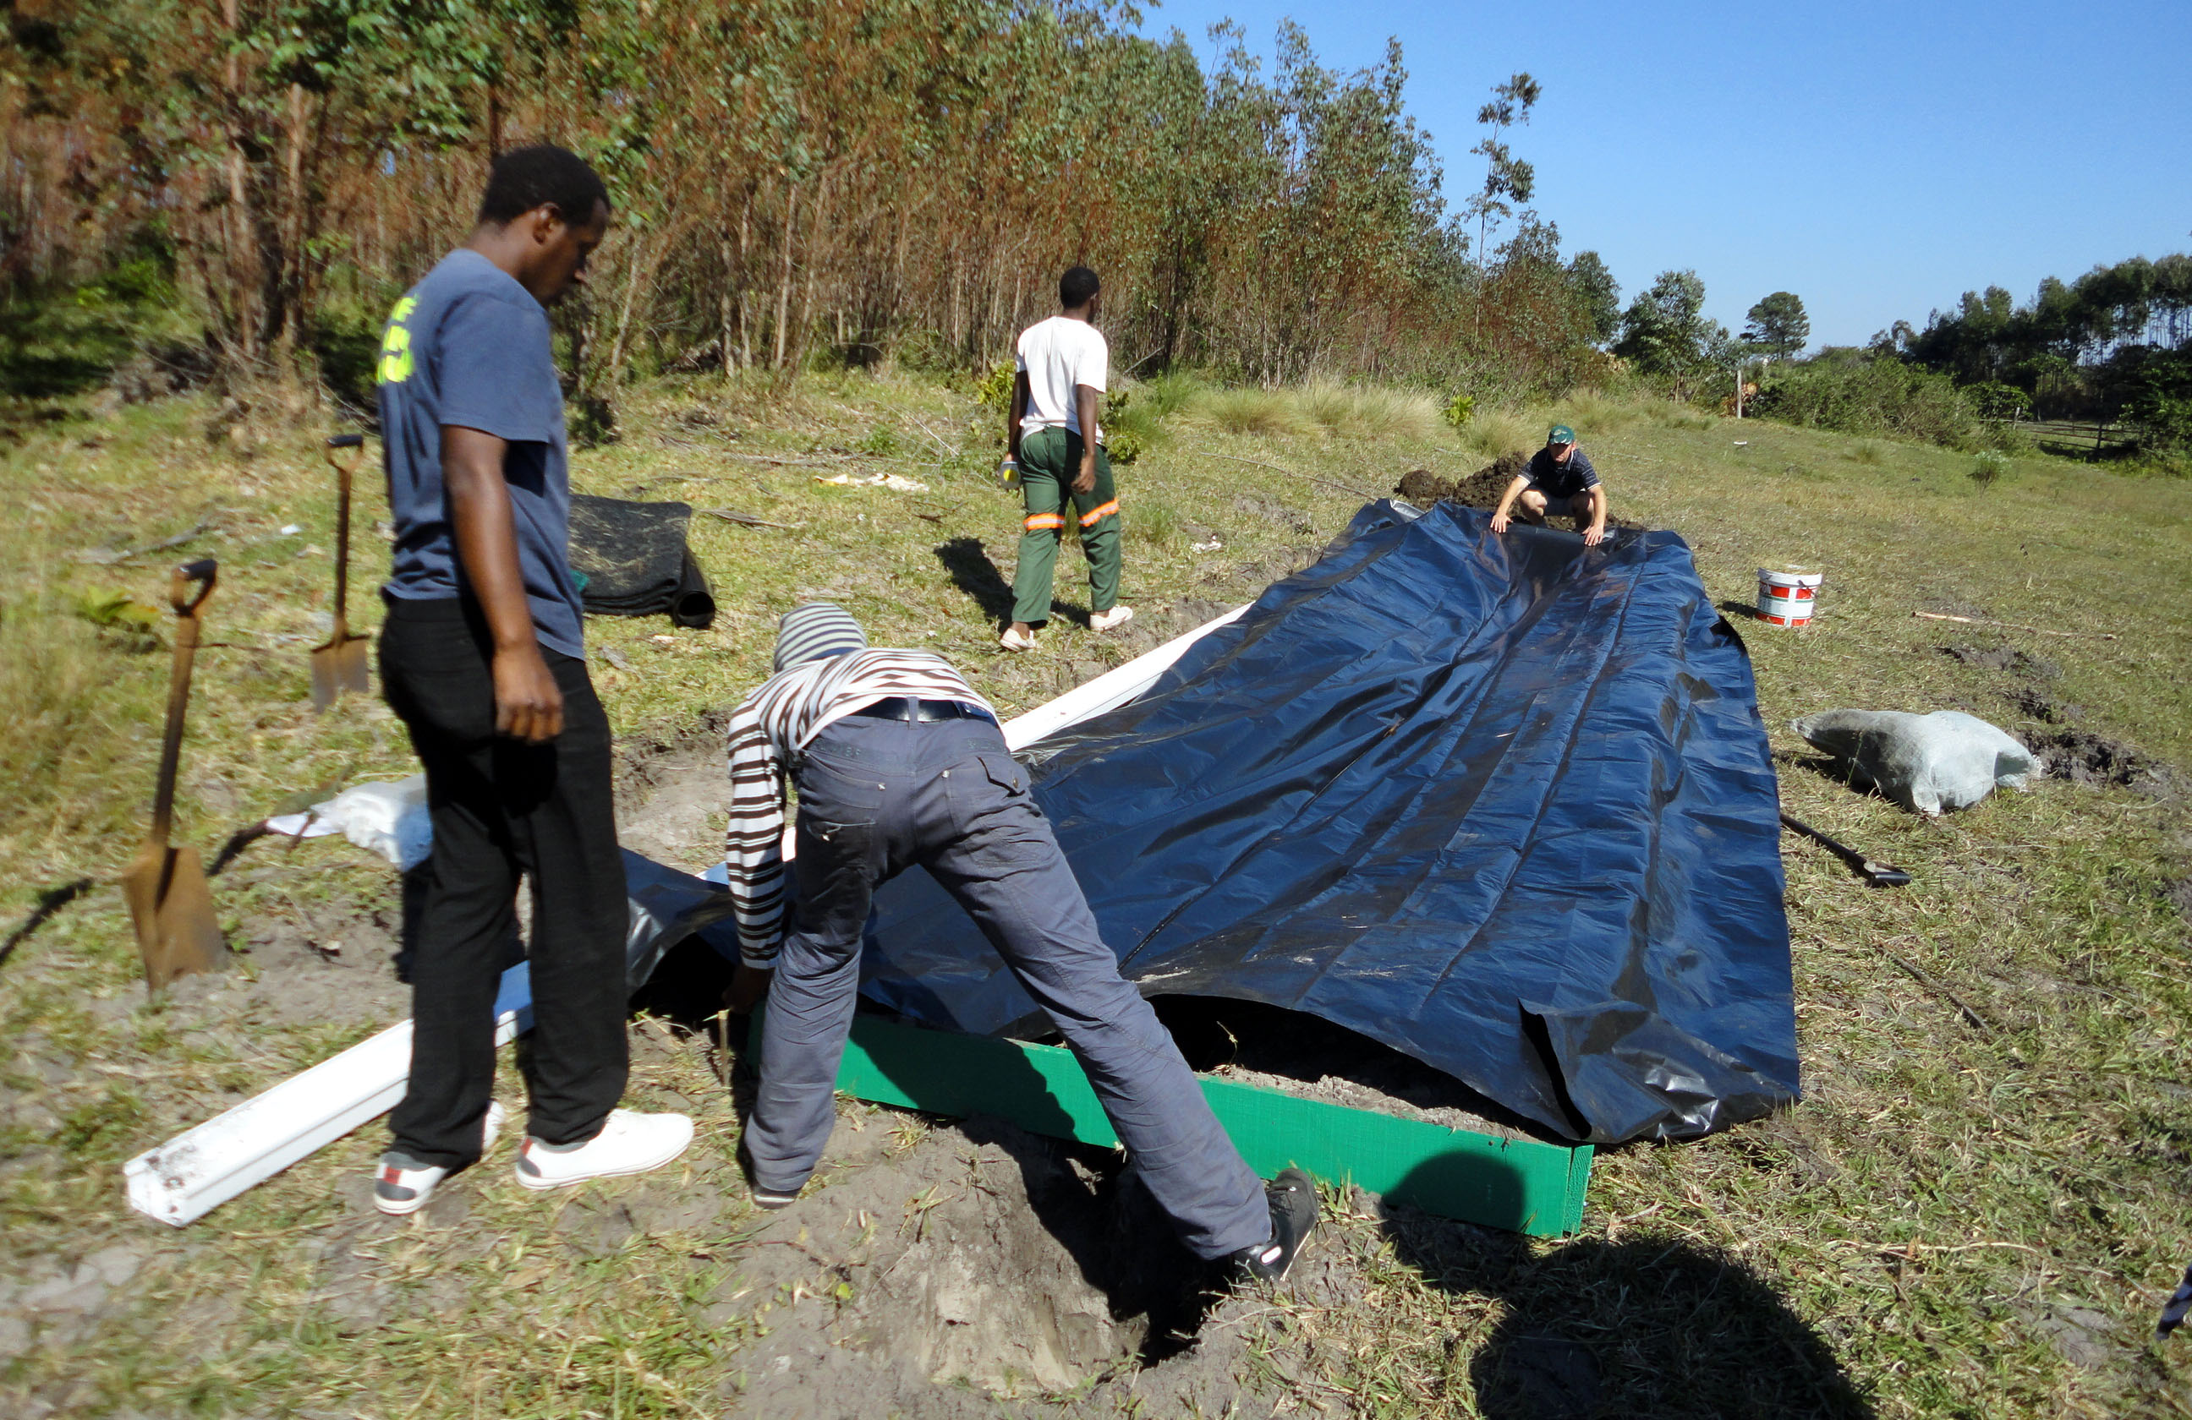

Slide 28
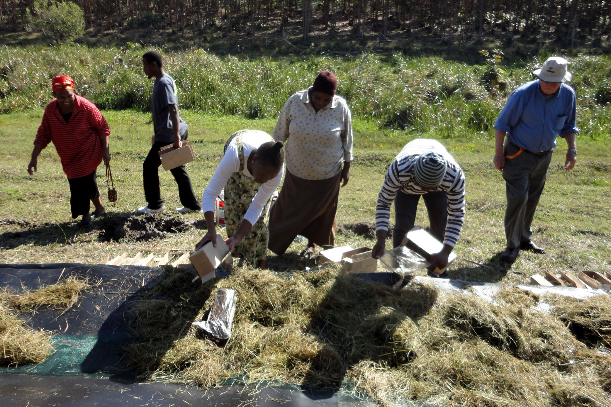

Slide 29
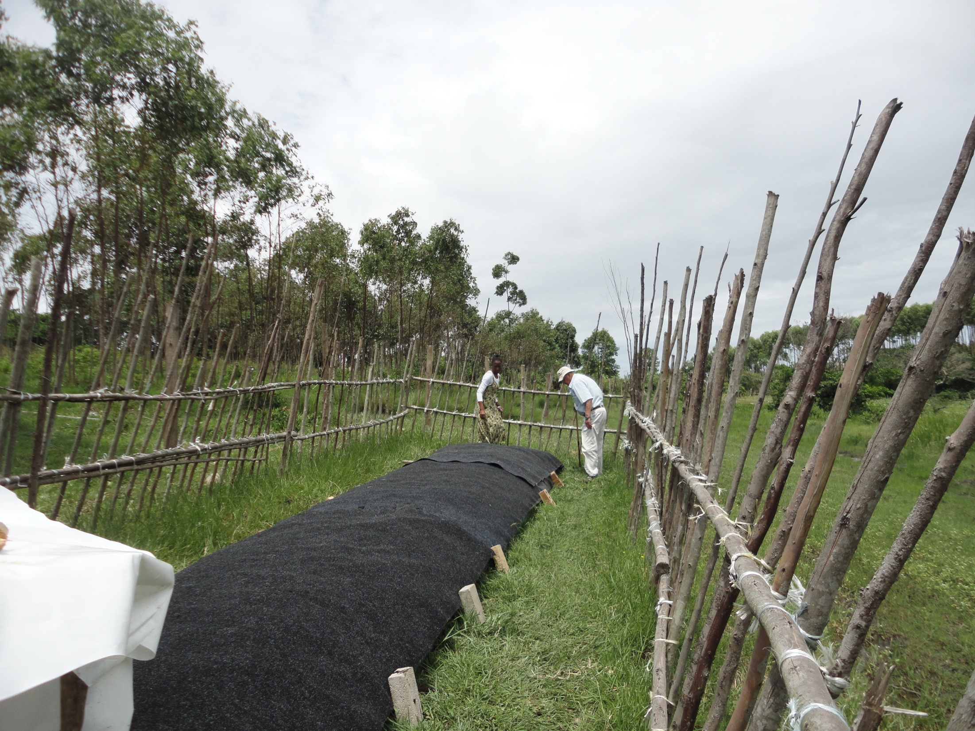

Slide 30
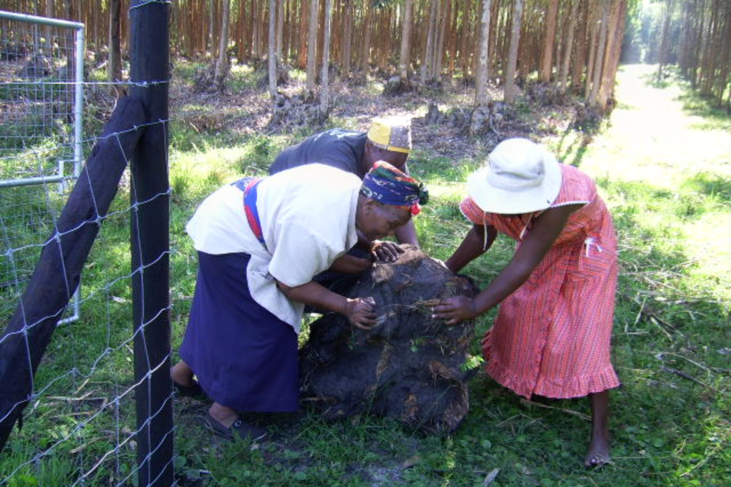

Slide 31
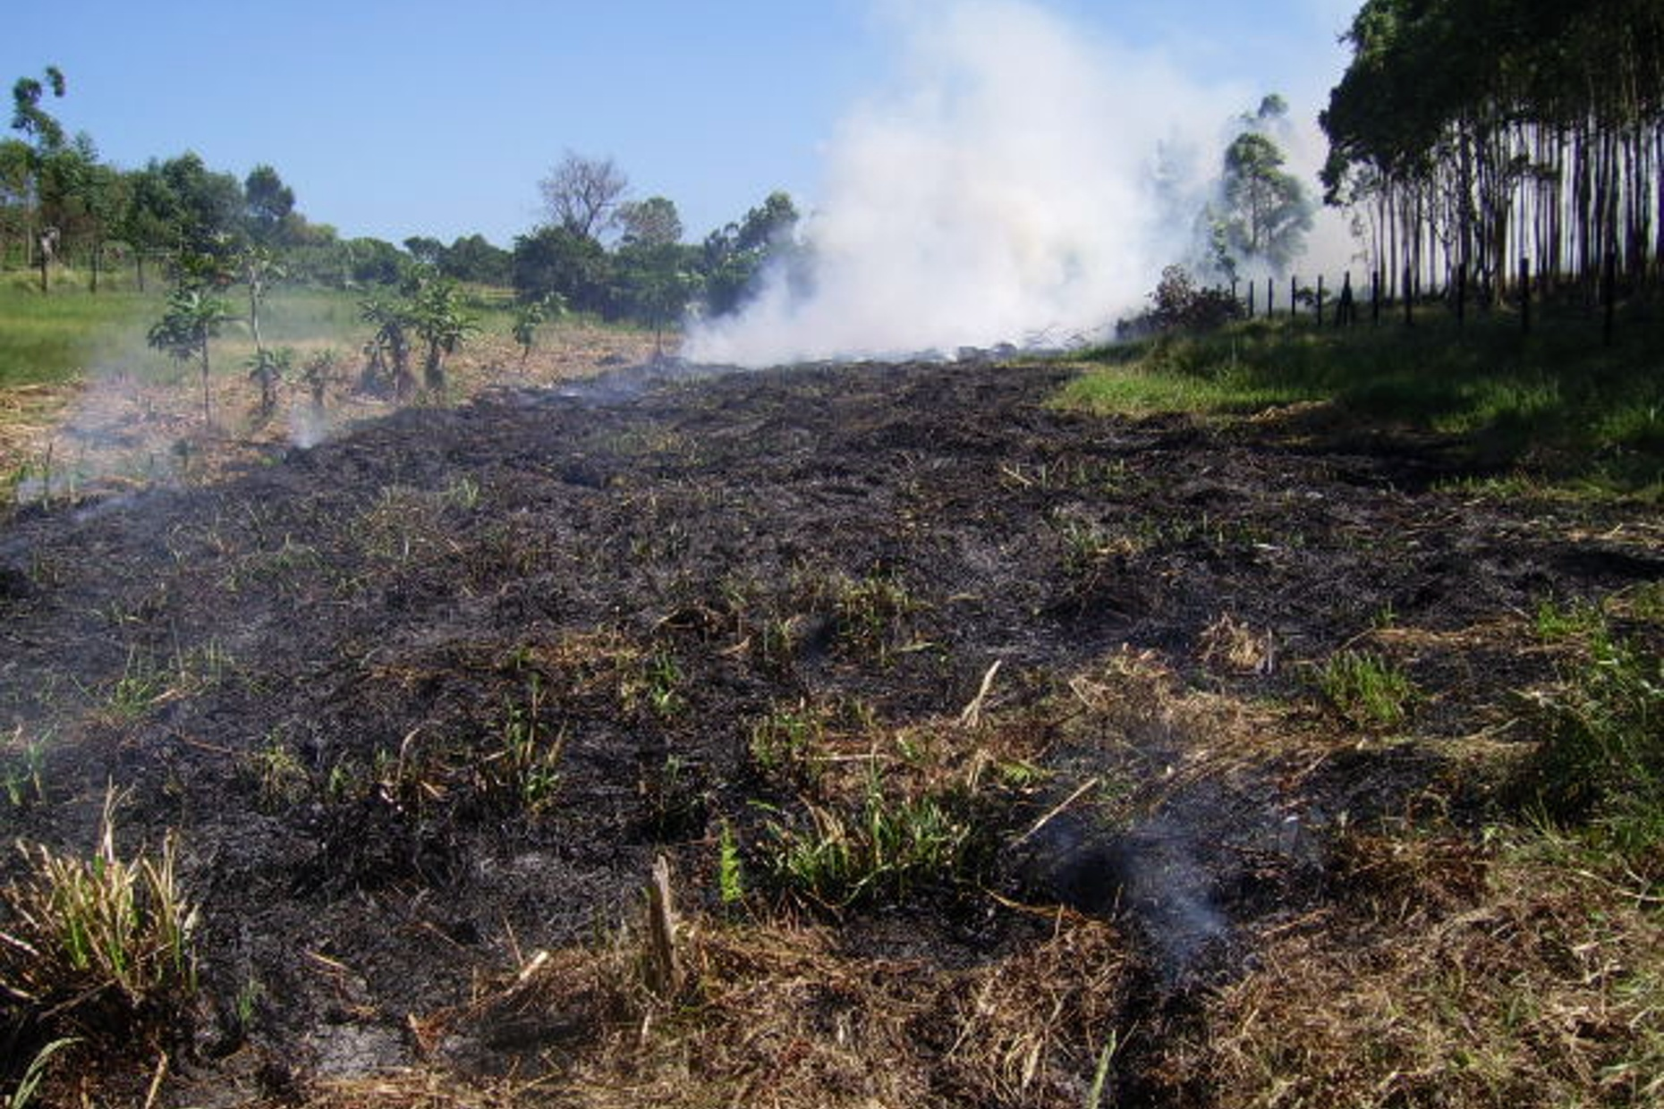

Slide 32
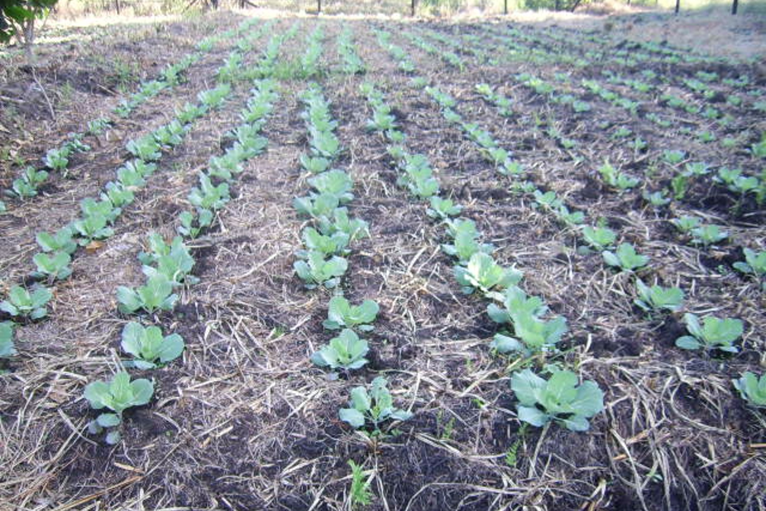

Slide 33
THANK YOU!

Slide 34
Sources/references
The SOFAR model of stakeholder/ constituency interaction, in: “Partnerships in Service Learning and Civic Engagement, Robert Bringle et al, in: Partnerships: A Journal of Service Learning and Civic Engagement. Vol 1, No 1, Summer 2009
Jules Pretty, 1995, Typology of Participation. Participatory Learning for Sustainable Agriculture in World Development, Vol 23, no.8. In “Climate Vulnerability and Capacity Analysis Handbook, CARE, p.21. http://www.careclimatechange.org
Meredith, J.R. & Mantel, S.J., 2006, Project Management: A Managerial Approach. John Wilie & Sons: New Jersey.
Wals, A. & Jickling, B. 2002 ‘Sustainability’ in Higher Education, from doublethink and newspeak to critical thinking and meaningful learning. Higher Education Policy, 15: 121 – 131.
http://www.kayoprojectmanagement.com/PM_templates.htm
http://www.projectconnections.com/templates/index.html

