Slide 1
CU Expo 13 Session: Local and Scholarly Knowledge: Connecting People and Community Heritage with GIS
Dr. Rainer Baehre (Historical Studies, Grenfell Campus, Memorial University)
Roxanne Abbott (Town of Humber Arm South, Resettlement House and Museum)

Slide 2
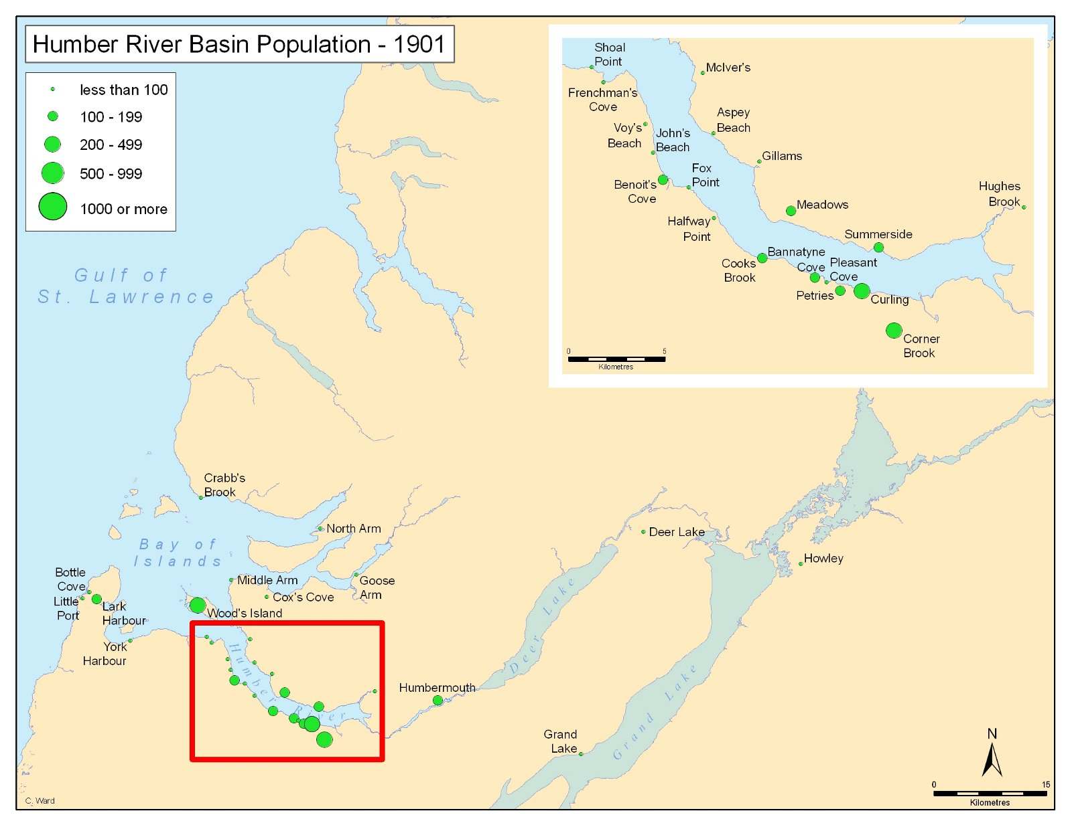

Slide 3
Source: Europa Nostra (online)
“Heritage is recognised as being vitally important to sustainability. Heritage reflects our ongoing relationship with the environment and plays a role in defining modern culture and identity. It is not thus simply concerned with the past but is about balancing conservation and change today and in the future. Sustainability is best understood through long-term perspectives on the interactions of people and environment. This reflexive relationship is crucial to inform future practice and research in sustainable development and cultural environment management, and for promoting cultural diversity, sustainability literacy and education.”

Slide 4
What is “local” constitutes “the centre of meaning.”
- James Opp and John C. Walsh, eds., Placing Memory and Remembering Place in Canada, 6.

Slide 5
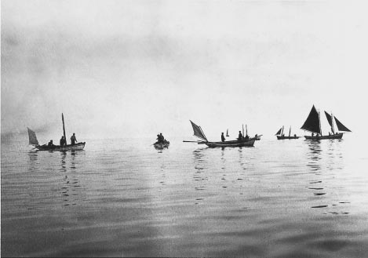
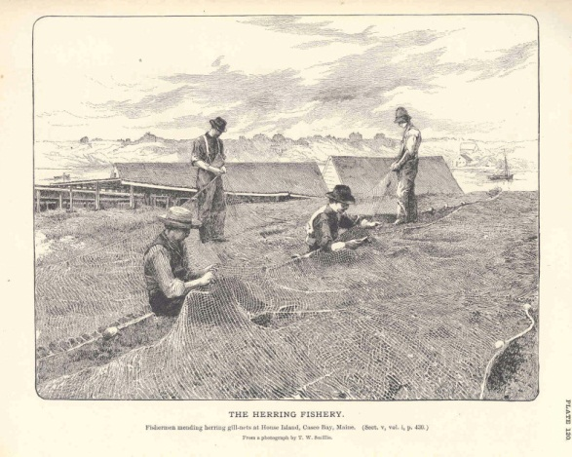
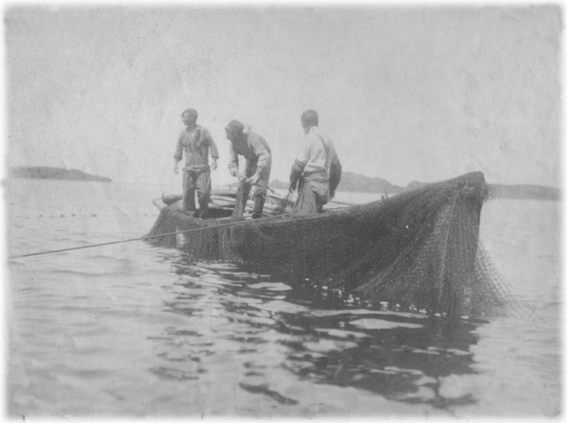
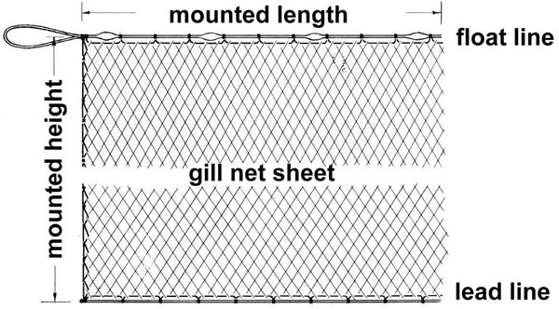

Slide 6
Marlene Creates, (Newfoundland artist)
When we describe the land – or, more frequently, remember events that occurred at particular points on it – the natural landscape becomes a centre of meaning, and its geographical features are constituted in relation to our experiences on it. The land is not the abstract physical location but a place, charged with personal significance, shaping the images we have of ourselves.

