Slide 1
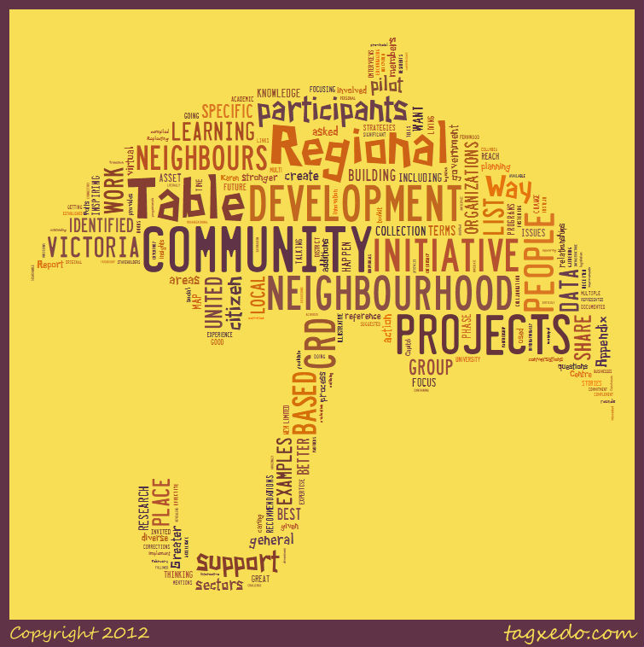

Slide 2
We were at a community meeting, and a kitchen party broke out: The Gorge Tillicum Community Table
Karen L. Potts
Gabe Epstein
Gorge Tillicum Residents

Slide 3
Abstract
Title: Firing up neighbourhood synapses: We were at a community meeting, and a kitchen party broke out
Conference themes being addressed: Community organizing, citizen engagement
Summary: Neighbourhood or locality development has always been a cornerstone of community development (Rothman, 1974). The usual initiators of community development projects – municipal governments, social planning councils or community associations – are now being joined by academics and researchers, interested in using their skills, expertise and resources to contribute to neighbourhood vitality. This is the case with the Community Tables: Engaging Neighbours project, co-initiated by the United Way of Greater Victoria and the University of Victoria’s Office of Community Based Research.
This presentation will share the work of the Community Table from inception, through structured facilitation, to local autonomy and sustainability.
Key learnings to be shared include:
• strategies for successfully tying into existing local, citizen leadership for building local relationships, credibility and sustainability;
• the importance of involving interested academics who, in addition to their academic roles, were able to participate primarily as neighbourhood residents;
• an understanding that sometimes successful initiatives come more from synergy and serendipity – a good idea combining with the right mix of neighbours at the right moment – rather than from all the best structured, carefully facilitated planning;
• the value associated with collaboration with local institutions, such as the public library, as long as control remains in the hands of the citizen residents; and,
• the value-added from scholarship, leadership, and inspiration of academic visionaries and writers – including sharing success stories and principles of organizing. (Specifically, Jim Diers, Neighbourhood Power and John McKnight, and Asset Based Community Development models were pivotal.)
The Gorge Tillicum Community Table is an interesting example of a community – university partnership initiative that was ‘the right thing at the right time’ for a neighbourhood on the cusp of becoming a ‘community’.

Slide 4
What we want to tell you about
The roots of the community table
– impetus for the project
Theory and key concepts
– inspiration for the process
Our Gorge Tillicum Community Table (GTCT) Story
Some events and happenings
In-process analysis
– what we are learning
Plans for the future
– the next course
A few references and resources

Slide 5
The roots of community tables – impetus for the project
United Way shift
UVic OCBR interest, funding and support for community-university partnerships
Neighbourhood readiness – Gorge Tillicum, 1 of 3 pilot neighbourhoods
Individual angst – local citizens with feelings of disconnect, yearning for community

Slide 6
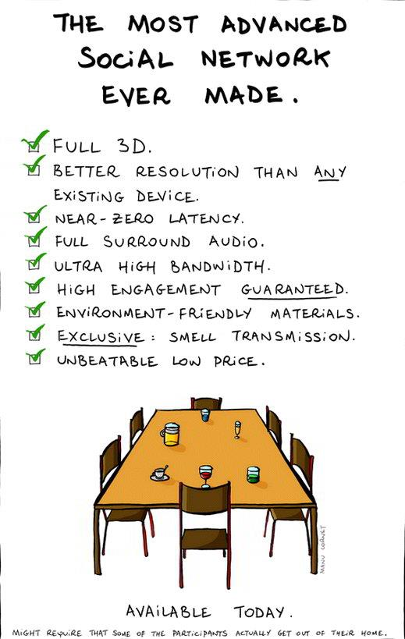
People at the United Way had been following a Montreal movement of neighbourhood, citizen based dialogues and actions, called, “community tables”

Slide 7
Theory and key concepts – inspiration for the process
Neighbourhood or locality development has always been a cornerstone of community development (Rothman, 1974).
The usual initiators of community development projects – municipal governments, social planning councils or community associations – are now being joined by academics and researchers, interested in using their skills, expertise and resources under the guise of various ‘missions’:
Community engagement
Community based research
Community-University partnerships
Knowledge mobilization

Slide 8
Neighbourhood Power – Diers Asset Based Community Development – McKnight

Slide 9
Our Gorge Tillicum Community Table (GTCT) Story
The Gorge Tillicum Community Table was instigated by a partnership between the United Way of Greater Victoria and the University of Victoria’s Office of Community Based Research creating the “Community Tables: Engaging Neighbours” project. We are now a committee of the Gorge Tillicum Community Association.
Initiated by Uvic OCBR 2011
- Identification of local leaders
Nomination of participants
Inspiration, launch by Jim Diers
Facilitated sessions by BC Healthy Communities
Support by UVic graduate student interns
Neighbourhood survey, map and report
Move to autonomy, Fall 2012
Meetings moved to ‘living rooms’, called by local leaders
Food and cordial replace flipcharts
Current focus is to further strengthen our Gorge Tillicum community through creating:
Activities/events
Spaces for engagement

Slide 10
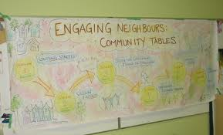
The BC Healthy Communities Facilitated Sessions

Slide 11
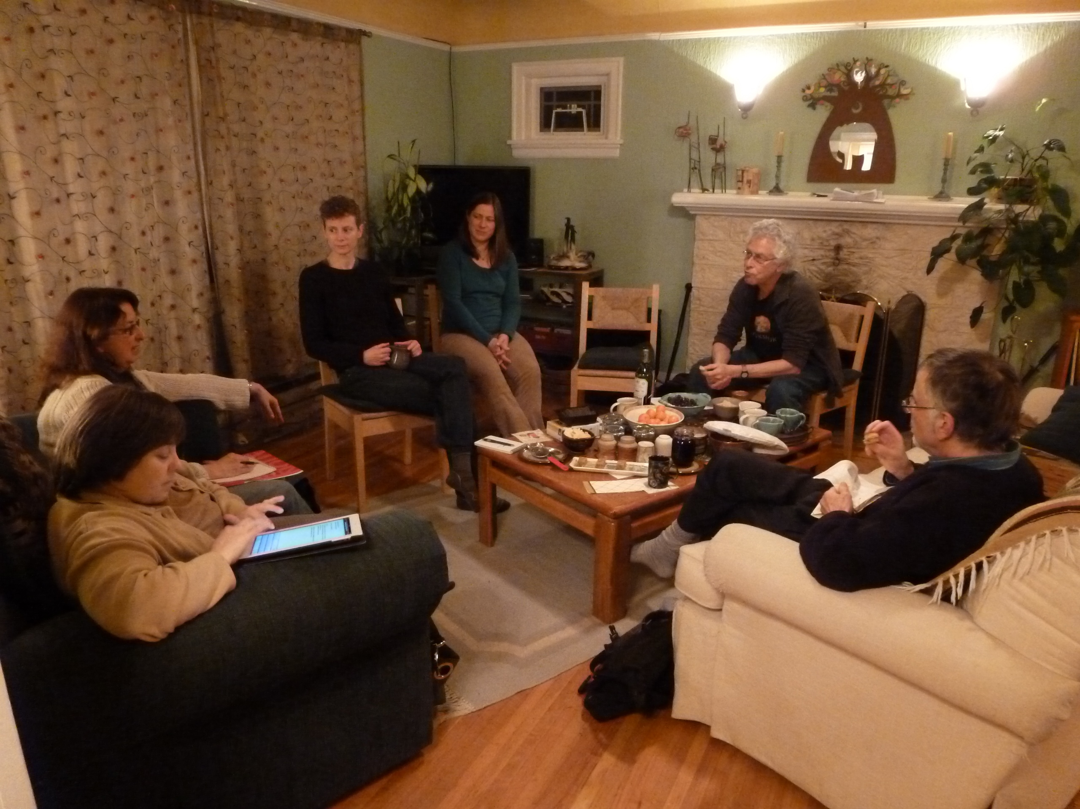

Slide 12
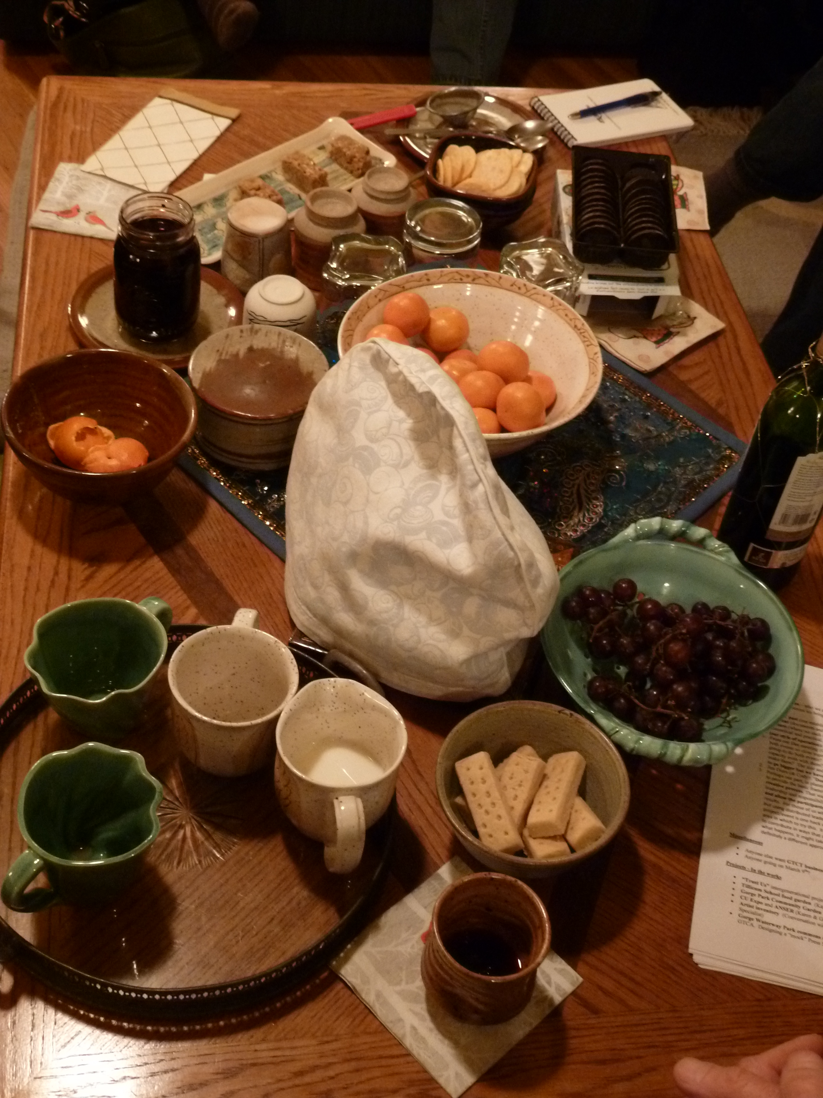

Slide 13
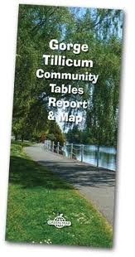
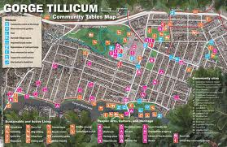
UVic Graduate Students worked on a local survey and map

Slide 14
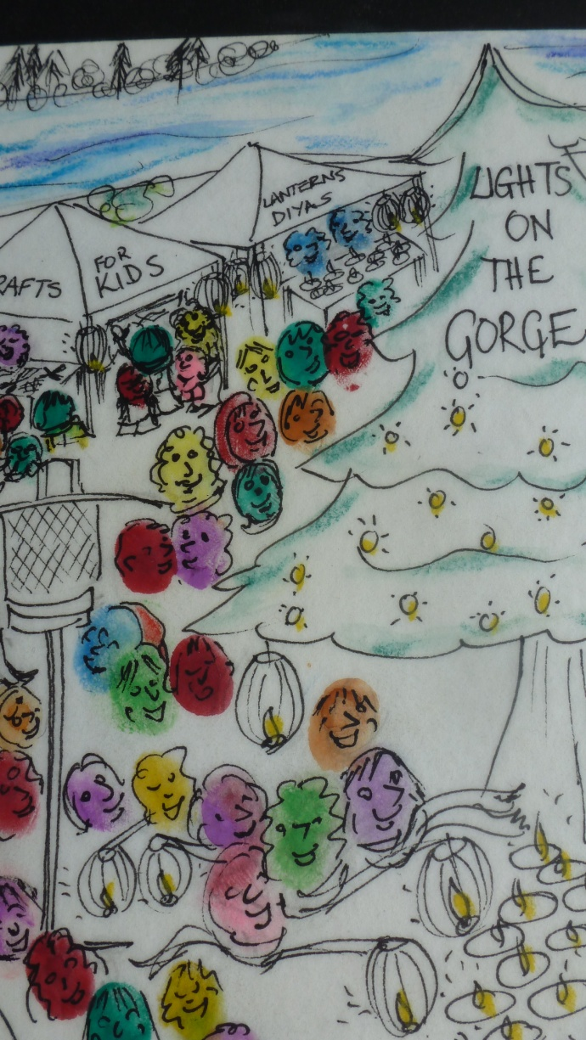
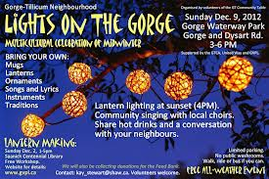
Some stories and happenings ...
Lights on the Gorge:
“We provide the space!
You make the magic!”

Slide 15
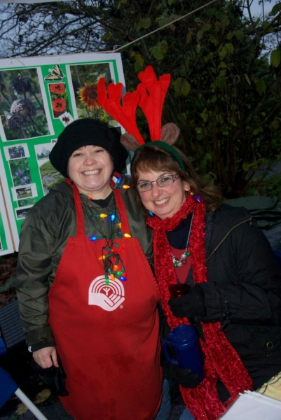
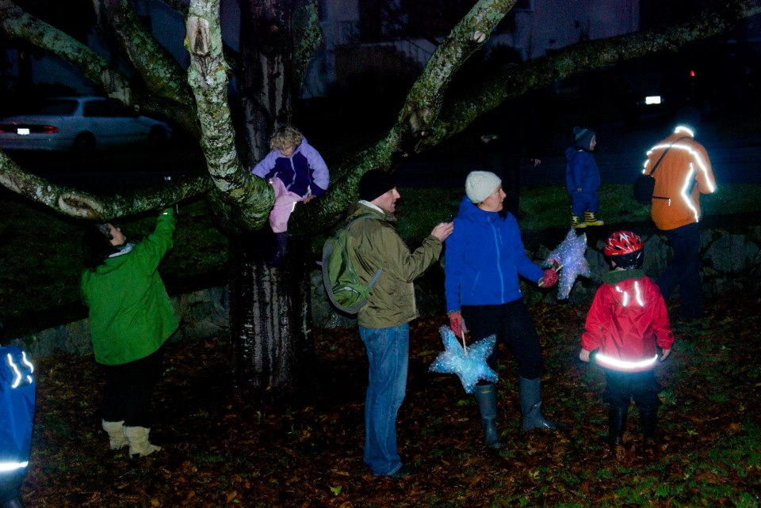
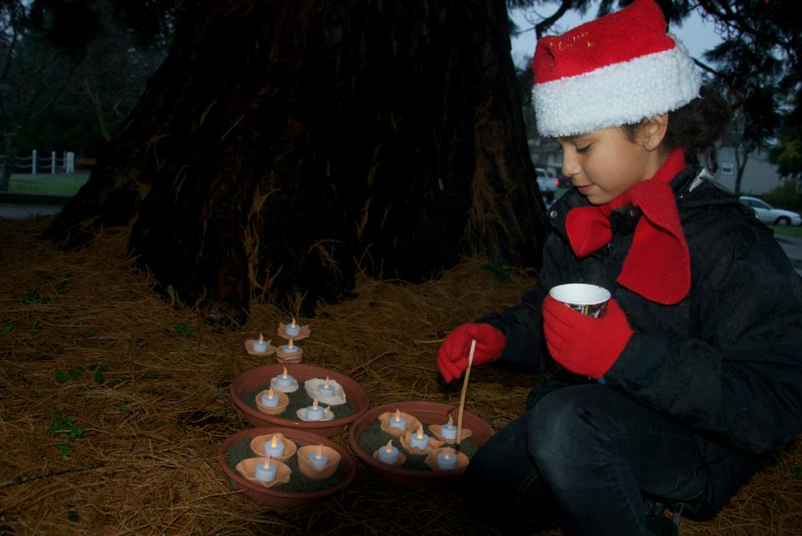
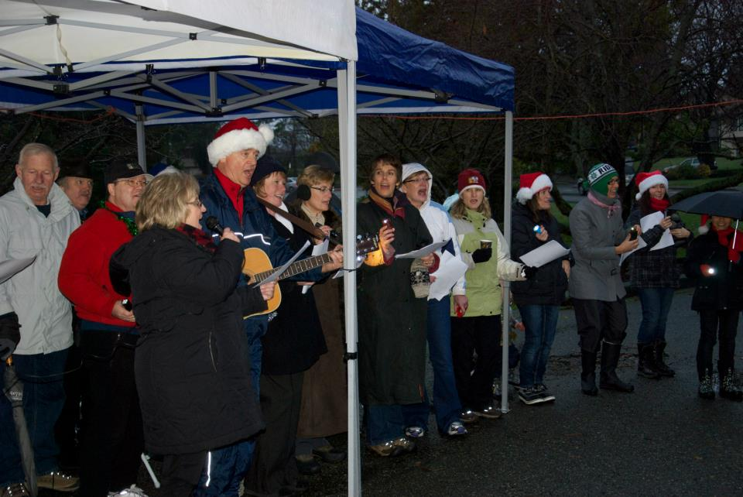

Slide 16
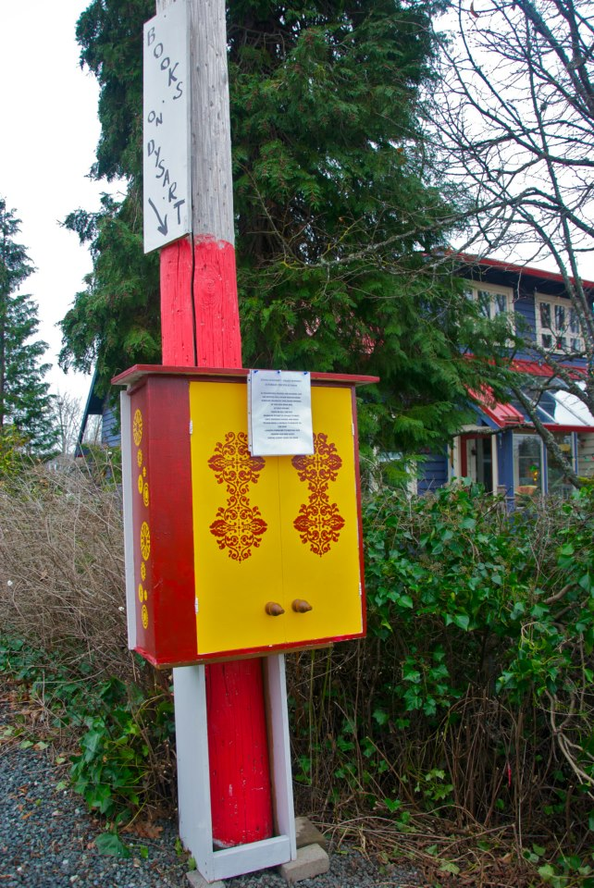
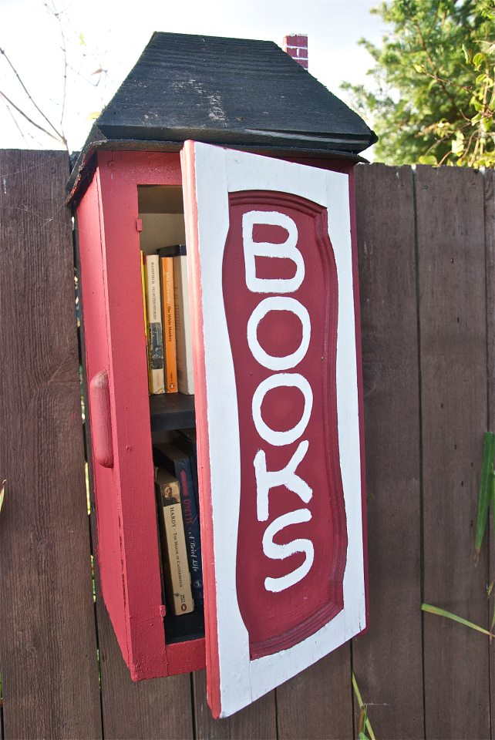
More stories and happenings ...
Book Boxes are popping up in Gorge Tillicum

Slide 17
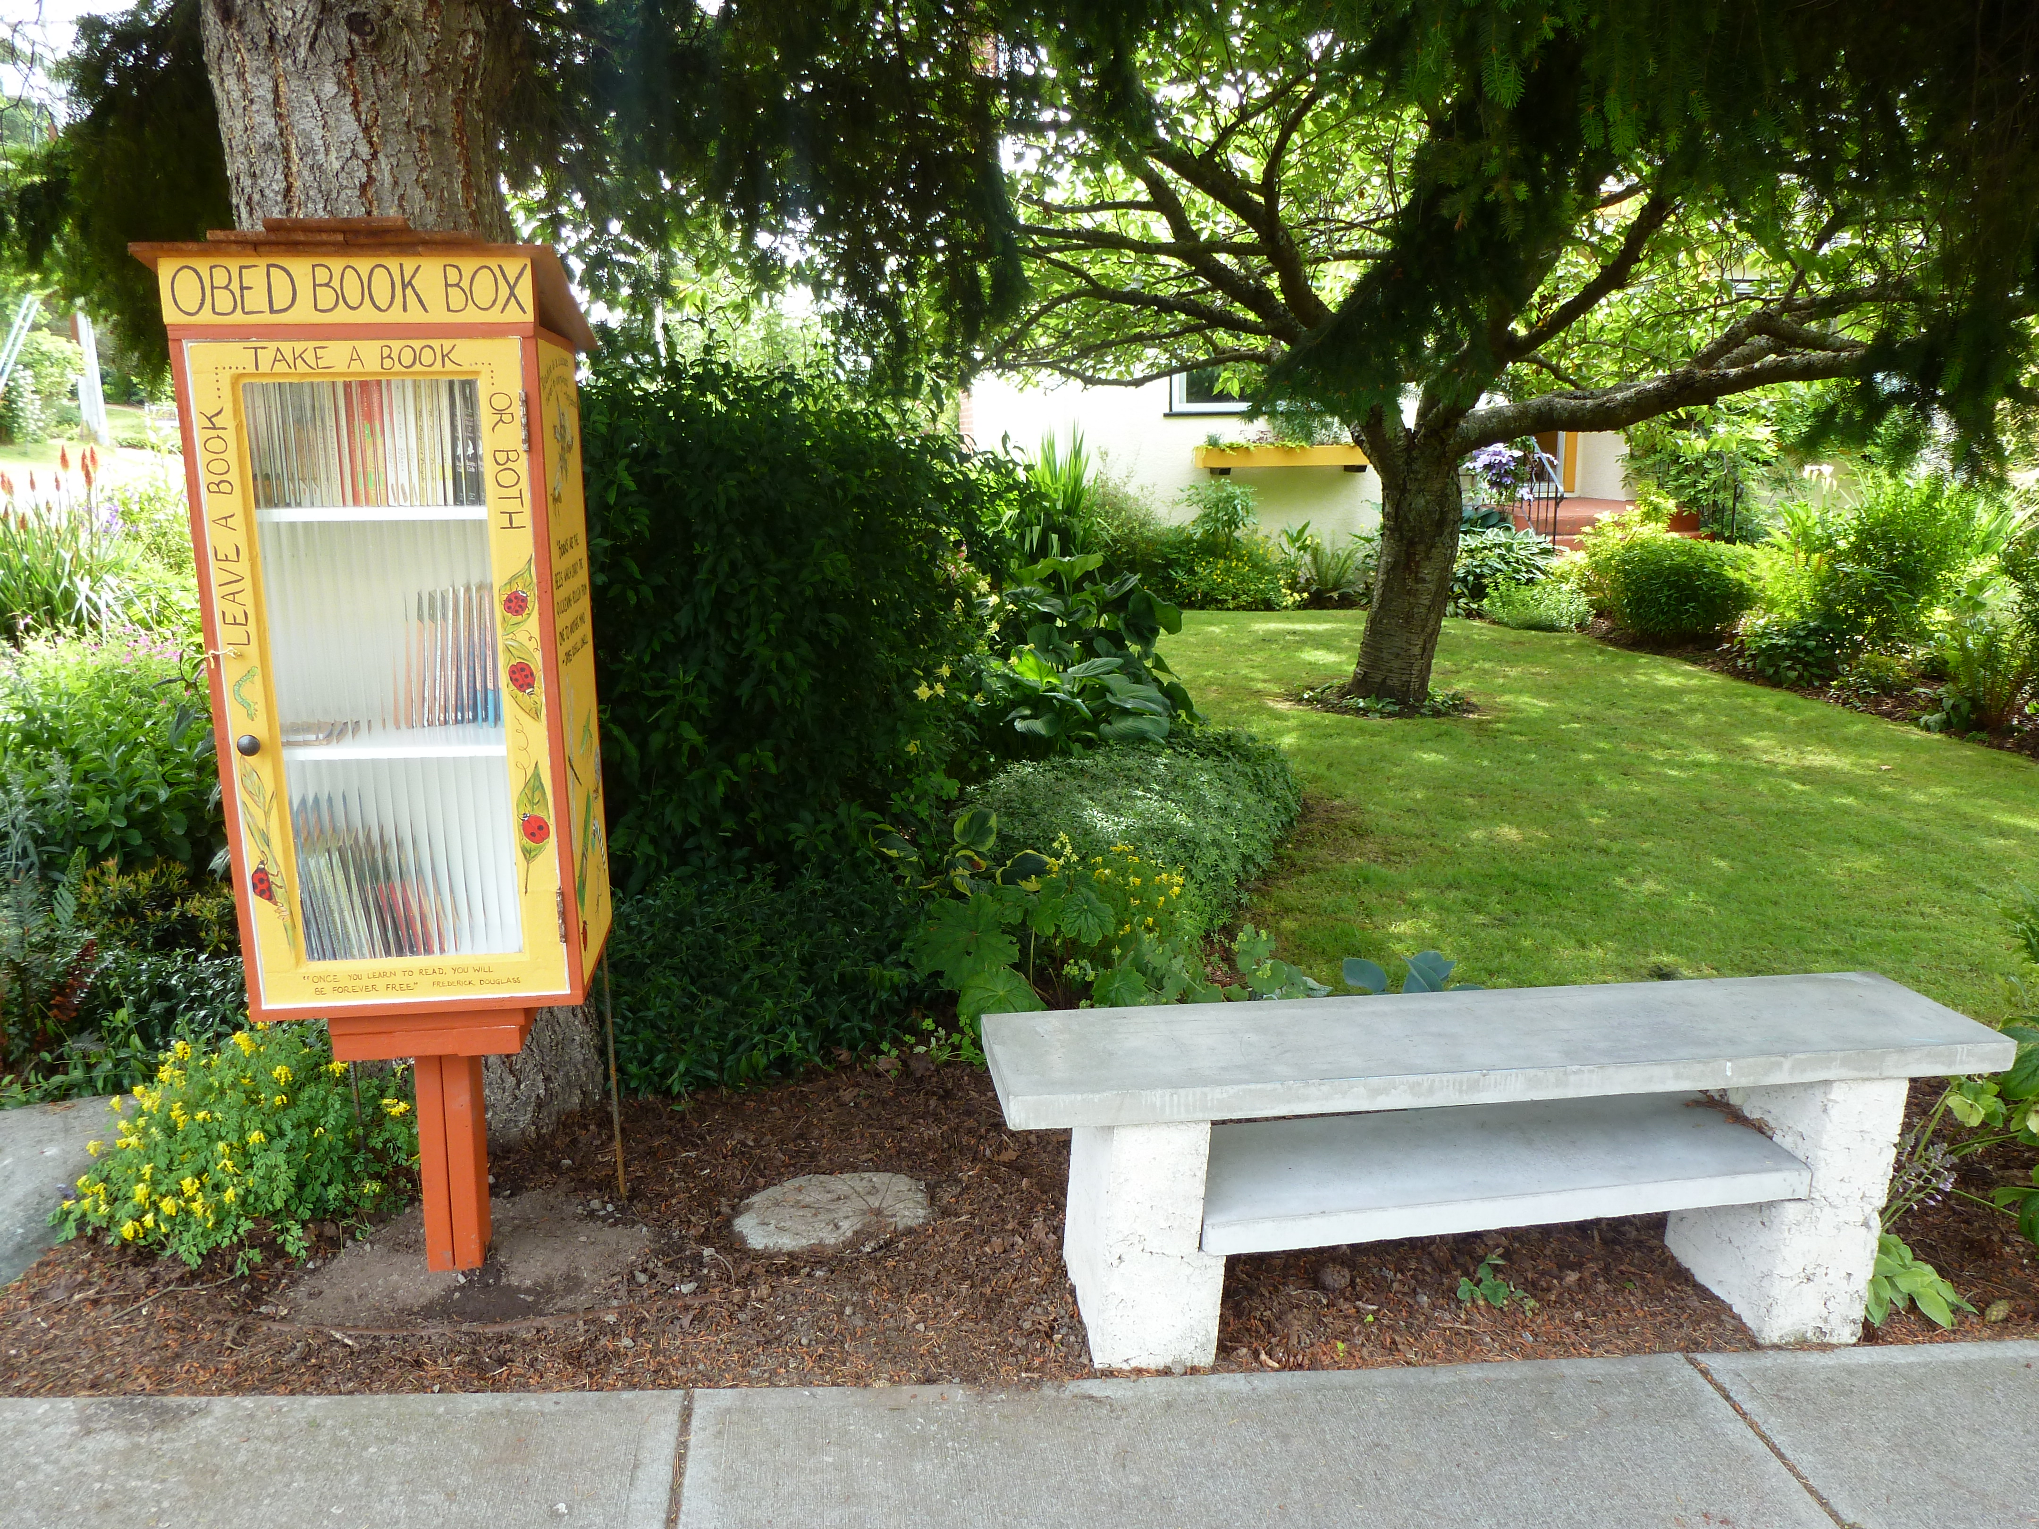

Slide 18
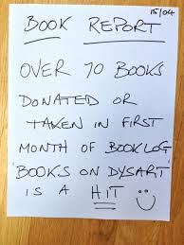
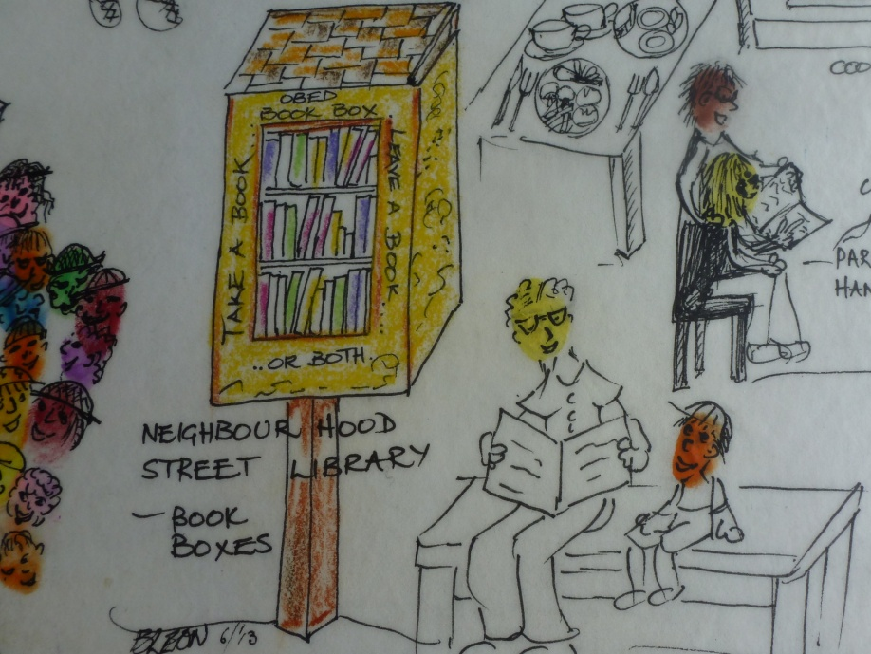
Interest in creating spaces for community sharing, conversation, aesthetics, vibrancy in the neighbourhood
Un-organized, uncoordinated, but done by local, grassroots leaders

Slide 19
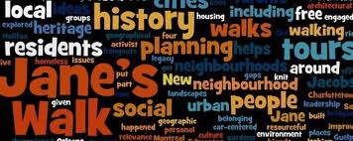
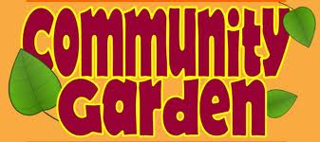
Connecting to, and supporting other neighbourhood initiatives ...

Slide 20
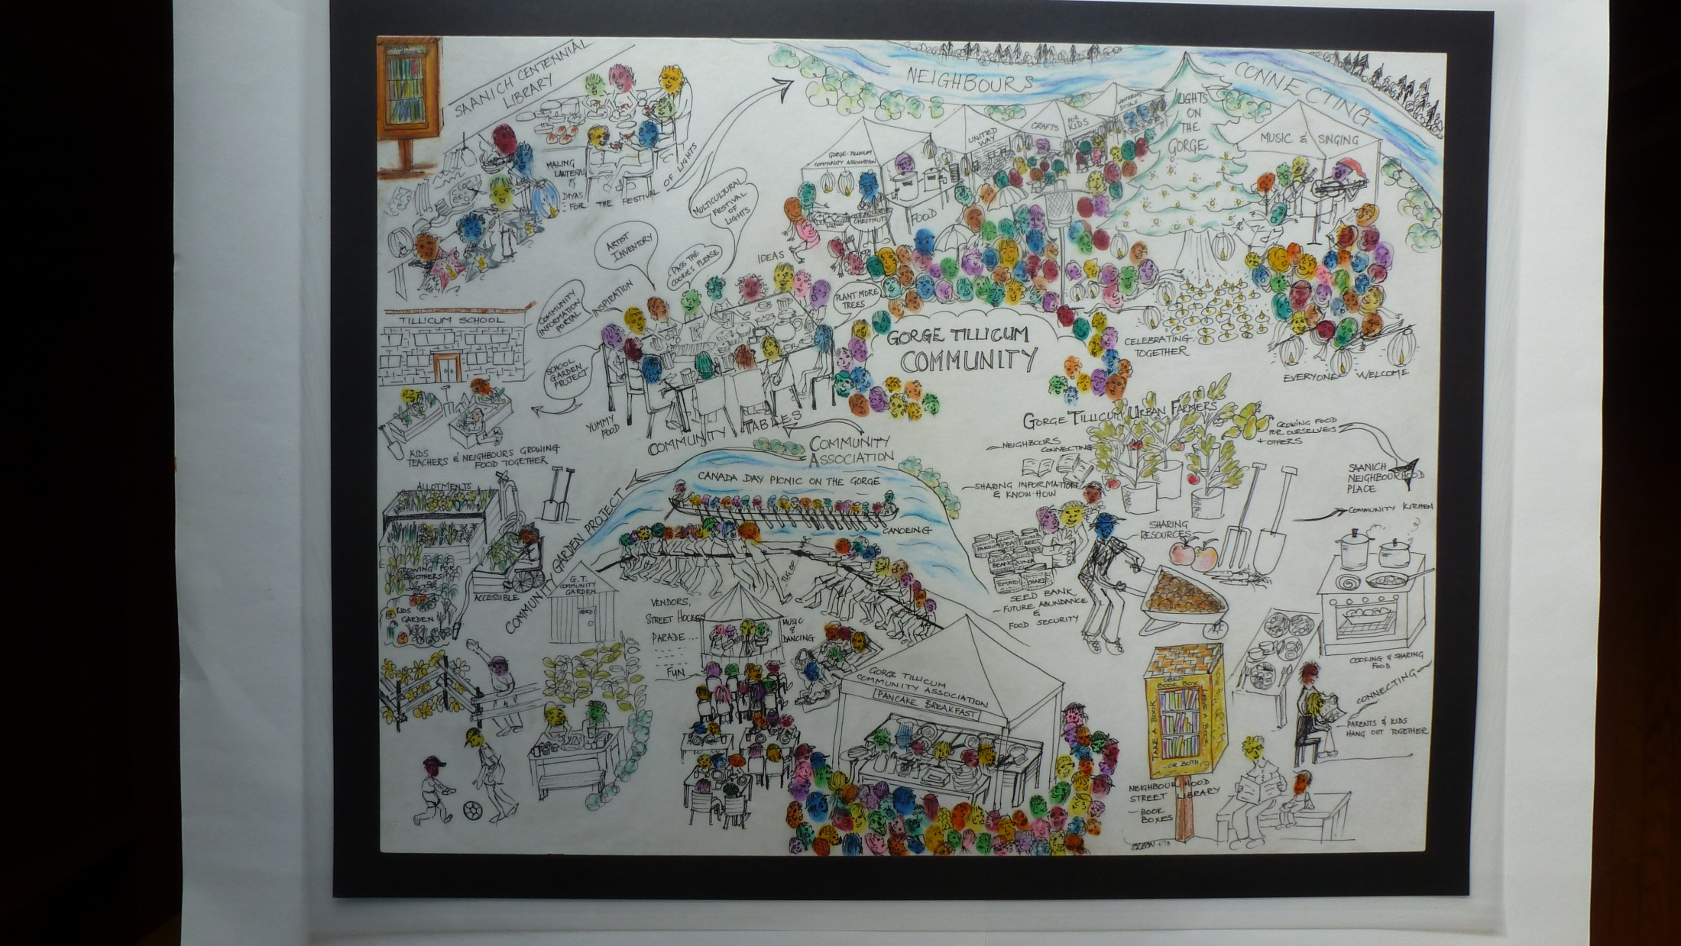

Slide 21
In-process analysis – what we are learning
1. Strategic planning – what is it good for?
The GTCT started with 6 facilitated, structured sessions walking participants through a visioning, planning process.
It gathered together local people interested in community, provided an agenda, a reason to meet, regular meeting dates, a place to build relationships and coalesce.
The actual product, the plan, turned out to be ... irrelevant.
Our process was not linear, its rhizomatic. We believe GTCT illustrates that sometimes successful initiatives come more from synergy and serendipity – a good idea combining with the right mix of neighbours at the right moment – rather than from all the best structured, carefully facilitated planning.

Slide 22
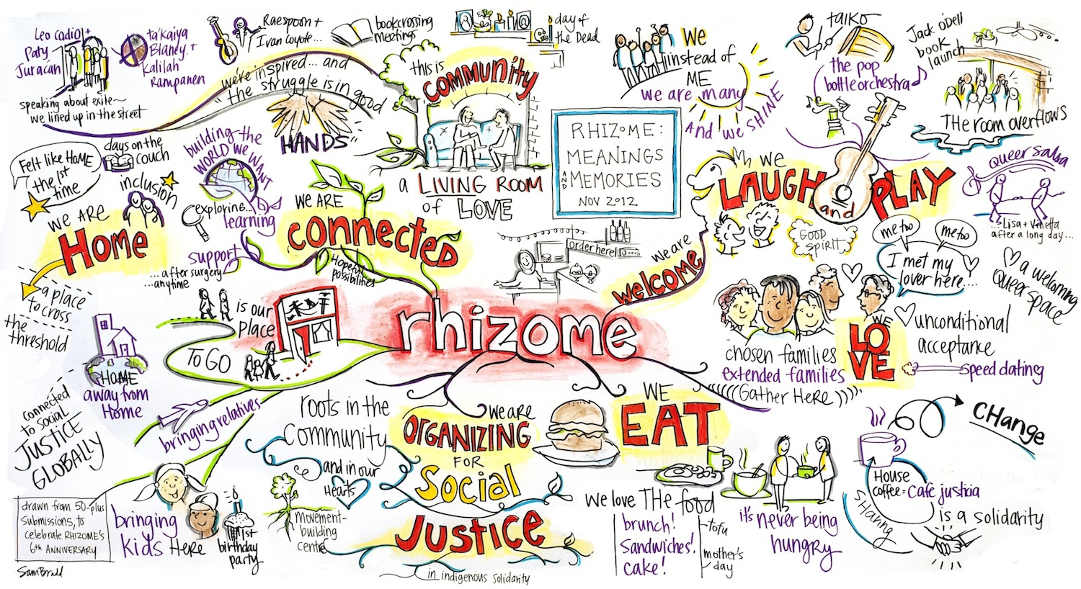

Slide 23
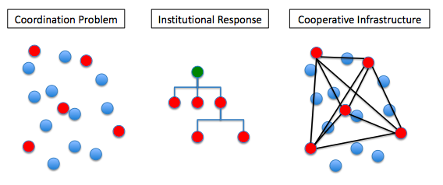
2. Resisting formal organization
Support of GTCA for insurance, pragmatics
We are a group of neighbours, fluid membership, some meet, some participate, some volunteer, some attend

Slide 24
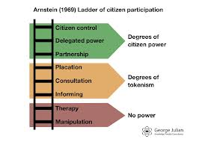
3. Who participates?
There was great value associated with collaboration with local institutions, such as the public library, but control remains in the hands of the citizen residents.

Slide 25
Targeting grassroots leadership – the personal call, using connections, relationship based recruitment
Recognizing that participation and leadership still requires ‘privilege’
Community organizing – Alinsky – the biggest organizing challenge is to mobilize the middle class out of its consumption-filled stupor to fulfill its potential to create social justice and transformative change

Slide 26
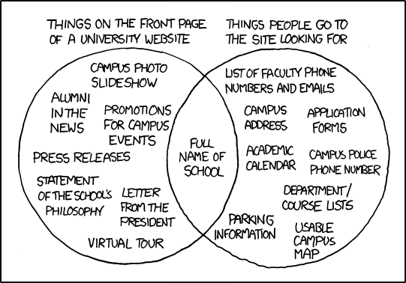
4. Bridging the university / community divide

Slide 27
Re-visioning Community Engagement of Academics
Maybe its not about bringing academics ‘in’ through artificial, formal partnerships
Maybe its about using the academics that are already ‘in’: the importance of involving academics who, in addition to their academic skills, knowledge and capacities, were able to participate primarily as neighbourhood residents.
We talk about turning ‘clients’ into citizens, maybe we need to remind academics how to be citizens in their own communities?
The value-added from scholarship, leadership, and inspiration of academic visionaries and writers – including sharing success stories and principles of organizing. (In our case, specifically Jim Diers and John McKnight, Neighbourhood Power and Asset Based Community Development models were pivotal.) We brought in books, shared ideas, got excited about ideas.

Slide 28
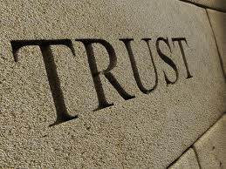
5. Seeing the critical, transformative action in a pot-luck
We see our work as building civil society/social capital (Putnam)
We recognize the impeding economic, environmental crisis, and so yes, we have thrown a party
Gathering spaces and signposts
are needed
pride in the territory
sense of belonging
building a ‘we’
we are reclaiming the Commons e.g. front yards, parks for parties and growing food

Slide 29
Recognizing that repetition, duplication, overlap has a purpose
Provides a backup plan, fall back organizations
Networks of support
Redefining success
“but we’ve only done one event!”. Avoiding the lure of busy-ness, the trap of project thinking
when everyone feels a sense of ownership, when we are confident in knowing what we bring, contribute
have we contributed to the ‘gross national happiness’ of Gorge Tillicum?

Slide 30
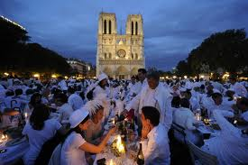
Plans for the future – the next course
Digital portal – more collaboration with the library
Artist’s inventory and map
Dinner in white
Harvest picnic
Community garden

Slide 31
Web Resources
150 Ways to Build Social Capital http://www.bettertogether.org/150ways.htm
Asset Based Community Development http://www.abcdinstitute.org
BC Healthy Communities http://bchealthycommunities.ca
Canadian Centre for Community Renewal – Community Resilience Manual http://communityrenewal.ca/community-resilience-manual
Citizen’s Handbook http://vcn.bc.ca/citizens-handbook/welcome.html
Community Mapping Network http://www.cmnbc.ca
Gorge Tillicum Community Table - Report and Map http://mapping.uvic.ca/uwgv/section/gorge-tillicum-community-table
Green Map http://www.greenmap.org
Human Library http://humanlibrary.org
Jane’s Walk http://www.janeswalk.net
Neighborhood Power http://www.neighborpower.org
Portland's City Repair http://cityrepair.org
Roberts, Jason “How to build a better block”
http://tedxtalks.ted.com/video/TEDxOU-Jason-Roberts-How-To-Bui
South Hill Inside Stories http://southhillcommunity.ca/insidestories
Tamarack: Institute for Community Engagement http://tamarackcommunity.ca
Ten Percent Shift http://www.tenpercentshift.ca
United Way of Greater Victoria - Engaging Neighbours: Community Tables Pilot
http://mapping.uvic.ca/uwgv/section/engaging-neighbours-community-tables-pilot

Slide 32
A few references and recommended readings
Addams, J. (1912). Twenty Years at Hull House. New York: Macmillan Company.
Alinsky, S. (1969). Reveille for Radicals (2ed ed.). Toronto: Random House.
Arnstein, S. R. (1969). A Ladder of Citizen Participation. Journal of the American Institute of Planners, 35(4), 216-224.
Block, P. (2008). Community: The Structure of Belonging. San Francisco: Berrett-Koehler.
Brody, S. (2012). How the Sausage Is Made: The Inside Story on Community Organizing. Analyses of Social Issues and Public Policy, 12(1), 412-416.
Chapin, R. (2011). Pocket Neighborhoods: Creating Small-scale Community in A Large-scale World Newtown, CT: Taunton Press.
Croft, S., & Beresford, P. (1988). Being on the Receiving End: Lessons for Community Development and User Involvement. Community Development Journal, 23(4), 273-279.
Diers, J. (2004). Neighbourhood Power: Building Community the Seattle Way. Seattle, WA: University of Washington Press.
Estill, L. (2008). Small Is Possible: Life in A Local Economy Gabriola Island, BC: New Society Publishers.
Follett, M. P. (1919). Community as Process. Philosophical Review, 28, 576-588.
Gonzales, P. (2004). The Lost Art of Dropping By. Journal, Summer(30). Retrieved from http://www.yesmagazine.org/issues/what-is-the-good-life/1181
Hollander, J. B. (2011). Keeping control: the paradox of scholarly community-based research in community development. Community Development Journal, 46(2), 265-272.
Hopkins, R. (2011). The Transition Companion: Making your Community More Resilient in Uncertain Times Chelsea Green Pub: White River Junction, Vt.
Ife, J., & Tesoriero, F. (2006). Community Development: Community-based alternatives in an age of globalisation. Toronto, ON: Pearson Education Canada.
Labonte, R. (2006). Social inclusion/exclusion and health: dancing the dialectic. In D. Raphael & T. Bryant (Eds.), Staying alive: critical perspectives on health, illness, and health care (pp. 115-135). Toronto: Canadian Scholars’ Press Inc.
Lewis, M. (2012). The Resilience Imperative: Co-operative Transitions to a Steady State Economy. Gabriola Island, BC: New Society Publishers.
Lydon, M. (Ed.). (2007). Mapping Our Common Ground: A Community and Green Mapping Resource Guide. Victoria, BC: Common Ground.
McKnight, J. (2010). The Abundant Community: Awakening the Power of Families and Neighborhoods San Francisco, CA: Berrett-Koehler Publishers.
McKnight, J. (1995). The Careless Society: Community and its Counterfeits. New York: Basic Books.
Purcell, R. (2012). Community development and everyday life. Community Development Journal, 47(2), 266-281.
Putnam, R. (1996). The Decline of Civil Society: How Come? So What? Ottawa: Canadian Centre for Management Development, The John Manion Lecture series.
Roseland, M. (1999). Natural Capital and Social Capital: Implications for Sustainable Community Development. In J. Pierce & A. Dale (Eds.), Communities, Development, and Sustainability Across Canada (pp. 18-32). Vancouver: UBC Press.
Schumacher, E. F. (1973). Small is Beautiful: Economics as if People Mattered: Harper Perennial.
Wharf Higgins, J. (1999). Who Participates? Citizen Participation in Health Reform. In B. Wharf & M. Clague (Eds.), Community Organizing: Canadian Experiences (pp. 273-295). Toronto: Oxford University Press.
Zamagni, S. (2001). Co-operation in the New Economy: A Civil-Economy Perspective. In J. Restakis & E. Lindquist (Eds.), The Co-op Alternative: Civil Society and the Future of Public Services (pp. 77-86). Toronto: The Institute of Public Administration of Canada.

Slide 33
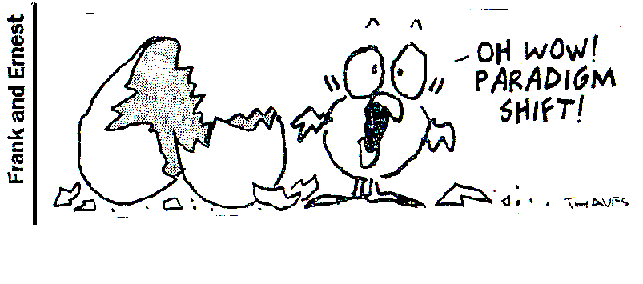

Slide 34
Some of the motivations for participation
Chris - enjoys the group and the process has been quite fun. The food, drink and merriment has been worth it. “Community projects with an edge” are his thing; he wants to achieve some effects in the community and get some mental stimulation from doing it.
Maria - I went to festivals and group activities in other neighbourhoods and didn't feel that this was my home neighbourhood. We are working towards a common goal and building a community connection is so important.
Katherine - Attending a Community Table is easy, it's close to home and I like the social aspect of these meetings. I'm at home these days and I don't get into social settings and this provides me with connections and interactions with people.
Gabe - I believe that small groups of people in neighbourhoods is a key piece of our collective future. I get meaning in my life when I get a sense of where we can go collectively.
Karen – our events help us build hope, reduce isolation and there's something subversive about a party! You feel good about the people around you and you're more likely to help people you know. Through our events you start to know about the capacity of different people and you know what skills each person has to collectively ‘save us’.
Belle -I come to these meetings because they are in my home. I don't like meetings as I'm a doer. I really enjoyed the events, but sitting around talking isn't my thing. But I do like being on the periphery of things as well as organizing things. I like knowing people in the area.

Slide 35
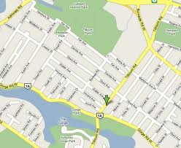

Slide 38
