Slide 1
The role of the university in the transformation of a territory of poverty

Slide 2
STUDENTS
RESEARCHERS
Ana Paula Cardoso
Antonio Nilson Moreira Eloísa Maia Vidal
Fátima Portela
Jacques Therrien
Larissa Martins Dantas
Paulo Speller
Rosalina Moraes
Samia Maluf
Stela Meneghel
Sofia Lerche Vieira (coord)
Alana Dutra
Steffany Barros
Willana Nogueira
Karine Fahel Evangelista
Priscila Marize Amorim
Eveline Ferreira
Cláudia Melo
Osmar Vasconcelos

Slide 3
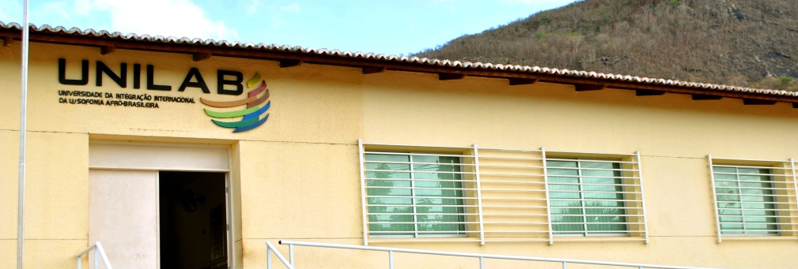
University of International Integration of the Afro-Brazilian Lusophony Countries
The newest public university in Brazil
Mission: to build a historical-cultural bridge between Brazil and the Portuguese-speaking Countries Community
Solidarity-based cooperation in the context of higher education internationalization
Increase higher education in poor regions
Strengthen cooperation with the African continent

Slide 4
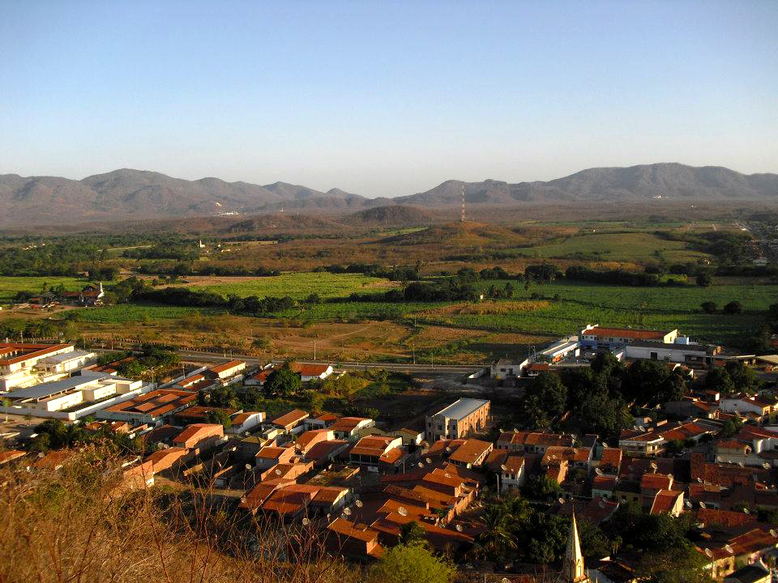
Location
Redenção – Ceará - Brazil
First Brazilian city to abolish slavery (1883)

Slide 5
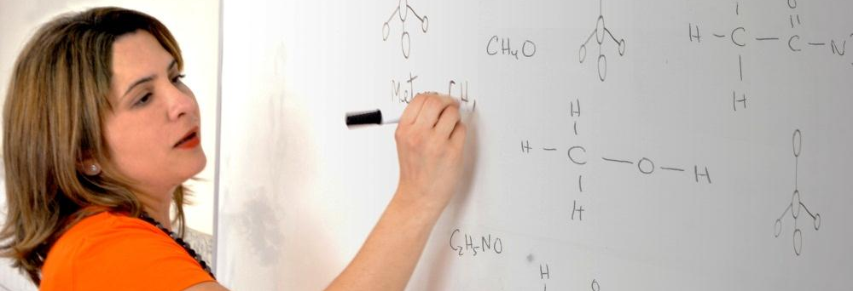
Partner countries
CPLP
Angola
Brazil
Cape Verde
Guinea-Bissau
Mozambique
Portugal
São Tomé and Príncipe
East Timor

Slide 6
Location
Partner countries

Slide 7
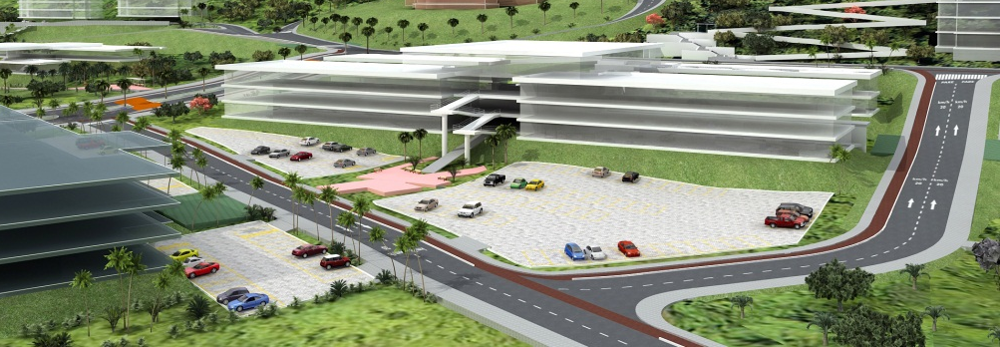
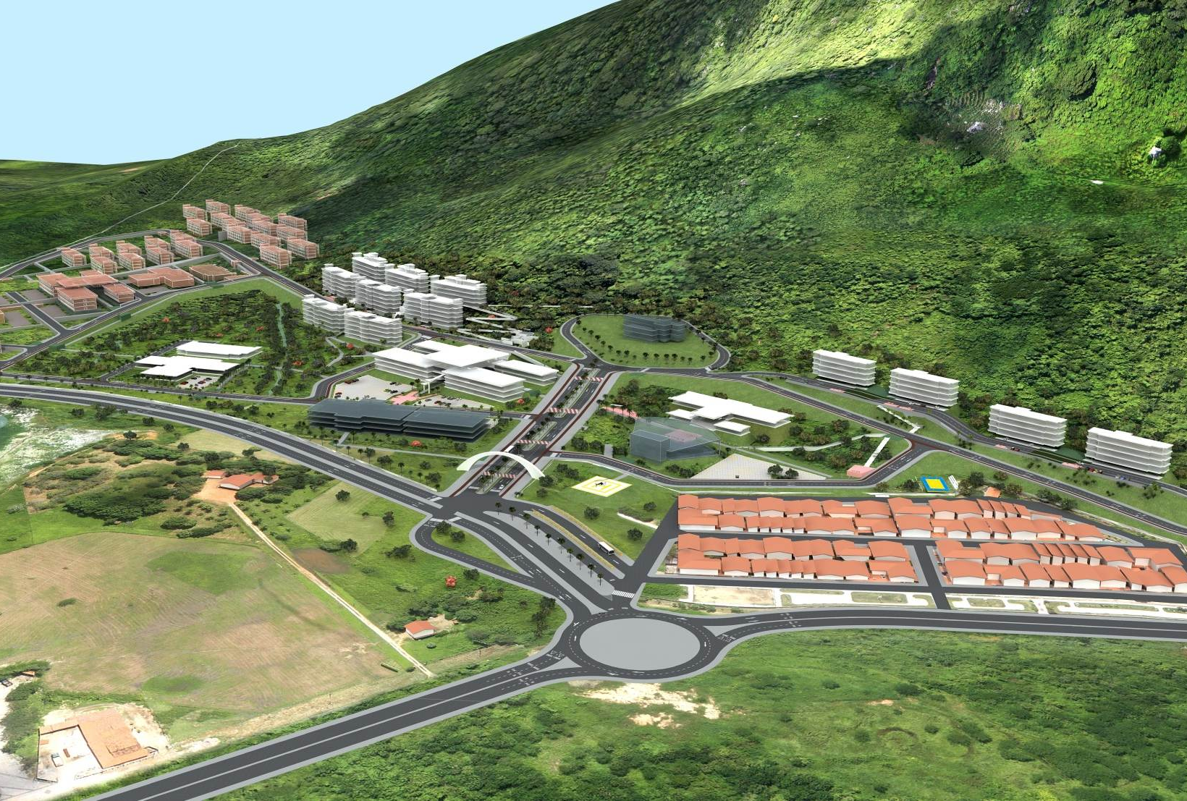
Campi
Campus da Liberdade
Campus das Auroras
Campus dos Palmares
Campus São Francisco do Conde

Slide 8
Undergraduate courses
Public Management
Agronomy
Humanities
Natural Sciences and Math
Nursing
Energy Engineering
Letters / Portuguese Language

Slide 9
Teaching staff
Total - 79

Slide 10
Students
Total - 979

Slide 11
A good practice
Education Observatory in the Baturité Massif
Quantitative/Qualitative Study: action research project on educational and school management practices
Sample: 15 municipalities / 30 schools
Training process for educational / school managers

Slide 12
A context of poverty
Over 90% of municipal income originates from federal and state transfers
91% of the population benefits from resources of a direct transfer of income program
Students indicators of performance below the media of the state

Slide 17
Schools
Generally poor infrastructure

Slide 24
Schools
Some with better conditions

Slide 32
Schools
Many schools located in distant and rural areas
Transportation available but not always safe

Slide 37
Some findings
Most schools in full operation
Motivated administrators, teachers and students
Good support to schools given by education departments
Positive working atmosphere
Not significant differences in performance by location (urban x rural)

Slide 43
Current steps
A proposal under construction
A training process for 500 school managers
Training materials based on evidences
Listening to the demands of schools’ staff
Working together for better results

Slide 44
www.unilab.edu.br
sofialerche@gmail.com

